Slide 1

Finding true Joy.
Would you like your heart to truly jump for joy
no matter how things are going each day?
smiley © sherv.net
jumping heart © www.fg-a.com

Slide 2

God’s gift of his Son
Jesus Christ

Slide 3

I am
God blessing
you with
every spiritual
blessing
I am fullness in God
I am reconciliation
to God
I am
peace
with God
I am
ransom
and
redemption
has many great gifts
in Christ to make us jump for joy in God.
I am deliverance from darkness
into the kingdom of God’s Son
I am
at-one-ment with the Lord
God’s wrath turned away
I am forgiveness
I am
the righteousness of God
justification
I am
eternal
life

Slide 4
I am
God blessing
you with
every spiritual
blessing
I am fullness in God
I am reconciliation
to God
I am
peace
with God
Here are a few of the many gifts of joy and satisfaction the Lord provides through
the death of Christ.
I am
ransom
and
redemption
I am deliverance from darkness
into the kingdom of God’s Son
I am
at-one-ment with the Lord
God’s wrath turned away
I am forgiveness
I am
the righteousness of God
justification
I am
eternal
life

Slide 5
To get this PPT to play properly so the smileys dance on your smart-phone or other device, you must download a free copy of Microsoft Office Powerpoint onto your phone, and when you go to this PPT, you must press the “play as a PPT” tab. Otherwise the smileys stand still and the heart doesn’t jump for joy!

Slide 6
Sharing with a friend
When you share this on your smart-phone, the slides are set up so you can ask simple who, what, when, where, why, how questions so there can be friendly discussion back and forth.
For instance, #1 justified: What do you see?
What’s the difference between the two?
What does the Bible say?
How did the one change?
Which one do you want to be?

Slide 7
in Christ
justified in Christ
the righteousness of God
ransomed and redeemed
propitiation, atonement,
God’s wrath turned away
forgiven
peace with God
reconciled to God
eternal life
faith
in Christ
Lord, thank you for these great gifts that all provide connection with God the Father, Son and Spirit!

Slide 8
1. Justified in Christ the righteousness of God
“just-as-if-I’d” never sinned
“just-as-if-I’d” obeyed all
The Lord accepts us as righteous in Christ and unites with us
Christ
THE LORD
black
black
black
white
white
white
one
one
one
smiley © sherv.net
Jumping heart © www.fg-a.com
“But now the righteousness of God has been manifested . . . the righteousness of God through faith in Jesus Christ for all who believe. . . . for all have sinned . . .
and are justified by his grace as a gift, through the redemption that is in Christ Jesus” Rom 3:21-24
1

Slide 9
Our greatest need
THE HOLY LORD
The holy Lord is the source of all lasting joy.
If we want to be accepted into the holy love relationships God the Father, Son and Spirit enjoys within himself and wants to share, then we need a way to be as righteous as God in God’s sight, because the holy Lord won’t join himself to anyone with a speck of unrighteousness.
Opposed
by God as unrighteous,
black with sin
Accepted
by God as righteous
in Christ
1

Slide 10
1. Justified in Christ the righteousness of God
“just-as-if-I’d” never sinned
“just-as-if-I’d” obeyed all
The Lord accepts us as righteous in Christ and unites with us
Christ
THE LORD
united with
the Lord
to enjoy
God the Father, Son and Spirit
our sin and
punishment
to Christ
Christ the righteousness
of God to us
smiley © sherv.net
Jumping heart © www.fg-a.com
“For our sake he (God) made him (Jesus) to be sin
who knew no sin, so that in him (Jesus) we might
become the righteousness of God.” 2 Cor 5:21
1

Slide 11
If we receive Christ the righteousness of God,
the Lord counts us as righteous in Christ and unites with us
in love relationship in Christ, in the Spirit, in God the Father.
THE LORD
The Lord’s love wants our hearts to jump for joy
in God the Father, Son and Spirit.
smiley © sherv.net
Jumping heart © www.fg-a.com
1

Slide 12
1. Justified in Christ the righteousness of God
“just-as-if-I’d” never sinned
“just-as-if-I’d” obeyed all
The Lord accepts us as righteous in Christ and unites with us
Christ
THE LORD
black
black
black
white
white
white
one
one
one
smiley © sherv.net
Jumping heart © www.fg-a.com
“I count everything as loss . . . in order that
I may gain Christ and be found in him,
not having a righteousness of my own that comes from the law, but that which comes through faith in Christ, the righteousness from God that depends on faith” Phil 3:8-9
1

Slide 13
1. Justified in Christ the righteousness of God
My unrighteousness
Justified in Christ
Counted righteous in God’s sight
in Christ alone
through faith alone
by God’s grace alone
Christ
Me
Christ the righteousness of God
Jesus lived in perfect obedience to all God’s righteous ways.
Jesus died as punishment for all our unrighteousness.
In justification, the LORD counts / credits to us Christ’s obedience as our righteousness, by faith apart from works, and doesn’t count our sins against us as he counts our punishment as fully paid by our substitute, the Lamb of God
(Greek logizomai, Latin imputata Rom 4:3,4,5,6,8,9,10,11,22,23,24).

Slide 14
“In your presence there is fullness
of joy;
THE LORD
at your right hand are pleasures forevermore”
Psa 16:11
smiley © sherv.net
Jumping heart © www.fg-a.com
There is nothing more breath-taking, delightful, exciting, and satisfying than a personal relationship
with God the Father, Son and Spirit to enjoy the supreme oneness, love, fellowship and cooperation the one holy Lord God Almighty enjoys in himself and shares with us.
To enjoy God as God enjoys God – what glory!
Heaven is a celebration of God, and life on earth is a bit of heaven when we rejoice in God as God rejoices in God!
1

Slide 15












THE LORD
God’s completely different way
to deepest joy and satisfaction
smiley © sherv.net
Jumping heart © www.fg-a.com
People circle © clipartfest.com
Do you think beauty, music, smart-phones, sports,
cars, money, friends, romance, sex, food, drinking parties, homes or jobs are better than joy in God?

Slide 16
Impossible! Nothing else will ever satisfy
the deep longings of our souls except God the Father, Son and Spirit in all his infinite perfections.
Alive, Self-existent
Spiritual Personal
Free Self-determining Independent
Wise Intelligent Infinite Eternal Unchanging
Immanent Transcendent Omniscient
Omnipresent Omnipotent Sovereign
Faithful Righteous Just Holy Perfect
Humble Love Gracious Merciful
Good Wrath Longsuffering Patient
True Truthful Jealous Zealous
Oneness and Trinity of Father, Son, Spirit
Creator Upholder/Sustainer Savior
Shepherd Judge King
Joy in Himself
smiley © sherv.net
Jumping heart © www.fg-a.com
People circle © clipartfest.com
1

Slide 17
My unrighteousness
Christ
“For Christ also suffered once for sins, the righteous for the unrighteous, that he might bring us to God”
1 Pet 3:18
Me
Christ the righteousness of God
Thank you, all-righteous Lord, that Christ suffered
once for sins, the righteous for the unrighteous,
to bring us to you, the supremely desirable God!
We want you! Your justification in Christ allows you to join yourself with us in eternal fellowship! Wonderful!
1

Slide 18
Justified in
my
Son
We believe Jesus is the Son of God who died to change us from black, black, black to white, white, white in your sight!
Lord, thank you, that no matter how messed up our past,
you see those who believe as perfectly righteous in Christ,
as righteous as your Son, as righteous as you are holy LORD,
justified in Christ, just-as-if-I’d never sinned,
just-as-if-I’d always obeyed! Amazing, Lord!
1

Slide 19
THE LORD
smiley © sherv.net
Jumping heart © www.fg-a.com
All praise to you, Lord, that you unite yourself with all you justify in Christ so we are in Christ in God in the Spirit, blessed with all your riches of grace in Christ!
1

Slide 20
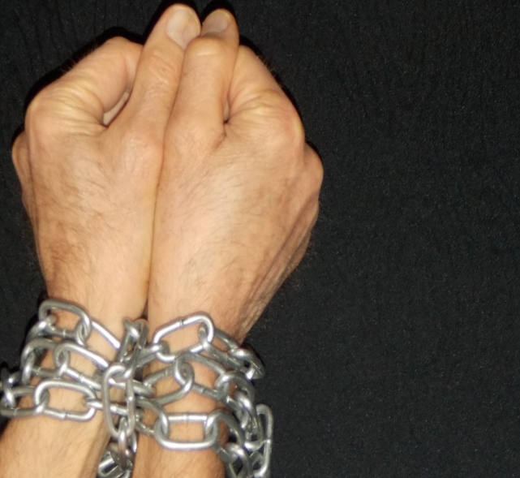

2. ransom, redemption
“You were ransomed . . . with the precious blood of Christ . . . a lamb without blemish” 1 Pet 1:18-19
“for all have sinned . . . and are justified by his grace as a gift, through the redemption that is in Christ Jesus” Rom 3:23-24
ransom
redemption
chains
of
sin
Satan
death
hell
No copyright John Crozier
Egyptian smiley © sherv.net
Jumping heart © www.fg-a.com
© GospelGifs.com
used with permission
free in the Lord
Christ’s ransom payment redeems / frees us from
slavery to sin into fullness of life in Christ in the Spirit,
including redemption of our bodies at Christ’s return
2

Slide 21
2. ransom, redemption
“the Son of Man came not to be served but to serve, and to give his life as a ransom for many” Mat 20:28
chains slave chains slave
chains slave
paid
paid
paid
free bought free bought
free bought
ransom
redemption
chains
of
sin
Satan
death
hell
No copyright John Crozier
Egyptian smiley © sherv.net
Jumping heart © www.fg-a.com
© GospelGifs.com
used with permission
free in the Lord
Christ’s ransom payment redeems / frees us from
slavery to sin into fullness of life in Christ in the Spirit,
including redemption of our bodies at Christ’s return
2

Slide 22
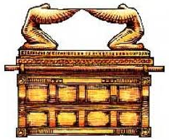
3. propitiation, atonement, God’s wrath turned away
under God’s wrath
wrath
turned
away
Christ
Egyptian smiley © sherv.net
Jumping heart © www.fg-a.com
at-one-ment
with the Lord
jewishvirtuallibrary.org
“Christ Jesus, whom God put forward as a propitiation (sacrifice of atonement, NIV) by his blood, to be received
by faith. This was to show God’s righteousness . . . ”
Rom 3:24-25
3

Slide 23
Thank you, Lord, for the two ways you are just to justify guilty sinners who deserve your just judgment.
1. Thank you for your infinitely righteous Son being your truly just sacrifice of atonement / propitiation so you justly count our sins as fully punished in Christ our substitute punishment. ¹
2. Thank you for your infinitely righteous Son obeying all your commands in the law on our behalf so you justly count us as fully righteous in Christ our substitute righteousness. ¹
You are just and the justifier of those who trust Jesus as their wrath-bearer and righteousness-provider! ¹
3

Slide 24
Thank you that your justification, redemption and atonement in Christ shows your righteousness and fully solves the greatest dilemma of every human being!
“Because of your hard and impenitent heart you are storing up wrath for yourself on the day of wrath when
God's righteous judgment will be revealed” Rom 2:5
“Both Jews and Greeks, are under sin, as it is written: “None is righteous, no, not one””
Rom 3:9-10
“For by works of the law no human being will be justified in his sight, since through the law comes knowledge of sin” Rom 3:20
3

Slide 25
God covers our sins
God cancels our debts
God sends away our sins
God frees us from our sins
God lifts off (nasa) our sins
God removes our sins from us
4. forgiven
Smiley © sherv.net
God treads our sins underfoot
God casts our sins into the sea
God blots out / wipes out our sins
God remembers our sins no more
God washes, cleanses us from sin
God casts our sins behind his back
God does not count our sins against us
“Blessed are those whose lawless deeds are forgiven . . .
against whom the Lord will not count his sin” Rom 4:7-8
“In him we have redemption through his blood,
the forgiveness of our trespasses” Eph 1:7
4

Slide 26
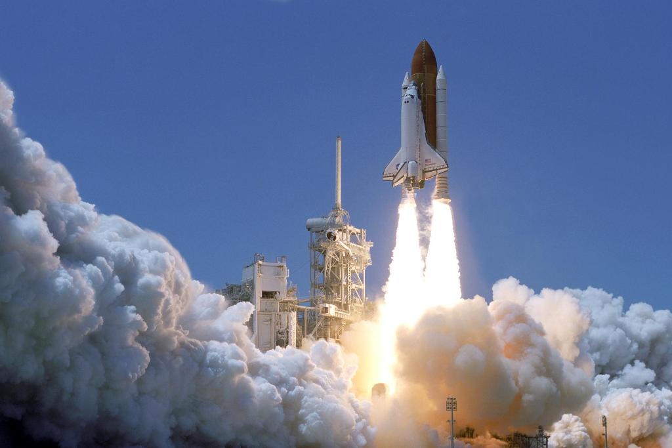
Lord, thank you that when you forgive us you “lift off / nasa” our sins from us.
Praise you that we can join your NASA (lift off) program of forgiveness!
“Please forgive (Hebrew nasa = lift off) the transgression of your brothers and their sin, because they did evil to you. And now, please forgive (nasa) the transgression of the servants of the God of your father.” Gen 50:17
4
www.nasa.gov 152294main_Launch-lg.jpg

Slide 27
Jesus
Mohammed
Confucius
Can anyone else give us these gifts?
Has anyone else died as God’s once-for-all sacrifice for sin? Is anyone else the infinite
Son of God, our resurrected Messiah and Lord,
who provides in himself all we need in God?
Hindu Gurus
Moses
Buddha

Slide 28
THE LORD
God’s completely different way
to deepest joy and satisfaction
smiley © sherv.net
Jumping heart © www.fg-a.com
People circle © clipartfest.com
Joy and satisfaction are in Christ, not beauty, music, smart-phones, sports, cars, money, friends, romance, sex, food, drinking parties, homes or jobs! Jesus had supreme joy without sex or money!

Slide 29
I am
God blessing
you with
every spiritual
blessing
I am fullness in God
I am reconciliation
to God
I am
peace
with God
I am
ransom
and
redemption
Find joy and satisfaction in God. Open Christ’s gifts to enjoy the Lord by faith in God’s promises expressed in praise!
Promises - Faith - Praise
I am deliverance from darkness
into the kingdom of God’s Son
I am
at-one-ment with the Lord
God’s wrath turned away
I am forgiveness
I am
the righteousness of God
justification
I am
eternal
life

Slide 30

5. peace with God
THE LORD
“peace by the blood of his cross”
Col 1:20
smiley © sherv.net
Jumping heart © www.fg-a.com
SHALOM
peace
peace
peace
You
You
You
“Since we have been justified by faith,
we have peace with God through our Lord Jesus Christ” Rom 5:1
THE
LORD
Microsoft clip art © 2013
Microsoft Corporation.
war war
war
me! me!
me!
5

Slide 31

Christ also makes peace between both
Jew and Gentile who believe in Christ.
“For he himself is our peace, who has made us both one” (Eph 2:14).
Microsoft clip art © 2013 Microsoft Corporation.
5

Slide 32

6. reconciled to God
“While we were enemies
we were reconciled to God
by the death of his Son”
Rom 5:10
Egyptian smiley © sherv.net
Jumping heart © www.fg-a.com
friends friends friends
Yes! Yes! Yes!
reconciled
No!
No!
No!
All this is from God,
who through Christ reconciled us to himself and gave us the ministry
of reconciliation
2 Cor 5:18
THE
LORD
fight
fight
fight
© GospelGifs.com
used with permission
6

Slide 33
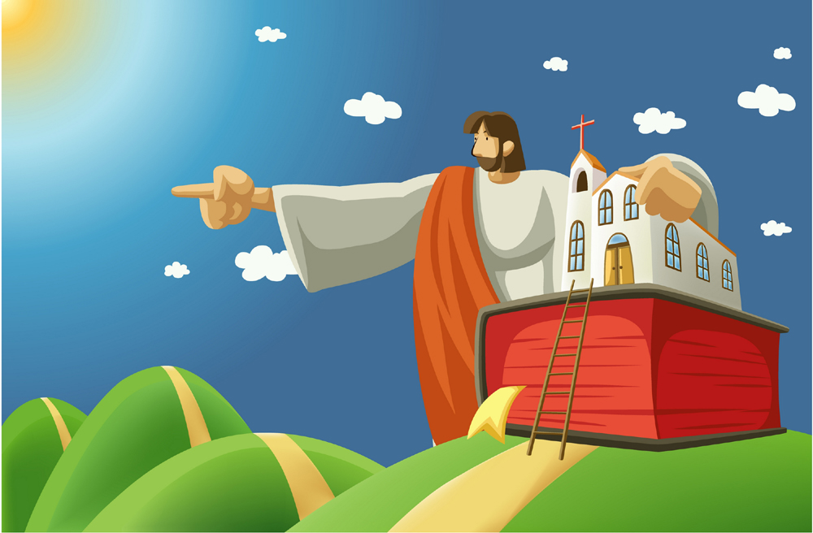
© iclickart.co.kr with permission from Iregihwek print shop in Yeosu, South Korea
“Therefore, we are ambassadors for Christ, God making his appeal through us. We implore you on behalf of Christ,
be reconciled to God. For our sake he made him to be sin who knew no sin, so that in him we might become
the righteousness of God.” 2 Cor 5:20-21
6

Slide 34


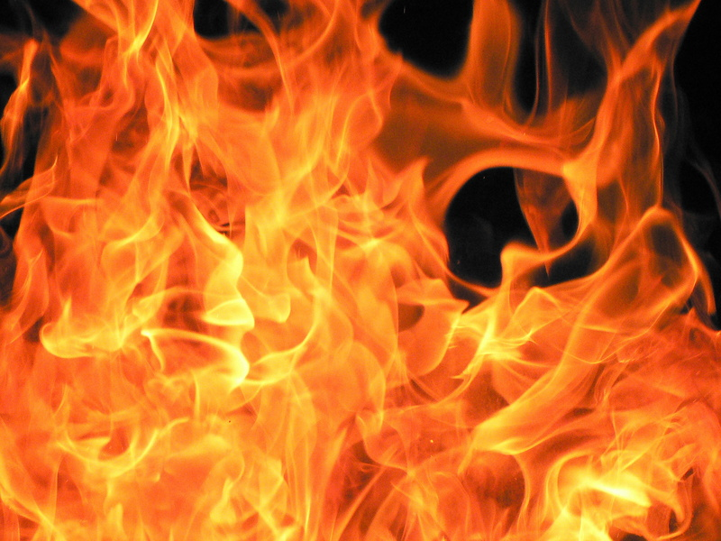
“For the wages of sin is death,
but the free gift of God is eternal life
in Christ Jesus our Lord” Rom 6:23
7. eternal life
THE LORD
JESUS
CHRIST
life, life, life
now and forever
eternal life in God
smiley © sherv.net
jumping heart © www.fg-a.com
psdgraphics.com in kidclipart.com
death
death
death
perish
perish
perish
“I give them eternal life, and they will never perish, and no one will snatch them out of my hand” John 10:28
Microsoft clip art © 2013 Microsoft Corp
7

Slide 35
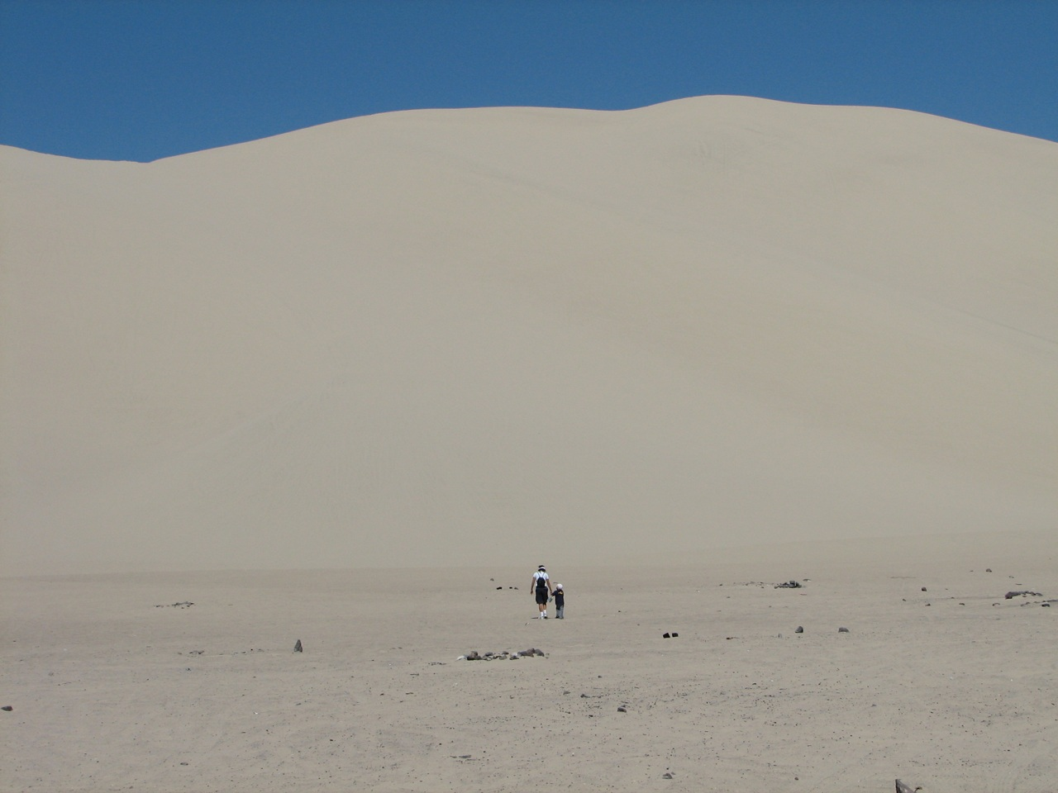
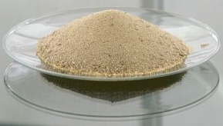
Sand Mountain, Nevada U.S.A.
Eternity - one grain of sand
every year.
3,281,579 grains of sand
3,281,579 years
Frankfurt Museum of Fine Arts
7

Slide 36
Jesus Christ believed in eternal life and eternal fire.
“I give them eternal life, and they will never perish”
John 10:28
“thrown into the eternal fire” Mat 18:8
“Depart from me . . . into the eternal fire” Mat 25:41
7
Microsoft clip art © 2013 Microsoft Corporation.

Slide 37
God sent his Son to die for our sin
and bear the wrath of God
THE LORD
now and forever
© GospelGifs.com
used with permission
smiley © sherv.net
Jumping heart © www.fg-a.com
and give us eternal life
enjoying the Lord.
in order to save us
from sin and wrath
7

Slide 38
“For those who shut out the infinitely good and desirable Lord to seek joy in other things as better and more satisfying,
God justly gives people what they choose – a place without God and his goodness.”
“In this place, instead of finding joy without God, they will justly find the most intense and lasting sorrow, regret, pain, anguish and suffering without God.” from John’s free eBook, “Know Your God” page 49, available at www.GraceGodChrist.com
7
Microsoft clip art © 2013 Microsoft Corporation.

Slide 39
“The Son of Man will send his angels, and they will gather out of his kingdom all causes of sin and all law-breakers, and throw them into the fiery furnace. In that place there will be weeping and gnashing of teeth. Then the righteous will shine like the sun in the kingdom of their Father. He who has ears, let him hear.” (Jesus in Matthew 13:42-43)
7
Microsoft clip art © 2013 Microsoft Corporation.

Slide 40
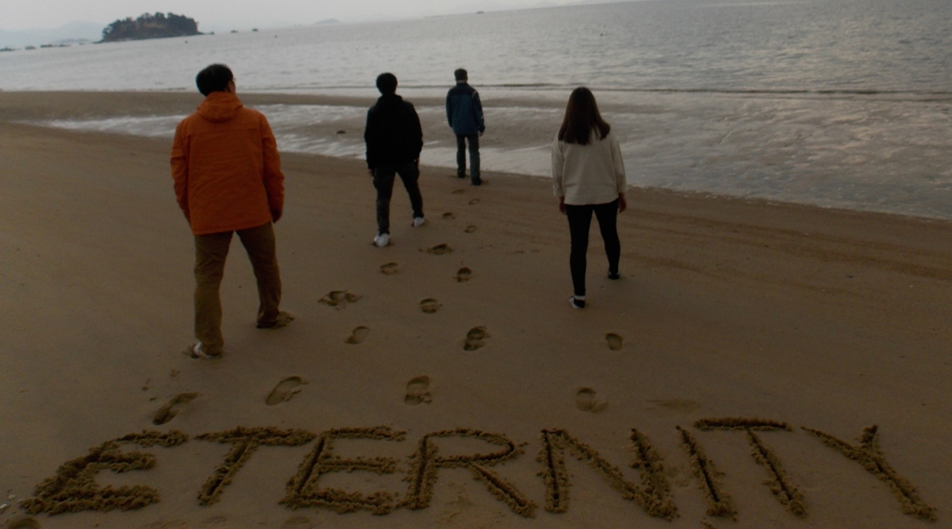
Everyone is going into eternity.
Photo John Crozier
Where will you go?
7

Slide 41
“For the wages of sin is death,
but the free gift of God is eternal life
in Christ Jesus our Lord” Rom 6:23
7. eternal life
THE LORD
JESUS
CHRIST
life, life, life
now and forever
eternal life in God
smiley © sherv.net
jumping heart © www.fg-a.com
psdgraphics.com in kidclipart.com
death
death
death
perish
perish
perish
“I give them eternal life, and they will never perish, and no one will snatch them out of my hand” John 10:28
Microsoft clip art © 2013 Microsoft Corp
7

Slide 42
in Christ
justified in Christ
the righteousness of God
ransomed and redeemed
propitiation, atonement,
God’s wrath turned away
forgiven
peace with God
reconciled to God
eternal life
faith
in Christ
Lord, thank you for these great gifts that all provide connection with God the Father, Son and Spirit!

Slide 43
THE LORD
God’s completely different way
to deepest joy and satisfaction
smiley © sherv.net
Jumping heart © www.fg-a.com
People circle © clipartfest.com
Joy and satisfaction are in Christ, not beauty, music, smart-phones, sports, cars, money, friends, romance, sex, food, drinking parties, homes or jobs! Jesus had supreme joy without sex or money!

Slide 44
Now here are five stupendous gifts of connection
with God the Father, Son and Spirit
to enjoy the supreme joy, oneness, love, fellowship, cooperation and satisfaction God enjoys and shares.
THE LORD
Smiley © sherv.net Jumping heart © www.fg-a.com
These are five ways God’s word describes the amazing connection Christ’s death and resurrection provides
with God the Father, Son and Spirit.

Slide 45
in Christ
in Christ and Christ in us
in the Spirit and the Spirit in us,
making us God’s temple
in God the Father and the Father in us
immersed in the Father, Son and Spirit
Father, Son and Spirit fellowship
with us and we with them
faith
in Christ
Lord, thank you that Christ’s death provides riches of
connection with you, God the Father, Son and Spirit,
that no one else can give!

Slide 46

8. in Christ and Christ in us!
“To the saints and faithful brothers
in Christ
in Colossae”
Col 1:2
“I have been crucified with Christ. It is . . . Christ who lives in me”
Gal 2:20
© GospelGifs.com
used with permission
© GospelGifs.com used with permission
NO!
8
© GospelGifs.com

Slide 47

9. in the Spirit and the Holy Spirit in us, God’s temple
“You, however, are not in the flesh but in the Spirit,
if in fact the Spirit of God dwells in you” Rom 8:9
“Do you not know that you are God's temple and that God's Spirit dwells
in you?” 1 Cor 3:16
“Or do you not know that your body is a temple
of the Holy Spirit within you,
whom you have from God?” 1 Cor 6:19
Dove and Bible
Microsoft clip art © 2013
Microsoft Corporation.
Dove and Bible
Microsoft clip art © 2013
Microsoft Corporation.
NO!
9
© GospelGifs.com

Slide 48
10. in God the Father and God the Father in us!
“To the church of the Thessalonians in God the Father
and the Lord Jesus Christ” 1 Thess 1:1
“If anyone loves me,
he will keep my word,
and my Father
will love him,
and we will come to him
and make our home
with him”
John 14:23
Abba
Abba
NO!
10
© GospelGifs.com

Slide 49
What a privilege! What undeserved favor in Christ!
All because God the Son died for us.
in Christ and Christ in us!
in the Spirit and the Spirit in us!
in the Father and the Father in us!
© GospelGifs.com
used with permission
Thank you, thank you, Lord!
And the best is yet to come!
NO!
8,9,10
© GospelGifs.com

Slide 50
What is the LORD’s supreme joy?
The LORD himself, in all his infinite holiness and perfections!
What was and is Jesus’ supreme joy?
The LORD himself, in all his infinite holiness and perfections!
What gives supreme joy to those made in God’s image?
The LORD himself, in all his infinite holiness and perfections!
From “Know Your God,” John’s eBook on God’s attributes, page 29, available at www.GraceGodChrist.com

Slide 51
Heaven is full of God enjoying God
and his people enjoying God as God enjoys God!
Life on earth is a bit of heaven as we enjoy God
as God enjoys God!
smiley © sherv.net
Jumping heart © www.fg-a.com
People circle © clipartfest.com

Slide 52
THE LORD
God’s completely different way
to deepest joy and satisfaction
smiley © sherv.net
Jumping heart © www.fg-a.com
People circle © clipartfest.com
Joy and satisfaction are in Christ, not beauty, music, smart-phones, sports, cars, money, friends, romance, sex, food, drinking parties, homes or jobs! Jesus had supreme joy without sex or money!

Slide 53

© GospelGifs.com
NO!
11. immersed in the Father, Son and Spirit!
THE LORD
“Go therefore and make disciples of all nations, baptizing (immersing) them in the name of the Father and of the Son and of the Holy Spirit, teaching them to observe all that I have commanded you.”
Mat 28:19-20
Egyptian smiley © sherv.net
Jumping heart © www.fg-a.com
We are in Christ and Christ is in us.
We are in the Spirit and the Spirit is in us.
We are in the Father and the Father is in us.
We are immersed in Christ in the Spirit in God.
11

Slide 54


© GospelGifs.com
Lord, what wisdom in choosing “immersion” to picture two of your great New Testament truths!
NO!
THE LORD
Abba
Yes!
1. I believe Jesus is
the Messiah who died
for my sins, was buried,
and rose again!
2. I believe God has
immersed me into
Christ and his death
and resurrection.
I am crucified and
raised with Christ;
I am immersed and
united with God the
Father, Son and Spirit!
Crown, Dove and Bible
Microsoft clip art © 2013
Microsoft Corporation.
There is more on this in Romans 6;
Immersed into Christ and his death and resurrection; United with Christ in a death
and resurrection like his, crucified and buried with Christ, raised and alive with Christ.
11

Slide 55

Jesus died to provide us with the righteousness of God which results in access to live in full fellowship in God’s presence continually in Christ, in the Father, in the Spirit. It’s as if we are seated in Christ at the table in their home to share in the personal relationships of oneness, love, fellowship and cooperation they enjoy with each other and want to share with us.
“Our fellowship
is with the
Father and
with his Son
Jesus Christ”
1 John 1:3
Abba
“. . . the fellowship
of the Holy Spirit be
with you all”
2 Cor 13:14
Microsoft clip art © 2013 Microsoft Corporation.
12. Father, Son and Holy Spirit fellowship with us!
NO!
12
© GospelGifs.com

Slide 56
in Christ
in Christ and Christ in us
in the Spirit and the Spirit in us,
making us God’s temple
in God the Father and the Father in us
immersed in the Father, Son and Spirit
Father, Son and Spirit fellowship
with us and we with them
faith
in Christ
Lord, thank you that Christ’s death provides riches of
connection with you, God the Father, Son and Spirit,
that no one else can give!

Slide 57
Jesus
Mohammed
Confucius
Can anyone else give us these gifts?
Has anyone else died as God’s once-for-all sacrifice for sin? Is anyone else the infinite
Son of God, our resurrected Messiah and Lord,
who provides in himself all we need in God?
Hindu Gurus
Moses
Buddha

Slide 58
THE LORD
God’s completely different way
to deepest joy and satisfaction
smiley © sherv.net
Jumping heart © www.fg-a.com
People circle © clipartfest.com
Joy and satisfaction are in Christ, not beauty, music, smart-phones, sports, cars, money, friends, romance, sex, food, drinking parties, homes or jobs! Jesus had supreme joy without sex or money!

Slide 59
I am
God blessing
you with
every spiritual
blessing
I am fullness in God
I am reconciliation
to God
I am
peace
with God
I am
ransom
and
redemption
Find joy and satisfaction in God. Open Christ’s gifts to enjoy the Lord by faith in God’s promises expressed in praise!
Promises - Faith - Praise
I am deliverance from darkness
into the kingdom of God’s Son
I am
at-one-ment with the Lord
God’s wrath turned away
I am forgiveness
I am
the righteousness of God
justification
I am
eternal
life

Slide 60
What is SIN?
S
I
N
Seeking joy and satisfaction in created things
rather than in our supremely enjoyable Creator
Suppressing, exchanging truth about God for lies
and other loves, disapproving of God (Rom 1:18,23,28)
Storing up wrath for ourselves on the day God’s
righteous judgment will be revealed (Rom 2:5)
Idolatrous Independence from God ; Ignoring God
I do what I want; I am lord over my choices
Iniquity = “crookedness” from God’s way
Not honoring, thanking, believing, worshipping,
serving, and approving of our Creator (Rom 1:21,25,28)

Slide 61
What is sin? It’s more than we think!
"You shall have no other gods before me.
You shall not make for yourself a carved image . . . You shall not bow down to them or serve them . . .
You shall not take the name of the LORD your God in vain . . . Remember the Sabbath day, to keep it holy. On it you shall not do any work . . .
Honor your father and your mother . . .
You shall not murder. You shall not commit adultery.
You shall not steal.
You shall not bear false witness against your neighbor.
You shall not covet your neighbor's house; you shall not covet your neighbor's wife . . . or anything that is your neighbor's.” The Ten Commandments in Exodus 20:3-17

Slide 62
What is sin? It’s more than we think!
“You have heard that it was said to those of old, ‘You shall not murder; and whoever murders will be liable to judgment.’ But I say to you that everyone who is angry with his brother . . . whoever insults his brother . . . and whoever says, ‘You fool!’ will be liable to the hell of fire.” Jesus in Matthew 5:21-22
“You have heard that it was said, ‘You shall not commit adultery.’ But I say to you that everyone who looks at a woman with lustful intent has already committed adultery with her in his heart.” Jesus in Matthew 5:27-28
(What does Jesus also think of pornography?)

Slide 63
What is sin? It’s more than we think!
“It was also said, ‘Whoever divorces his wife, let him give her a certificate of divorce.’
But I say to you that everyone who divorces his wife, except on the ground of sexual immorality, makes her commit adultery, and whoever marries a divorced woman commits adultery.” Jesus in Matthew 5:31-32
“You have heard that it was said, ‘You shall love your neighbor and hate your enemy.’ But I say to you, Love your enemies and pray for those who persecute you, so that you may be sons of your Father who is in heaven.”
Jesus in Matthew 5:43-45

Slide 64
What is sin? It’s more than we think!
“They are full of envy, murder, strife, deceit, maliciousness. They are gossips, slanderers, haters of God, insolent, haughty, boastful, inventors of evil, disobedient to parents, foolish, faithless, heartless, ruthless.” Rom 1:29-31
“Everyone looks out for their own interests, not those of Jesus Christ.” Phil 2:21 NIV
“Sodom and Gomorrah and the surrounding cities,
which likewise indulged in sexual immorality and pursued unnatural desire, serve as an example by undergoing a punishment of eternal fire.”
Jude the brother of Jesus in Jude 7

Slide 65
What is sin?
“God will judge the sexually immoral and adulterous.”
Heb 13:4 (Do you also do pornography? God will judge!)
Consider the contrast at the end of the Bible:
Blessed are those who wash their robes, so that they may have the right to the tree of life and that they may enter the city by the gates. Outside are . . . sorcerers and the sexually immoral and murderers and idolaters, and everyone who loves and practices falsehood.” Rev 22:14-15
Don’t we all desperately need the death of Jesus
to provide righteousness, redemption, atonement , forgiveness, peace with God and eternal life in Christ?
Are you desperate to connect with Jesus and his cross?

Slide 66
THE LORD
God’s completely different way
to deepest joy and satisfaction
smiley © sherv.net
Jumping heart © www.fg-a.com
People circle © clipartfest.com
Sin is seeking joy and satisfaction in beauty, music, smart-phones, sports, cars, money, friends, romance, sex, food, drinking parties, homes or jobs instead of enjoying the Lord!

Slide 67
I am
God blessing
you with
every spiritual
blessing
I am fullness in God
I am reconciliation
to God
I am
peace
with God
I am
ransom
and
redemption
Three more lovely gifts to open and jump for joy with delight in Christ.
I am deliverance from darkness
into the kingdom of God’s Son
I am
at-one-ment with the Lord
God’s wrath turned away
I am forgiveness
I am
the righteousness of God
justification
I am
eternal
life

Slide 68

13. delivered from the domain of darkness and transferred
to the kingdom of God’s Son
Microsoft clip art © 2013
Microsoft Corporation.
“called . . . out of darkness into his marvelous light” 1 Pet 2:9
“He has delivered us from the domain of darkness and transferred us to the kingdom of his beloved Son” Col 1:13
dominated by darkness
13
Microsoft clip art © 2013 Microsoft Corporation.

Slide 69
dominated by darkness
Microsoft clip art © 2013
Microsoft Corporation.
Microsoft clip art © 2013 Microsoft Corporation.
Thank you, Lord, that although we were dead in trespasses and sins, following Satan, the prince of the power of the air, the spirit now at work in the sons of disobedience, by nature children of wrath,
you Lord, being rich in mercy and great love, made us alive together with Christ, and raised us up with him and seated us with him in the heavenly places under Christ Jesus our King (Eph 2:1-6)!
13

Slide 70
dominated by darkness
Microsoft clip art © 2013
Microsoft Corporation.
Microsoft clip art © 2013 Microsoft Corporation.
Thank you, Lord, that if you have delivered us from the domain of darkness into the kingdom of your Son,
we are under the authority of the King of kings, the Lord of all, and by the death of Christ we are freed from
the domination of spirits of darkness, as it is written,
“He disarmed the rulers and authorities and put them to open shame, by triumphing over them in him” Col 2:15!
13

Slide 71
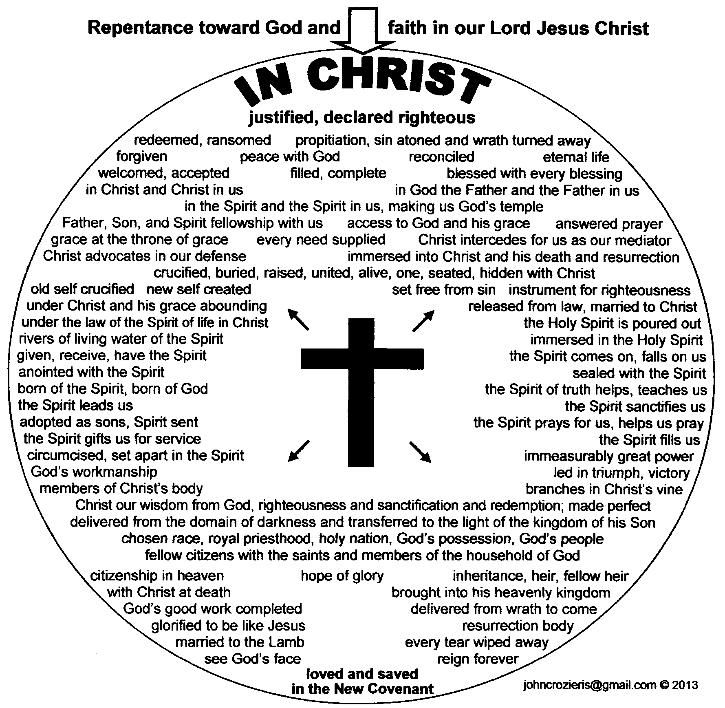
smiley © sherv.net
Jumping heart © www.fg-a.com
People circle © clipartfest.com
THE LORD
“Blessed be the God and Father
of our Lord Jesus Christ, who has blessed us in Christ with every spiritual blessing in the heavenly places”
Eph 1:3
14. blessed
in Christ
with every spiritual blessing
Microsoft clip art © 2013
Microsoft Corporation.
no blessing
all blessing
Hands - Microsoft clip art © 2013
Microsoft Corporation.
14

Slide 72
Lord, thank you that Jesus is the fullness of your blessing!
Thank you that Christ’s death and resurrection provides all your blessing!
It is finished!
We believe and receive all you freely give in Christ!
  Repentance toward God and faith in our Lord Jesus Christ
in Christ
justified in Christ the righteousness of God
ransomed, redeemed propitiation, sin atoned, wrath turned
forgiven peace with God reconciled ambassadors eternal life
welcomed, accepted filled, complete blessed with every blessing
Christ our wisdom from God, righteousness, sanctification and redemption
delivered from the domain of darkness into the light of the kingdom of the beloved Son
in Christ and Christ in us in the Spirit and the Spirit in us, made God’s temple
in God the Father and the Father in us immersed in Father, Son, and Spirit
Father, Son, and Spirit fellowship with us access to God and his grace answered prayer
grace at the throne of grace every need supplied the Spirit prays for us, helps us pray
Christ intercedes as mediator Christ advocates in our defense
immersed into Christ and his death and resurrection united with Christ in death and resurrection
crucified and buried with Christ raised and alive with Christ
one with Christ seated with Christ
hidden with Christ in God old self crucified
new self created set free from sin
instrument for righteousness under Christ, abundant grace
released from law, married to Christ under law of the Spirit
Spirit and God’s love poured out rivers of living water of Spirit
immersed in the Spirit given, receive, have Spirit
Spirit comes on, falls on us anointed with the Spirit
sealed with the Spirit guarantee of the Spirit
born of the Spirit Spirit of truth helps, teaches
Spirit leads us Spirit sanctifies us
adopted as sons, Spirit sent Spirit gifts for service
the Spirit fills us circumcised, set apart in the Spirit
immeasurably great power God’s workmanship led in triumph, victory
members of Christ’s body brothers and sisters branches in Christ’s vine
  chosen race, royal priesthood, holy nation, God’s possession, God’s people
fellow citizens with the saints and members of the household of God
citizenship in heaven hope of glory inheritance, heir, fellow heir
with Christ at death made perfect glorified to be like Jesus
into heavenly kingdom enter joy of Lord delivered from wrath
God’s good work completed resurrection body like Jesus
married to the Lamb every tear wiped away
see God’s face reign forever
loved and saved
in New Covenant
14
johncrozieris@gmail.com © 2017

Slide 73
smiley © sherv.net
Jumping heart © www.fg-a.com
People circle © clipartfest.com
THE LORD
“If God is for us, who can be against us? He who did not spare his own Son but gave him up for us all, how will he not also with him graciously give us all things?” Rom 8:31-32
14. blessed
in Christ
with every spiritual blessing
Microsoft clip art © 2013
Microsoft Corporation.
no blessing
all blessing
Hands - Microsoft clip art © 2013
Microsoft Corporation.
14

Slide 74
Lord, we praise you that the fullness of your blessing is given in Christ by faith in what Christ has DONE, and not by religious efforts we DO.
It is finished!
We rest in Christ and his finished work rather than DO, DO, DO to earn your blessing.
justified, declared righteous ransomed, redeemed propitiation, sin atoned, God’s wrath turned away
forgiven peace with God reconciled ambassadors eternal life welcomed, accepted filled, complete
blessed with every blessing
Christ is our wisdom from God, our righteousness
and sanctification and redemption
delivered from the domain of darkness into
the light of the kingdom of the beloved Son
in Christ and Christ in us in the Spirit and the Spirit in us, God’s temple in God the Father and Father in us immersed in the Father, Son and Holy Spirit Father, Son and Holy Spirit fellowship with us access to God and his grace answered prayer grace at the throne of grace
every need supplied the Spirit prays for us, helps us pray
Christ intercedes for us as our one mediator Christ advocates his propitiation in our defense immersed into Christ and his death and resurrection united with Christ in his death and resurrection
crucified and buried with Christ raised and alive with Christ one with Christ
seated with Christ hidden with Christ in God old self crucified
new self created set free from sin instrument for righteousness
under Christ and his abundant grace released from the law to be married to Christ
under the law of the Spirit of life in Christ Jesus the Spirit and God’s love poured out
rivers of living water of the Spirit flow out of us immersed in the Spirit
given the Spirit receive the Spirit have the Spirit
the Spirit comes on us, falls on us anointed with the Spirit
sealed with Spirit, guaranteed inheritance born of the Spirit
the Spirit of truth helps and teaches us
the Spirit leads and sanctifies us
adopted as sons with the Spirit of the Son in us
the Spirit gifts for service the Spirit fills us
circumcised, set apart to God in the Spirit
immeasurably great power God’s workmanship
led in triumphal procession and nike victory
members of Christ’s body brothers and sisters
branches in Christ’s vine
Chosen race, royal priesthood, holy nation,
God’s possession, God’s people
fellow citizens with the saints members of God’s household
citizenship in heaven hope of glory
inheritance, heir, fellow heir with Christ at death
made perfect in his presence glorified to be like Jesus
into heavenly kingdom enter the joy of the Lord
delivered from wrath to come God’s good work completed
resurrection body like Jesus married to the Lamb every tear wiped away
see God’s face reign forever loved and saved in the New Covenant
johncrozieris
@gmail.com
© 2017
14

Slide 75
Jesus
Mohammed
Confucius
Can anyone else give us these gifts?
Has anyone else died as God’s once-for-all sacrifice for sin? Is anyone else the infinite
Son of God, our resurrected Messiah and Lord,
who provides in himself all we need in God?
Hindu Gurus
Moses
Buddha

Slide 76
THE LORD
God’s completely different way
to deepest joy and satisfaction
smiley © sherv.net
Jumping heart © www.fg-a.com
People circle © clipartfest.com
Joy and satisfaction are in Christ, not beauty, music, smart-phones, sports, cars, money, friends, romance, sex, food, drinking parties, homes or jobs! Jesus had supreme joy without sex or money!

Slide 77
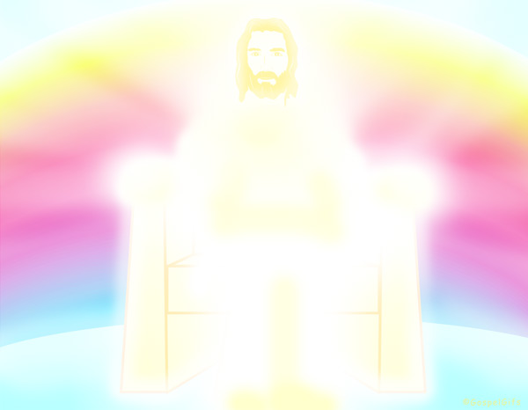
“For in him the whole fullness of deity dwells bodily
and you have been filled
in him, who is the head
of all rule and authority”
Col 2:9-10
empty
in myself
15. filled and
complete
in Christ
© GospelGifs.com
with permission
If we are “in Christ” in whom God’s fullness dwells, the head of all rule and authority, we are spiritually filled and complete in God by faith.
No other power or anything we do makes us more complete or “spiritual.”
15

Slide 78
“For in him the whole fullness of deity
dwells bodily
and you have been filled
in him, who is the head
of all rule and authority”
Col 2:9-10
If we are
“in Christ”
in whom the whole fullness of deity dwells,
the head of all rule and authority,
we are spiritually filled and complete in God by faith.
No other power or anything we do makes us more complete or “spiritual.”
15. filled and
complete
in Christ
empty
in myself
© GospelGifs.com
with permission
15

Slide 79
“For in him all the fullness of God was pleased to dwell”
Col 1:19
“For in him the whole fullness of deity dwells bodily”
Col 2:9
Alive, Self-existent
Spiritual Personal
Free Self-determining Independent
Wise Intelligent Infinite Eternal Unchanging
Immanent Transcendent Omniscient
Omnipresent Omnipotent Sovereign
Faithful Righteous Just Holy Perfect
Humble Love Gracious Merciful
Good Wrath Longsuffering Patient
True Truthful Jealous Zealous
Oneness - Trinity of Father, Son, Spirit
Creator Upholder/Sustainer Savior
Shepherd Judge King
Joy in God
© GospelGifs.com
with permission
Jesus Christ is the fullness of God in human flesh.
“The Word became flesh and dwelt among us,
and we have seen his glory” John 1:14
15

Slide 80
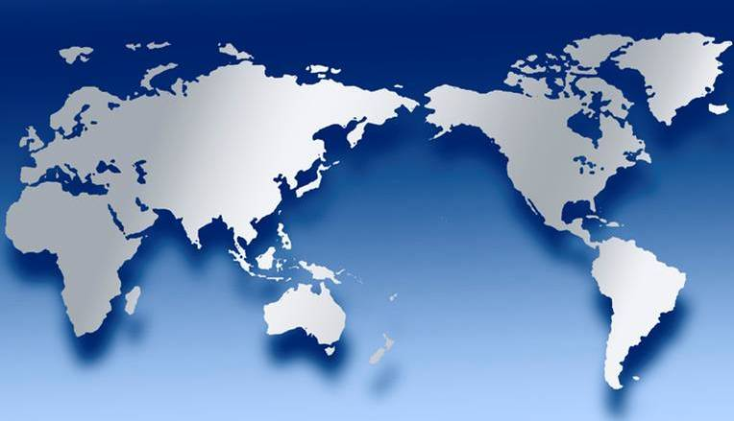
Roman gods had some power as heads of some things.
All the powers of all gods made up “the fullness of deity.”
But Jesus has “the whole fullness of deity” and is head of all. If in Christ the fullness of God, we are “filled” in him by faith, needing nothing more to make us more complete in God.
Jesus Christ is Lord of all
X
Ceres
X
Vulcan
X
X
Jupiter
Mercury
X
X
Bacchus
Venus
X
© GospelGifs.com
Minerva
X
Diana
X
Mars
Juno
X
X
X
Neptune
Apollo
World map
various copies on internet,
original source unknown

Slide 81
“For in him all the fullness of God was pleased to dwell”
Col 1:19
“For in him the whole fullness of deity dwells bodily”
Col 2:9
He is the image of the invisible God
the firstborn of all creation
By him all things were created
All things were created through him and for him
He is before all things
In him all things hold together
He is the head of the body, the church
He is the beginning, the firstborn from the dead
that in everything he might be preeminent
In him all the fullness of God was pleased to dwell
Through him God reconciled to himself all things
making peace by the blood of his cross.
© GospelGifs.com
with permission
The fullness of God in Christ is described in Col 1:15-20
15

Slide 82
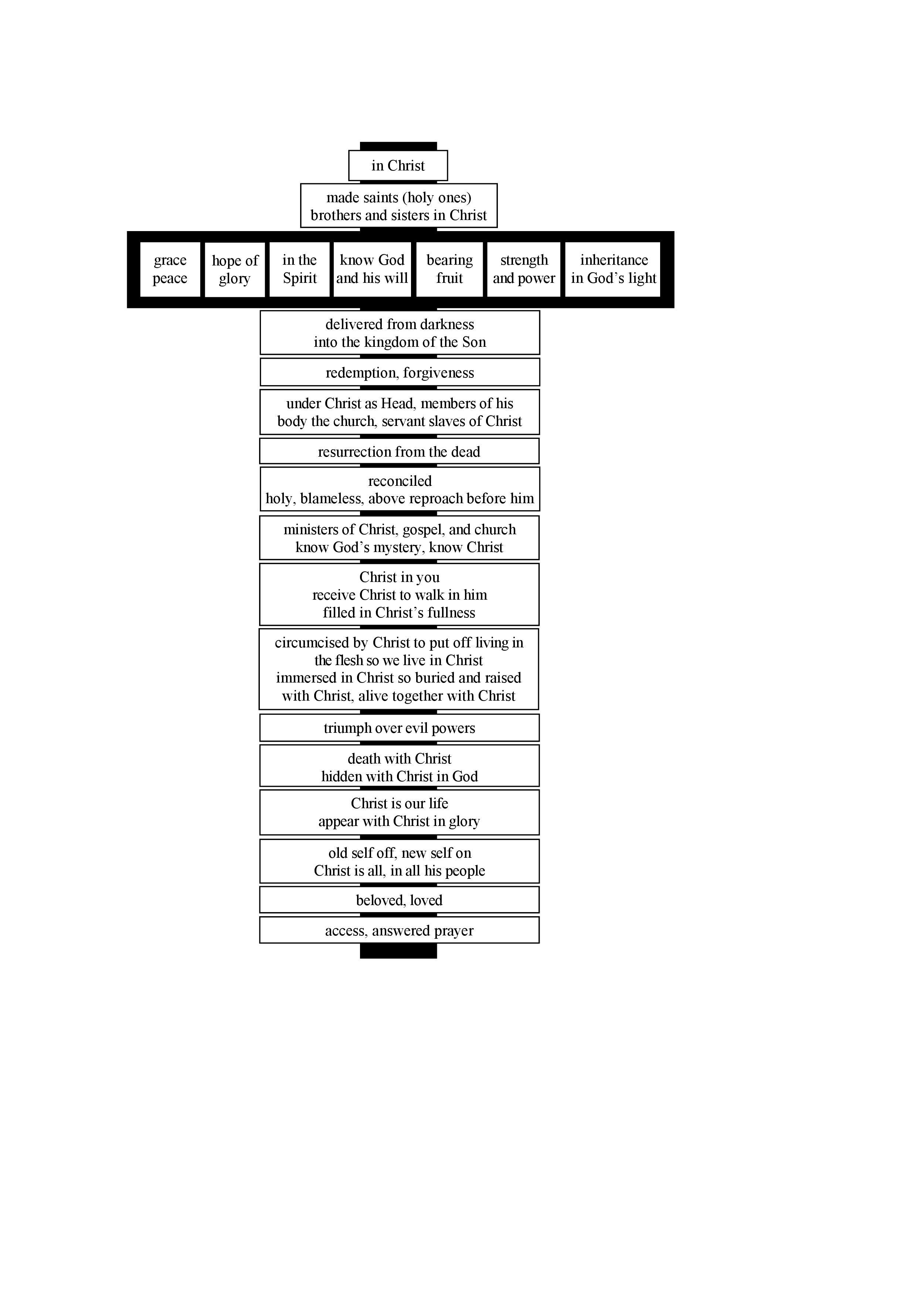
The fullness of God’s grace in Christ crucified is like gifts attached to Christ’s cross.
This diagram shows the gifts of God’s grace in Christ in Colossians.
(For a free diagram for each NT book, go to www.GraceGodChrist.com then to “The Grace of God in Christ eBook” then click on
“The Grace of God in Christ in each NT book”)
15

Slide 83
  Repentance toward God and faith in our Lord Jesus Christ
in Christ
If we are in Christ
the fullness of God,
we have the
fullness of
God’s grace
in Christ.
We are
spiritually
full,
lacking
nothing,
filled with
God’s fullness in
Christ and his grace, complete in Christ.
justified in Christ the righteousness of God
ransomed, redeemed propitiation, sin atoned, wrath turned
forgiven peace with God reconciled ambassadors eternal life
welcomed, accepted filled, complete blessed with every blessing
Christ our wisdom from God, righteousness, sanctification and redemption
delivered from the domain of darkness into the light of the kingdom of the beloved Son
in Christ and Christ in us in the Spirit and the Spirit in us, made God’s temple
in God the Father and the Father in us immersed in Father, Son, and Spirit
Father, Son, and Spirit fellowship with us access to God and his grace answered prayer
grace at the throne of grace every need supplied the Spirit prays for us, helps us pray
Christ intercedes as mediator Christ advocates in our defense
immersed into Christ and his death and resurrection united with Christ in death and resurrection
crucified and buried with Christ raised and alive with Christ
one with Christ seated with Christ
hidden with Christ in God old self crucified
new self created set free from sin
instrument for righteousness under Christ, abundant grace
released from law, married to Christ under law of the Spirit
Spirit and God’s love poured out rivers of living water of Spirit
immersed in the Spirit given, receive, have Spirit
Spirit comes on, falls on us anointed with the Spirit
sealed with the Spirit guarantee of the Spirit
born of the Spirit Spirit of truth helps, teaches
Spirit leads us Spirit sanctifies us
adopted as sons, Spirit sent Spirit gifts for service
the Spirit fills us circumcised, set apart in the Spirit
immeasurably great power God’s workmanship led in triumph, victory
members of Christ’s body brothers and sisters branches in Christ’s vine
  chosen race, royal priesthood, holy nation, God’s possession, God’s people
fellow citizens with the saints and members of the household of God
citizenship in heaven hope of glory inheritance, heir, fellow heir
with Christ at death made perfect glorified to be like Jesus
into heavenly kingdom enter joy of Lord delivered from wrath
God’s good work completed resurrection body like Jesus
married to the Lamb every tear wiped away
see God’s face reign forever
loved and saved
in New Covenant
johncrozieris@gmail.com © 2017
15

Slide 84
Jesus is our fullness by faith
as Jesus is our righteousness by faith!
Our unrighteousness and emptiness
Filled with spiritual fullness in God,
needing nothing to be more complete,
in Christ alone, through faith alone,
by God’s grace alone
Christ
Me
Christ the righteousness of God
Christ the fullness of God
“reconciled . . . by his death, in order to present you holy and blameless and above reproach before him” Col 1:22
“For in him the whole fullness of deity dwells bodily,
and you have been filled in him, who is the head
of all rule and authority” Col 2:9-10
15

Slide 85
The false teachers in Colossians taught that being in Christ by faith was not enough for spiritual fullness in God.
They proclaimed deeper “wisdom and knowledge” (2:2,3)
and “fullness” (2:9-10) beyond receiving Christ Jesus
the Lord by faith and walking in him (2:6-7).
Christ is not enough. You need spiritual experiences of knowing and
fullness by worship encounters with angels in visions
of the spirit world
(Col 2:18-19).
Faith is not enough. You need to not eat
certain food and
drink with ascetic severity to your
body and observe special holy days as
you seek angels and visions (Col 2:16-23).
in Christ
spiritual
fullness
in God
Microsoft clip art © 2013
Microsoft Corporation.
15

Slide 86


No! Christ is enough! Faith is enough!
We are filled in Christ the fullness of God!
In Christ are hidden all
treasures of wisdom
and knowledge!
Dove and Bible
Microsoft clip art © 2013
Microsoft Corporation.
© Yoon Nam Sun
Therefore, as you received Christ Jesus the Lord,
so walk in him, rooted and built up in him
and established in the faith, just as you were taught,
abounding in thanksgiving. (Col 2:6-7)
15

Slide 87
Receive Christ the Lord by faith (2:6), for God’s wisdom (2:3) and fullness (2:9-10) are by faith in Christ.
Then keep on walking in Christ.
Keep on being rooted in Christ.
Keep on being built up in Christ, established in faith in Christ, the same kind of faith the apostles taught when you received Christ.
Keep on overflowing with thanksgiving because of Christ.
2:8 See to it that no one takes you captive by philosophy and empty deceit, according to human tradition, according to the elemental spirits of the world, and not according to Christ.
(Don’t be taken captive by any who say Christ isn’t enough.
It’s just philosophy, deceit, human, elemental.)
15

Slide 88
THE LORD
God’s completely different way
to fullness
smiley © sherv.net
Jumping heart © www.fg-a.com
People circle © clipartfest.com
Fullness is in Christ, not in beauty, music, smart-phones, sports, cars, money, friends, romance, sex, food,
drinking parties, homes or jobs!

Slide 89
Fullness is not through other gods, meditation similar to Buddha, honoring ancestors, pleasing the spirits, going to witchdoctors, making pilgrimages, bathing in the Ganges, observing special holy days, speaking in tongues, asceticism, worship of angels, visions (Col 2:18) or being a very religious Christian.
15

Slide 90
Fullness is by faith in Christ the fullness of God!
15

Slide 91
Stop doing something to be more whole and complete.
Stop searching for fullness in other ways.
Enjoy God’s fullness in Christ by faith in his Word with prayers of thanks.
15

Slide 92
“I have greater fullness than you. I’m more spiritual than you.”
“Jesus is the
fullness of God in human flesh.”
When anyone tells you they have a greater “fullness” than the fullness we receive when we receive Christ the fullness of God
by faith apart from
any of our efforts or spiritual experiences,
they repeat the Colossian error.
“You need to DO what
I DO and experience what I experience
to be as full and
spiritual as I am.”
“If Christ the fullness of God dwells in me
by faith,
I’m filled in him.”
Be on guard for anyone who says you will have greater fullness
if you DO something, rather than receiving Christ the fullness of God and walking in him by faith based on all he has DONE.
15

Slide 93
“If we do not rely on Christ for wholeness, all our relationships are an attempt to complete ourselves.” adapted from Drs. Les and Leslie Parrott
Lord, I trust Christ as my spiritual wholeness and fullness, Jesus in whom the whole fullness of God dwells.
I am filled in him who is the fullness of God.
I am filled with the riches of the grace of God in Christ.
It is finished. I am complete in Christ by faith
without tongues, dreams, visions, miracles, or “words.”
15

Slide 94
“For in him the whole fullness of deity dwells bodily
and you have been filled
in him, who is the head
of all rule and authority”
Col 2:9-10
empty
in myself
15. filled and
complete
in Christ
© GospelGifs.com
with permission
If we are in Christ in whom God’s fullness dwells, the head of all rule and authority, we are spiritually filled and complete in God by faith.
No other power or anything we do makes us more complete or “spiritual.”
15

Slide 95
Jesus
Mohammed
Confucius
Can anyone else give us fullness in God?
Is anyone else the one in whom God’s fullness dwells, the head of all rule and authority,
who fills all in him with spiritual fullness in God?
Has anyone else died for our sins to become
for us the fullness of God’s blessing?
Hindu Gurus
Moses
Buddha
15

Slide 96
Let’s come to a conclusion rather than wandering along being indecisive and unfulfilled.
Let’s enter into true joy and satisfaction in the Lord.

Slide 97
When Jesus came to earth,
he completely changed our understanding of God.
The Lord is very different than we thought.
THE LORD
Jesus revealed that the one
Lord God Almighty is also
God the Father, Son and Spirit.
Jesus was killed
for his claims
to be Christ
the Son of God
living in “Abba”
and “Abba” in him.
smiley © sherv.net
(The Lord is infinitely greater than a smiley!)

Slide 98
After Jesus was crucified, raised and reigning with the Father, the Apostles began to deeply grasp how God the Father, Son and Spirit enjoyed personal relationships within himself
of oneness, love, fellowship and cooperation.
THE LORD
Father, Son and Spirit oneness
love, fellowship and cooperation
smiley © sherv.net

Slide 99
Jesus was the happiest person ever on earth
because his love, joy and satisfaction was in God.
THE LORD
smiley © sherv.net
Jesus had fullness of love, joy and satisfaction in God because he enjoyed the Lord as the Lord enjoys the Lord.

Slide 100
The joy of Jesus was the joy of Father, Son and Spirit oneness in holy love and all their other perfections.
THE LORD
Father, Son and Spirit oneness
love, fellowship and cooperation
Wise Infinite
Eternal Sovereign
Omniscient Omnipotent
Omnipresent Transcendent
Faithful Righteous
Holy Perfect
Love Just
Longsuffering Patient
True Truthful Gracious
Merciful Unchanging
Zealous Wrathful
Good Humble
smiley © sherv.net
Don’t you long to enjoy the relationships of oneness, love, fellowship and cooperation God the Father, Son and Spirit enjoys within himself and shares with his people now and far more in glory?

Slide 101
Jesus died so the Lord can share himself with people
in an eternal love relationship of oneness.
“that they may all be one, just as you, Father, are in me, and
I in you, that they also may be in us”
John 17:21
“I in them and you in me,
that they
may become perfectly one”
John 17:23
THE LORD
smiley © sherv.net
jumping heart © www.fg-a.com
“that they also, whom you have given me, may be with me where I am . . that the love with which you have loved me may be in them, and I in them” John 17:24,26

Slide 102
If we want a relationship of greatest possible love, joy and satisfaction for any human being, enjoy oneness in love with God the Father, Son and Spirit through faith in Christ!
smiley © sherv.net
Jumping heart © www.fg-a.com
People circle © clipartfest.com

Slide 103
This is what God wants for those he made in his image!
God wants to share himself with us!
God wants us to enjoy the Lord as he enjoys himself!
smiley © sherv.net
Jumping heart © www.fg-a.com
People circle © clipartfest.com

Slide 104
Imagine the repentant thief on the cross the moment
he saw the Lord as he is and was embraced in the arms
of God the Father, Son and Spirit (Luke 23:39-43).
Holy, holy, holy
Lord God Almighty!
What love and mercy!
Father, thank you for sending your Son
to save me!
Lord Jesus, you
are the King of kings!
Thank you for dying
to include me in your kingdom to be with
you forever!
Holy Spirit, praise you for changing my mocking heart to believing! (Mt 27:44; Mk 15:32)
smiley © sherv.net
Jumping heart © www.fg-a.com
People circle © clipartfest.com
Blessed be God the Father, Son and Holy Spirit!

Slide 105
Imagine Mary when she entered the Lord’s presence. What wonder and praise she would have for each of the distinct relationships of God the Father, Son and Spirit.
Holy, holy, holy Abba! Thank you for sending your Son, the Christ! Thank you for your infinitely wise ways!
Lord Jesus, at last I see you as you really are in eternal glory!
Thank you for dying
to redeem your people!
Holy Spirit, praise you for coming upon me to form in me the Son of God!
smiley © sherv.net
Jumping heart © www.fg-a.com
People circle © clipartfest.com
Blessed be the Lord God of Israel, Father, Son and Holy Spirit!
How amazing you are! How personal you are! All praise to you!

Slide 106
Imagine the celebration of God the Father, Son and Spirit when the beloved Son returned to heaven, the high fives and rejoicing in which all heaven joined.
Well done, my
humble Son in whom
I am well pleased!
All authority in heaven and earth is given you!
Holy Abba, what
joy to please you
and be with you again! You are the
supremely best!
Holy Spirit, we delight in how you have made our mission succeed! Oh, Father and Son, victory and praise to you!
smiley © sherv.net
Jumping heart © www.fg-a.com
People circle © clipartfest.com
“To him who sits on the throne and to the Lamb be blessing and honor and glory and might forever and ever!” Rev 5:13

Slide 107
Imagine some of the joy of God the Father, Son and Spirit before the angels of God over one sinner who repents (Luke 15:10)
I love how there
is salvation in no one else but you, my Son!
No one else can save!
Great sovereign
plan for their life,
Abba! Excellent!
How longsuffering!
Good work, Holy Spirit, wooing and winning their heart, convincing with our word of truth!
smiley © sherv.net
Jumping heart © www.fg-a.com
People circle © clipartfest.com
There is no greater joy or delight or affection or respect in the universe than that between the Father, Son and Holy Spirit.

Slide 108
THE LORD
God’s completely different way
to deepest joy and satisfaction
smiley © sherv.net
Jumping heart © www.fg-a.com
People circle © clipartfest.com
We seek joy and satisfaction in beauty, music, phones, sports, cars, money, friends, romance, sex, food, drinking parties, homes or jobs.
But Jesus could have supreme joy and satisfaction without sex or money or any of these things because his joy and satisfaction was in the Lord!

Slide 109
THE LORD
God’s completely different way
to deepest joy and satisfaction
smiley © sherv.net
Jumping heart © www.fg-a.com
People circle © clipartfest.com
When Jesus enjoyed a refreshing drink, the beauty of flowers, or a nice meal, Jesus received all as a gift from God and rejoiced in Abba creating all for his praise and our enjoyment and good. However, we seek joy
by trying to satisfy our needs through other things than God.

Slide 110
THE LORD
God’s completely different way
to deepest joy and satisfaction
smiley © sherv.net
Jumping heart © www.fg-a.com
People circle © clipartfest.com
God diagnoses our problem. “My people have committed two evils: they have forsaken me, the fountain of living waters, and hewed out cisterns for themselves, broken cisterns that can hold no water.” Jer 2:13

Slide 111
THE LORD
God’s completely different way
to deepest joy and satisfaction
smiley © sherv.net
Jumping heart © www.fg-a.com
People circle © clipartfest.com
“Do not love the world or the things in the world. . . . For all that is in the world—the desires of the flesh and the desires of the eyes and pride of life—is not from the Father but is from the world.” 1 John 2:15-16

Slide 112
THE LORD
God’s completely different way
to deepest joy and satisfaction
smiley © sherv.net
Jumping heart © www.fg-a.com
People circle © clipartfest.com
“And the world is passing away along with its desires,
but whoever does the will of God abides forever.” 1 John 2:17

Slide 113
The Lord sent his Son to die for us
so we can enjoy God the Father, Son and Spirit
in a personal love relationship for all eternity!
Is this what you want?
smiley © sherv.net
Jumping heart © www.fg-a.com
People circle © clipartfest.com

Slide 114
Would you like your heart to jump for joy?
Here’s how to make the connection . . .
smiley © sherv.net
jumping heart © www.fg-a.com

Slide 115
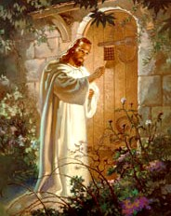
If we want connection with God the Father, Son and Spirit,
we ask the Lord to connect with us as he promises. If we truly turn to Jesus Christ from our sinful ways, he will keep his promise.
Here is a promise from Christ: “Be zealous and repent. Behold, I stand at the door and knock. If anyone hears my voice and opens the door, I will come in to him and eat with him, and he with me” (Rev 3:19-20).
Will you believe Jesus is the Son of God who died for your sin and rose so that if you open the door of your soul, he will come in to you, make his home with you, and eat together with you in heart to heart fellowship forever?
Christ at Heart’s Door by Warner Sallman
© Warner Press Inc.
Will you become zealous for Jesus and repent of your zeal for seeking joy and satisfaction from the wrong things?
Notes:
Will you become zealous for Jesus and repent?

Slide 116
THE LORD
God’s completely different way
to deepest joy and satisfaction
smiley © sherv.net
Jumping heart © www.fg-a.com
People circle © clipartfest.com
Lord, I have sought joy and satisfaction from the wrong things. I have disobeyed your command to love you with all my heart and strength. I have sought my own interests and not loved others as you do.

Slide 117
THE LORD
God’s completely different way
to deepest joy and satisfaction
smiley © sherv.net
Jumping heart © www.fg-a.com
People circle © clipartfest.com
Eternal Lord, I want connection with you. You are the source of deepest joy and satisfaction. Temporary earthly things can never satisfy the eternal longings of my soul; only you can.

Slide 118
1. Justified in Christ the righteousness of God
Please change me from being black, black, black
to white, white, white in your sight
in Christ the righteousness of God.
Christ
THE LORD
black
black
black
white
white
white
one
one
one
smiley © sherv.net
Jumping heart © www.fg-a.com
“For our sake he (God) made him (Jesus) to be sin
who knew no sin, so that in him (Jesus) we might
become the righteousness of God.” 2 Cor 5:21
1

Slide 119
2. ransom, redemption
Through the ransom payment of Christ, please free me from being a slave chained to my sins and make me free, free, free, bought to belong to you, Lord.
chains slave chains slave
chains slave
paid
paid
paid
free bought free bought
free bought
chains
of
sin
Satan
death
hell
ransom
redemption
No copyright John Crozier
Egyptian smiley © sherv.net
Jumping heart © www.fg-a.com
© GospelGifs.com
used with permission
free in the Lord
“the Son of Man came not to be served but to serve, and to give his life as a ransom for many” Mat 20:28
2

Slide 120
3. propitiation, atonement, God’s wrath turned away
Through Christ’s sacrifice of propitiation that atoned
for my sin, please turn away your wrath from me
and give me at-one-ment with you, Lord.
under God’s wrath
wrath
turned
away
Christ
Egyptian smiley © sherv.net
Jumping heart © www.fg-a.com
at-one-ment
with the Lord
jewishvirtuallibrary.org
“Christ Jesus, whom God put forward as a propitiation (sacrifice of atonement, NIV) by his blood,
to be received by faith” Rom 3:24
3

Slide 121
God covers our sins
God cancels our debts
God sends away our sins
God frees us from our sins
God lifts off (nasa) our sins
God removes our sins from us
4. forgiven
Smiley © sherv.net
God treads our sins underfoot
God casts our sins into the sea
God blots out / wipes out our sins
God remembers our sins no more
God washes, cleanses us from sin
God casts our sins behind his back
God does not count our sins against us
Lord, forgive my many sins through Christ’s death for sin.
Cover my sins. Cancel my debts. Free me. Wash me.
“In him we have redemption through his blood,
the forgiveness of our trespasses” Eph 1:7
4

Slide 122
5. peace with God
THE LORD
I turn from warring against you, Lord, with my “me, me, me” ways of doing whatever I want.
smiley © sherv.net
Jumping heart © www.fg-a.com
I surrender. I depend on Christ’s death to make peace with God.
SHALOM
peace
peace
peace
You
You
You
“Since we have been justified by faith,
we have peace with God through our Lord Jesus Christ” Rom 5:1
THE
LORD
Microsoft clip art © 2013
Microsoft Corporation.
war war
war
me! me!
me!
5

Slide 123
6. reconciled to God
“While we were enemies
we were reconciled to God
by the death of his Son”
Rom 5:10
Egyptian smiley © sherv.net
Jumping heart © www.fg-a.com
friends friends friends
Yes! Yes! Yes!
reconciled
No!
No!
No!
I’ve been your enemy, fighting with you, saying “No! No! No!”
I want to be reconciled
to you by the death of your Son, made friends, saying “Yes! Yes! Yes!”
THE
LORD
fight
fight
fight
© GospelGifs.com
used with permission
6

Slide 124
Lord, please give me eternal life with you as you promise. I do not want to perish in eternal death. I want life, life, life
in God the Father, Son and Spirit forever.
7. eternal life
THE LORD
JESUS
CHRIST
life, life, life
now and forever
eternal life in God
smiley © sherv.net
jumping heart © www.fg-a.com
psdgraphics.com in kidclipart.com
death
death
death
perish
perish
perish
“I give them eternal life, and they will never perish, and no one will snatch them out of my hand” John 10:28
Microsoft clip art © 2013 Microsoft Corp
7

Slide 125
Thank you for your invitation to connect and fellowship together
as you promise in Revelation 3:19-20.
“Be zealous and repent. Behold, I stand at the door and knock. If anyone hears my voice and opens the door, I will come in to him and eat with him, and he with me.”
I believe Jesus is the Son of God who died for our sin and rose as Lord of all, the King of kings. I hear you knocking. I open the door of my soul to you. I want you to come in and make your home with me. I want to eat together with you in heart to heart fellowship in your word forever.
Christ at Heart’s Door by Warner Sallman
© Warner Press Inc.
I want to be zealous for you as the source of joy and satisfaction. I repent of seeking joy and satisfaction from all the wrong things.
Notes:
Will you become zealous for Jesus and repent?

Slide 126
Did you sincerely open the door to Jesus Christ our Lord?
What does the Lord promise to do?
“Be zealous and repent. Behold, I stand at the door and knock. If anyone hears my voice and opens the door, I will come in to him and eat with him, and he with me.”
Did he keep his promise?
If so, what has Christ done for you?
Why not thank him for keeping his promise?
This is part of your new relationship and fellowship with the Lord, to keep reflecting on his promises in the Bible (hear his voice),
to have faith in his faithfulness to keep his word,
and to thank him for what he provides in Christ.
Christ at Heart’s Door by Warner Sallman
© Warner Press Inc.
Notes:
Will you become zealous for Jesus and repent?

Slide 127
Did the Lord keep his promises to make you white, white, white,
free, free, free, one, one, one, forgiven, at peace, and reconciled with life, life, life in Christ?
Does the Lord keep his promises?
Yes! Of course!
This is what faith is all about.
“Lord, I believe your promises.”
Therefore, what has Christ done for you?
Why not thank him for keeping his promises?
This is part of your new relationship and fellowship with the Lord, to keep reflecting on his promises in the Bible (hear his voice),
to have faith in his faithfulness to keep his word,
and to thank him for what he provides in Christ.
Christ at Heart’s Door by Warner Sallman
© Warner Press Inc.
Notes:
Will you become zealous for Jesus and repent?

Slide 128
Now we can finish really well by expressing our faith in God’s promises with thanking the Lord for what he just did for us if we opened the door and welcomed him in! faith – promises – praise faith in God’s promises with praise

Slide 129
1. Justified in Christ the righteousness of God
Lord, thank you for changing me from black, black, black
to white, white, white in your sight
in Christ the righteousness of God.
Christ
THE LORD
black
black
black
white
white
white
one
one
one
smiley © sherv.net
Jumping heart © www.fg-a.com
“For our sake he (God) made him (Jesus) to be sin
who knew no sin, so that in him (Jesus) we might
become the righteousness of God.” 2 Cor 5:21
1

Slide 130
2. ransom, redemption
Thank you for freeing me from being a slave chained to my sins to being free, free, free, bought to belong to you, Lord, through the ransom payment of Christ.
chains slave chains slave
chains slave
paid
paid
paid
free bought free bought
free bought
chains
of
sin
Satan
death
hell
ransom
redemption
No copyright John Crozier
Egyptian smiley © sherv.net
Jumping heart © www.fg-a.com
© GospelGifs.com
used with permission
free in the Lord
“the Son of Man came not to be served but to serve, and to give his life as a ransom for many” Mat 20:28
2

Slide 131
3. propitiation, atonement, God’s wrath turned away
Thank you, holy Lord, for turning away your wrath
and giving me at-one-ment with you through Christ’s sacrifice of propitiation that atoned for my sin.
under God’s wrath
wrath
turned
away
Christ
Egyptian smiley © sherv.net
Jumping heart © www.fg-a.com
at-one-ment
with the Lord
jewishvirtuallibrary.org
“Christ Jesus, whom God put forward as a propitiation (sacrifice of atonement, NIV) by his blood,
to be received by faith” Rom 3:24
3

Slide 132
God covers our sins
God cancels our debts
God sends away our sins
God frees us from our sins
God lifts off (nasa) our sins
God removes our sins from us
4. forgiven
Smiley © sherv.net
God treads our sins underfoot
God casts our sins into the sea
God blots out / wipes out our sins
God remembers our sins no more
God washes, cleanses us from sin
God casts our sins behind his back
God does not count our sins against us
Praise you, Lord, for forgiving my sins through Christ’s death, covering my sins, cancelling my debts, washing me clean.
“In him we have redemption through his blood,
the forgiveness of our trespasses” Eph 1:7
4

Slide 133
5. peace with God
THE LORD
Thank you for peace with God through our Lord Jesus Christ.
I want to be “You, You, You”
not “me, me, me!”
smiley © sherv.net
Jumping heart © www.fg-a.com
SHALOM
peace
peace
peace
You
You
You
“Since we have been justified by faith,
we have peace with God through our Lord Jesus Christ” Rom 5:1
THE
LORD
Microsoft clip art © 2013
Microsoft Corporation.
war war
war
me! me!
me!
5

Slide 134
6. reconciled to God
“While we were enemies
we were reconciled to God
by the death of his Son”
Rom 5:10
Egyptian smiley © sherv.net
Jumping heart © www.fg-a.com
friends friends friends
Yes! Yes! Yes!
reconciled
No!
No!
No!
Thank you for reconciling with me by the death of your Son to make us
friends, friends, friends.
I want to be “Yes! Yes! Yes!” with you from now on.
THE
LORD
fight
fight
fight
© GospelGifs.com
used with permission
6

Slide 135
Lord, thank you for Christ dying to give me eternal life, life, life now and forever with God the Father, Son and Spirit.
7. eternal life
THE LORD
JESUS
CHRIST
life, life, life
now and forever
eternal life in God
smiley © sherv.net
jumping heart © www.fg-a.com
psdgraphics.com in kidclipart.com
death
death
death
perish
perish
perish
“I give them eternal life, and they will never perish, and no one will snatch them out of my hand” John 10:28
Microsoft clip art © 2013 Microsoft Corp
7

Slide 136
Thank you for your invitation to connect and fellowship together
as you promise in Revelation 3:19-20.
“Be zealous and repent. Behold, I stand at the door and knock. If anyone hears my voice and opens the door, I will come in to him and eat with him, and he with me.”
Thank you for coming in when I opened the door of my soul to welcome you into my home. Thank you that you have come to make your home with me and share yourself with me as we eat your word together in heart to heart fellowship.
Christ at Heart’s Door by Warner Sallman
© Warner Press Inc.
Notes:
Will you become zealous for Jesus and repent?

Slide 137
One, one, one with you, Lord,
all because God the Son died for me.
in Christ and Christ in me!
in the Spirit and the Spirit in me!
in the Father and the Father in me!
© GospelGifs.com
used with permission
Thank you, thank you, Lord!
You are what I want!
NO!
8,9,10
© GospelGifs.com

Slide 138
“For in him the whole fullness of deity dwells bodily
and you have been filled
in him, who is the head
of all rule and authority”
Col 2:9-10
empty
in myself
I am filled and
complete
in Christ!
Thank you, Lord!
© GospelGifs.com
with permission
If we are in Christ in whom God’s fullness dwells, the head of all rule and authority, we are spiritually filled and complete in God by faith.
No other power or anything we do makes us more complete or “spiritual.”
15

Slide 139
THE LORD
God’s completely different way
to deepest joy and satisfaction
smiley © sherv.net
Jumping heart © www.fg-a.com
People circle © clipartfest.com
Lord, thank you that joy and satisfaction are in Christ, not beauty, music, smart-phones, sports, cars, money, friends, romance, sex, food, drinking parties, homes or jobs! Thank you, Lord!

Slide 140
Amen!
(Saying “amen” at the end of a prayer is like saying
“So be it!” as in “May this truly come to pass!”
Saying “amen, amen” at the start of a statement is like saying “Truly, truly” as in “I speak the truth;
I am not lying” or “This is true, this is true” or “I assure you that this is true and trustworthy.”)
If you truly prayed in sincere faith as “amen” is supposed to mean, the Lord says, “Amen, amen, truly, truly, I will do for you what I promised!
What I promised is true and worthy of your trust!”

Slide 141
I am
God blessing
you with
every spiritual
blessing
I am fullness in God
I am reconciliation
to God
I am
peace
with God
I am
ransom
and
redemption
If you received God’s gift of his Son, there are many more gifts to enjoy inside the gift of Christ!
I am deliverance from darkness
into the kingdom of God’s Son
I am
at-one-ment with the Lord
God’s wrath turned away
I am forgiveness
I am
the righteousness of God
justification
I am
eternal
life

Slide 142
Enjoy opening all “God’s gifts of delight
in Christ” which the Lord has given us
to bring us into fullest joy and satisfaction in God the Father, Son and Spirit!
  Repentance toward God and faith in our Lord Jesus Christ
in Christ
justified in Christ the righteousness of God
ransomed, redeemed propitiation, sin atoned, wrath turned
forgiven peace with God reconciled ambassadors eternal life
welcomed, accepted filled, complete blessed with every blessing
Christ our wisdom from God, righteousness, sanctification and redemption
delivered from the domain of darkness into the light of the kingdom of the beloved Son
in Christ and Christ in us in the Spirit and the Spirit in us, made God’s temple
in God the Father and the Father in us immersed in Father, Son, and Spirit
Father, Son, and Spirit fellowship with us access to God and his grace answered prayer
grace at the throne of grace every need supplied the Spirit prays for us, helps us pray
Christ intercedes as mediator Christ advocates in our defense
immersed into Christ and his death and resurrection united with Christ in death and resurrection
crucified and buried with Christ raised and alive with Christ
one with Christ seated with Christ
hidden with Christ in God old self crucified
new self created set free from sin
instrument for righteousness under Christ, abundant grace
released from law, married to Christ under law of the Spirit
Spirit and God’s love poured out rivers of living water of Spirit
immersed in the Spirit given, receive, have Spirit
Spirit comes on, falls on us anointed with the Spirit
sealed with the Spirit guarantee of the Spirit
born of the Spirit Spirit of truth helps, teaches
Spirit leads us Spirit sanctifies us
adopted as sons, Spirit sent Spirit gifts for service
the Spirit fills us circumcised, set apart in the Spirit
immeasurably great power God’s workmanship led in triumph, victory
members of Christ’s body brothers and sisters branches in Christ’s vine
  chosen race, royal priesthood, holy nation, God’s possession, God’s people
fellow citizens with the saints and members of the household of God
citizenship in heaven hope of glory inheritance, heir, fellow heir
with Christ at death made perfect glorified to be like Jesus
into heavenly kingdom enter joy of Lord delivered from wrath
God’s good work completed resurrection body like Jesus
married to the Lamb every tear wiped away
see God’s face reign forever
loved and saved
in New Covenant
johncrozieris@gmail.com © 2017

Slide 143
To enjoy more gifts in Christ, download
“God’s gifts of delight in Christ”
100 gifts of delight we receive in the Lord’s gift of Jesus Christ www.GraceGodChrist.com
Gifts that are a firm foundation 1-14
Gifts of connection with Father, Son and Spirit 15-23
Gifts of life at God’s throne 24-31
Gifts of being set free from sin 32-48
Gifts of life in the Holy Spirit 48-71
Gifts of being the body of Christ 72-82
Gifts of future glory 83-97
Three great gifts that include all the others 98-100

Slide 144
Come to me!
I died for you
to give you
what no one else can give!
Believe!
Receive!
Rejoice!
© GospelGifs.com
used with permission

Slide 145
Come to me and joyfully receive the many riches of the grace of God.
I can give you what no one else can give!
Believe! Receive!
Rejoice!
  Repentance toward God and faith in our Lord Jesus Christ
in Christ
justified in Christ the righteousness of God
ransomed, redeemed propitiation, sin atoned, wrath turned
forgiven peace with God reconciled ambassadors eternal life
welcomed, accepted filled, complete blessed with every blessing
Christ our wisdom from God, righteousness, sanctification and redemption
delivered from the domain of darkness into the light of the kingdom of the beloved Son
in Christ and Christ in us in the Spirit and the Spirit in us, made God’s temple
in God the Father and the Father in us immersed in Father, Son, and Spirit
Father, Son, and Spirit fellowship with us access to God and his grace answered prayer
grace at the throne of grace every need supplied the Spirit prays for us, helps us pray
Christ intercedes as mediator Christ advocates in our defense
immersed into Christ and his death and resurrection united with Christ in death and resurrection
crucified and buried with Christ raised and alive with Christ
one with Christ seated with Christ
hidden with Christ in God old self crucified
new self created set free from sin
instrument for righteousness under Christ, abundant grace
released from law, married to Christ under law of the Spirit
Spirit and God’s love poured out rivers of living water of Spirit
immersed in the Spirit given, receive, have Spirit
Spirit comes on, falls on us anointed with the Spirit
sealed with the Spirit guarantee of the Spirit
born of the Spirit Spirit of truth helps, teaches
Spirit leads us Spirit sanctifies us
adopted as sons, Spirit sent Spirit gifts for service
the Spirit fills us circumcised, set apart in the Spirit
immeasurably great power God’s workmanship led in triumph, victory
members of Christ’s body brothers and sisters branches in Christ’s vine
  chosen race, royal priesthood, holy nation, God’s possession, God’s people
fellow citizens with the saints and members of the household of God
citizenship in heaven hope of glory inheritance, heir, fellow heir
with Christ at death made perfect glorified to be like Jesus
into heavenly kingdom enter joy of Lord delivered from wrath
God’s good work completed resurrection body like Jesus
married to the Lamb every tear wiped away
see God’s face reign forever
loved and saved
in New Covenant
johncrozieris@gmail.com © 2017

Slide 146
Lord, thank you that all these gifts in Christ are provided for us by Christ’s death and resurrection!
It is finished.
You give all in Christ the moment we open our hearts to receive Christ.
justified, declared righteous ransomed, redeemed propitiation, sin atoned, God’s wrath turned away
forgiven peace with God reconciled ambassadors eternal life welcomed, accepted filled, complete
blessed with every blessing
Christ is our wisdom from God, our righteousness
and sanctification and redemption
delivered from the domain of darkness into
the light of the kingdom of the beloved Son
in Christ and Christ in us in the Spirit and the Spirit in us, God’s temple in God the Father and Father in us immersed in the Father, Son and Holy Spirit Father, Son and Holy Spirit fellowship with us access to God and his grace answered prayer grace at the throne of grace
every need supplied the Spirit prays for us, helps us pray
Christ intercedes for us as our one mediator Christ advocates his propitiation in our defense immersed into Christ and his death and resurrection united with Christ in his death and resurrection
crucified and buried with Christ raised and alive with Christ one with Christ
seated with Christ hidden with Christ in God old self crucified
new self created set free from sin instrument for righteousness
under Christ and his abundant grace released from the law to be married to Christ
under the law of the Spirit of life in Christ Jesus the Spirit and God’s love poured out
rivers of living water of the Spirit flow out of us immersed in the Spirit
given the Spirit receive the Spirit have the Spirit
the Spirit comes on us, falls on us anointed with the Spirit
sealed with Spirit, guaranteed inheritance born of the Spirit
the Spirit of truth helps and teaches us
the Spirit leads and sanctifies us
adopted as sons with the Spirit of the Son in us
the Spirit gifts for service the Spirit fills us
circumcised, set apart to God in the Spirit
immeasurably great power God’s workmanship
led in triumphal procession and nike victory
members of Christ’s body brothers and sisters
branches in Christ’s vine
Chosen race, royal priesthood, holy nation,
God’s possession, God’s people
fellow citizens with the saints members of God’s household
citizenship in heaven hope of glory
inheritance, heir, fellow heir with Christ at death
made perfect in his presence glorified to be like Jesus
into heavenly kingdom enter the joy of the Lord
delivered from wrath to come God’s good work completed
resurrection body like Jesus married to the Lamb every tear wiped away
see God’s face reign forever loved and saved in the New Covenant
johncrozieris
@gmail.com
© 2017

Slide 147
The End but I hope it is just the beginning of using God’s truth in these PPTs to rejoice in God’s greatest gift of the Lord Jesus Christ in whom are many, many gifts, all the gifts we need in God!
Get this on your Smartphone from www.GraceGodChrist.com

Slide 148
Endnote 1 from slide 23 regarding Christ our substitute punishment and Christ our substitute righteousness
John Piper uses the terms “righteousness-provider” and “sin-bearer” in a sermon on Romans 13:8-10. “Love Is a Fulfilling of the Law, Part 3” August 7, 2005 at DesiringGod.org
John Piper uses the helpful terms Christ our “substitute perfection” and our “substitute pardon” in: John Piper and Justin Taylor, “What God Requires, Christ Provides” January 1, 2004 at DesiringGod.org.
Of his daughter he says, “Jesus' punishment and Jesus' righteousness
. . . Jesus is her righteousness and Jesus is her punishment.”
Piper also uses “substitute punishment” and “substitute perfection” and “substitute sacrifice and substitute righteousness” in:
John Piper, “When Does God Become 100% For Us?
Answering a Good Question” October 3, 2007 at DesiringGod.org
Also see John Piper’s book, Counted Righteous in Christ: Should We Abandon the Imputation of Christ's Righteousness? at DesiringGod.org

Slide 149
The above PPT is based on the book
“The Grace of God in Christ:
Sixty days of enjoying Jesus Christ and God’s riches of grace in Christ.” by John Crozier free eBook at www.GraceGodChrist.com
John is a Pastor and missionary.
From 1979-2008 he was a Pastor in Canada.
Since then John has been a missionary and Pastor, mainly training Korean missionaries in South Korea.
His Doctor of Ministry is from Trinity Evangelical Divinity School in Deerfield, Illinois (Chicago). Contact John at: johncrozieris@gmail.com

Slide 150
John’s book on the powers and perfections of God the Father, Son and Spirit is
“Know Your God:
Thirty days of enjoying the Lord and His Character” by John Crozier free eBook at www.GraceGodChrist.com
In this life, two key fountains to constantly drink from are God’s character and his riches in Christ. They are really one fountain, the fountain of God in Christ. All God’s grace in Christ is that we may know God as he is, rejoicing in him forever.
“Know Your God” focuses on God’s character. “The Grace of God in Christ” focuses on all God provides in Christ.

Slide 151
All Scripture quotations are taken from
The Holy Bible, English Standard Version (ESV), copyright © 2001 by Crossway Bibles, a publishing ministry of Good News Publishers. Used by permission. All rights reserved.

Slide 152
“John’s carefully calibrated study of the believer’s blessings in Christ is superbly done! It breathes Scripture – exalts Christ – is most practical and adaptable.
These truths are much needed in our time. Highly recommended.”
Dr. David Larsen
Trinity Evangelical Divinity School

Slide 153
“I love being reminded daily of who I am in Christ and of all that Christ has done for me. John's study has helped me to live a more joyous and victorious life.
We are indeed rich in Christ.”
Bob Arnold, SIM International, visiting Professor at SIMTI Korea, former Director of SIM Benin

Slide 154
“As we train missionaries at MTI Korea, the skills and experiences our veteran missionaries share are important, but secondary. Above all, God calls us to give the nations the true Jesus in his saving fullness. The Grace of God in Christ leads our students to Jesus on a deeper level. Again and again, my own heart has found new freedom to relax in my Lord and Savior, even though I am busy with many things. Wonderful!”
Mihyang Choi, Director, Missionary Training Institute, Yeosu, South Korea

Slide 155
“As I read John’s study, I found myself being blessed by the truths being presented, and incorporated them into my own devotional life.
I shared the list of the riches with my study group and we spent time each week reflecting on each truth.
I commend the study of God’s riches of grace by those who desire to move to the next level of their maturing in Christ.”
Dr. Gene Swanstrom
Trinity Evangelical Divinity School

Slide 156
“Before John’s class at MTI, I didn’t know about the riches of grace even though I’m a seminary grad and a Pastor for ten years. Now I’m excited about God’s grace in Christ, and preaching Christ’s riches. Because the Korean church in general does not preach the riches of grace, it makes church members weak and religious. Now when I teach, God’s people are surprised by God’s wonderful grace and the amazing love of Jesus.”
Pastor Jin Woo Lee, MTI, now a missionary with AIM in Africa

Slide 157
“I love John’s PPT diagrams of the many riches of the Grace of God in Christ.
It’s a great way to learn to share the gospel in depth with simple questions, terms and pictures. I believe this is what mission trainees need. We can use John’s PPT on our smart-phone to share Christ effectively in any language.”
Pastor Hakjin Chun, Vlodivostok, Russia former Director of SIM Korea and GLTC Nepal

Slide 158
This PPT is “Finding true joy” for sharing Christ with friends
There are other free PPT’s at www.GraceGodChrist.com
“God’s Gifts of Delight in Christ” in English, Korean, Nepali, and Chinese
“100 Christmas Gifts in Christ” “100 Easter Gifts” and
“100 Thanksgiving Gifts in Christ” are all based on “God’s Gifts of Delight in Christ”
“Phone Food - The Grace of God in Christ” in English, Korean, and English/Korean together
“Nos Richesses” The Grace of God in Christ in French
“Lord, thank you!” in English and Korean, “Phone Food” titles turned into short prayers
“How Easter Opens the Door to Deepest Joy” good for sharing the gospel briefly
“The Grace of God in Christ in Romans” in English
“The Grace of God in Christ in Colossians” in English
“Nike in the New Testament” in English, Korean and English/Korean

Slide 159
Sharing with a friend
When you share this on your smart-phone, the slides are set up so you can ask simple who, what, when, where, why, how questions so there can be friendly discussion back and forth.
For instance, #1 justified: What do you see?
What’s the difference between the two?
What does the Bible say?
How did the one change?
Which one do you want to be?

Slide 160
Please spread this PPT to as many as possible without charge.
Please send it to missionaries for their encouragement and use!
I would gladly help missionaries translate the PPT as much as I can if they contact me.
Other resources are available at www.GraceGodChrist.com
Contact John at johncrozieris@gmail.com

Slide 161
To get this PPT to play properly so the smileys dance on your smart-phone or other device, you must download a free copy of Microsoft Office Powerpoint onto your phone, and when you go to this PPT, you must press the “play as a PPT” tab. Otherwise the smileys stand still and the heart doesn’t jump for joy!

Slide 162
PPT © copyright by John Crozier 2017
Available without cost.
For educational purposes.
I have used Google image search to try to find the original source of the graphics from the internet in order to give proper credit.
If you know of the original source of any graphics that say
“various copies on internet, original source unknown,” please contact me at: johncrozieris@gmail.com

