Slide 1
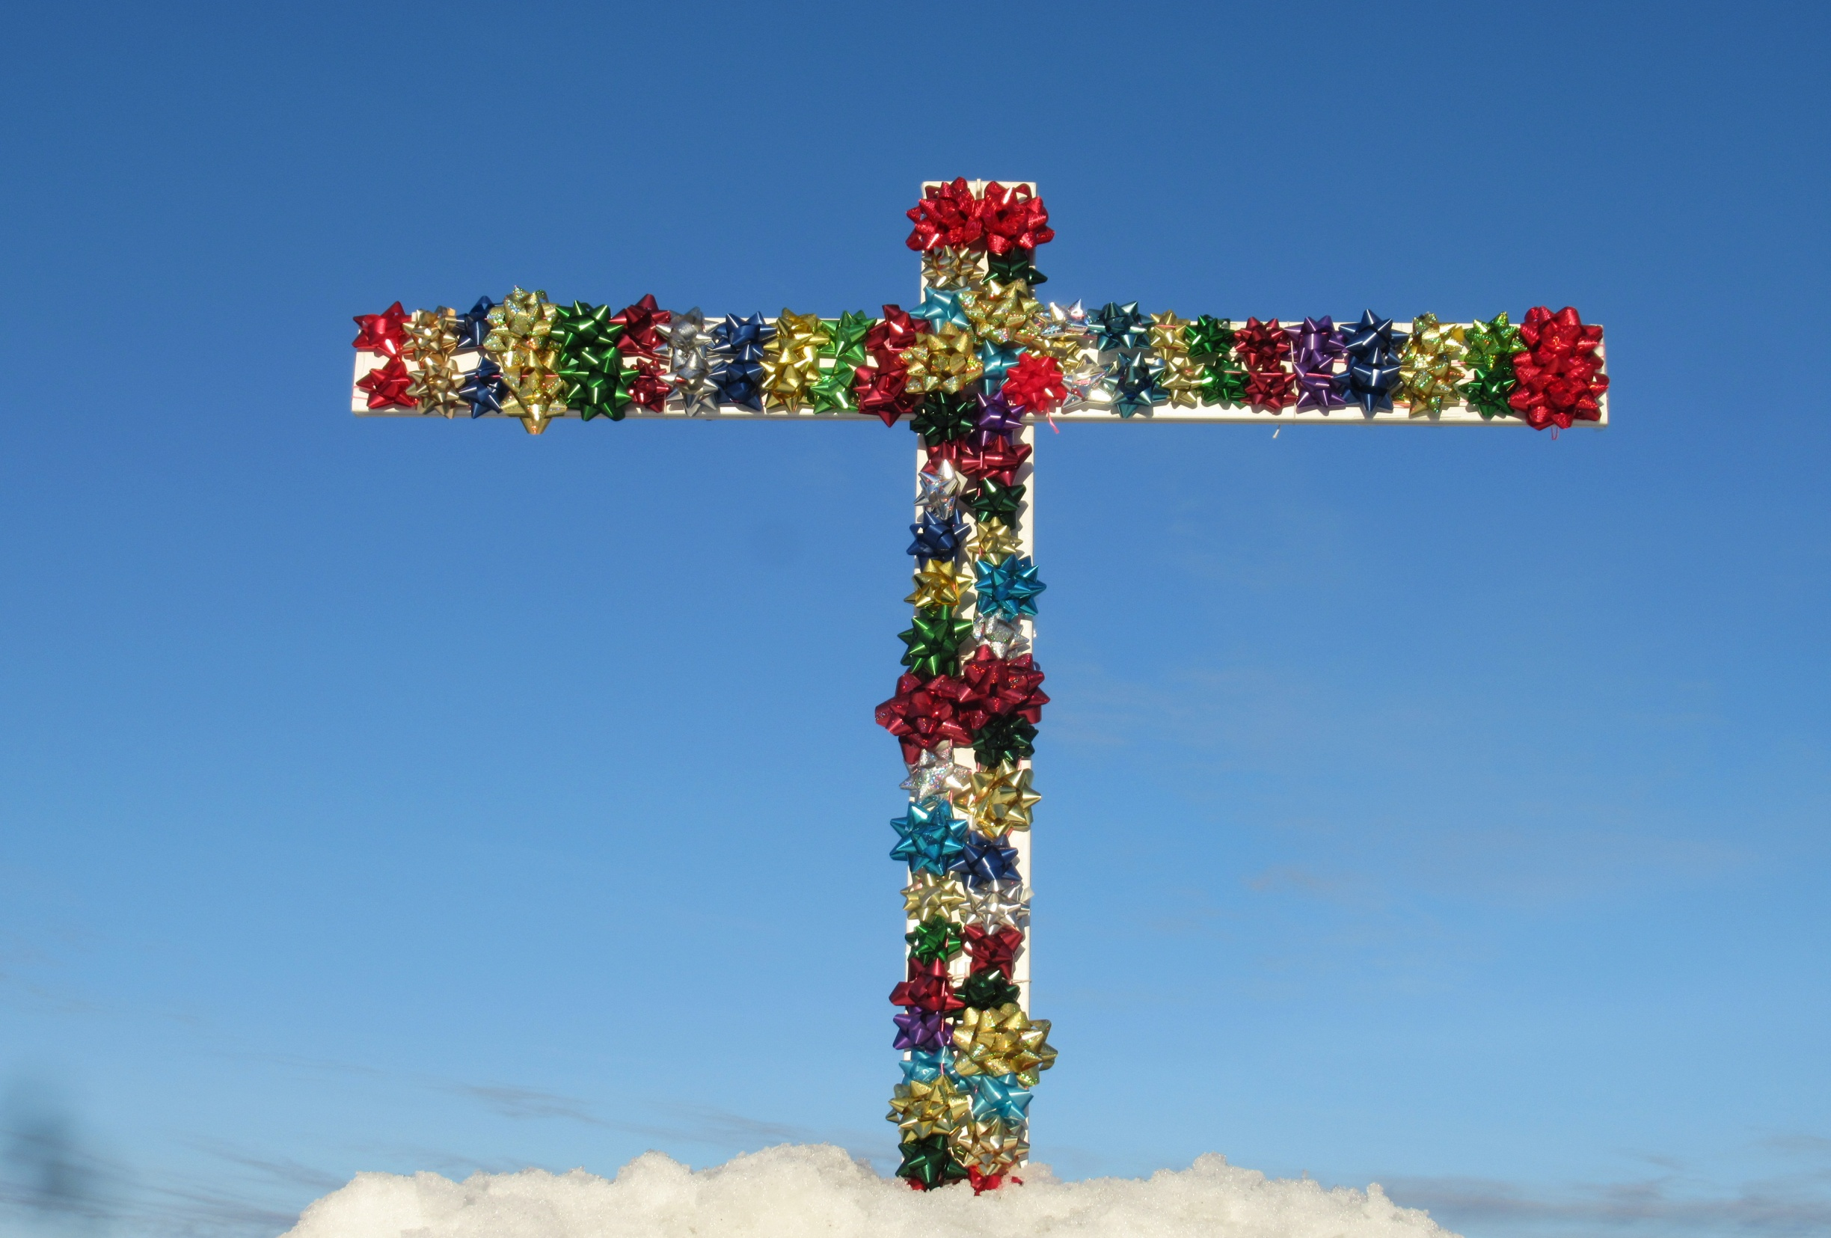
Daily
Praise
for 100
Gifts of
Grace
in Christ

Slide 2
  Repentance toward God and faith in our Lord Jesus Christ
The Grace
of God
in Christ:
100 gifts of delight we receive
in the Lord’s gift of Christ crucified and risen
in Christ
justified in Christ the righteousness of God
ransomed, redeemed propitiation, sin atoned, wrath turned
forgiven peace with God reconciled eternal life adopted sons
welcomed, accepted filled, complete blessed with every blessing
Christ our wisdom from God, righteousness and sanctification and redemption
delivered from the domain of darkness into the light of the kingdom of the beloved Son
in Christ and Christ in us in the Spirit and the Spirit in us, made God’s temple
in God the Father and the Father in us immersed in Father, Son, and Spirit
Father, Son, and Spirit fellowship with us access to God and his grace answered prayer
grace at the throne of grace every need supplied Holy Spirit prays for us, helps us pray
Christ our High Priest intercedes as mediator Christ our High Priest advocates in our defense
immersed into Christ in death and resurrection united with Christ in death and resurrection
old self in Adam crucified and buried with Christ new self in Christ raised and alive with Christ
set free from sin instrument for righteousness
under Christ, abundant grace slaves of Christ not sin
joined to Christ one with Christ
seated with Christ hidden with Christ in God
released from law, married to Christ under law of the Spirit
Spirit and God’s love poured out rivers of living water of Spirit
immersed in the Spirit born of the Spirit
given, receive, have Spirit Spirit comes on, falls on us
anointed with the Spirit sealed with the Spirit
guarantee of the Spirit Spirit of truth helps, teaches
Spirit leads Spirit sanctifies
Spirit power to be ambassadors Spirit gifts for service
Spirit fills circumcised, set apart in the Spirit
immeasurably great power God’s workmanship led in triumph and nike victory
members of Christ’s body brothers and sisters branches in Christ’s vine
  chosen race, royal priesthood, holy nation, God’s possession, God’s people
fellow citizens with the saints and members of the household of God
citizenship in heaven hope of glory inheritance, heir, fellow heir
with Christ at death made perfect glorified to be like Jesus
into heavenly kingdom enter joy of Lord delivered from wrath
God’s good work completed resurrection body like Jesus
married to the Lamb every tear wiped away
see God’s face reign forever
loved and saved
in New Covenant
johncrozieris@gmail.com © 2020

Slide 3
Highly recommended
To enjoy Christ and develop eyes that see God’s riches of grace in Christ in each NT book, during prayer time each of the seven days of the week, praise the Lord through section 1 on Day 1, two on Day 2, . . . seven on Day 7!
Monday – Section 1
Tuesday – Section 2
Wednesday – Section 3
Thursday – Section 4
Friday – Section 5
Saturday – Section 6
Sunday – Section 7

Slide 4
The Grace of God in Christ Monday praise
100 gifts of delight we receive in the Lord’s gift of Christ crucified and risen
Section 1. Gifts that are a Firm Foundation 1-14
1. justified in Christ the righteousness of God.
Rom 3:20-24; 4:25; 2 Cor 5:21; Gal 2:16; Phil 3:8-9;
Acts 13:38-39; Jer 23:5-6
2. ransom and redemption.
Rom 3:24; Matt 20:28; Eph 1:7; 1 Pet 1:18-19;
Titus 2:14; Gal 3:13
3. propitiation, atonement, God’s wrath turned away.
Rom 3:25; Heb 2:17; 1 John 4:10; Gal 3:13

Slide 5
Monday praise cont’d Gifts that are a Firm Foundation 1-14
4. forgiven.
Rom 4:7-8; Eph 1:7; Acts 5:31; 1 John 1:9
5. peace with God.
Rom 5:1; Acts 10:36; John 16:33; Col 1:20
6. reconciled to God.
Rom 5:10; 2 Cor 5:17-20; Eph 2:16; Col 1:21-22
7. eternal life.
John 3:16; 3:36; 10:28; 17:3; Rom 6:23; 1 John 5:11-12
8. adopted as sons with the Spirit of God’s Son in his children.
Gal 4:4-7; Rom 8:15-16; 2 Cor 6:18; Eph 1:5

Slide 6
Monday praise cont’d Gifts that are a Firm Foundation 1-14
9. welcomed and accepted.
Rom 14:3; 15:7; 11:15
10. filled and complete in Christ in whom God’s fullness
dwells. Col 2:9-10
11. blessed in Christ with every spiritual blessing.
Eph 1:3; Rom 8:32
12. wisdom from God, Christ our righteousness, sanctification and redemption. 1 Cor 1:30
13-14. delivered from the domain of darkness and transferred to the light of the kingdom of the Son. Col 1:13; Col 2:15; Acts 26:17-18; 1 Pet 2:9

Slide 7
Section 2. Gifts of connection with the Father, Son and Spirit 15-23 Tuesday praise
15-16. in Christ and Christ in us. Eph 1:13; 3:17; Col 1:2,27; 1 Thess 1:1; 1 Pet 5:14; Rev 3:20; Rom 8:10; Gal 2:20
17-19. in the Spirit and the Spirit in us, made God’s temple.
Rom 8:9; 1 Cor 3:16; 1 Cor 6:19; Gal 3:3
20-21. in God the Father and the Father in us.
John 14:23; Rom 8:9-11; 1 Thess 1:1
22. immersed in the Father, Son and Holy Spirit.
Mat 28:19
23. Father, Son and Spirit fellowship with us and we with them. 1 Cor 1:9; 2 Cor 13:14; 1 John 1:3

Slide 8
Section 3. Gifts of life at God’s Throne 24-31 Wednesday praise
24. access to God and his grace in Christ in one Spirit.
Mat 27:50-51; Eph 2:18; 3:12; Heb 10:19-22; Rom 5:2
25. answered prayer in Jesus’ name.
John 15:6; 16:24; Luke 11:9-10
26. receive mercy, grace, and help at the throne of grace.
Heb 2:18; 4:14-16
27. every need supplied. Phil 4:13, 19
28-29. the Spirit prays for us and helps us pray in the Spirit using God’s word. Rom 8:26-27; Eph 5:18-20;
Eph 6:17-18; Jude 20-21

Slide 9
Wed. praise cont’d Gifts of life at God’s Throne 24-31
30. Christ our High Priest intercedes for us as the one mediator and ransom for all.
Rom 8:34; Heb 7:24-27; 1 Tim 2:5-6
31. Christ our High Priest advocates his propitiation for
our sins in our defense.
1 John 2:1-2; Rom 8:33-34

Slide 10
Section 4. Gifts of being set free from sin 32-48 Thursday praise
32-33. immersed into Christ and united with Christ in death with Christ and resurrection with Christ.
Rm 6:3-10; 1 Cor 6:17; Gal 3:27
34-35. old self in Adam crucified with Christ and buried with Christ in death with Christ.
Rm 6:6-7; Gal 2:20; Eph 4:22; Col 2:12; 3:3,9; 2 Cor 5:17
36-37. new self in Christ raised with Christ and alive with Christ in resurrection with Christ to walk with Christ in newness of life, dead to sin and alive to God in Christ
Rm 6:4-5, 8-11; Gal 2:20; Eph 2:4-6; 4:24; Col 2:12; Col 3:1,3,10; 2 Cor 5:17

Slide 11
Thurs. praise cont’d Gifts of being set free from sin 32-48
38. set free from slavery to sin, dead to sin,
body members no longer ruled by sin,
sin no longer has dominion.
Rom 6:6-7,11-14,18,22; 8:2; Rev 1:5
39. body members now instruments for righteousness. Rom 6:12-14, 19
40. under Christ and his abundant grace, not sin and law.
Rom 6:14; 5:15,17,20; Eph 1:6-8; 2 Cor 9:8
41. under Christ as slaves of Christ and God for righteousness
Rom 6:14,16,18,22; Gal 1:10; Col 4:12; Jude 1

Slide 12
Thurs. praise cont’d Gifts of being set free from sin 32-48
42-45. joined to Christ, one with Christ, seated with Christ, hidden with Christ in God.
1 Cor 6:17; Eph 2:6; 5:32; Col 3:3
(not in Rom 6, but similar to 32-33, 36-37)
46-47. released from the law to marry Christ in the Spirit. Rom 7:4,6; 9:30-32; 10:3-4; Gal 2:19
48. the law of the Spirit of life sets us free in Christ from the law of sin and death. Rom 8:2-4; Gal 5:16
(Being set free from sin also involves all of life in the Spirit 48-71, especially 61, 62, 63, 66, 67, 70-71)

Slide 13


Dove and Bible
Microsoft clip art © 2013
Microsoft Corporation.
© Yoon Nam Sun
set free from sin by union with Christ crucified and risen
to walk in Christ in the Spirit in God’s You-You-You
love for others, not our Me-Me-Me selfishness

Slide 14
Section 5. Gifts of life in the Holy Spirit 48-71 Friday praise
Praise the Lord for the gifts of life in the Spirit we have already enjoyed:
8. adopted as sons with the Spirit of the Son in our hearts
19. in the Spirit and the Spirit in us, temples of the Spirit
22. immersed in the Father, Son and Spirit
23. the Spirit fellowships with us and we with him
24. access to God and his grace in Christ in one Spirit
28-29. the Spirit prays for us and helps us pray in the Spirit using God’s word
48. the law of the Spirit of life sets us free in Christ from the law of sin and death.

Slide 15
Section 5. Gifts of life in the Holy Spirit 48-71 Friday praise
Now let’s continue with more praise for more wonderful ways the Holy Spirit ministers to those in Christ:
49. God’s Spirit is poured into our hearts.
Acts 2:17-18; Rom 5:5; Titus 3:4-7
50. God’s love is poured into our hearts through the Holy Spirit. Rom 5:5
51. rivers of life in the Spirit satisfy thirsty hearts
John 7:37-39; 4:14
52. immersed in the Spirit.
Acts 1:5, 8; Mark 1:8; Acts 11:16; 1 Cor 12:13

Slide 16
Friday praise cont’d Gifts of life in the Holy Spirit 48-71
53. born again of the Spirit, born of God.
John 3:3-8; 1 John 3:9; 4:7; 5:4
54-56. given, receive, have the gift of the Spirit.
Rom 5:5; 1 John 4:13; 1 Cor 12:13; Rom 8:9, 23;
Acts 2:38; John 7:39
57. the Spirit comes on us and falls on us.
Acts 1:8; 11:15; John 16:7, 8, 13
58. anointed with the Spirit. 2 Cor 1:21-22; 1 John 2:20,27
59. sealed with the Spirit. 2 Cor 1:21-22; Eph 1:13; 4:30
60. the Spirit is the guarantee of our inheritance.
2 Cor 1:21-22; 5:5; Eph 1:13-14

Slide 17
Friday praise cont’d Gifts of life in the Holy Spirit 48-71
61. the Spirit of truth helps and teaches us God’s truth in Christ. John 14:16-18, 26; 15:26; 16:7-15;
1 Cor 2:10-16; Eph 6:17-18; 1 Jn 2:20,27
62. the Spirit leads us.
Rom 8:4-5, 12-14; Gal 5:18
63. the Spirit sanctifies us. Rom 15:16; Gal 5:16-23;
Col 3:5-17; 2 Thess 2:13; 1 Peter 1:1-2
64. empowered by the Spirit to be ambassadors for Christ.
2 Cor 5:17-20; Acts 1:8; John 15:26-27
65. the Spirit gifts us to serve others.
Rom 12:6-8; 1 Cor 12:4-11; 1 Pet 4:10

Slide 18
Friday praise cont’d Gifts of life in the Holy Spirit 48-71
66. the Spirit fills us to do the Lord’s will and walk as Jesus walked. Eph 5:18; Acts 2:4; 4:31; 13:52; 1 John 2:6
67. circumcised by Christ in the Spirit, putting off life in the flesh to live in Christ in the Spirit in God.
Col 2:11-13; Rom 2:29; 8:9
68. immeasurably great power and strength.
Eph 1:19; 3:20; Acts 1:8; 2 Cor 4:7; Luke 24:49;
Phil 4:13
69. God’s workmanship. Eph 2:10; Phil 2:13
70-71. led in triumphal procession and nike victory.
2 Cor 2:14; 1 Cor 15:57

Slide 19
Praise you, Lord, that all the ministry of the Spirit we have just enjoyed is just the “firstfruits of the Spirit” (Rom 8:23), with the full fruits of all the Spirit ministers to believers coming in eternity, including:
88. the Spirit will conform us to the image of Jesus
93. the Spirit will raise us in a resurrection body like Jesus’
Lord, the Holy Spirit is you! The Spirit of God who is Spirit,
the Spirit of Jesus, the Spirit of the Father and the Son.
You are here, working in us! Jesus is here, working in us!
We give ourselves. We yield. We offer ourselves.
(In A-Z order, the gifts of life in the Holy Spirit are: adopted, anointed, access, born, circumcised, conformed to Christ, comes, falls, fills, fellowship, gifts, given, God’s love, guarantee, have, helps, in, immeasurably great power, immersed, law, led,
nike victory, power to be ambassadors, poured, prays, receive, resurrection body, rivers, sanctified, sealed, teaches, temples, triumphal procession, workmanship.)

Slide 20
Section 6. Gifts of being the body of Christ 72-82 Saturday praise
72. members of Christ’s body, the church, united with Christ our head. 1 Cor 12:13, 27; Eph 1:22-23; 5:23, 30
73. brothers and sisters in Christ. Eph 6:23; Rom 16:1,14; Jas 2:15
74. branches united with Christ our vine. John 15:5
75-79. chosen race, royal priesthood, holy nation, God’s possession, God’s people. 1 Pet 2:9-10
80-82. fellow citizens with the saints, members of God’s household. Eph 2:19; Rom 1:7; 8:27; 2 Cor 1:1

Slide 21
Sat. praise cont’d Gifts of being the body of Christ 72-82
Note additional aspects of being the body of Christ in:
8 adoption as sons includes believers being sons of God, children of God
19 God’s Temple 46-47, 94 married to Christ
Note how 72-73, 80-82 above includes being God’s family, the Church

Slide 22
Section 7. Gifts of future glory 83-97 Sunday praise
83. citizenship in heaven.
Phil 3:20; Heb 12:23
84. the hope of glory.
Rom 5:2; 15:13; Col 1:27
85. inheritance, heirs of God and fellow heirs with Christ.
Rom 8:17; 1 Pet 1:4; Mt 25:34; Acts 20:32;
Eph 1:14,18; Col 1:12; Heb 9:15
86. with Christ when we die.
Phil 1:23; 2 Cor 5:6-8
87. made perfect in God’s presence.
Heb 12:23; 10:14

Slide 23
Section 7. Gifts of future glory 83-97 Sunday praise
88. like Jesus, conformed to his image.
1 John 3:2-3; Rom 8:29-30
89. brought safely into his heavenly kingdom.
2 Tim 4:18
90. enter into the joy of our Lord.
Matt 25:21,23; Zeph 3:17
91. delivered from the wrath to come.
1 Thess 1:10
92. the Lord will bring to completion his good work begun. Phil 1:6

Slide 24
Sunday praise cont’d Gifts of future glory 83-97
93. resurrection body like Jesus.
Phil 3:21; 1 Cor 15:20,21,23,35-57
94. marriage of the Lamb to his Bride.
Rev 19:7, 9; 2 Cor 11:2-3
95. every tear wiped away.
Rev 7:17; 21:4
96. see his face.
Rev 22:3-4; 1 Cor 13:12
97. reign with Christ forever and ever.
Rev 2:26-27; 3:21; 22:5; Rom 16:20

Slide 25
Sunday praise cont’d
Three gifts that include all the others 98-100
98. loved.
1 John 4:8-10; Rom 5:8
99. saved.
Matt 1:21; Acts 16:31; Heb 7:25; Rom 1:17; 5:9
100. in the New Covenant.
Luke 22:20; Heb 9:14-15

Slide 26
Jesus
Mohammed
Confucius
Can anyone else give us these gifts?
Has anyone else died as God’s once-for-all sacrifice for sin? Is anyone else the infinite
Son of God, our resurrected Messiah and Lord,
who provides in himself all we need in God?
Hindu Gurus
Moses
Buddha

Slide 27
  Repentance toward God and faith in our Lord Jesus Christ
Lord, thank you that all these gifts of grace are really Jesus himself in all he is to his people
through the cross!
in Christ
justified in Christ the righteousness of God
ransomed, redeemed propitiation, sin atoned, wrath turned
forgiven peace with God reconciled eternal life adopted sons
welcomed, accepted filled, complete blessed with every blessing
Christ our wisdom from God, righteousness and sanctification and redemption
delivered from the domain of darkness into the light of the kingdom of the beloved Son
in Christ and Christ in us in the Spirit and the Spirit in us, made God’s temple
in God the Father and the Father in us immersed in Father, Son, and Spirit
Father, Son, and Spirit fellowship with us access to God and his grace answered prayer
grace at the throne of grace every need supplied Holy Spirit prays for us, helps us pray
Christ our High Priest intercedes as mediator Christ our High Priest advocates in our defense
immersed into Christ in death and resurrection united with Christ in death and resurrection
old self in Adam crucified and buried with Christ new self in Christ raised and alive with Christ
set free from sin instrument for righteousness
under Christ, abundant grace slaves of Christ not sin
joined to Christ one with Christ
seated with Christ hidden with Christ in God
released from law, married to Christ under law of the Spirit
Spirit and God’s love poured out rivers of living water of Spirit
immersed in the Spirit born of the Spirit
given, receive, have Spirit Spirit comes on, falls on us
anointed with the Spirit sealed with the Spirit
guarantee of the Spirit Spirit of truth helps, teaches
Spirit leads Spirit sanctifies
Spirit power to be ambassadors Spirit gifts for service
Spirit fills circumcised, set apart in the Spirit
immeasurably great power God’s workmanship led in triumph and nike victory
members of Christ’s body brothers and sisters branches in Christ’s vine
  chosen race, royal priesthood, holy nation, God’s possession, God’s people
fellow citizens with the saints and members of the household of God
citizenship in heaven hope of glory inheritance, heir, fellow heir
with Christ at death made perfect glorified to be like Jesus
into heavenly kingdom enter joy of Lord delivered from wrath
God’s good work completed resurrection body like Jesus
married to the Lamb every tear wiped away
see God’s face reign forever
loved and saved
in New Covenant
johncrozieris@gmail.com © 2020

Slide 28
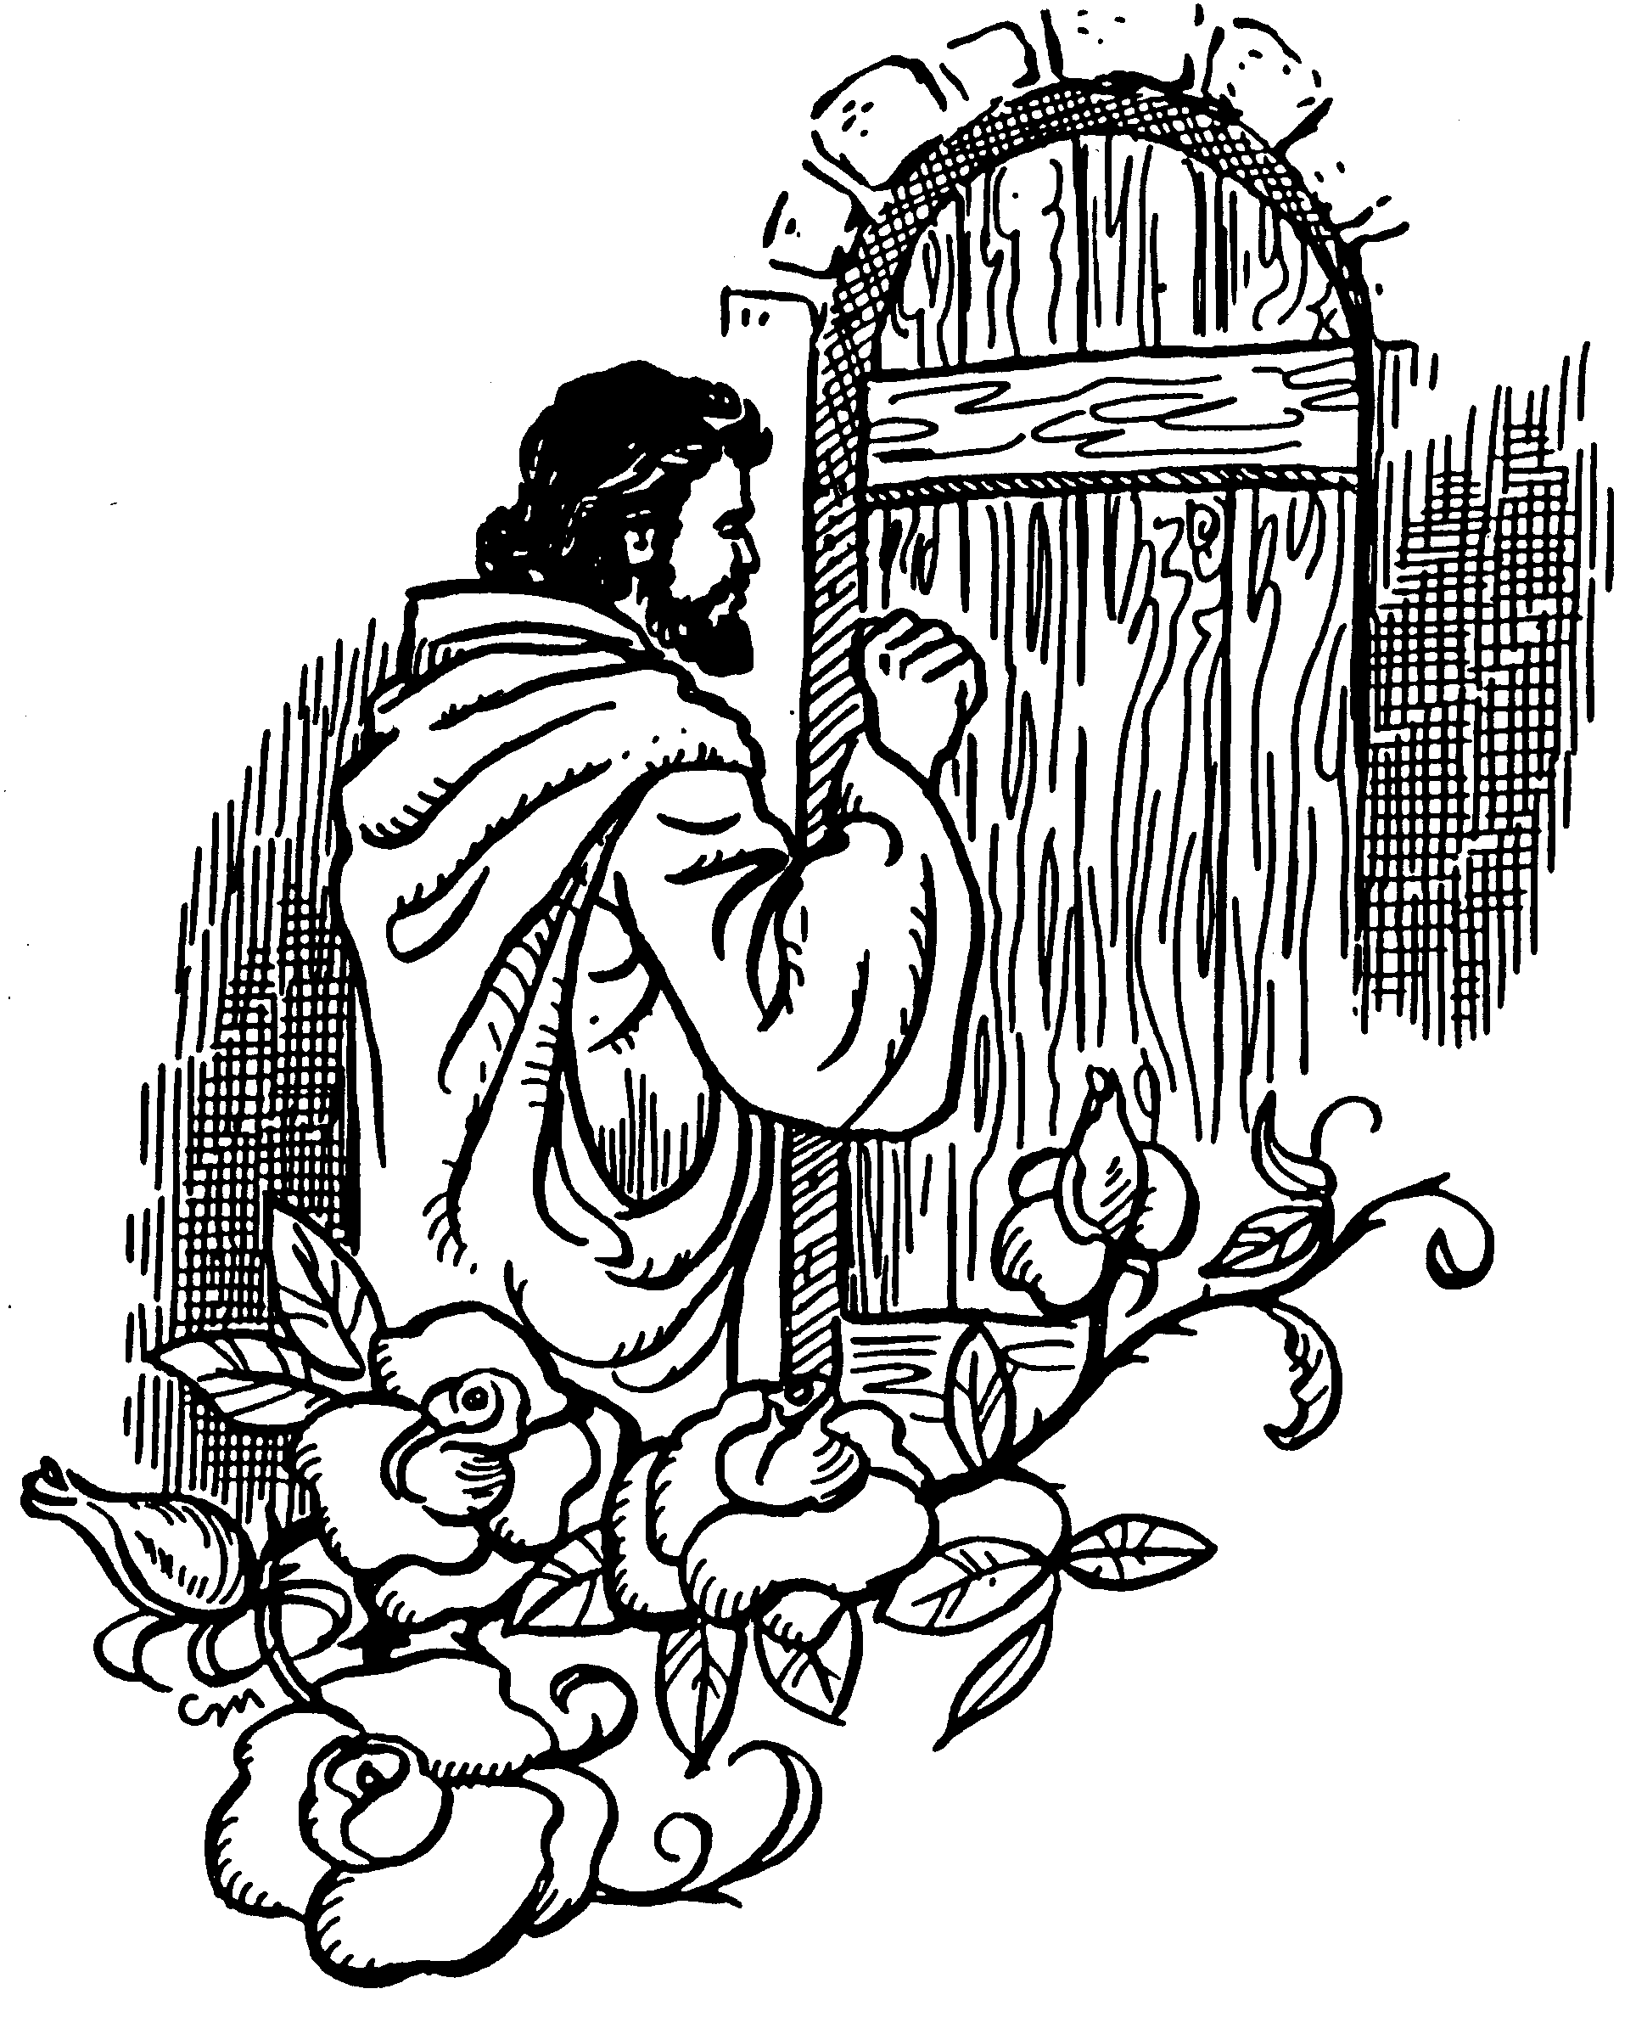
When we receive Jesus, we receive all Christ is by his death and resurrection.
He is our righteousness, ransom, redemption, atonement, forgiveness, peace, reconciliation, eternal life, immersion in the Spirit, life in the Spirit, freedom from sin, citizenship in heaven, hope of glory in seeing his face and reigning forever . . . and all the rest of the riches of the grace of God in Christ!
However, if we don’t receive Jesus, we don’t receive any of God’s grace in Christ.
original author unknown
Original author unknown
If you open the door to welcome me in,
I become your righteousness, redemption, peace with God, eternal life . . . and all I am by the cross. If your heart continues hard and unrepentant, “you are storing up wrath for yourself on the day of wrath when God’s righteous judgment will be revealed.”

Slide 29
Lord, we praise you that the fullness of your blessing is given in Christ by faith in what Christ has DONE, and not by things we DO.
It is finished!
We rest in Christ and his finished work rather than DO, DO, DO
to earn your blessing.
righteous before God though Christ, justified
ransomed, redeemed sin atoned, wrath turned forgiven peace reconciled eternal life
adopted sons accepted filled, complete
blessed with all blessing Christ our wisdom
righteousness and sanctification and redemption
delivered from darkness to light of kingdom of Son
in Christ and Christ in us in the Spirit and the Spirit in us, made God’s temple in God the Father and the Father in us
immersed in Father, Son, and Spirit Father, Son, and Spirit fellowship with us access to God and his grace
answered prayer grace at the throne of grace every need supplied the Spirit prays for us, helps us pray
Christ our High Priest intercedes as mediator Christ our High Priest advocates in our defense
immersed and united with Christ in death and resurrection old self in Adam crucified buried with Christ
new self in Christ raised and alive with Christ set free from sin body members instruments for righteousness
under Christ, abundant grace slaves of Christ not sin joined to Christ one with Christ seated with Christ
hidden with Christ in God released from law, married to Christ under law of the Spirit Spirit and God’s love poured out
rivers of living water of the Spirit immersed in the Spirit
born of the Spirit given, receive, have the Spirit
Spirit comes on, falls on anointed and sealed with the Spirit guarantee of the Spirit Spirit of truth helps, teaches
Spirit leads and sanctifies Spirit power ambassadors
Spirit gifts for service Holy Spirit fills
circumcised, by Christ, set apart in the Spirit
immeasurably great power of the Spirit
God’s workmanship created in Christ
led in triumph and nike victory
members of Christ’s body
brothers and sisters
branches in Christ’s vine
  chosen race royal priesthood
  holy nation, God’s possession
  God’s people fellow citizens with saints
members of the household of God
citizenship in heaven hope of glory
inheritance, heirs of God, fellow heirs
with Christ at death made perfect
glorified to be like Jesus
brought safely into the heavenly kingdom
enter joy of Lord delivered from wrath
God’s good work completed in us
resurrection body like Jesus married to the Lamb
every tear wiped away see God’s face reign forever
loved and saved in the New Covenant
johncrozieris@gmail.com
© 2020

Slide 30
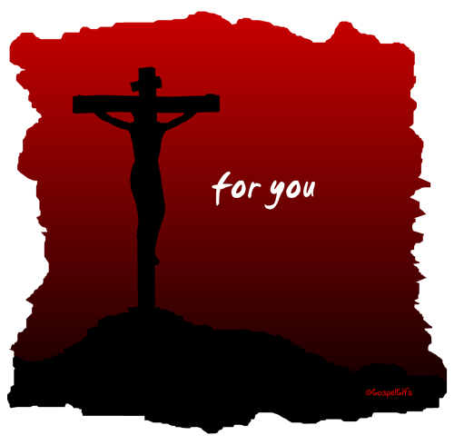
Buddha says:
Do Do Do
Do Do Do
Do Do.
You Do.
8-fold path
Mohammed
says:
Do Do Do
Do Do all Allah wants.
You Do.
5 pillars
Hinduism
says:
Do Do Do
Do Do Do
Do Do Do.
You Do.
many paths
Jesus
says:
It is DONE.
I am all you need.
I give, you receive.
I Do for you.
Come to me
and drink.
GospelGifs.com
More free resources on the grace of God in Christ @ www.GraceGodChrist.com

Slide 31


“If anyone thirsts, let him come to me and drink.
Whoever believes in me, as the Scripture has said,
‘Out of his heart will flow rivers of living water.’”
John 7:37-38
jumping heart © www.fg-a.com
Jesus © GospelGifs.com with permission

