Slide 1

Jesus Christ has niked and gives us nike victory!
Copyright by Nike

Slide 2
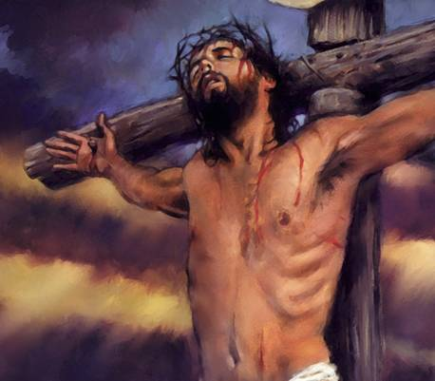

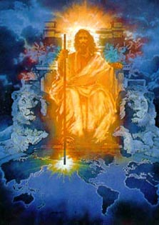
Jesus Christ has niked, will nike and is helping his church nike!
various copies on internet, original sources unknown

Slide 3










The Lord leads us in triumphal procession
and nike victory in Christ
Microsoft clip art © 2013
Microsoft Corporation.
Copyright by Nike
After his victory, our Commander Jesus leads his troops in triumphal procession
“But thanks be to God, who in Christ always leads us
in triumphal procession” 2 Co 2:14, ESV
“But thanks be to God, who gives us the victory (nike) through our Lord Jesus Christ” 1 Cor 15:57, ESV

Slide 4
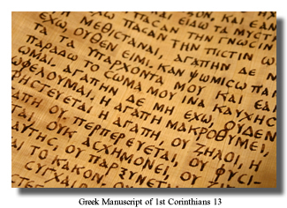
The New Testament was written in Greek.
It uses nike thirty-four times.
Nike is a word from the Greek language.
Copyright by Nike

Slide 5
In the English
New Testament, to nike is translated to be victorious, to conquer, and to overcome.
“But thanks be to God, who gives us the victory (nike) through our Lord Jesus Christ”
1 Cor 15:57, ESV
Copyright by Nike

Slide 6
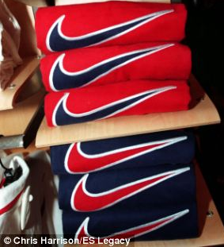
Youth around the world love wearing Nike shoes and shirts.

Slide 7
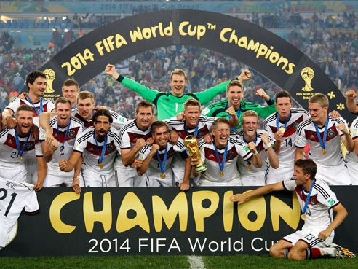
Nike is at every major sports event.
Germany World Cup 2014, from www.philstar.com

Slide 8
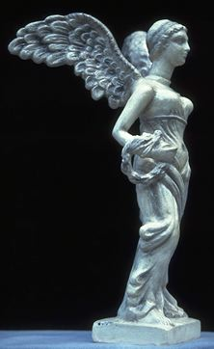
Nike is the Greek goddess of Victory.
Copyright © 1999 Jai Bhagavan Ltd.

Slide 9
She is the fastest runner among the gods.
Copyright © 1999 Jai Bhagavan Ltd.

Slide 10
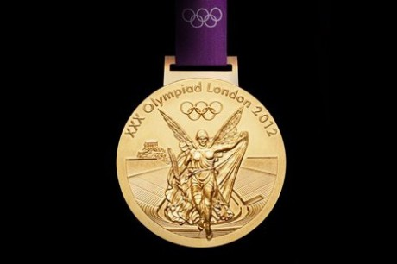
The goddess Nike is on every Olympic medal.
www.theenglishgroup.co.uk

Slide 11
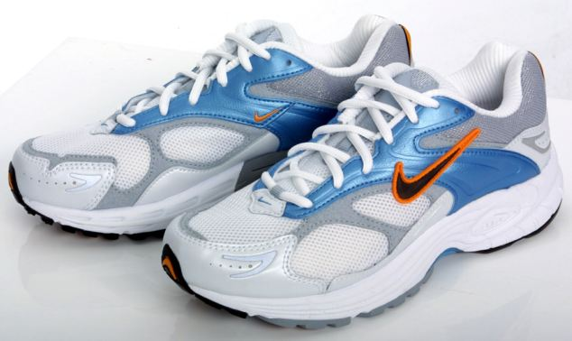
Nike shoes are named after the goddess Nike.
nike article-2004273-004613C800000258-519 Techno clothing for Ami Anderson

Slide 12
Nike shoes are for victory in races.
nike article-2004273-004613C800000258-519 Techno clothing for Ami Anderson

Slide 13
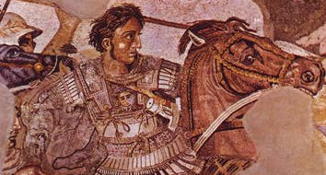
Alexander the Great conquered (niked) many nations from 336 – 323 B.C. to form the Greek Empire with Greek as the official language.
Mosaic at National Archaeological Museum of Naples

Slide 14
Alexander the Great means
Alexander the great nike conqueror.
Mosaic at National Archaeological Museum of Naples

Slide 15
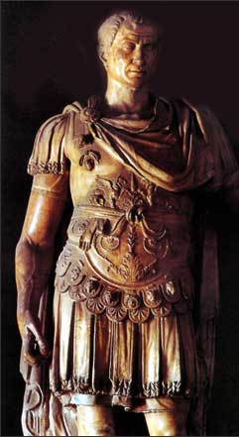
In 47 B.C., Julius Caesar defeated the king of Pontus and announced his victory in Latin with “Veni, vidi, vici” which means
“I came, I saw, I conquered.”
Various copies on internet, original source unknown, but the statue of Julius Caesar is apparently in the Council Chamber, Capitol Hill, Rome

Slide 16
The word for
“I conquered” is vici in Latin, and nike in Greek.
The Romans spoke both languages.
(The notice on the cross was in Latin, Greek and Aramaic. John 19:20)
Various copies on internet, original source unknown, but the statue of Julius Caesar is apparently in the Council Chamber, Capitol Hill, Rome

Slide 17
Caesar was declaring,
“I came, I saw, I niked.
The Romans saw themselves as the great conquerors, the nike victors over other nations.
“We are victorious, we conquer, we overcome, we nike.”
Various copies on internet, original source unknown, but the statue of Julius Caesar is apparently in the Council Chamber, Capitol Hill, Rome

Slide 18
Various copies on internet, original source unknown, but the statue of Julius Caesar is apparently in the Council Chamber, Capitol Hill, Rome
various copies on internet, original source unknown
The New Testament presents Jesus as
the great nike victor and conqueror, not Caesar.

Slide 19
For centuries,
the Latin church
has hailed Jesus as “Christus Victor,” Christ the Victor,
the Nike Christ.
various copies on internet, original source unknown

Slide 20
Jesus said, “In the world you will have tribulation.
But take heart;
I have overcome (niked) the world.”
John 16:33, ESV

Slide 21
In Revelation 5, which introduces Jesus as he is in heaven, the first verb describing him is nike.
“the Lion of the tribe of Judah, the Root of David, has conquered (niked), so that he can open the scroll and its seven seals.” Rev 5:5, ESV
various copies on internet, original source unknown

Slide 22
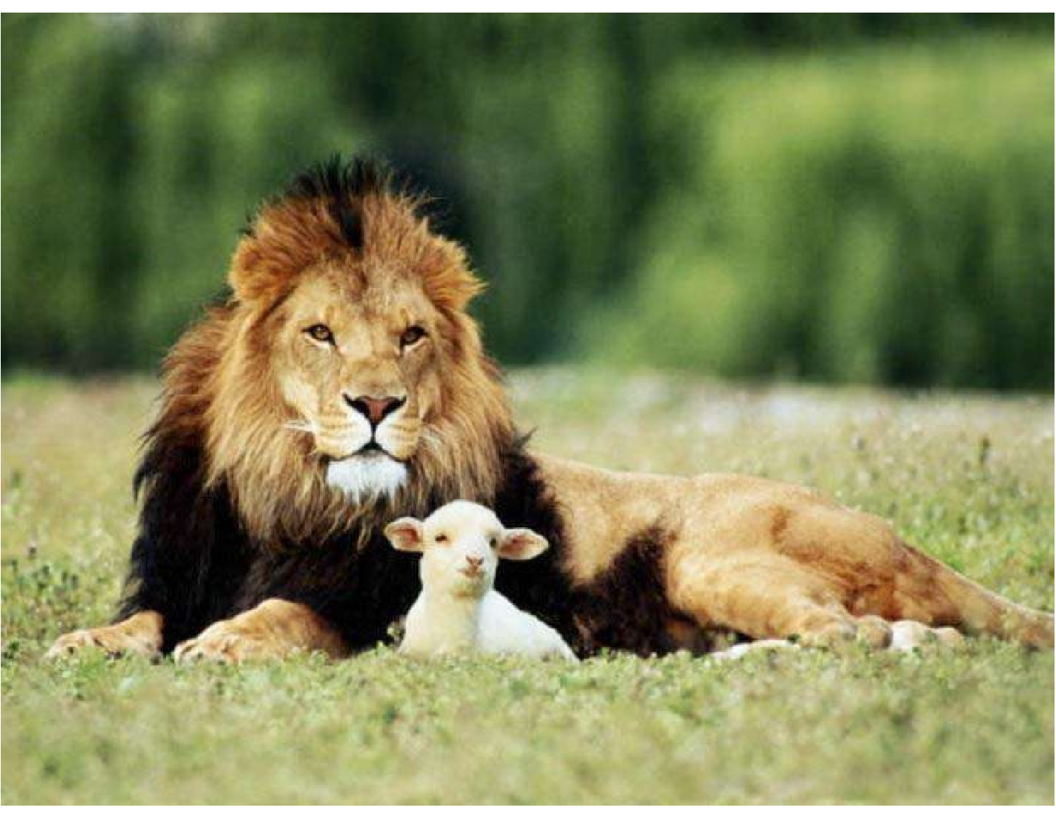
The Lion nikes by being a Lamb slain. “I saw a Lamb standing, as though it had been slain, with seven horns and with seven eyes, which are the seven spirits of God sent out into all the earth.” Rev 5:6
various copies on internet, original source unknown

Slide 23
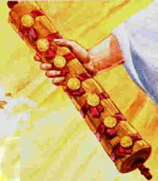
7 He went and took the scroll from the right hand of him who was seated on the throne.
Original author unknown.
If you know, please email me at
johncrozieris@gmail.com

Slide 24
Christ is praised for
his nike victory
9 “Worthy are you to take the scroll and to open its seals,
for you were slain, and by your blood you ransomed people for God from every tribe and language and people and nation, 10 and you have made them a kingdom and priests to our God, and they shall reign on the earth.” Rev 5:9-10, ESV
various copies on internet, original source unknown

Slide 25
5 aspects of
Christ’s nike victory
9 you were slain,
by your blood you ransomed people for God
from every tribe and language and people and nation
10 kingdom
priests to our God
they shall reign on the earth Rev 5:9-10, ESV
various copies on internet, original source unknown

Slide 26
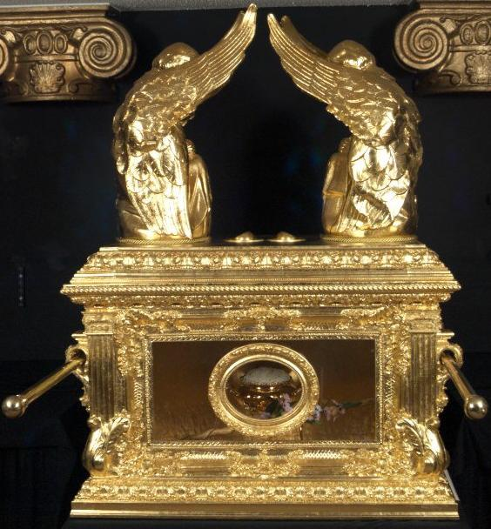
various copies on internet, original source unknown
photo of replica of ark of covenant in Ethiopia
Ransomed for God by Christ’s blood
The foundation of nike victory
The basis for all other nike victory

Slide 27
Various copies on internet, original source unknown
Nike victory is that the Lion of Judah was slain as the Lamb
of God to ransom people by his blood from all nations
to belong to God as priests worshipping God
and reigning in his kingdom forever.

Slide 28
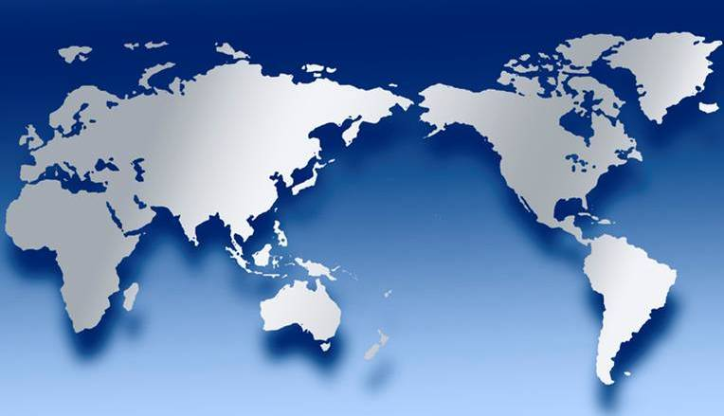
Nike victory for Jesus includes redeeming people for God the Father from every tribe and language and people and nation
various copies on internet, original source unknown

Slide 29
By the Spirit sent out into all the earth (Rev 5:6)
to empower witnesses to the ends of the earth (Acts 1:8), the Lamb is saving people
from every tribe, language, people and nation. These are days of great nike victory for Christ!
various copies on internet, original source unknown

Slide 30
Nike victory for us includes making disciples of every tribe, language, people and nation
various copies on internet, original source unknown

Slide 31



Priests with access to God
and his grace
in Christ!
Praise you, Lord!
Smiley © sherv.net
Jumping heart ©
www.fg-a.com
THE LORD
Photo of sun shining
through curtain
John Crozier
“Jesus cried out again with a loud voice and yielded up
his spirit. And behold, the curtain of the temple was torn in two, from top to bottom.” Matt 27:60-61
NO!
© GospelGifs.com

Slide 32
New Testament Priests in Heb 10:19-22
(19) Therefore, brothers, since we have confidence to enter the holy places by the blood of Jesus,
(20) by the new and living way that he opened for us through the curtain, that is, through his flesh,
(21) and since we have a great priest over the house of God,
(22) let us draw near with a true heart in full assurance of faith, with our hearts sprinkled clean from an evil conscience and our bodies washed with pure water.

Slide 33
New Testament Priests in 1 Tim 2:1,4 and Rom 15:15-16
1 Tim 2:1,4
(1) First of all, then, I urge that supplications, prayers, intercessions, and thanksgivings be made for all people
(4) who desires all people to be saved and to come to the knowledge of the truth.
Rom 15:15-16
(15) the grace given me by God
(16) to be a minister of Christ Jesus to the Gentiles in the priestly service of the gospel of God, so that the offering of the Gentiles may be acceptable, sanctified by the Holy Spirit.

Slide 34
Rev 5:10
You have made them a kingdom and priests to our God, and they shall reign on the earth.
Rev 11:15
Then the seventh angel blew his trumpet, and there were loud voices in heaven, saying,
“The kingdom of the world has become the kingdom of our Lord and of his Christ, and he shall reign forever and ever.”

Slide 35
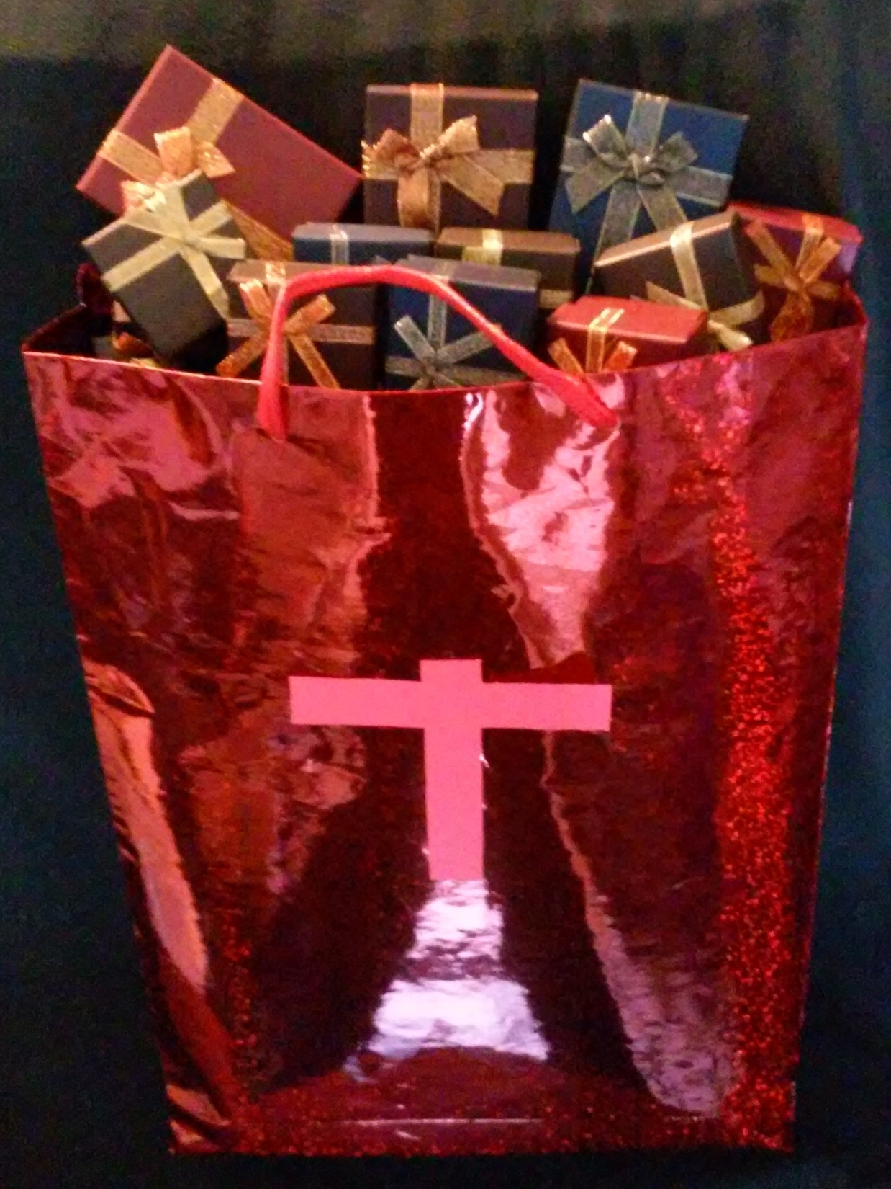
Revelation 5:9-10 praises Jesus for five big aspects of his nike victory.
The New Testament praises the Lord for Christ’s death giving us every spiritual blessing in Christ.
All blessing and all victory is in Christ!

Slide 36
Nike victory in Christ includes using God’s promises in his word to open and enjoy all God’s grace in Christ with faith that praises him.
Promises
Faith
Praise!

Slide 37
Various copies on internet, original source unknown, but the statue of Julius Caesar is apparently in the Council Chamber, Capitol Hill, Rome
various copies on internet, original source unknown
The world thinks nike victory is power to make others serve ME, ME, ME, but for Christians, nike is walking in Christ in the Spirit in YOU, YOU, YOU agape love that serves others.

Slide 38



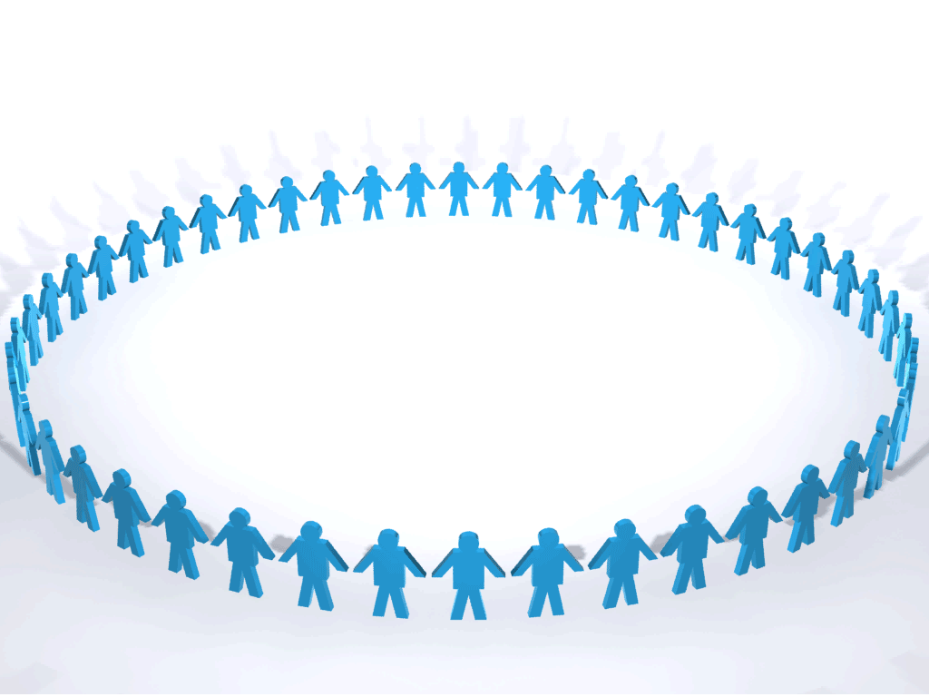
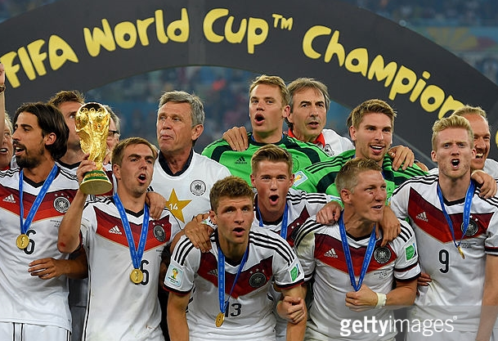


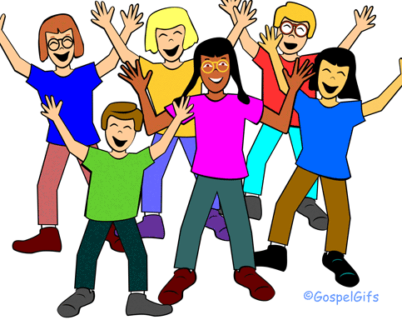
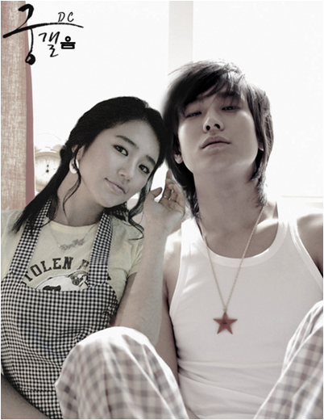

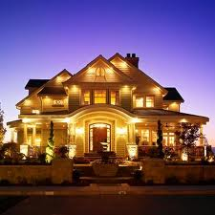

THE LORD
God’s completely different way
to deepest joy and satisfaction
smiley © sherv.net
Jumping heart © www.fg-a.com
People circle © clipartfest.com
The world’s kingdom seeks joy and satisfaction from beauty, music, smart-phones, sports, cars, money, friends, romance, sex, food, drinking, homes and jobs! Jesus had all joy without sex or money!

Slide 39
Nike victory is living in Christ in the Spirit in agape love
enjoying the Lord as the source of all satisfaction,
and reaching every tribe, language, people and nation!
smiley © sherv.net
Jumping heart © www.fg-a.com
People circle © clipartfest.com

Slide 40
Nike victory in heaven is to eternally enjoy
God the Father, Son and Spirit as all-satisfying as he shares his eternal glory with us face to face in eternal embrace!
smiley © sherv.net
Jumping heart © www.fg-a.com
People circle © clipartfest.com

Slide 41
Jesus Christ is the real nike victory! Christ has niked, will nike, and is helping his church nike!
various copies on internet, original sources unknown

Slide 42
“For everyone who has been born of God overcomes (nikes) the world.
And this is the victory (nike) that has overcome (niked) the world—our faith.” 1 John 5:4, ESV

Slide 43
“No, in all these things we are more than conquerors (supernike) through him who loved us.” Rom 8:37, ESV
(verb – supernikao, super - more than, nike – conquer. Note it is a verb – we more than conquer trouble, hardship, persecution, famine, nakedness, danger and sword (8:35) through Christ who loved us.
Loved in the past tense points to the cross.
We supernike through the supernike grace Jesus gives based on his supernike victory at the cross!)

Slide 44

Jesus will nike.
“They will make war on the Lamb, and the Lamb will conquer (nike) them, for he is Lord of lords and King of kings, and those with him are called and chosen and faithful.” Rev 17:14, ESV
“Maranatha!” © 1988/2000 by Stephen Gjertson. All rights reserved. Used with permission.

Slide 45
Christ has niked,
but we too must nike.
“The one who conquers (nikes), I will grant him to sit with me on my throne, as I also conquered (niked) and sat down with my Father on his throne.”
Rev 3:21, ESV
various copies on internet, original source unknown

Slide 46
In Revelation 2-3, as we live under the authority of
Christ our King,
the King empowers
his church to nike
false teaching,
idolatry,
sexual immorality, persecution,
and leaving our first love for Christ to become lukewarm.
Rev 2:7, 11, 17, 26
3:5, 12, 21
various copies on internet, original source unknown

Slide 47
When we see a nike swoosh, we can praise God that Jesus Christ has niked and gives us nike victory!
Copyright by Nike

Slide 48
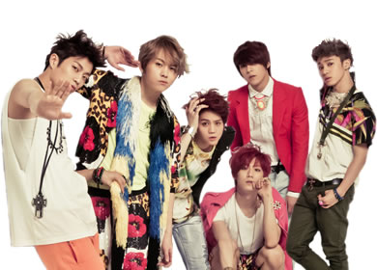
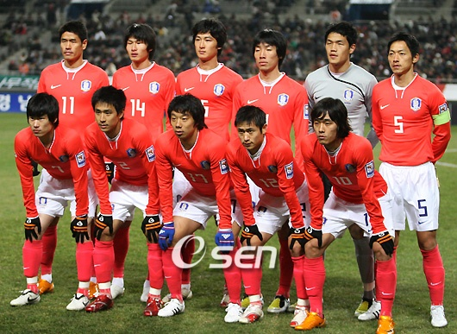

Many think beauty, music, booze, cars, sports, romance, sex, money or homes is nike victory.

Slide 49
Nike victory is living in Christ
in the Spirit in Abba
reaching the lost from every tribe, language,
people and nation!
smiley © sherv.net
Jumping heart © www.fg-a.com
People circle © clipartfest.com

Slide 50
Nike victory is living in Christ
in the Spirit in Abba
reaching the lost from every tribe, language,
people and nation!
various copies on internet, original source unknown

Slide 51
Jesus Christ is real nike victory.
Jesus Christ has niked and gives us nike victory!
various copies on internet, original sources unknown

Slide 52
  Repentance toward God and faith in our Lord Jesus Christ
Great joy, not in the world,
but in God and his grace in Christ,
leads to nike victory!
in Christ
justified in Christ the righteousness of God
ransomed, redeemed propitiation, sin atoned, wrath turned
forgiven peace with God reconciled eternal life adopted sons
welcomed, accepted filled, complete blessed with every blessing
Christ our wisdom from God, righteousness and sanctification and redemption
delivered from the domain of darkness into the light of the kingdom of the beloved Son
in Christ and Christ in us in the Spirit and the Spirit in us, made God’s temple
in God the Father and the Father in us immersed in Father, Son, and Spirit
Father, Son, and Spirit fellowship with us access to God and his grace answered prayer
grace at the throne of grace every need supplied Holy Spirit prays for us, helps us pray
Christ our High Priest intercedes as mediator Christ our High Priest advocates in our defense
immersed into Christ and his death and resurrection united with Christ in death and resurrection
old self crucified and buried with Christ new self raised and alive with Christ
set free from sin instrument for righteousness
under Christ, abundant grace slaves of Christ not sin
joined to Christ one with Christ
seated with Christ hidden with Christ in God
released from law, married to Christ under law of the Spirit
Spirit and God’s love poured out born of the Spirit
given, receive, have Spirit rivers of living water of Spirit
immersed in the Spirit Spirit comes on, falls on us
Spirit power to be ambassadors anointed with the Spirit
sealed with the Spirit guarantee of the Spirit
Spirit of truth helps, teaches Spirit leads
Spirit sanctifies Spirit gifts for service
Spirit fills circumcised, set apart in the Spirit
immeasurably great power God’s workmanship led in triumph and nike victory
members of Christ’s body brothers and sisters branches in Christ’s vine
  chosen race, royal priesthood, holy nation, God’s possession, God’s people
fellow citizens with the saints and members of the household of God
citizenship in heaven hope of glory inheritance, heir, fellow heir
with Christ at death made perfect glorified to be like Jesus
into heavenly kingdom enter joy of Lord delivered from wrath
God’s good work completed resurrection body like Jesus
married to the Lamb every tear wiped away
see God’s face reign forever
loved and saved
in New Covenant
jumping heart © www.fg-a.com
johncrozieris@gmail.com © 2020

Slide 53
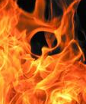
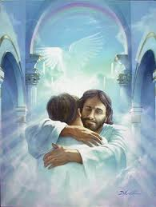
Will your eternity be total defeat or total victory?
Microsoft clip art © 2013
Microsoft Corporation.
various copies on internet, original source unknown
although author’s signature is to the right

Slide 54
9 “You are worthy to take the scroll and to open its seals, because you were slain, and with your blood you purchased men for God from every tribe and language and people and nation. 10 You have made them to be a kingdom and priests to serve our God, and they will reign on the earth.”
Rev 5:9-10, ESV

Slide 55
All praise and thanks be to you, Lord, for giving us the victory over death and everything else through our Lord Jesus Christ!
When Christ returns, what unimaginable new victory will be in you, the God of victory in Christ.

Slide 57
From the eBook, “The Grace of God in Christ:
Sixty days of enjoying Jesus Christ and God’s riches of grace in Christ” by John Crozier free eBook at www.GraceGodChrist.com
John was a Pastor in Canada from 1979-2008.
From 2009-2016, John was an ESL teacher and Pastor in South Korea, mainly training Korean missionaries at MTI, the Missionary Training Institute. Now retired, he serves with AIM, Advancing Indigenous Missions (www.aimi.ca), with the privilege of encouraging indigenous leaders in India, Bangladesh, Myanmar, Nepal and Indonesia.
John’s Doctor of Ministry is from Trinity Evangelical Divinity School in Deerfield, Illinois (Chicago).
Contact John at: johncrozieris@gmail.com

Slide 58
“John’s carefully calibrated study of the believer’s blessings in Christ is superbly done! It breathes Scripture – exalts Christ – is most practical and adaptable.
These truths are much needed in our time. Highly recommended.”
Dr. David Larsen
Trinity Evangelical Divinity School

Slide 59
“I love being reminded daily of who I am in Christ and of all that Christ has done for me. John's study has helped me to live a more joyous and victorious life.
We are indeed rich in Christ.”
Bob Arnold, SIM International, visiting Professor at SIMTI Korea, former Director of SIM Benin

Slide 60
“As we train missionaries at MTI Korea, the skills and experiences our veteran missionaries share are important, but secondary. Above all, God calls us to give the nations the true Jesus in his saving fullness. The Grace of God in Christ leads our students to Jesus on a deeper level. Again and again, my own heart has found new freedom to relax in my Lord and Savior, even though I am busy with many things. Wonderful!”
Mihyang Choi, Director, Missionary Training Institute, Yeosu, South Korea

Slide 61
“As I read John’s study, I found myself being blessed by the truths being presented, and incorporated them into my own devotional life.
I shared the list of the riches with my study group and we spent time each week reflecting on each truth.
I commend the study of God’s riches of grace by those who desire to move to the next level of their maturing in Christ.”
Dr. Gene Swanstrom
Trinity Evangelical Divinity School

Slide 62
“Before John’s class at MTI, I didn’t know about the riches of grace even though I’m a seminary grad and a Pastor for ten years. Now I’m excited about God’s grace in Christ, and preaching Christ’s riches. Because the Korean church in general does not preach the riches of grace, it makes church members weak and religious. Now when I teach, God’s people are surprised by God’s wonderful grace and the amazing love of Jesus.”
Pastor Jin Woo Lee, MTI, now a missionary with AIM in Africa

Slide 63
“I love John’s PPT diagrams of the many riches of the Grace of God in Christ.
It’s a great way to learn to share the gospel in depth with simple questions, terms and pictures. I believe this is what mission trainees need. We can use John’s PPT on our smart-phone to share Christ effectively in any language.”
Pastor Hakjin Chun, former Director of SIM Korea

Slide 64
Unless otherwise indicated, all Scripture quotations are taken from
The Holy Bible, English Standard Version (ESV), copyright © 2001 by Crossway Bibles, a publishing ministry of Good News Publishers. Used by permission. All rights reserved.

Slide 65
The book
“God’s Riches of Grace:
Sixty days of enjoying Jesus Christ and all the Lord provides in Christ” has a page on each of the riches together with a page of Bible study questions.
It is a discipleship book for use in devotions each day for 60 days. eBook available at www.GraceGodChrist.com

Slide 66
PPT © copyright by John Crozier 2020
Available without cost.
For educational purposes.
I have used Google image search to try to find the original source of the graphics from the internet in order to give proper credit.
If you know of the original source of any graphics that say
“various copies on internet, original source unknown,” please contact me at: johncrozieris@gmail.com

Slide 67
Helpful improvements and suggestions are welcome at johncrozieris@gmail.com

