Slide 1

Nike in the book of Revelation
Jesus Christ has niked, will nike, and is helping the church nike!
Copyright by Nike

Slide 2
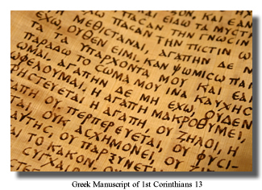
The New Testament was written in Greek.
It uses nike 34 times, including 17 times in the book of Revelation.
Nike is a word from the Greek language.
Copyright by Nike

Slide 3
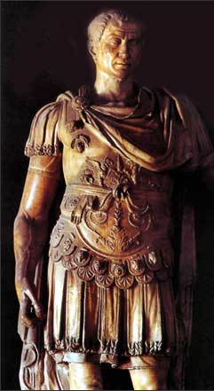
In 47 B.C., Julius Caesar declared “Veni, vidi, vici”
“I came, I saw, I conquered.”
“I conquered” is vici in Latin, and nike in Greek.
The Romans spoke both.
Caesar saw himself as the great nike conqueror over other nations.
Various copies on internet, original source unknown, but the statue of Julius Caesar is apparently in the Council Chamber, Capitol Hill, Rome

Slide 4

Various copies on internet, original source unknown, but the statue of Julius Caesar is apparently in the Council Chamber, Capitol Hill, Rome
various copies on internet, original source unknown
Romans despised Jews as nothings, losers, but Jesus dared to assert, “In the world you will have tribulation. But take heart; I have overcome (niked) the world.” John 16:33 ESV

Slide 5
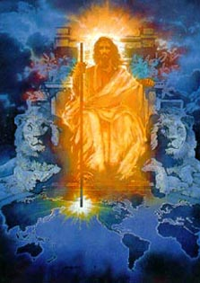
Various copies on internet, original source unknown, but the statue of Julius Caesar is apparently in the Council Chamber, Capitol Hill, Rome
various copies on internet, original source unknown
In the New Testament, Jesus is the great nike victor and conqueror, not Caesar. For Christians, nike is like a secret code word, “Psst, we know who the real nike is!”

Slide 6
In the English
New Testament, nike is translated as victory, conquer, and overcome.
Copyright by Nike

Slide 7
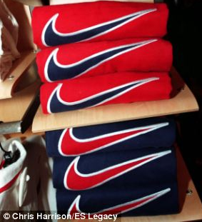
Youth around the world love wearing Nike shoes and shirts.

Slide 8
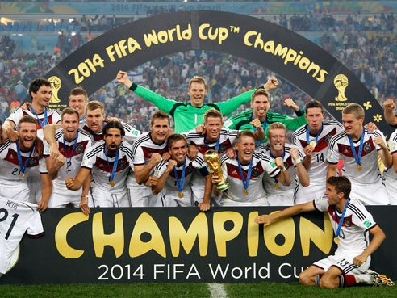
Nike is at every major sports event.
Germany World Cup 2014, from www.philstar.com

Slide 9
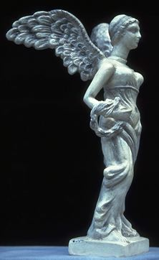
Nike is the Greek goddess of Victory.
Copyright © 1999 Jai Bhagavan Ltd.

Slide 10
She is the fastest runner among the gods.
Copyright © 1999 Jai Bhagavan Ltd.

Slide 11
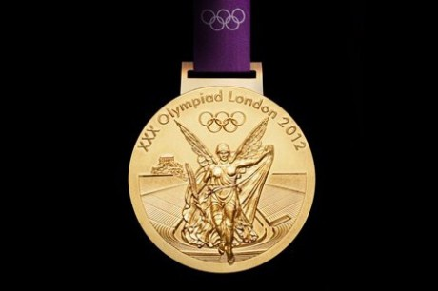
The goddess Nike is on every Olympic medal.
www.theenglishgroup.co.uk

Slide 12
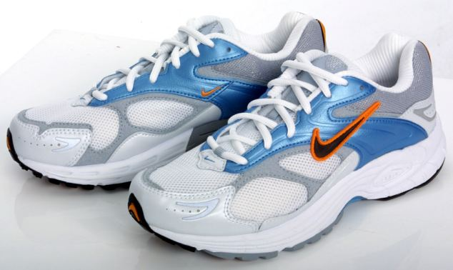
Nike shoes are named after the goddess Nike.
nike article-2004273-004613C800000258-519 Techno clothing for Ami Anderson

Slide 13
Nike shoes are for victory in races.
nike article-2004273-004613C800000258-519 Techno clothing for Ami Anderson

Slide 14
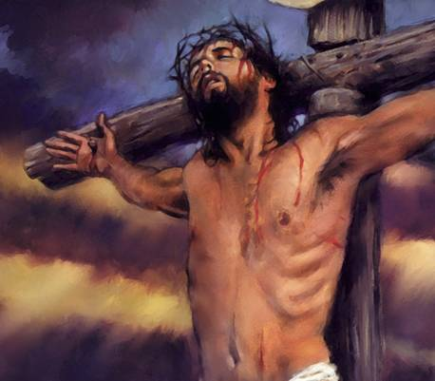
In the New Testament,
Jesus Christ is the great victorious nike!
Jesus Christ is the key to nike victory for us.
Christ has niked, will nike, and is helping his people nike!
various copies on internet, original sources unknown

Slide 15
In Revelation 5, which introduces Jesus as he is in heaven, the first verb describing him is nike.
“the Lion of the tribe of Judah, the Root of David, has conquered (niked), so that he can open the scroll and its seven seals.” Rev 5:5, ESV
various copies on internet, original source unknown

Slide 16
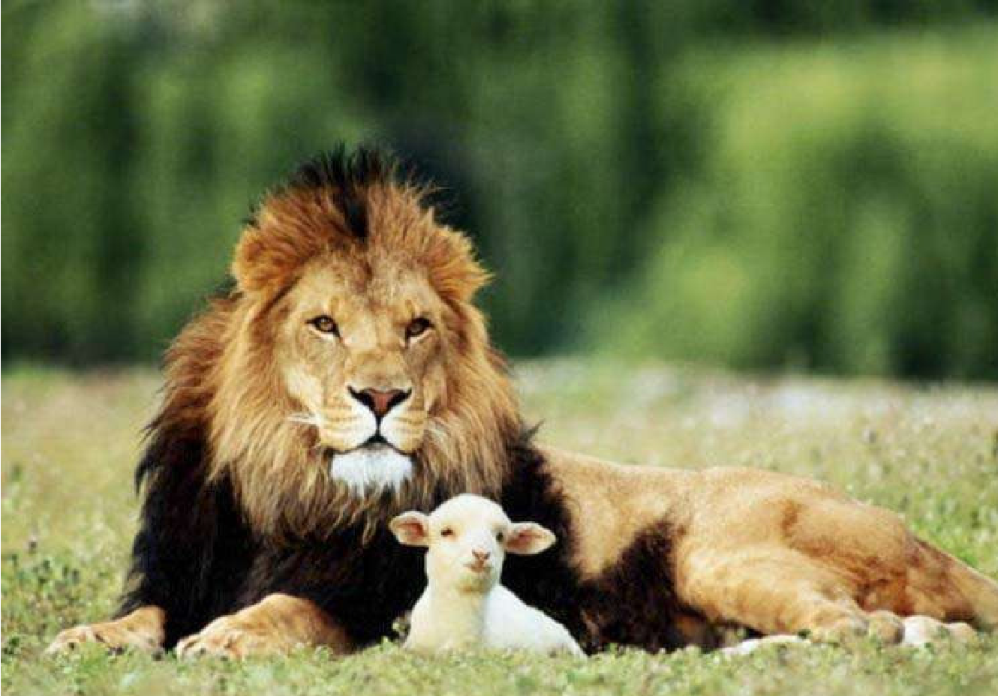
The Lion nikes by being a Lamb slain. “I saw a Lamb standing, as though it had been slain, with seven horns and with seven eyes, which are the seven spirits of God sent out into all the earth.” Rev 5:6
various copies on internet, original source unknown

Slide 17
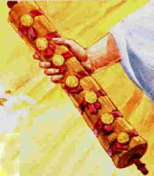
7 He went and took the scroll from the right hand of him who was seated on the throne.
Original author unknown.
If you know, please email me at
johncrozieris@gmail.com

Slide 18
Christ is praised for his nike victory
9 “Worthy are you to take the scroll and to open its seals,
for you were slain, and by your blood you ransomed people for God from every tribe and language and people and nation, 10 and you have made them a kingdom and priests to our God, and they shall reign on the earth.” Rev 5:9-10, ESV
various copies on internet, original source unknown
various copies on internet, original source unknown

Slide 19
5 aspects of
Christ’s nike victory
9 you were slain,
by your blood you ransomed people for God
from every tribe and language and people and nation
10 kingdom
priests to our God
they shall reign on the earth Rev 5:9-10, ESV
various copies on internet, original source unknown
various copies on internet, original source unknown

Slide 20
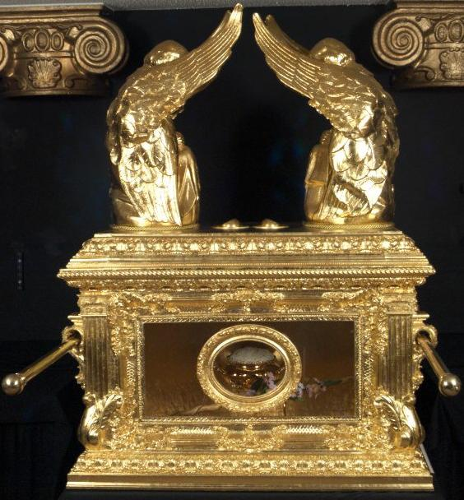
various copies on internet, original source unknown
photo of replica of ark of covenant in Ethiopia
Ransomed for God by Christ’s blood
The foundation of nike victory

Slide 21



Priests with access to God
and his grace
in Christ!
Praise you, Lord!
Smiley © sherv.net
Jumping heart ©
www.fg-a.com
THE LORD
Photo of sun shining
through curtain
John Crozier
“Jesus cried out again with a loud voice and yielded up
his spirit. And behold, the curtain of the temple was torn in two, from top to bottom.” Matt 27:60-61
NO!
© GospelGifs.com

Slide 22

Nike victory for Jesus includes redeeming people for God the Father from every tribe
and language and people and nation
various copies on internet, original source unknown

Slide 23
Nike victory for us includes making disciples of every tribe, language, people and nation
various copies on internet, original source unknown

Slide 24

Revelation 5:9-10 praises Jesus for five big aspects of his nike victory.
The New Testament praises the Lord for Christ’s death giving us every spiritual blessing in Christ.
All blessing and all victory is in Christ!

Slide 25
Nike victory in Christ includes using God’s promises in his word to open and enjoy all God’s grace in Christ with faith that praises him.
Promises
Faith
Praise!

Slide 26

Jesus will nike.
“They will make war on the Lamb, and the Lamb will conquer (nike) them, for he is Lord of lords and King of kings, and those with him are called and chosen and faithful.” Rev 17:14, ESV
“Maranatha!” © 1988/2000 by Stephen Gjertson. All rights reserved. Used with permission.

Slide 27
“From his mouth comes a sharp sword with which to strike down the nations, and he will rule them with a rod of iron. He will tread the winepress of the fury of the wrath of God the Almighty.” Rev 19:15
“Maranatha!” © 1988/2000 by Stephen Gjertson. All rights reserved. Used with permission.

Slide 28
Jesus Christ has niked, will nike and is helping his church nike!
various copies on internet, original sources unknown

Slide 29
In Revelation 2-3
Jesus Christ is helping his church nike
false teaching,
idolatry,
sexual immorality, persecution,
and being lukewarm.
Rev 2:7, 11, 17, 26
3:5, 12, 21
various copies on internet, original source unknown

Slide 30
“The one who conquers (nikes), I will grant him to sit with me on my throne, as I also conquered (niked) and sat down with my Father on his throne.”
Rev 3:21, ESV
various copies on internet, original source unknown

Slide 31
Rev 12:9, 11
And the great dragon
. . . Satan . . . was thrown down to the earth, and his angels were thrown down with him.
They overcame niked him
by the blood of the Lamb and by the word of their testimony, for they loved not their lives even unto death.
various copies on internet, original source unknown

Slide 32
Three key ways
to nike Satan (12:11)
they niked him
by the blood of the Lamb
by the word of their testimony
they loved not their lives even unto death.
various copies on internet, original source unknown

Slide 33

various copies on internet, original source unknown
David Miles
1 And I saw a beast rising out of the sea . . .
it was allowed to make war on the saints and to nike conquer them.
10 If anyone is to be taken captive, to captivity he goes; if anyone is to be slain with the sword, with the sword must he be slain. Here is a call for the endurance and faith of the saints. Rev 13:1,7,10

Slide 34

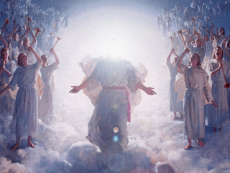
Rev 15:2 I saw . . . those who had niked conquered the beast and its image and the number of its name . . . with harps of God in their hands.

Slide 35
Rev 21:6-8
(6) “It is done! I am the Alpha and the Omega, the beginning and the end. . . .
(7) The one who nikes conquers will have this heritage, and I will be his God and he will be my son.
(8) But as for the cowardly, the faithless, the detestable, as for murderers, the sexually immoral, sorcerers, idolaters, and all liars, their portion will be in the lake that burns with fire and sulfur”
various copies on internet, original source unknown

Slide 36
When we see a nike swoosh, we can praise God that Jesus Christ has niked, will nike, and is helping us nike!
Copyright by Nike

Slide 37
Various copies on internet, original source unknown, but the statue of Julius Caesar is apparently in the Council Chamber, Capitol Hill, Rome
various copies on internet, original source unknown
The world thinks nike victory is power to make others serve ME, ME, ME, but for Christians, nike is walking in Christ in the Spirit in YOU, YOU, YOU agape love that serves others.

Slide 38







Nike victory is not in beauty, music, booze, cars, sports, romance, sex, money or homes!

Slide 39

Nike victory is living in Christ in the Spirit in agape love
enjoying the Lord as the source of all satisfaction,
and reaching every tribe, language, people and nation!
smiley © sherv.net
Jumping heart © www.fg-a.com
People circle © clipartfest.com

Slide 40
Nike victory in heaven is to eternally enjoy
God the Father, Son and Spirit as all-satisfying as he shares his eternal glory with us face to face in eternal embrace!
smiley © sherv.net
Jumping heart © www.fg-a.com
People circle © clipartfest.com

Slide 41
9 “You are worthy to take the scroll and to open its seals, because you were slain, and with your blood you purchased men for God from every tribe and language and people and nation. 10 You have made them to be a kingdom and priests to serve our God, and they will reign on the earth.”
Rev 5:9-10, ESV

Slide 42
All praise and thanks be to you, Lord, for giving us the victory over death and everything else through our Lord Jesus Christ!
When Christ returns, what unimaginable new victory will be in you, the God of victory in Christ.

Slide 44
From the eBook, “The Grace of God in Christ:
Sixty days of enjoying Jesus Christ and God’s riches of grace in Christ” by John Crozier free eBook at www.GraceGodChrist.com
John was a Pastor in Canada from 1979-2008.
From 2009-2016, John was an ESL teacher and Pastor in South Korea, mainly training Korean missionaries at MTI, the Missionary Training Institute. Now retired, he serves with AIM, Advancing Indigenous Missions (www.aimi.ca), with the privilege of encouraging indigenous leaders in India, Bangladesh, Myanmar, Nepal and Indonesia.
John’s Doctor of Ministry is from Trinity Evangelical Divinity School in Deerfield, Illinois (Chicago).
Contact John at: johncrozieris@gmail.com

Slide 45
“John’s carefully calibrated study of the believer’s blessings in Christ is superbly done! It breathes Scripture – exalts Christ – is most practical and adaptable.
These truths are much needed in our time. Highly recommended.”
Dr. David Larsen
Trinity Evangelical Divinity School

Slide 46
“I love being reminded daily of who I am in Christ and of all that Christ has done for me. John's study has helped me to live a more joyous and victorious life.
We are indeed rich in Christ.”
Bob Arnold, SIM International, visiting Professor at SIMTI Korea, former Director of SIM Benin

Slide 47
“As we train missionaries at MTI Korea, the skills and experiences our veteran missionaries share are important, but secondary. Above all, God calls us to give the nations the true Jesus in his saving fullness. The Grace of God in Christ leads our students to Jesus on a deeper level. Again and again, my own heart has found new freedom to relax in my Lord and Savior, even though I am busy with many things. Wonderful!”
Mihyang Choi, Director, Missionary Training Institute, Yeosu, South Korea

Slide 48
“As I read John’s study, I found myself being blessed by the truths being presented, and incorporated them into my own devotional life.
I shared the list of the riches with my study group and we spent time each week reflecting on each truth.
I commend the study of God’s riches of grace by those who desire to move to the next level of their maturing in Christ.”
Dr. Gene Swanstrom
Trinity Evangelical Divinity School

Slide 49
“Before John’s class at MTI, I didn’t know about the riches of grace even though I’m a seminary grad and a Pastor for ten years. Now I’m excited about God’s grace in Christ, and preaching Christ’s riches. Because the Korean church in general does not preach the riches of grace, it makes church members weak and religious. Now when I teach, God’s people are surprised by God’s wonderful grace and the amazing love of Jesus.”
Pastor Jin Woo Lee, MTI, now a missionary with AIM in Africa

Slide 50
“I love John’s PPT diagrams of the many riches of the Grace of God in Christ.
It’s a great way to learn to share the gospel in depth with simple questions, terms and pictures. I believe this is what mission trainees need. We can use John’s PPT on our smart-phone to share Christ effectively in any language.”
Pastor Hakjin Chun, former Director of SIM Korea

Slide 51
Unless otherwise indicated, all Scripture quotations are taken from
The Holy Bible, English Standard Version (ESV), copyright © 2001 by Crossway Bibles, a publishing ministry of Good News Publishers. Used by permission. All rights reserved.

Slide 52
The book
“God’s Riches of Grace:
Sixty days of enjoying Jesus Christ and all the Lord provides in Christ” has a page on each of the riches together with a page of Bible study questions.
It is a discipleship book for use in devotions each day for 60 days. eBook available at www.GraceGodChrist.com

Slide 53
PPT © copyright by John Crozier
2020 available without cost
If you know of the original source of any diagrams that say
“various copies on internet, original source unknown” please let me know.

Slide 54
Helpful improvements and suggestions are welcome at johncrozieris@gmail.com

