Slide 1
To get this PPT to play properly so the smileys dance on your smart-phone or other device, please press the “play as a PPT” tab. Otherwise the smileys stand still and the heart doesn’t jump for joy!
All Scripture quotations are taken from
The Holy Bible, English Standard Version (ESV), copyright © 2001 by Crossway Bibles,
a publishing ministry of Good News Publishers.
Used by permission. All rights reserved.

Slide 2

Jesus Christ has niked and gives us nike victory!
Copyright by Nike

Slide 3
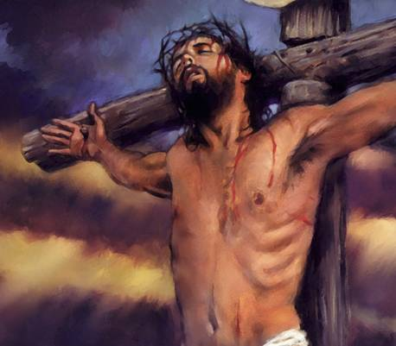

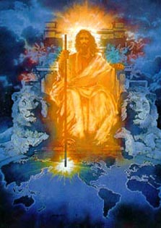
Jesus Christ has niked, will nike and is helping his church nike!
various copies on internet, original sources unknown

Slide 4
Jesus declared, “In the world you will have tribulation.
But take heart; I have overcome (niked) the world.”
John 16:33, ESV
Copyright by Nike
“But thanks be to God, who gives us the victory (nike) through our Lord Jesus Christ” 1 Cor 15:57, ESV

Slide 5
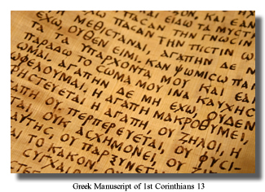
The New Testament was written in Greek.
It uses nike thirty-four times.
Nike is a word from the Greek language.
Copyright by Nike

Slide 6
In the English New Testament, to nike is translated to be victorious, to conquer, and to overcome.
“Everyone who has been born of God overcomes (nikes) the world. And this is the victory (nike) that has overcome (niked) the world—our faith”
1 John 5:4, ESV
Copyright by Nike

Slide 7
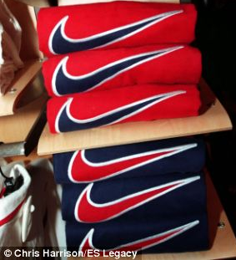
Youth around the world love wearing Nike shoes and shirts.

Slide 8
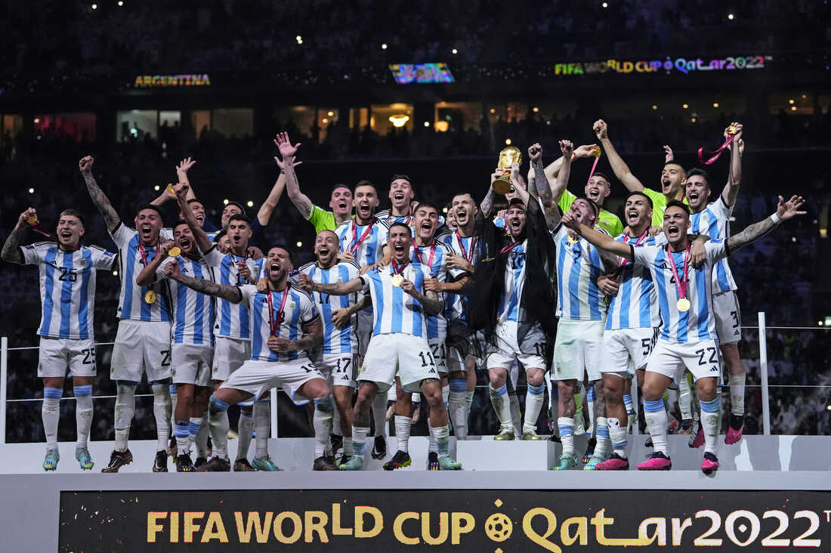
Nike is at every major sports event.
photo by Manu Fernandez AP

Slide 9
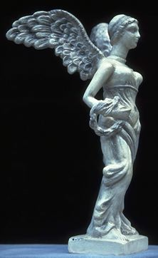
Nike is the Greek goddess of Victory.
Copyright © 1999 Jai Bhagavan Ltd.

Slide 10
She is the fastest runner among the gods.
Copyright © 1999 Jai Bhagavan Ltd.

Slide 11
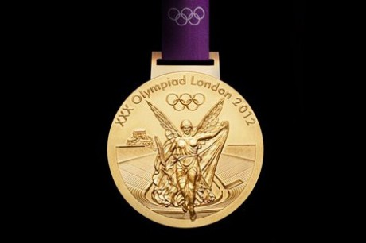
The goddess Nike is on every Olympic medal.
www.theenglishgroup.co.uk

Slide 12
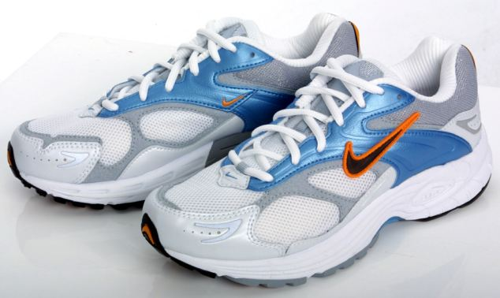
Nike shoes are named after the goddess Nike.
nike article-2004273-004613C800000258-519 Techno clothing for Ami Anderson

Slide 13
Nike shoes are for victory in races.
nike article-2004273-004613C800000258-519 Techno clothing for Ami Anderson

Slide 14
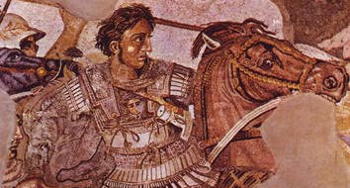
Alexander the Great conquered (niked) many nations from 336 – 323 B.C. to form the Greek Empire with Greek as the official language.
Mosaic at National Archaeological Museum of Naples

Slide 15
Alexander the Great means
Alexander the great nike conqueror.
Mosaic at National Archaeological Museum of Naples

Slide 16
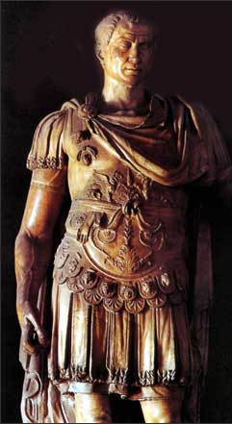
In 47 B.C., Julius Caesar defeated the king of Pontus and announced his victory in Latin with “Veni, vidi, vici” which means
“I came, I saw, I conquered.”
Various copies on internet, original source unknown, but the statue of Julius Caesar is apparently in the Council Chamber, Capitol Hill, Rome

Slide 17
The word for
“I conquered” is vici in Latin, and nike in Greek.
The Romans spoke both languages.
(The notice on the cross was in Latin, Greek and Aramaic. John 19:20) vici in Latin = νῖκη in Greek
= nike in English
Various copies on internet, original source unknown, but the statue of Julius Caesar is apparently in the Council Chamber, Capitol Hill, Rome

Slide 18
Caesar was declaring,
“I came, I saw, I niked.
The Romans saw themselves as the great conquerors, the nike victors over other nations.
“We are victorious, we conquer, we overcome, we nike.”
Various copies on internet, original source unknown, but the statue of Julius Caesar is apparently in the Council Chamber, Capitol Hill, Rome

Slide 19
Various copies on internet, original source unknown, but the statue of Julius Caesar is apparently in the Council Chamber, Capitol Hill, Rome
various copies on internet, original source unknown
The New Testament presents Jesus as
the great nike victor and conqueror, not Caesar.

Slide 20
For centuries,
the Latin church
has hailed Jesus as “Christus Victor,” Christ the Victor,
the Nike Christ.
various copies on internet, original source unknown

Slide 21
“I have said these things to you, that in me you may have peace. In the world you will have tribulation. But take heart;
I have overcome niked
the world.” John 16:33
This is the concluding statement of John 14-16.
What has Jesus promised in John 14-16 that we receive because he will nike all through his death and resurrection?
various copies on internet, original source unknown

Slide 22
John 14 promises of nike grace and peace in Christ include:
I will come again and take you to be with me 14:1-3
I am the way, the truth,
and life in God 14:6
The Spirit of truth helps and teaches us as he dwells in us; we know him; Jesus comes
to us 14:16-18; 26
We live in Christ in the Father, we are in Christ and Father, Son and Spirit in us 14:21,23
Because I live,
you also will live 14:19
various copies on internet, original source unknown

Slide 23
John 15 nike victory in Christ:
I am the Vine; you are my branches. Abide in me and I will abide in you, and you will bear much fruit 15:4-5
Abide in my words and in love and the Father will answer
your prayer 15:7,12,16
I chose you out of the world who hates you, but the Spirit will bear witness about me and help you bear witness 15:18-17
various copies on internet, original source unknown

Slide 24
John 16 nike victory for us:
Your new Helper, the Holy Spirit, will convict others of their sin and my being the Righteous Savior!
He will glorify me as he guides you into more of my truth, makes me known, and reveals things to come. 16:8-15
Ask the Father in my name and receive! 16:23-24, 26-27
In the world, trouble.
In me, peace, because I will nike as the Father is with me.
I will die, but I’ll rise and you’ll see me again before I will go back to the Father. 16:16-22, 28
various copies on internet, original source unknown

Slide 25
Thank you, Father, for all we receive in John 14-16
because of your nike victory through the death and resurrection of your Son!
various copies on internet, original source unknown

Slide 26
Paul says those in Christ are supernikes,
“In all these things we are more than conquerors (supernike) through him who loved us.” Rom 8:37, ESV
(verb – supernikao, super - more than, nike – conquer. Note it is a verb – we more than conquer trouble, hardship, persecution, famine, nakedness, danger and sword (8:35) through Christ who loved us.
Loved in the past tense points to the cross.
We supernike through the supernike grace Jesus gives based on his supernike victory at the cross!)

Slide 27
In Revelation 5, which introduces Jesus as he is in heaven, the first verb describing him is nike.
“the Lion of the tribe of Judah, the Root of David, has conquered (niked), so that he can open the scroll and its seven seals.” Rev 5:5, ESV
various copies on internet, original source unknown

Slide 28
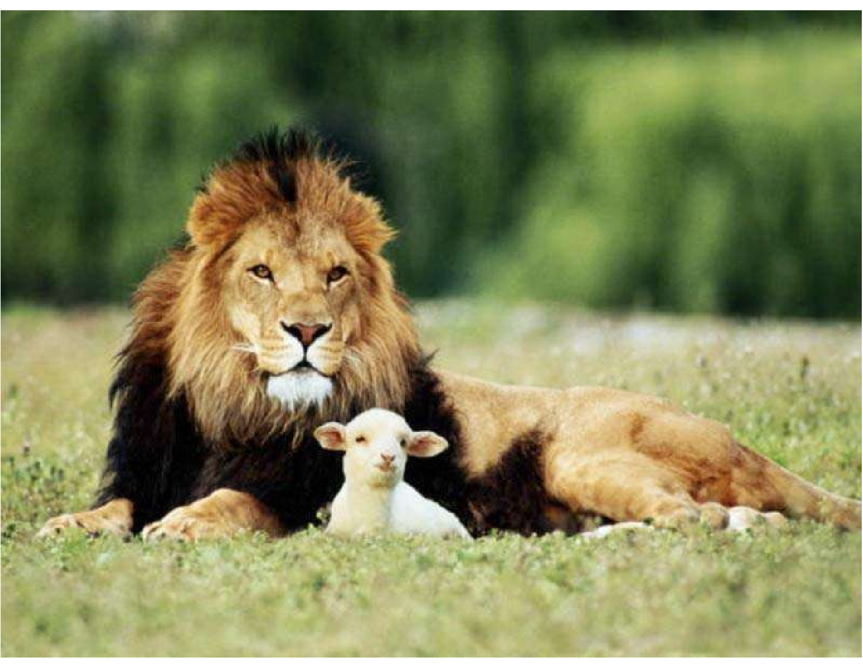
The Lion nikes by being a Lamb slain.
“I saw a Lamb standing, as though it had been slain,
with seven horns and with seven eyes, which are the seven spirits of God sent out into all the earth.” Rev 5:6
various copies on internet, original source unknown

Slide 29
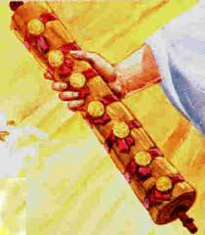
7 He went and took the scroll from the right hand of him who was seated on the throne.
Original author unknown.
If you know, please email me at
johncrozieris@gmail.com

Slide 30
Christ is praised for
his nike victory
9 “Worthy are you to take the scroll and to open its seals,
for you were slain, and by your blood you ransomed people for God from every tribe and language and people and nation, 10 and you have made them a kingdom and priests to our God, and they shall reign on the earth.” Rev 5:9-10, ESV
various copies on internet, original source unknown
various copies on internet, original source unknown

Slide 31
5 aspects of
Christ’s nike victory
9 you were slain,
by your blood you ransomed people for God
from every tribe and language and people and nation
10 kingdom
priests to our God
they shall reign on the earth Rev 5:9-10, ESV
various copies on internet, original source unknown
various copies on internet, original source unknown

Slide 32
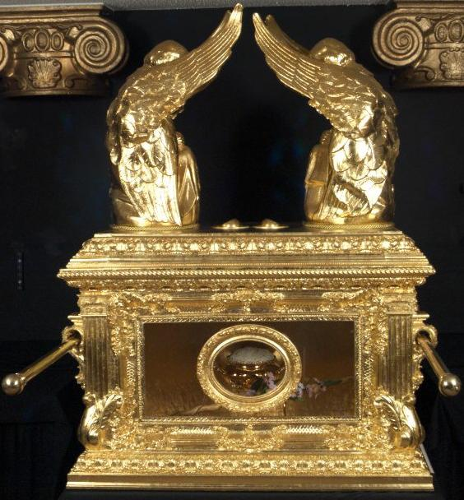
various copies on internet, original source unknown
photo of replica n Ethiopia of the ark of the covenant
Ransomed for God by Christ’s blood
The foundation of nike victory
The basis for all other nike victory

Slide 33
Various copies on internet, original source unknown
Nike victory is that the Lion of Judah was slain as the Lamb
of God to ransom people by his blood from all nations
to belong to God as priests worshipping God
and reigning in his kingdom forever.

Slide 34
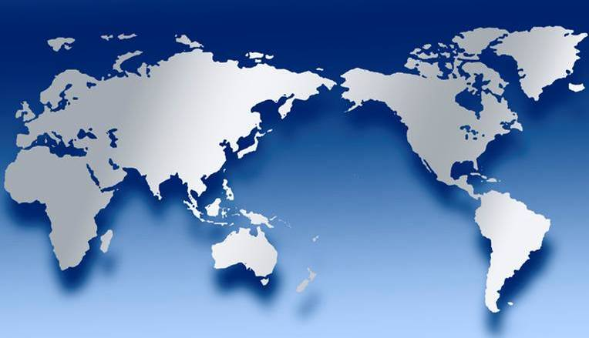
Nike victory for Jesus includes redeeming people
for God the Father from every tribe
and language and people and nation

Slide 35
Nike victory for us includes abounding in the work of the Lord to make Christ known to every tribe, language, people and nation

Slide 36
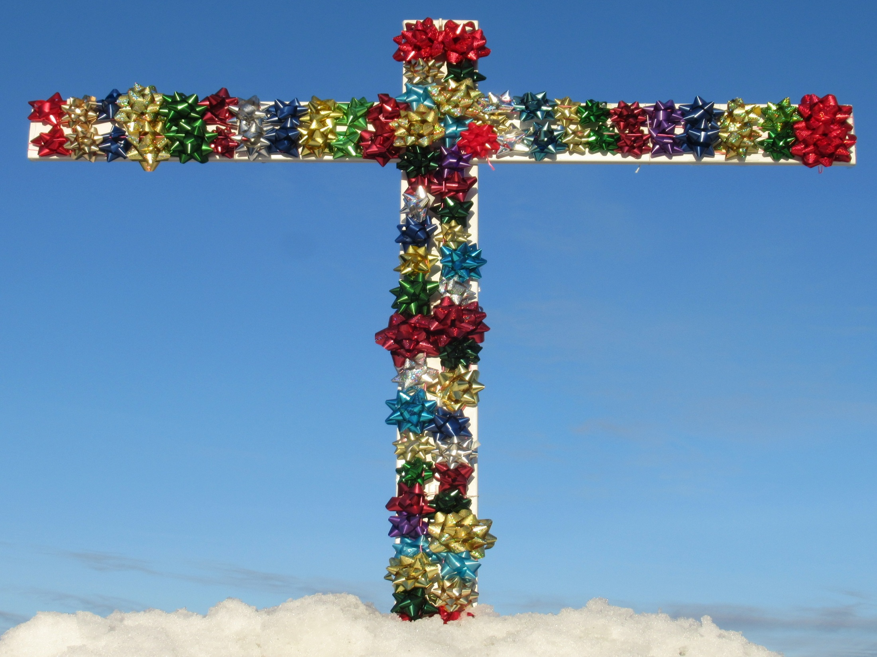
Revelation 5:9-10 praises Jesus for five big aspects
of his nike victory.
The New Testament
praises the Lord
for Christ’s death giving us
every spiritual blessing in Christ.
All blessing and all victory is in Christ!

Slide 37
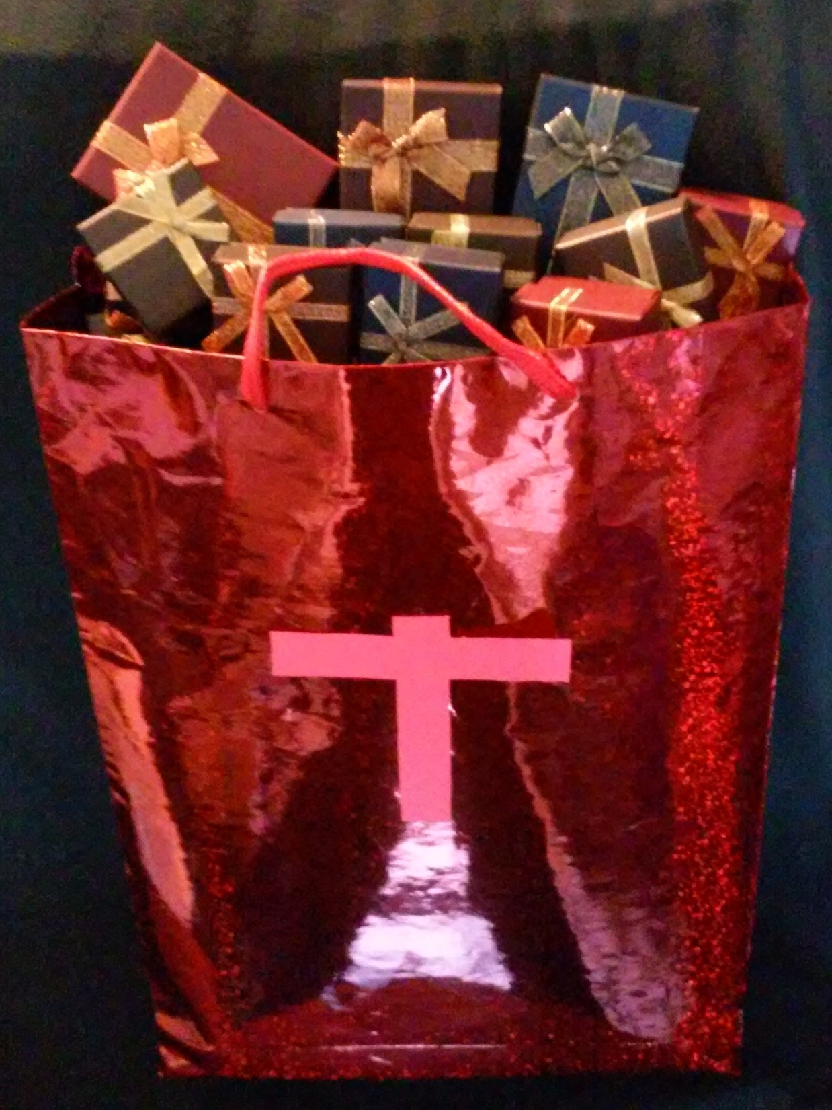
Nike victory in Christ includes using God’s promises in his word to open and enjoy all God’s grace in Christ with faith that praises him.
Promises
Faith
Praise!

Slide 38
Various copies on internet, original source unknown, but the statue of Julius Caesar is apparently in the Council Chamber, Capitol Hill, Rome
various copies on internet, original source unknown
The world thinks nike victory is power to make others serve ME, ME, ME, but for Christians, nike is walking in Christ in the Spirit in YOU, YOU, YOU agape love that serves others.

Slide 39



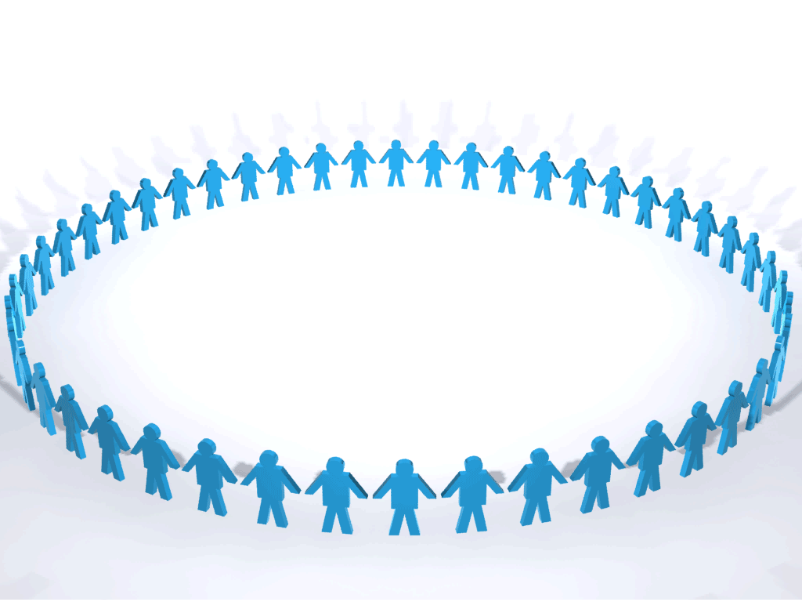

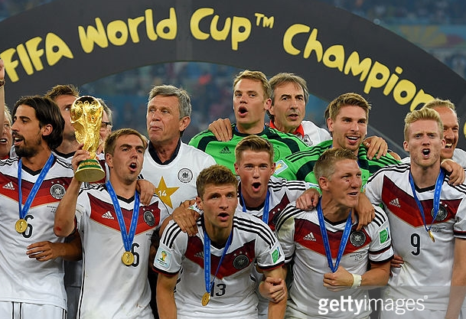


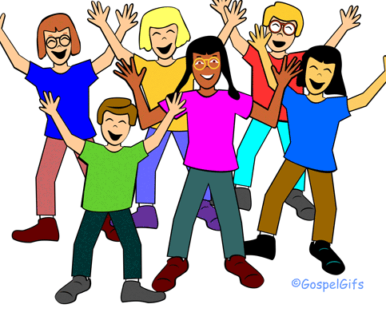


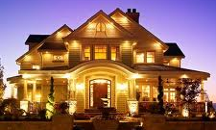

THE LORD
God’s completely different way
to deepest joy and satisfaction
smiley © sherv.net
Jumping heart © www.fg-a.com
People circle © clipartfest.com
The world seeks joy and satisfaction from beauty, music,
smart-phones, sports, cars, money, friends, romance, sex, food, drinking, homes and jobs! Jesus had all joy without sex or money!

Slide 40
THE LORD
God’s completely different way
to deepest joy and satisfaction
smiley © sherv.net
Jumping heart © www.fg-a.com
People circle © clipartfest.com
Nike victory in Christ is to drink deeply from Christ all he provides by his death so that we have deep joy and satisfaction in the LORD rather than seeking joy and satisfaction from Satan’s ways!

Slide 41
Nike victory is living in Christ in the Spirit in agape love
enjoying the Lord as the source of all satisfaction,
and reaching every tribe, language, people and nation!
smiley © sherv.net
Jumping heart © www.fg-a.com
People circle © clipartfest.com

Slide 42
Nike victory in heaven is to eternally enjoy
God the Father, Son and Spirit as all-satisfying as he shares his eternal glory with us face to face in eternal embrace!
smiley © sherv.net
Jumping heart © www.fg-a.com
People circle © clipartfest.com

Slide 43
Jesus Christ is the real nike victory! Christ has niked, will nike, and is helping his church nike!
various copies on internet, original sources unknown

Slide 44
In Revelation 2-3
Jesus Christ makes seven nike promises to those who nike false teaching,
leaving our first love (lukewarm), idolatry,
incomplete deeds, persecution, and
sexual immorality.
(note that the problems the church must nike spell FLIPS)
Rev 2:7, 11, 17, 26
3:5, 12, 21
various copies on internet, original source unknown

Slide 45
Ephesus must nike leaving their first love 2:1-7
“To the one who conquers (nikes) I will grant to eat of the tree of life, which is in the paradise of God.”
Rev 2:7
various copies on internet, original source unknown

Slide 46
Smyrna must nike persecution
2:8-11
“The one who conquers (nikes)
will not be hurt
by the second death.”
Rev 2:11
various copies on internet, original source unknown

Slide 47
Pergamum must nike false teaching, idolatry and sexual immorality
2:12-17
“To the one who conquers (nikes)
I will give some of
the hidden manna,
and I will give him
a white stone,
with a new name written on the stone that no one knows except the one who receives it.”
Rev 2:17
various copies on internet, original source unknown

Slide 48
Thyratira must nike
false teaching, idolatry
and sexual immorality 2:18-29
“The one who conquers (nikes) and who keeps my works until the end,
to him I will give authority over the nations, and he will rule them with a rod of iron, as when earthen pots are broken in pieces, even as
I myself have received authority from my Father.
And I will give him the morning star.” Rev 2:26-28
various copies on internet, original source unknown

Slide 49
Sardis must nike incomplete works, not doing ALL
the Lord wants 3:1-6
“The one who
conquers (nikes)
will be clothed thus
in white garments,
and I will never blot
his name out of
the book of life.
I will confess his name
before my Father
and before his angels.”
Rev 3:5
various copies on internet, original source unknown

Slide 50
Philadelphia has niked persecution from the Jews
by keeping Jesus’ words,
not denying his name
and patiently enduring 3:7-13
“The one who conquers (nikes), I will make him a pillar in
the temple of my God. Never shall he go out of it, and I will write on him the name of my God, and the name of the city of my God, the new Jerusalem, which comes down from my God out of heaven, and my own new name.” Rev 3:12
various copies on internet, original source unknown

Slide 51
Laodicea must nike
being lukewarm,
not hot for Jesus
3:14-22
“The one who conquers (nikes), I will grant him to sit with me on my throne, as I also conquered (niked) and sat down with my Father on his throne.”
Rev 3:21
various copies on internet, original source unknown

Slide 52
Try to grasp what Jesus promises in Rev 3:21!
“The one who conquers (nikes), I will grant him to sit with me on my throne, as I also conquered (niked) and sat down with my Father on his throne.”
Rev 3:21
Christ has niked,
but we too must nike.
various copies on internet, original source unknown

Slide 53
“He who has an ear, let him hear what the Spirit says to the churches”
Rev 2:7,11,17,29; 3:6,13,21
Nike false teaching,
being lukewarm
(leaving your first love, incomplete deeds), idolatry,
persecution,
and sexual immorality.
Rev 2:7, 11, 17, 26
3:5, 12, 21
various copies on internet, original source unknown

Slide 54
In Revelation 2-3, as we live under the authority of
Christ our King,
the King empowers
his church to nike
false teaching,
idolatry,
sexual immorality, persecution,
and leaving our first love for Christ to become lukewarm.
Rev 2:7, 11, 17, 26
3:5, 12, 21
various copies on internet, original source unknown

Slide 55
These same evils are attacking the church today.
Jesus calls us to nike through his power in the Spirit.
1. False teaching - Nicolas 2:6,15;
Balaam 2:14; Jezebel 2:20-24
2. Lukewarm hearts 3:16; leaving your first love 2:4; incomplete deeds 3:2
3. Idolatry 2:14,20
4. Persecution 2:9-10,13; 3:9-10
5. Adultery 2:14,20-21
“The one who conquers (nikes), I will grant him to sit with me on my throne, as I also conquered (niked) and sat down with my Father on his throne.” Rev 3:21

Slide 56
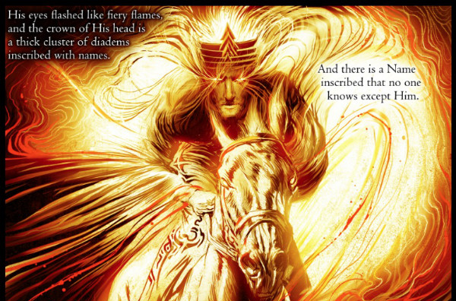
“The words of the Son of God, who has eyes like a flame of fire . . . I have this against you, that you tolerate . . .
I will strike her children dead. And all the churches will know that I am he who searches mind and heart, and I will give to each of you according to your works” Rev 2:18,20,23
© Kris Koelle

Slide 57

various copies on internet, original source unknown
“The accuser of our brothers has been thrown down . . . They have conquered him by the blood of the Lamb
and by the word of their testimony, for they loved not their lives even unto death” Rev 12:10-11
How did Jesus nike Satan?
How do we nike Satan?

Slide 58
various copies on internet, original source unknown
Rev 13:1, 7, 10
And I saw a beast rising out of the sea . . .
(7) it was allowed to make war on the saints and to nike conquer them.
(10) If anyone is to be taken captive, to captivity he goes; if anyone is to be slain with the sword, with the sword must he be slain. Here is a call for the endurance and faith of the saints.
David Miles

Slide 59
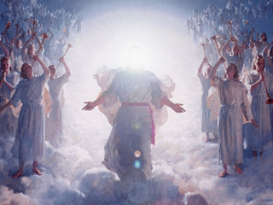
Rev 15:2 I saw . . . those who had niked conquered the beast and its image and the number of its name . . . with harps of God in their hands.

Slide 60

Jesus will nike.
“They will make war on the Lamb, and the Lamb will conquer (nike) them, for he is Lord of lords and King of kings, and those with him are called and chosen and faithful.” Rev 17:14, ESV
“Maranatha!” © 1988/2000 by Stephen Gjertson. All rights reserved. Used with permission.

Slide 61
Rev 21:6-8
(6) “It is done! I am the Alpha and the Omega, the beginning and the end. . . .
(7) The one who nikes conquers will have this heritage, and I will be his God and he will be my son.
(8) But as for the cowardly, the faithless, the detestable, as for murderers, the sexually immoral, sorcerers, idolaters, and all liars, their portion will be in the lake that burns with fire and sulfur”
various copies on internet, original source unknown

Slide 62
smiley © sherv.net Jumping heart © www.fg-a.com
People circle © clipartfest.com
“It is done! I am the Alpha and the Omega, the beginning and the end. . . .
The one who nikes conquers will have this heritage,
and I will be his God
and he will be my son.
But as for the cowardly, the faithless, the detestable, as for murderers, the sexually immoral, sorcerers, idolaters, and all liars, their portion will be in the lake that burns with fire and sulfur” Rev 21:6-8
THE LORD
Nike victory is to live
in Christ in the Spirit
in agape love enjoying God as we take the gospel of Christ to all people,
rather than living according to our flesh desires.

Slide 63
“Let not sin therefore reign in your mortal body, to make you obey its passions.
Do not present your members to sin as instruments for unrighteousness,
but present
yourselves to God
. . . and your members
to God as instruments
for righteousness.
For sin will have no dominion over you, since you are not under law but under grace” Rom 6:12-14
THE LORD
Father, Son and Spirit oneness
love, fellowship and cooperation
smiley © sherv.net

Slide 64
  Repentance toward God and faith in our Lord Jesus Christ
Great joy, not in the world,
but in God and his grace in Christ,
leads to nike victory!
in Christ
justified in Christ the righteousness of God
ransomed, redeemed propitiation, sin atoned, wrath turned
forgiven peace with God reconciled eternal life adopted sons
welcomed, accepted filled, complete blessed with every blessing
Christ our wisdom from God, righteousness and sanctification and redemption
delivered from the domain of darkness into the light of the kingdom of the beloved Son
in Christ and Christ in us in the Spirit and the Spirit in us, made God’s temple
in God the Father and the Father in us immersed in Father, Son, and Spirit
Father, Son, and Spirit fellowship with us access to God and his grace answered prayer
grace at the throne of grace every need supplied Holy Spirit prays for us, helps us pray
Christ our High Priest intercedes as mediator Christ our High Priest advocates in our defense
immersed into Christ and his death and resurrection united with Christ in death and resurrection
old self crucified and buried with Christ new self raised and alive with Christ
set free from sin instrument for righteousness
under Christ, abundant grace slaves of Christ not sin
joined to Christ one with Christ
seated with Christ hidden with Christ in God
released from law, married to Christ under law of the Spirit
Spirit and God’s love poured out born of the Spirit
given, receive, have Spirit rivers of living water of Spirit
immersed in the Spirit Spirit comes on, falls on us
Spirit power to be ambassadors anointed with the Spirit
sealed with the Spirit guarantee of the Spirit
Spirit of truth helps, teaches Spirit leads
Spirit sanctifies Spirit gifts for service
Spirit fills circumcised, set apart in the Spirit
immeasurably great power God’s workmanship led in triumph and nike victory
members of Christ’s body brothers and sisters branches in Christ’s vine
  chosen race, royal priesthood, holy nation, God’s possession, God’s people
fellow citizens with the saints and members of the household of God
citizenship in heaven hope of glory inheritance, heir, fellow heir
with Christ at death made perfect glorified to be like Jesus
into heavenly kingdom enter joy of Lord delivered from wrath
God’s good work completed resurrection body like Jesus
married to the Lamb every tear wiped away
see God’s face reign forever
loved and saved
in New Covenant
jumping heart © www.fg-a.com
johncrozieris@gmail.com © 2020

Slide 65
Nike victory is living in Christ
in the Spirit in Abba
reaching the lost from every tribe, language,
people and nation!
smiley © sherv.net
Jumping heart © www.fg-a.com
People circle © clipartfest.com

Slide 66
Nike victory is living in Christ
in the Spirit in Abba
reaching the lost from every tribe, language,
people and nation!
various copies on internet, original source unknown

Slide 67
Jesus Christ is real nike victory.
Jesus Christ has niked and gives us nike victory!
various copies on internet, original sources unknown

Slide 68
When we see a nike swoosh, we can praise God that Jesus Christ has niked and gives us nike victory!
Copyright by Nike

Slide 69
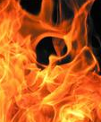
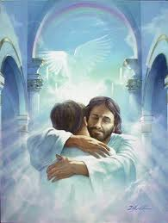
Will your eternity be total defeat or total victory?
Microsoft clip art © 2013
Microsoft Corporation.
various copies on internet, original source unknown
although author’s signature is to the right

Slide 70
9 “You are worthy to take the scroll and to open its seals, because you were slain, and with your blood you purchased men for God from every tribe and language and people and nation. 10 You have made them to be a kingdom and priests to serve our God, and they will reign on the earth.”
Rev 5:9-10, ESV

Slide 71
All praise and thanks be to you, Lord, for giving us the victory over death and everything else through our Lord Jesus Christ!
When Christ returns, what unimaginable new victory will be in you, the God of victory in Christ.

Slide 73
From the eBook, “The Grace of God in Christ:
Sixty days of enjoying Jesus Christ and God’s riches of grace in Christ” by John Crozier free eBook at www.GraceGodChrist.com
John was a Pastor in Canada from 1979-2008.
From 2009-2016, John was an ESL teacher and Pastor in South Korea, mainly training Korean missionaries at MTI, the Missionary Training Institute. Now retired, he serves with Engage Today (www.engage.today), with the privilege of encouraging indigenous leaders in India, Bangladesh, Myanmar, Nepal and Indonesia.
John’s Doctor of Ministry is from Trinity Evangelical Divinity School in Deerfield, Illinois (Chicago).
Contact John at: johncrozieris@gmail.com

Slide 74
“John’s carefully calibrated study of the believer’s blessings in Christ is superbly done! It breathes Scripture – exalts Christ – is most practical and adaptable.
These truths are much needed in our time. Highly recommended.”
Dr. David Larsen
Trinity Evangelical Divinity School

Slide 75
“I love being reminded daily of who I am in Christ and of all that Christ has done for me. John's study has helped me to live a more joyous and victorious life.
We are indeed rich in Christ.”
Bob Arnold, SIM International, visiting Professor at SIMTI Korea, former Director of SIM Benin

Slide 76
“As we train missionaries at MTI Korea, the skills and experiences our veteran missionaries share are important, but secondary. Above all, God calls us to give the nations the true Jesus in his saving fullness. The Grace of God in Christ leads our students to Jesus on a deeper level. Again and again, my own heart has found new freedom to relax in my Lord and Savior, even though I am busy with many things. Wonderful!”
Mihyang Choi, Director, Missionary Training Institute, Yeosu, South Korea

Slide 77
“As I read John’s study, I found myself being blessed by the truths being presented, and incorporated them into my own devotional life.
I shared the list of the riches with my study group and we spent time each week reflecting on each truth.
I commend the study of God’s riches of grace by those who desire to move to the next level of their maturing in Christ.”
Dr. Gene Swanstrom
Trinity Evangelical Divinity School

Slide 78
“Before John’s class at MTI, I didn’t know about the riches of grace even though I’m a seminary grad and a Pastor for ten years. Now I’m excited about God’s grace in Christ, and preaching Christ’s riches. Because the Korean church in general does not preach the riches of grace, it makes church members weak and religious. Now when I teach, God’s people are surprised by God’s wonderful grace and the amazing love of Jesus.”
Pastor Jin Woo Lee, MTI, now a missionary with AIM in Africa

Slide 79
“I love John’s PPT diagrams of the many riches of the Grace of God in Christ.
It’s a great way to learn to share the gospel in depth with simple questions, terms and pictures. I believe this is what mission trainees need. We can use John’s PPT on our smart-phone to share Christ effectively in any language.”
Pastor Hakjin Chun, former Director of SIM Korea

Slide 80
Unless otherwise indicated, all Scripture quotations are taken from
The Holy Bible, English Standard Version (ESV), copyright © 2001 by Crossway Bibles, a publishing ministry of Good News Publishers. Used by permission. All rights reserved.

Slide 81
“Nike in the New Testament” is a complete list of all 34 uses of nike, available in English, Hindi, Indonesian, Korean, and Nepali at www.GraceGodChrist.com

Slide 82
The book
“God’s Riches of Grace:
Sixty days of enjoying Jesus Christ and all the Lord provides in Christ” has a page on each of the riches together with a page of Bible study questions.
It is a discipleship book for use in devotions each day for 60 days. eBook available at www.GraceGodChrist.com

Slide 83
The book
“Daily Joy in the LORD; drinking at the fountain of God in Christ every day each month” has one page on an attribute of God for each day of the month and one page each day of God’s riches of grace in Christ.
Highly recommended. I’ve enjoyed praising the LORD for one of his attributes and some of his riches in Christ every day since 1986-87. eBook available at www.GraceGodChrist.com

Slide 84
PPT © copyright by John Crozier 2023
Available without cost.
For educational purposes.
I have used Google image search to try to find the original source of the graphics from the internet in order to give proper credit.
If you know of the original source of any graphics that say
“various copies on internet, original source unknown,” please contact me at: johncrozieris@gmail.com

Slide 85
Helpful improvements and suggestions are welcome at johncrozieris@gmail.com

