Slide 1

100 Christmas Gifts in Christ:
100 gifts of delight we receive in God’s gift of Christ crucified
to make our hearts jump for joy!
smiley © sherv.net
jumping heart © www.fg-a.com

Slide 2

Jesus completely changed our understanding
of the one true God, the LORD
Holy LORD
God Almighty
Father, Son and Spirit oneness
love, fellowship, cooperation
smiley © sherv.net
heart © clipartbest.com
heart © clipartbest.com

Slide 3
“O righteous Father . . . I made known to them your name”
John 17:25-26
Holy LORD
God Almighty
Father, Son and Spirit oneness
love, fellowship, cooperation
smiley © sherv.net
heart © clipartbest.com
heart © clipartbest.com

Slide 4
God the Father eternally loves his Son!
This is a great mystery revealed through Jesus coming!
Father, Son and Spirit oneness
love, fellowship, cooperation
smiley © sherv.net
“This is my beloved Son” The Father in Mat 3:17; 17:5
“Father . . . you loved me before the foundation
of the world” Jesus in John 17:24
“the Father . . . his beloved Son” Col 1:12-13

Slide 5
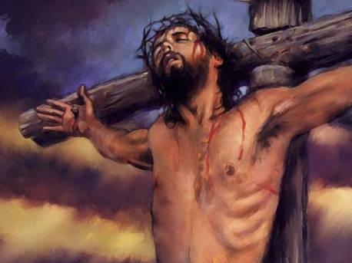
God the Son eternally loves his Father!
This is a great mystery supremely revealed at the cross!
“I love
You first,
Father”
heart © clipartbest.com
original author of picture unknown
“I do as the Father has commanded me, so that the world may know that I love the Father” John 14:31

Slide 6
Jesus also changed our understanding of
relationship with God by the grace of God in Christ
Holy LORD
God Almighty
Father, Son and Spirit oneness
love, fellowship, cooperation
smiley © sherv.net
jumping heart © www.fg-a.com
heart © clipartbest.com

Slide 7
THE LORD
Father, Son and Spirit oneness
love, fellowship and cooperation
“conformed to
the image of his Son,
in order that he might be the firstborn among many brothers”
Rom 8:29
smiley © sherv.net

Slide 8
THE LORD
Father, Son and Spirit oneness
love, fellowship and cooperation
“I made known
to them your name . . . that the love with which you have loved me
may be in them, and I in them”
John 17:26
smiley © sherv.net

Slide 9
Our relationship with God through faith
in Christ is far more personal and intimate
than anyone understood before Jesus came!
“The two shall
become one . . .
This mystery is profound, and I am saying that it refers to Christ and the church”
Eph 5:31-32
THE LORD
Father, Son and Spirit oneness
love, fellowship and cooperation
smiley © sherv.net

Slide 10
“God . . . even when we were dead in our trespasses, made us alive together with Christ . . . and raised
us up with him and seated us with him
in the heavenly
places in Christ
Jesus . . .
For by grace you
have been saved through faith . . .
not a result of works” Eph 2:4-9
THE LORD
Father, Son and Spirit oneness
love, fellowship and cooperation
smiley © sherv.net

Slide 11

When we receive God’s gift of his Son
Jesus Christ

Slide 12
we receive all
Jesus is as our crucified and reigning Savior.

Slide 13

I am your ransom
and redemption
I am your forgiveness
from God
I am your
righteousness
from God
justification
I am
your
peace
with God
Receiving Jesus is like receiving a large gift with many gifts inside.
I am your
adoption
as God’s
child
I am your
deliverance from darkness
into the kingdom of God’s Son
I am your
hope of glory
I am your
fullness
of blessing
I am your
at-one-ment with the Lord
God’s wrath turned away
I am your spiritual
fullness in God
I am your
eternal
life

Slide 14
I am your ransom
and redemption
I am your forgiveness
from God
I am your
righteousness
from God
justification
I am
your
peace
with God
“From his fullness we have all received, grace upon grace.” John 1:16
I am your
adoption
as God’s
child
I am your
deliverance from darkness
into the kingdom of God’s Son
I am your
hope of glory
I am your
fullness
of blessing
I am your
at-one-ment with the Lord
God’s wrath turned away
I am your spiritual
fullness in God
I am your
eternal
life

Slide 15
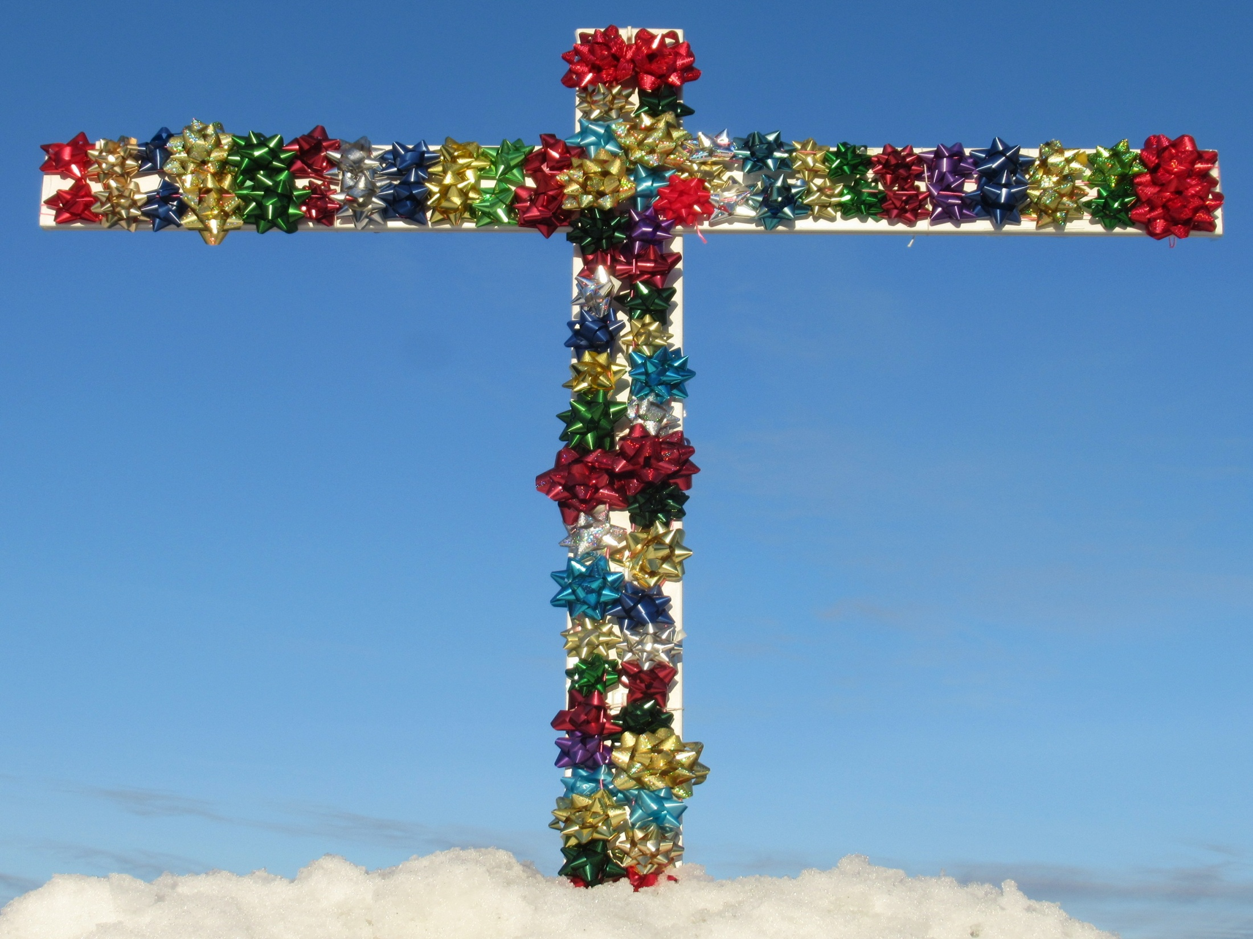
Let’s enjoy all the ways Christ
is all in all
to his people!

Slide 16
  Repentance toward God and faith in our Lord Jesus Christ
Lord, thank you that Jesus died to give us
all your amazing
grace,
the riches of the
grace
of God
in Christ!
in Christ
justified in Christ the righteousness of God
ransomed, redeemed Passover Lamb, sin atoned, wrath turned
forgiven peace with God reconciled eternal life adopted sons
welcomed, accepted filled, complete blessed with every blessing
Christ our wisdom from God, righteousness and sanctification and redemption
delivered from the domain of darkness into the light of the kingdom of the beloved Son
in Christ and Christ in us in the Spirit and the Spirit in us, made God’s temple
in God the Father and the Father in us immersed in Father, Son, and Spirit
Father, Son, and Spirit fellowship with us access to God and his grace answered prayer
grace at the throne of grace every need supplied Holy Spirit prays for us, helps us pray
Christ our High Priest intercedes as mediator Christ our High Priest advocates in our defense
immersed into Christ and his death and resurrection united with Christ in death and resurrection
old self crucified and buried with Christ new self raised and alive with Christ
set free from sin instrument for righteousness
under Christ, abundant grace slaves of Christ not sin
joined to Christ one with Christ
seated with Christ hidden with Christ in God
released from law, married to Christ under law of the Spirit
Spirit and God’s love poured out born of the Spirit
given, receive, have Spirit rivers of living water of Spirit
immersed in the Spirit Spirit comes on, falls on us
Spirit power to be ambassadors anointed with the Spirit
sealed with the Spirit guarantee of the Spirit
Spirit of truth helps, teaches Spirit leads
Spirit sanctifies Spirit gifts for service
Spirit fills circumcised, set apart in the Spirit
immeasurably great power God’s workmanship led in triumph and nike victory
members of Christ’s body brothers and sisters branches in Christ’s vine
  chosen race, royal priesthood, holy nation, God’s possession, God’s people
fellow citizens with the saints and members of the household of God
citizenship in heaven hope of glory inheritance, heir, fellow heir
with Christ at death made perfect glorified to be like Jesus
into heavenly kingdom enter joy of Lord delivered from wrath
God’s good work completed resurrection body like Jesus
married to the Lamb every tear wiped away
see God’s face reign forever
loved and saved
in New Covenant
jumping heart © www.fg-a.com
johncrozieris@gmail.com © 2022

Slide 17
Lord, thank you that all these gifts
in Christ
are provided
for us by Christ’s death and resurrection!
It is finished.
You give all
in Christ
the moment we open our hearts to receive Christ.
justified, righteous in Christ, ransomed, redeemed Passover Lamb, propitiation, sin atoned, wrath turned forgiven peace reconciled eternal life
adopted sons accepted filled, complete
blessed with all blessing Christ our wisdom
righteousness and sanctification and redemption
delivered from darkness to light of kingdom of Son
in Christ and Christ in us in the Spirit and the Spirit in us, made God’s temple in God the Father and the Father in us
immersed in Father, Son, and Spirit Father, Son, and Spirit fellowship with us access to God and his grace
answered prayer grace at the throne of grace every need supplied the Spirit prays for us, helps us pray
Christ our High Priest intercedes as mediator Christ our High Priest advocates in our defense
immersed into Christ and his death and resurrection united with Christ in death and resurrection
old self crucified buried with Christ new self raised alive with Christ set free from sin instrument for righteousness
under Christ, abundant grace slaves of Christ not sin joined to Christ one with Christ seated with Christ
hidden with Christ in God released from law, married to Christ under law of the Spirit Spirit and God’s love poured out
born of the Spirit given, receive, have the Spirit
rivers of living water of the Spirit immersed in the Spirit
Spirit comes on, falls on us Spirit power to be ambassadors anointed and sealed with the Spirit guarantee of the Spirit
Spirit of truth helps, teaches Spirit leads and sanctifies Spirit gifts for service Holy Spirit fills
circumcised, by Christ, set apart in the Spirit
immeasurably great power of the Spirit
God’s workmanship created in Christ
led in triumph and nike victory
members of Christ’s body
brothers and sisters
branches in Christ’s vine
  chosen race royal priesthood
  holy nation, God’s possession
  God’s people fellow citizens with saints
members of the household of God
citizenship in heaven hope of glory
inheritance, heirs of God, fellow heirs
with Christ at death made perfect
glorified to be like Jesus
brought safely into the heavenly kingdom
enter joy of Lord delivered from wrath
God’s good work completed in us
resurrection body like Jesus married to the Lamb
every tear wiped away see God’s face reign forever
loved and saved in the New Covenant
johncrozieris@gmail.com
© 2020

Slide 18

justified in Christ the righteousness of God
ransomed, redeemed Passover Lamb, sin atoned, wrath turned
forgiven peace with God reconciled eternal life adopted sons
welcomed, accepted filled, complete blessed with every blessing
Christ our wisdom from God, righteousness and sanctification and redemption
delivered from the domain of darkness into the light of the kingdom of the beloved Son
in Christ and Christ in us in the Spirit and the Spirit in us, made God’s temple
in God the Father and the Father in us immersed in the Father, Son, and Spirit
Father, Son, and Spirit fellowship with us access to God and his grace
answered prayer grace at the throne of grace
every need supplied Holy Spirit prays for us, helps us pray
Christ our H.P. intercedes as our mediator Christ our H.P. advocates in our defense
immersed in Christ and his death and res. united with Christ in his death and res.
old self crucified and buried with Christ new self raised and alive with Christ
set free from sin instrument for righteousness
under Christ, abundant grace slaves of Christ not sin
joined to Christ one with Christ
seated with Christ hidden with Christ in God
released from law, married to Christ under law of the Spirit
Spirit and God’s love poured out born of the Spirit
given, receive, have Spirit rivers of living water of Spirit
immersed in the Spirit Spirit comes on, falls on us
Spirit power to be ambassadors anointed with the Spirit
sealed with the Spirit guarantee of the Spirit
Spirit of truth helps, teaches Spirit leads
Spirit sanctifies Spirit gifts for service
Spirit fills circumcised, set apart in the Spirit
immeasurably great power God’s workmanship
led in triumph and nike victory members of Christ’s body
brothers and sisters branches in Christ’s vine
  chosen race, royal priesthood, holy nation God’s possession, God’s people
fellow citizens with the saints members of the household of God
citizenship in heaven hope of glory inheritance, heir, fellow heir
with Christ at death made perfect glorified to be like Jesus
into heavenly kingdom enter joy of Lord delivered from wrath
God’s good work completed resurrection body like Jesus married to the Lamb
every tear wiped away see God’s face reign forever
loved and saved in the New Covenant
Receive me - receive all I provide through my death
I DO 4 U
Jesus © GospelGifs.com
Pulsing heart @clipartbest.com

Slide 19
To get this PPT to play properly so the smileys dance on your smart-phone or other device, you must download a free copy of Microsoft Office Powerpoint onto your phone, and when you go to this PPT, you must press the “play as a PPT” tab. Otherwise the smileys stand still and the heart doesn’t jump for joy!
All Scripture quotations are taken from
The Holy Bible, English Standard Version (ESV), copyright © 2001 by Crossway Bibles,
a publishing ministry of Good News Publishers.
Used by permission. All rights reserved.

Slide 20
The Grace of God in Christ
100 gifts of delight we receive in the Lord’s gift of Christ crucified
Gifts that are a firm foundation 1-14
Gifts of connection with Father, Son and Spirit 15-23
Gifts of life at God’s throne 24-31
Gifts of being set free from sin 32-48
Gifts of life in the Holy Spirit 48-71
Gifts of being the body of Christ 72-82
Gifts of future glory 83-97
Three great gifts that include all the others 98-100
Use “search” on your smart-phone

Slide 21
Highly recommended
Develop the habit of praising the LORD every day for his grace in Christ. Develop a mind and heart that rests in Christ for all.
During your prayer time each of the seven days of the week, praise the Lord through section 1 on Day 1,
section two on Day 2, . . . seven on Day 7!
Monday – Section 1 Gifts that are a firm foundation
Tuesday – Section 2
Wednesday – Section 3
Thursday – Section 4
Friday – Section 5
Saturday – Section 6
Sunday – Section 7

Slide 22
Gifts 1-14
in Christ
justified in Christ
the righteousness of God
ransomed and redeemed
Passover Lamb and propitiation, atonement, wrath turned away
forgiven peace reconciled adopted sons
eternal life welcomed, accepted
filled in Christ the fullness of God
blessed with every blessing
Christ our wisdom from God, righteousness, sanctification, redemption
delivered from domination of darkness
transferred into the kingdom of light
faith
in Christ
Lord, thank you that Christ’s death provides
such a firm foundation of riches of grace in Christ!

Slide 23
1. Justified in Christ the righteousness of God.
Thank you, Lord!
Christ the righteousness of God
THE LORD
Christ la justice de Dieu
black
unclean
condemned
© GospelGifs.com
white
holy
blameless
one
one
one
pulsing heart © clipartbest.com
smiley © sherv.net
“But now the righteousness of God has been manifested . . . the righteousness of God through faith in Jesus Christ for all who believe. . . . for all have sinned . . .
and are justified by his grace as a gift, through the redemption that is in Christ Jesus” Rom 3:21-24

Slide 24
1. Justified in Christ the righteousness of God.
Thank you, Lord!
Christ the righteousness of God
THE LORD
Christ la justice de Dieu
black
unclean
condemned
© GospelGifs.com
white
holy
blameless
one
one
one
pulsing heart © clipartbest.com
smileys © sherv.net
“For our sake he made him to be sin who knew no sin,
so that in him we might become the righteousness of God”
2 Cor 5:21
“reconciled . . . by his death, in order to present you holy and blameless and above reproach before him” Col 1:22

Slide 25
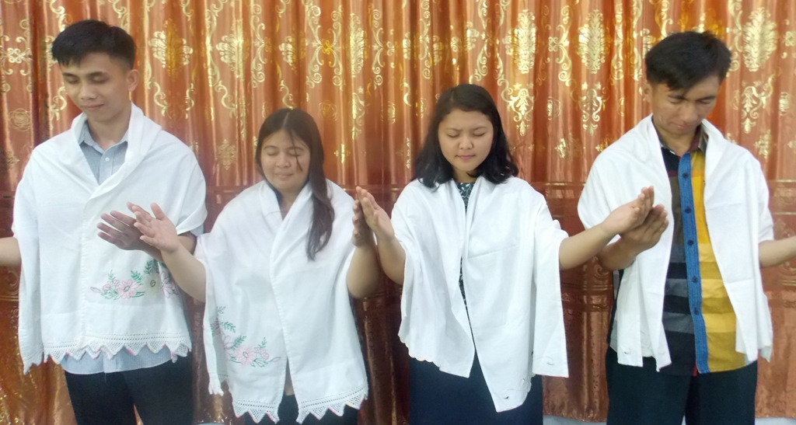
Have you received Jesus Christ, the Righteous One, crucified and risen, as God’s robe of infinite righteousness?
Has God justified you in Christ the righteousness of God?
photo by John Crozier
free to use
No one is as righteous in God’s sight as God himself without receiving Christ as God’s robe of righteousness.
God doesn’t contaminate heaven with one speck of dirt!
Our own efforts to be righteous are not enough!
More on justification in Christ in Appendices 1, slide 307

Slide 26
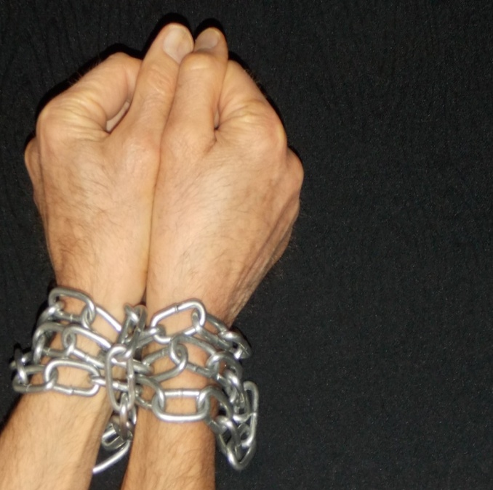
2. Ransom, redemption in Christ. Thank you, Lord!
THE LORD
“the Son of Man came not to be served but to serve, and to give his life as a ransom for many” Mat 20:28
Christ la justice de Dieu
redemption
chains
of
sin
Satan
death
hell
No copyright John Crozier
ransom
chains chains chains
slave slave slave
free free free
bought to belong
smileys © sherv.net
Jesus © GospelGifs.com
pulsing heart © clipartbest.com
Jumping heart © www.fg-a.com
“all have sinned . . . and are justified by his grace as a gift, through the redemption that is in Christ” Rom 3:23-24

Slide 27
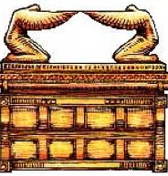
3. Passover Lamb and propitiation, atonement for sin,
God’s wrath turned away. Praise you, Lord!
under God’s wrath
Christ la justice de Dieu
wrath
turned
away
atonement
smileys © sherv.net
Jesus © GospelGifs.com
pulsing heart © clipartbest.com
Jumping heart © www.fg-a.com
at-one-ment
with the Lord
ark jewishvirtuallibrary.org
“Jesus Christ, the Righteous One. He is the atoning sacrifice for our sins, and not only for ours but also for the sins of the whole world” 1 John 2:1-2
“Christ, our Passover Lamb, has been sacrificed” 1 Cor 5:7

Slide 28

Photo of sun shining
through curtain
John Crozier
Most Holy Place
“Jesus . . . yielded up his spirit. . . . the curtain of the
temple was torn in two” Matt 27:50-51
When God the Father tore the curtain, he indicated that he accepted the blood of Jesus as our Passover Lamb, and also as the blood of atonement for sin, the only sacrifice sprinkled on the ark of the covenant behind the curtain.
NO!

Slide 29
Photo of sun shining
through curtain
John Crozier
Most Holy Place
“When Christ appeared as a high priest . . . he entered once for all into the holy places . . . by means of his own blood, thus securing an eternal redemption.” Heb 9:11-12
“Christ has entered, not into holy places made with hands
. . . but into heaven itself, now to appear in the presence
of God on our behalf.” Heb 9:24
NO!

Slide 30
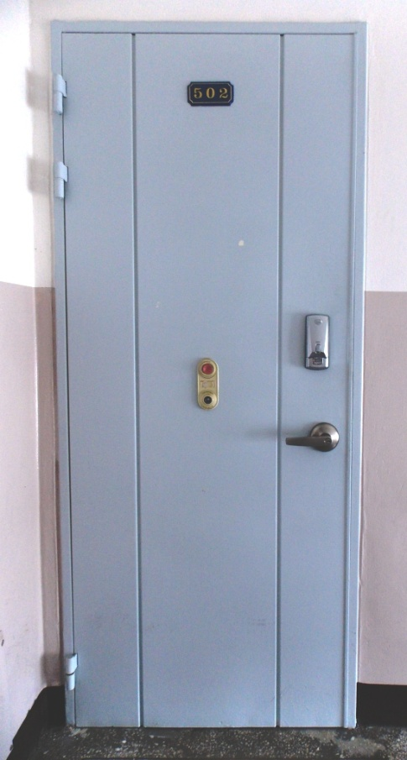
“When I see the blood, I will pass over you, and no plague will befall you to destroy you” Exodus 12:13
Photo of door by John Crozier
Pulsing heart © clipartbest.com
Is the blood
of Christ your Passover Lamb
sprinkled on
the door
of your heart?

Slide 31
3. Passover Lamb and propitiation, atonement for sin,
God’s wrath turned away. Praise you, Lord!
under God’s wrath
Christ la justice de Dieu
wrath
turned
away
atonement
smileys © sherv.net
Jesus © GospelGifs.com
pulsing heart © clipartbest.com
Jumping heart © www.fg-a.com
at-one-ment
with the Lord
ark jewishvirtuallibrary.org
“the day of God’s wrath, when his righteous judgment will be revealed . . . his wrath . . . God presented Christ as a sacrifice of atonement, through the shedding of his blood—to be received by faith. He did this to demonstrate his righteousness” Rom 2:5; 3:5, 24-25

Slide 32
1-3
Smiley © sherv.net
Jumping heart © www.fg-a.com
THE LORD
Righteous through Christ, not by keeping the Law! Redemption by Christ from slavery to sin in the heart,
not just redemption from slavery to other nations!
Atonement for all time by Christ’s once-for-all sacrifice! How amazing to Jewish thinking! You tore the curtain; the sacrifices, priests and Temple are finished. Jesus is our sacrifice, High Priest and access into your presence!

Slide 33
God covers our sins
God cancels our debts
God sends away our sins
God frees us from our sins
God lifts off (nasa) our sins
God removes our sins from us
4. Forgiven
Smiley © sherv.net
God treads our sins underfoot
God casts our sins into the sea
God casts our sins behind his back
God blots out / wipes out our sins
God washes / cleanses us from sin
God remembers our sins no more
God does not count our sins against us
“Blessed are those whose lawless deeds are forgiven,
and whose sins are covered; blessed is the man against whom the Lord will not count his sin” Rom 4:7-8
“In him… redemption… forgiveness of our trespasses” Eph 1:7

Slide 34
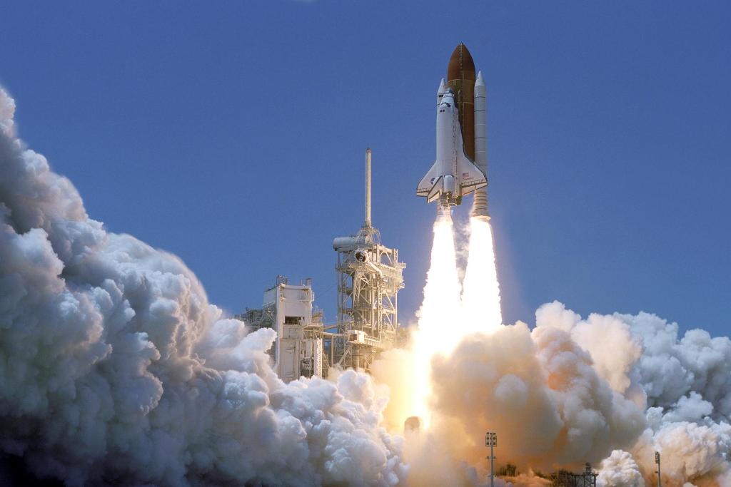
Lord, thank you that when you forgive us you “lift off / nasa” our sins from us.
Praise you that all can join your NASA (lift off) program of forgiveness!
“Please forgive (Hebrew nasa = lift off) the transgression of your brothers and their sin, because they did evil to you. And now, please forgive (nasa) the transgression
of the servants of the God of your father.” Gen 50:17
www.nasa.gov 152294main_Launch-lg.jpg

Slide 35

5. Peace with God. Thank you, Lord!
THE LORD
Christ la justice de Dieu
THE LORD
peace
War War War
Me! Me! Me!
Peace Peace Peace
You! You! You!
smileys © sherv.net
Smiley with sword © sherv.net
Jesus © GospelGifs.com
pulsing heart © clipartbest.com
Jumping heart © www.fg-a.com
“Since we have been justified by faith, we have peace with God through our Lord Jesus Christ” Rom 5:1
“Peace by the blood of his cross” Col 1:20

Slide 36
This can make your time with God more wonderful.
1. For each of the riches, look at the diagrams and praise the Lord for the truths you see.
2. Look at the Bible verses and praise the Lord for what he says he gives us through the death and resurrection of Christ!
As you learn to do this, you will be thrilled as the Lord gives you fresh insights over and over.

Slide 37

Lord, without Jesus Christ . . . but I praise you that through Christ’s death . . .
When you praise the Lord for what Christ has done,
if you start by reflecting on the condition you would be in without Christ, it increases your praise and joy in Christ.
from pqhobbit.files.wordpress.com

Slide 38
Lord, without Jesus Christ I am in chains, chains, chains, a slave, slave, slave to sin, Satan, death and hell . . . but I praise you that through Christ’s death I am free, free, free, since Christ’s ransom payment redeems me . . .
Lord, without Jesus Christ I am black, black, black
in your sight, totally unrighteous, unholy . . .
but I praise you that through Christ’s death I am white, white, white in Christ’s righteousness . . .
from pqhobbit.files.wordpress.com

Slide 39
6. Reconciled to God. Praise you, Lord!
THE LORD
Christ la justice de Dieu
THE LORD
reconciliation
Fight Fight Fight
No! No! No!
Friends Friends Friends
Yes! Yes! Yes!
Egyptian smileys © sherv.net
Smiley with sword © sherv.net
Jesus © GospelGifs.com
pulsing heart © clipartbest.com
Jumping heart © www.fg-a.com
“While we were enemies we were reconciled to God
by the death of his Son” Rom 5:10
“God, who through Christ reconciled us to himself
and gave us the ministry of reconciliation” 2 Cor 5:18

Slide 40
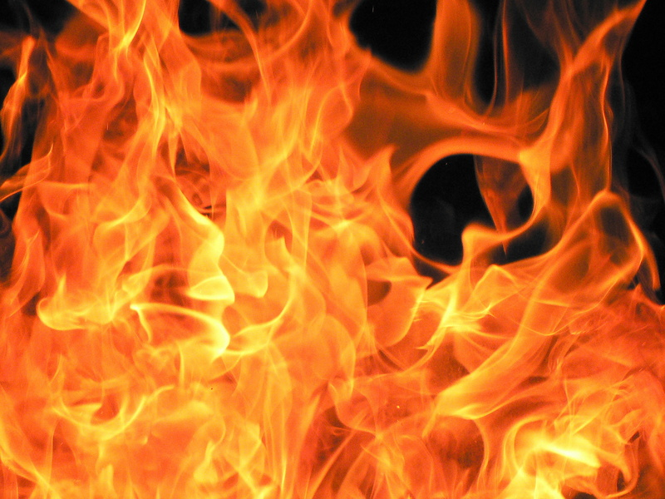
7. Eternal life in Christ. Thank you, Lord!
Christ la justice de Dieu
THE LORD
eternal life
Microsoft clip art © 2013 Microsoft Corp
death death death
perish perish perish
life, life, life
now and forever
smileys © sherv.net
Jesus © GospelGifs.com
pulsing heart © clipartbest.com
Jumping heart © www.fg-a.com
“I give them eternal life, and they will never perish,
and no one will snatch them out of my hand” John 10:28
“the wages of sin is death, but the free gift of God is eternal life in Christ Jesus our Lord” Rom 6:23

Slide 41
Jesus Christ believed in eternal life and eternal fire.
“I give them eternal life, and they will never perish”
John 10:28
“thrown into the eternal fire” Mat 18:8
“Depart from me . . . into the eternal fire” Mat 25:41
fire Microsoft Corp clip art © 2013

Slide 42
Jesus Christ believed in eternal life and eternal fire.
“The Son of Man will send his angels, and they will gather out of his kingdom all causes of sin and all law-breakers, and throw them into the fiery furnace. In that place there will be weeping and gnashing of teeth. Then the righteous will shine like the sun in the kingdom of their Father. He who has ears, let him hear.” (Jesus in Matthew 13:41-43)
fire Microsoft Corp clip art © 2013

Slide 43
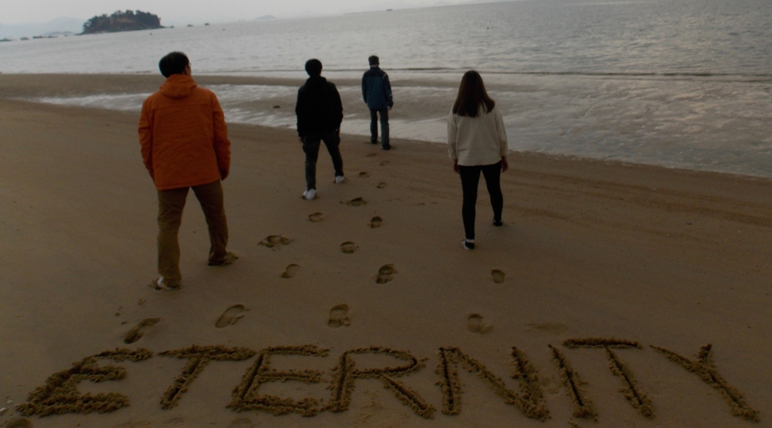
Everyone is going into eternity.
Photo John Crozier
Where will you go?

Slide 44
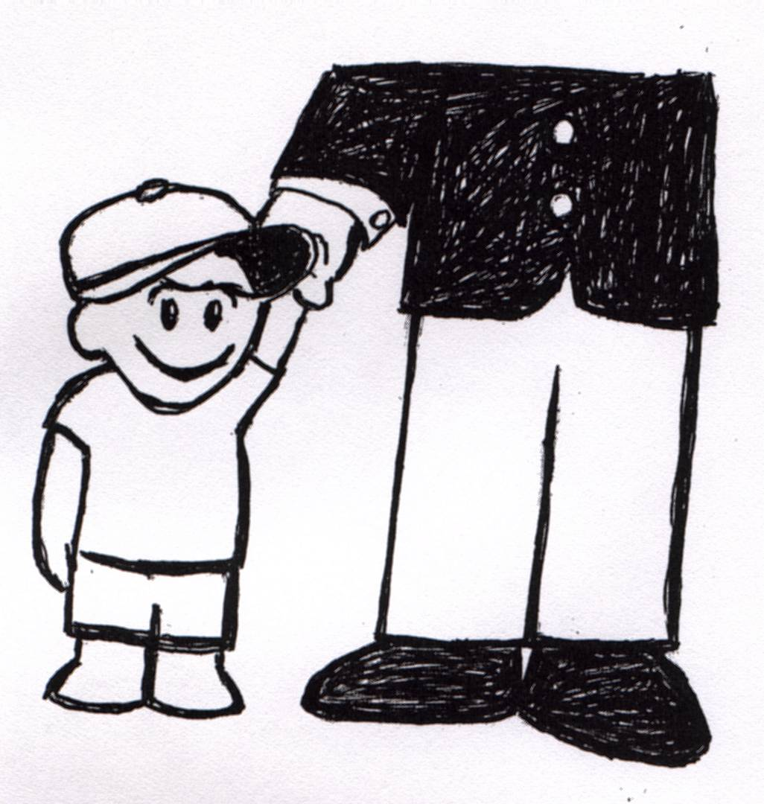


8. adopted as sons with the Spirit of God’s Son
sent into our hearts. Thank you, Father!
“Because you are sons, God has sent
the Spirit of his Son
into our hearts, crying, ‘Abba! Father!’” Gal 4:6
adopted
by
Abba
Bible and Dove
Microsoft clip art © 2013
Microsoft Corporation.
sketch adapted from original
by Phil Crozier
NO!
“He predestined us for adoption as sons
through Jesus Christ” Eph 1:5
© GospelGifs.com

Slide 45
8. adopted as sons with the Spirit of God’s Son
sent into our hearts. Thank you, Father!
“All who are led by the Spirit of God are sons of God. . . . you have received the Spirit of adoption as sons, by whom we cry, “Abba! Father!” The Spirit himself bears witness with our spirit that we are children of God” (Rom 8:14-16)
adopted
by
Abba
Bible and Dove
Microsoft clip art © 2013
Microsoft Corporation.
sketch adapted from original
by Phil Crozier
NO!
© GospelGifs.com

Slide 46
THE LORD
Adopted as God’s sons.
Loved as God’s sons.
Conformed to the
image of God’s Son.
Sons in the Son.
Brothers with the Son.
Amazing Lord!
smiley © sherv.net

Slide 47
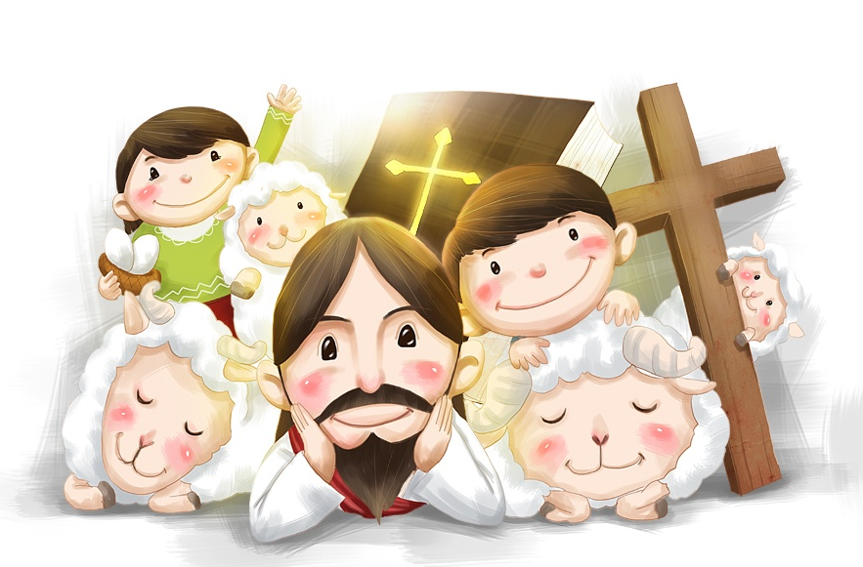
9. welcomed and accepted in Christ.
Praise you, Lord!
not accepted
© iclickart.co.kr with permission from Iregihwek print shop in Yeosu, South Korea
“Accept one another, then, just as Christ accepted you, in order to bring praise to God” Rom 15:7, NIV
“their rejection . . . their acceptance” Rom 11:15
accept, NIV = welcome, ESV

Slide 48
“For in him the whole fullness of deity dwells bodily
and you have been filled in him, who is the head
of all rule and authority” Col 2:9-10
fullness of God’s powers
fullness of God’s salvation
10. filled and
complete
in Christ
in whom God’s fullness dwells.
Thank you, Lord!
empty
in myself
Jesus © GospelGifs.com
with permission
jumping heart © www.fg-a.com
If we are in Christ in whom God’s fullness dwells,
we are spiritually filled and complete in God by faith.
Nothing else makes us more “spiritual” or more “full” in God’s sight.

Slide 49
Alive Self-existent
Active Spiritual Personal
Self-conscious Free Self-determining
Independent Wise Intelligent Infinite
Eternal Incomprehensible Omniscient
Omnipotent Sovereign
Omnipresent Immanent
Transcendent Immense Faithful Holy
Righteous Perfect Love Just
Longsuffering True Truthful
Gracious Merciful
Unchanging Jealous
Zealous Wrathful Good Humble
Oneness and Trinity of Father, Son, Spirit
Creator Upholder/Sustainer Savior
Shepherd Judge King
Joy in God
fullness of God’s powers
Jesus © GospelGifs.com
with permission
jumping heart © www.fg-a.com

Slide 50
justified in Christ the righteousness of God
ransomed, redeemed Passover Lamb, sin atoned, wrath turned
forgiven peace with God reconciled eternal life adopted sons
welcomed, accepted filled, complete blessed with every blessing
Christ our wisdom from God, righteousness and sanctification and redemption
delivered from the domain of darkness into the light of the kingdom of the beloved Son
in Christ and Christ in us in the Spirit and the Spirit in us, made God’s temple
in God the Father and the Father in us immersed in the Father, Son, and Spirit
Father, Son, and Spirit fellowship with us access to God and his grace
answered prayer grace at the throne of grace
every need supplied Holy Spirit prays for us, helps us pray
Christ our H.P. intercedes as our mediator Christ our H.P. advocates in our defense
immersed in Christ and his death and res. united with Christ in his death and res.
old self crucified and buried with Christ new self raised and alive with Christ
set free from sin instrument for righteousness
under Christ, abundant grace slaves of Christ not sin
joined to Christ one with Christ
seated with Christ hidden with Christ in God
released from law, married to Christ under law of the Spirit
Spirit and God’s love poured out born of the Spirit
given, receive, have Spirit rivers of living water of Spirit
immersed in the Spirit Spirit comes on, falls on us
Spirit power to be ambassadors anointed with the Spirit
sealed with the Spirit guarantee of the Spirit
Spirit of truth helps, teaches Spirit leads
Spirit sanctifies Spirit gifts for service
Spirit fills circumcised, set apart in the Spirit
immeasurably great power God’s workmanship
led in triumph and nike victory members of Christ’s body
brothers and sisters branches in Christ’s vine
  chosen race, royal priesthood, holy nation God’s possession, God’s people
fellow citizens with the saints members of the household of God
citizenship in heaven hope of glory inheritance, heir, fellow heir
with Christ at death made perfect glorified to be like Jesus
into heavenly kingdom enter joy of Lord delivered from wrath
God’s good work completed resurrection body like Jesus married to the Lamb
every tear wiped away see God’s face reign forever
loved and saved in the New Covenant
fullness of God’s salvation
Jesus © GospelGifs.com
with permission
jumping heart © www.fg-a.com

Slide 51
Christ the fullness of God is in
those in Christ,
but the false teachers
in Colossae say,
“We are more spiritual;
We have greater fullness.”
Are you serious?
Christ, the fullness of God in you, does not make you spiritually full?
God the Father, Son and Spirit is
in you, and you aren’t filled
with spiritual fullness? Really?
Christ la justice de Dieu
Christ the fullness of God
Jesus © GospelGifs.com
pulsing heart © clipartbest.com
smileys © sherv.net
To better understand how those today who claim to be more spiritual repeat the error of the false teachers in Colossians, see Appendices 2, slide 321

Slide 52












THE LORD
God’s completely different way
to deepest joy, satisfaction and fullness
smiley © sherv.net
Jumping heart © www.fg-a.com
People circle © clipartfest.com
Fullness is in Christ, not in beauty, music, smart-phones, sports, cars, money, friends, romance, sex, food,
drinking parties, homes or jobs!

Slide 53
“If we do not rely on Christ for wholeness, all our relationships are an attempt to complete ourselves.” adapted from Drs. Les and Leslie Parrott
Lord, I trust Christ as my spiritual wholeness and fullness, Jesus in whom the whole fullness of God dwells bodily.
I am filled in him in whom God’s fullness dwells.
I am filled with the riches of the grace of God in Christ.
It is finished. I am complete in Christ by faith apart from tongues, dreams, visions, miracles, ‘words’
or anything else!

Slide 54
You can’t DO anything to make yourself more righteous; I am your righteousness.
You can’t DO anything to be more forgiven;
I am your forgiveness from God.
You can’t DO anything to be more reconciled to God;
I am your reconciliation with God.
You can’t DO anything to be more accepted;
I am your acceptance with God.
You can’t DO anything to be more spiritual;
If I, in whom the fullness of God dwells, am in you,
I am your spiritual fullness in God; nothing can add to my spiritual fullness.

Slide 55
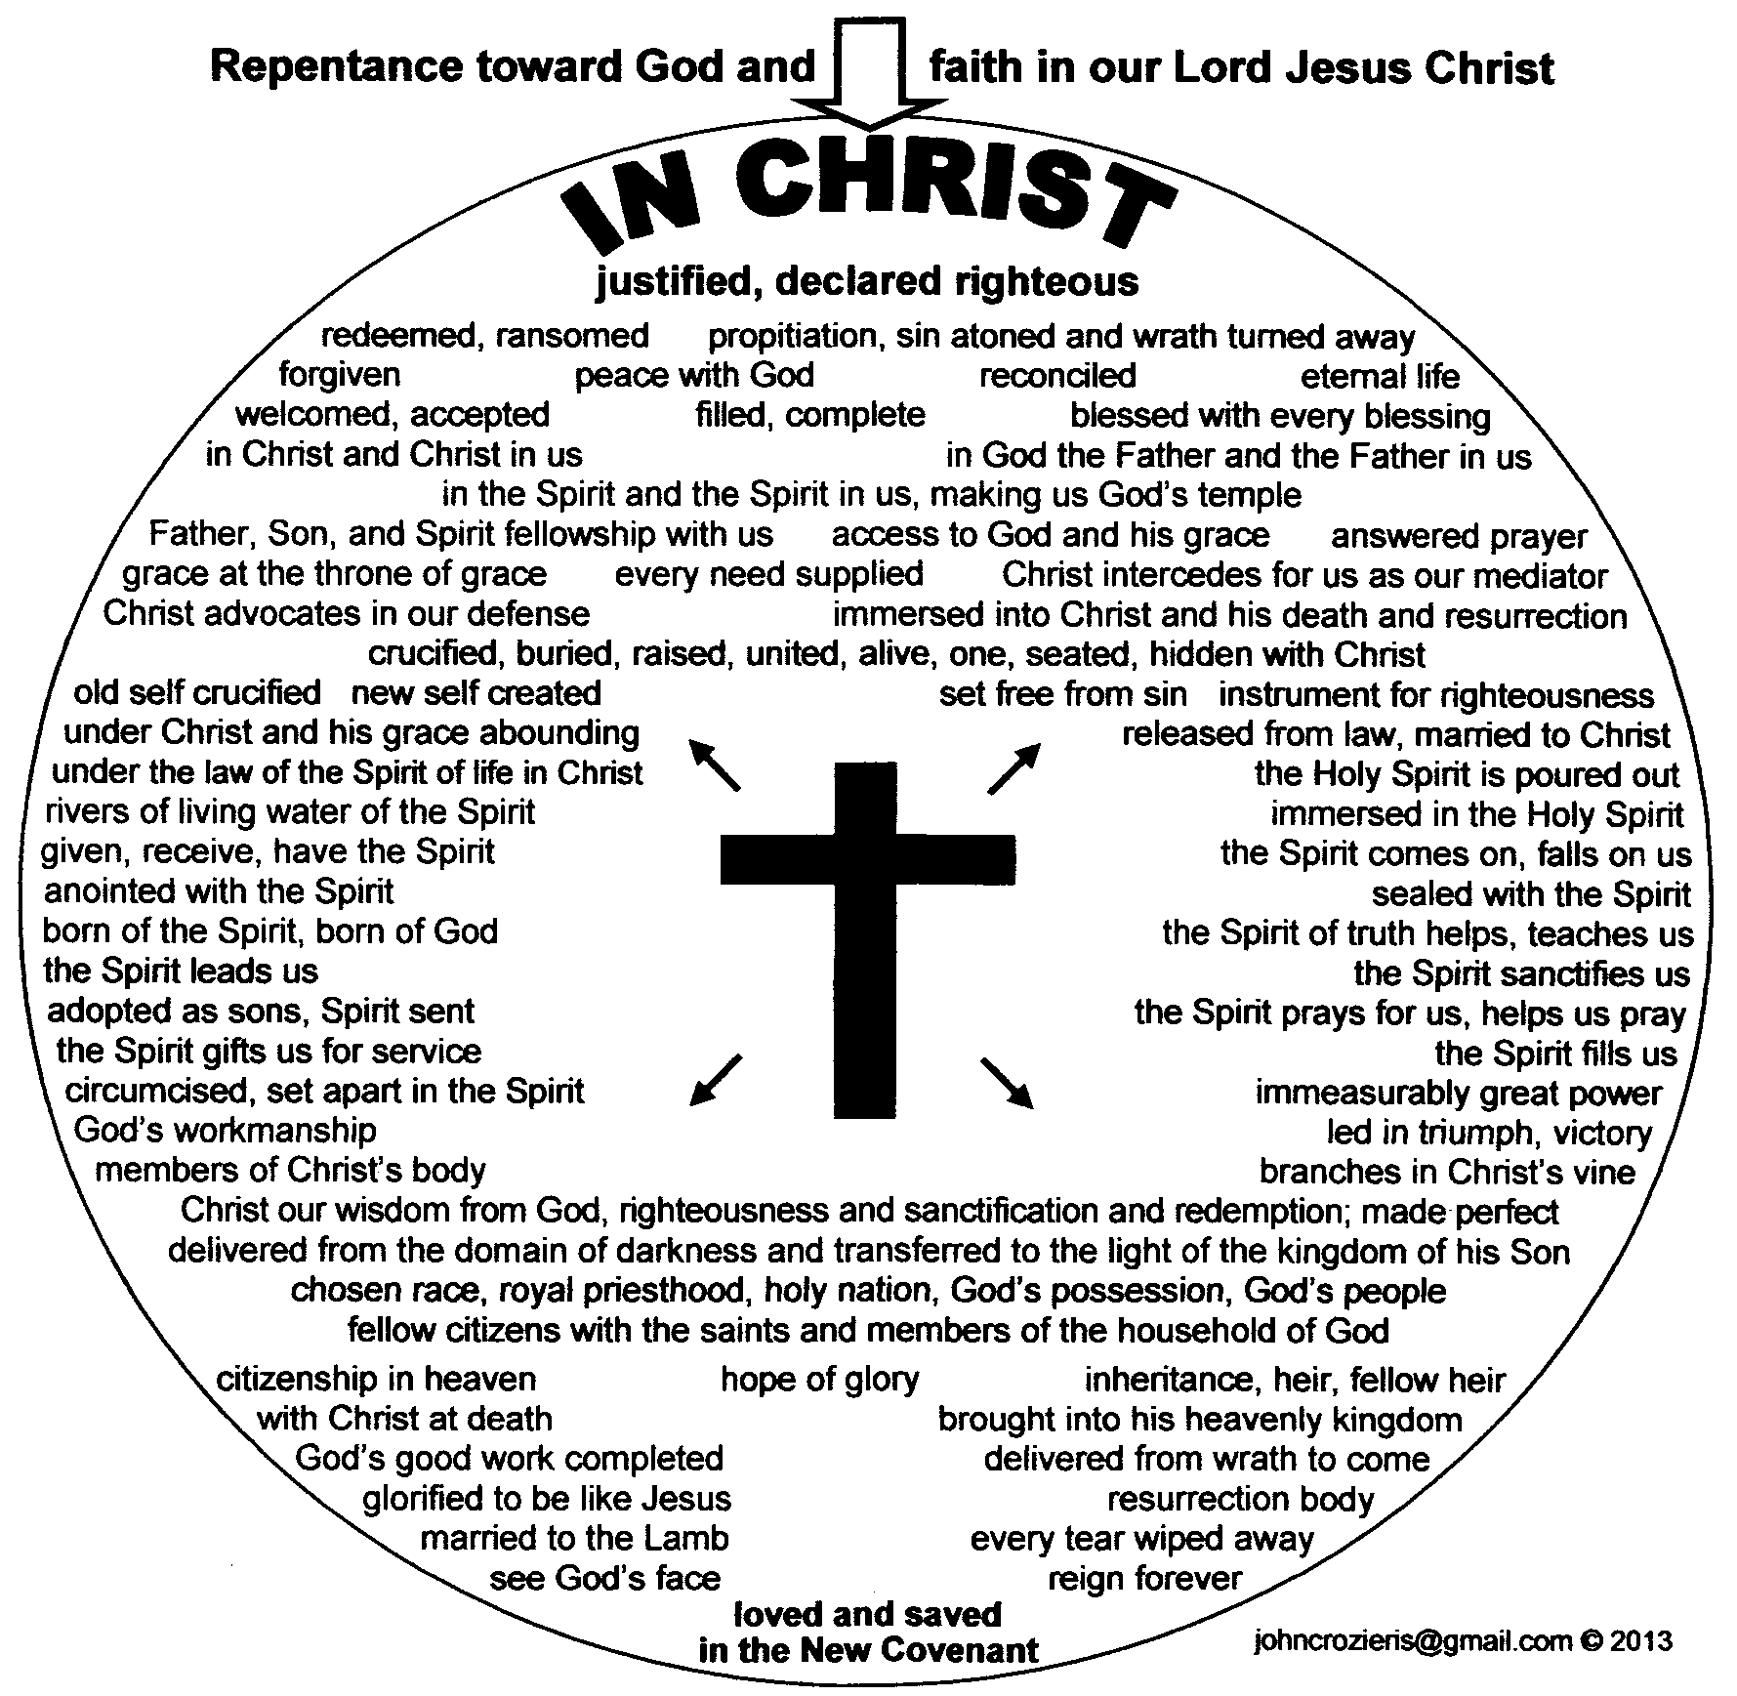


smiley © sherv.net
Jumping heart © www.fg-a.com
THE LORD
“Blessed be the God and Father
of our Lord Jesus Christ, who has blessed us in Christ with every spiritual blessing in the heavenly places”
Eph 1:3
11. blessed
in Christ
with every spiritual blessing.
Thank you, Lord!
big tears smiley © sherv.net
no blessing
all blessing
Hands - Microsoft clip art © 2013
Microsoft Corporation.

Slide 56
  Repentance toward God and faith in our Lord Jesus Christ
in Christ
Lord, thank you that Jesus is
the fullness of your blessing!
Thank you
that Christ’s death and resurrection provides all
your
blessing!
It is finished!
We believe
and receive all you freely give
in Christ!
justified in Christ the righteousness of God
ransomed, redeemed Passover Lamb, sin atoned, wrath turned
forgiven peace with God reconciled eternal life adopted sons
welcomed, accepted filled, complete blessed with every blessing
Christ our wisdom from God, righteousness and sanctification and redemption
delivered from the domain of darkness into the light of the kingdom of the beloved Son
in Christ and Christ in us in the Spirit and the Spirit in us, made God’s temple
in God the Father and the Father in us immersed in Father, Son, and Spirit
Father, Son, and Spirit fellowship with us access to God and his grace answered prayer
grace at the throne of grace every need supplied Holy Spirit prays for us, helps us pray
Christ our High Priest intercedes as mediator Christ our High Priest advocates in our defense
immersed into Christ and his death and resurrection united with Christ in death and resurrection
old self crucified and buried with Christ new self raised and alive with Christ
set free from sin instrument for righteousness
under Christ, abundant grace slaves of Christ not sin
joined to Christ one with Christ
seated with Christ hidden with Christ in God
released from law, married to Christ under law of the Spirit
Spirit and God’s love poured out born of the Spirit
given, receive, have Spirit rivers of living water of Spirit
immersed in the Spirit Spirit comes on, falls on us
Spirit power to be ambassadors anointed with the Spirit
sealed with the Spirit guarantee of the Spirit
Spirit of truth helps, teaches Spirit leads
Spirit sanctifies Spirit gifts for service
Spirit fills circumcised, set apart in the Spirit
immeasurably great power God’s workmanship led in triumph and nike victory
members of Christ’s body brothers and sisters branches in Christ’s vine
  chosen race, royal priesthood, holy nation, God’s possession, God’s people
fellow citizens with the saints and members of the household of God
citizenship in heaven hope of glory inheritance, heir, fellow heir
with Christ at death made perfect glorified to be like Jesus
into heavenly kingdom enter joy of Lord delivered from wrath
God’s good work completed resurrection body like Jesus
married to the Lamb every tear wiped away
see God’s face reign forever
loved and saved
in New Covenant
jumping heart © www.fg-a.com
johncrozieris@gmail.com © 2020

Slide 57
smiley © sherv.net
Jumping heart © www.fg-a.com
THE LORD
“If God is for us, who can be against us? He who did not spare his own Son but gave him up for us all, how will he not also with him graciously give us all things?” Rom 8:31-32
11. blessed
in Christ
with every spiritual blessing.
Thank you, Lord!
big tears smiley © sherv.net
no blessing
all blessing
Hands - Microsoft clip art © 2013
Microsoft Corporation.

Slide 58
Lord, we praise you that the fullness of your blessing is given
in Christ
by faith in what Christ has DONE, and not by things we DO.
It is finished!
We rest in Christ and his finished work rather than DO, DO, DO
to earn your blessing.
justified, righteous in Christ, ransomed, redeemed Passover Lamb, propitiation, sin atoned, wrath turned forgiven peace reconciled eternal life
adopted sons accepted filled, complete
blessed with all blessing Christ our wisdom
righteousness and sanctification and redemption
delivered from darkness to light of kingdom of Son
in Christ and Christ in us in the Spirit and the Spirit in us, made God’s temple in God the Father and the Father in us
immersed in Father, Son, and Spirit Father, Son, and Spirit fellowship with us access to God and his grace
answered prayer grace at the throne of grace every need supplied the Spirit prays for us, helps us pray
Christ our High Priest intercedes as mediator Christ our High Priest advocates in our defense
immersed into Christ and his death and resurrection united with Christ in death and resurrection
old self crucified buried with Christ new self raised alive with Christ set free from sin instrument for righteousness
under Christ, abundant grace slaves of Christ not sin joined to Christ one with Christ seated with Christ
hidden with Christ in God released from law, married to Christ under law of the Spirit Spirit and God’s love poured out
born of the Spirit given, receive, have the Spirit
rivers of living water of the Spirit immersed in the Spirit
Spirit comes on, falls on us Spirit power to be ambassadors anointed and sealed with the Spirit guarantee of the Spirit
Spirit of truth helps, teaches Spirit leads and sanctifies Spirit gifts for service Holy Spirit fills
circumcised, by Christ, set apart in the Spirit
immeasurably great power of the Spirit
God’s workmanship created in Christ
led in triumph and nike victory
members of Christ’s body
brothers and sisters
branches in Christ’s vine
  chosen race royal priesthood
  holy nation, God’s possession
  God’s people fellow citizens with saints
members of the household of God
citizenship in heaven hope of glory
inheritance, heirs of God, fellow heirs
with Christ at death made perfect
glorified to be like Jesus
brought safely into the heavenly kingdom
enter joy of Lord delivered from wrath
God’s good work completed in us
resurrection body like Jesus married to the Lamb
every tear wiped away see God’s face reign forever
loved and saved in the New Covenant
johncrozieris@gmail.com
© 2020

Slide 59
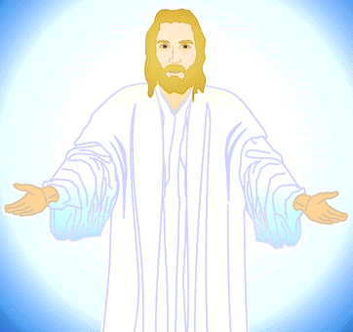
Receive me and you receive all I am as
your crucified and
reigning Lord and
Saviour, the
the fullness of
God’s blessing.
Find all in Me
by faith, so
you stop
demanding
others serve
you and meet
your needs, and
you are freed
to walk with me
in the Spirit in agape
love serving others.
justified in Christ the righteousness of God
ransomed, redeemed Passover Lamb, sin atoned, wrath turned
forgiven peace with God reconciled eternal life adopted sons
welcomed, accepted filled, complete blessed with every blessing
Christ our wisdom from God, righteousness and sanctification and redemption
delivered from the domain of darkness into the light of the kingdom of the beloved Son
in Christ and Christ in us in the Spirit and the Spirit in us, made God’s temple
in God the Father and the Father in us immersed in Father, Son, and Spirit
Father, Son, and Spirit fellowship with us access to God and his grace answered prayer
grace at the throne of grace every need supplied Holy Spirit prays for us, helps us pray
Christ our High Priest intercedes as mediator Christ our High Priest advocates in our defense
immersed into Christ and his death and resurrection united with Christ in death and resurrection
old self crucified and buried with Christ new self raised and alive with Christ set free from sin
instrument for righteousness under Christ, abundant grace slaves of Christ not sin joined to Christ
one with Christ seated with Christ hidden with Christ in God released from law, married to Christ
under law of the Spirit Spirit and God’s love poured out born of the Spirit given, receive, have Spirit
rivers living water of Spirit immersed in Spirit Spirit comes, falls on us Spirit power to be ambassadors
anointed, sealed with Spirit guarantee of Spirit Spirit of truth helps, teaches Spirit leads, sanctifies
Spirit gifts for service Spirit fills circumcised, set apart in the Spirit immeasurably great power
God’s workmanship led in triumph + nike victory members of Christ’s body brothers and sisters branches in Christ’s vine chosen race,royal priesthood,holy nation,God’s possession,God’s people
fellow citizens with the saints and members of the household of God
citizenship in heaven hope of glory inheritance, heir, fellow heir
with Christ at death made perfect glorified to be like Jesus
into heavenly kingdom enter joy of Lord delivered from wrath
God’s good work completed resurrection body like Jesus
married to the Lamb every tear wiped away
see God’s face reign forever
loved saved
in the New Covenant
© GospelGifs.com used with permission

Slide 60

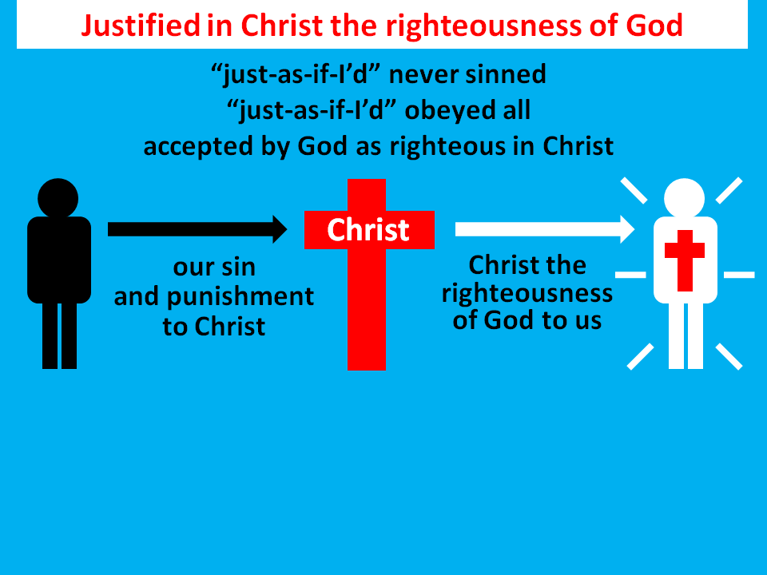

© Yoon Nam Sun
© GospelGifs.com
Christ our
righteousness
Christ our
holiness
Christ our
redemption
jumping heart © www.fg-a.com
12. wisdom from God
“It is because of him that you are in Christ Jesus,
who has become for us wisdom from God—
that is, our righteousness, holiness and redemption” 1 Cor 1:30 NIV
Thank you, Lord!
Thank you!
foolish
unwise

Slide 61

13-14. delivered from
the domain of darkness
and transferred to the kingdom of God’s Son.
Praise you, Lord!
© GospelGifs.com
“out of darkness into his marvelous light” 1 Pet 2:9
jumping heart © www.fg-a.com
“He has delivered us from the domain of darkness and transferred us to the kingdom of his beloved Son” Col 1:13
dominated by darkness
Microsoft clip art © 2013 Microsoft Corporation.

Slide 62
dominated by darkness
© GospelGifs.com
Microsoft clip art © 2013 Microsoft Corporation.
jumping heart © www.fg-a.com
Thank you, Lord, that if you have delivered us from the domain of darkness into the kingdom of your Son,
we are under the authority of the King of kings,
the Lord of all, and Christ’s death has freed us from
the domination of spirits of darkness, as it is written,
“He disarmed the rulers and authorities and put them to open shame, by triumphing over them in him” Col 2:15!

Slide 63
Gifts 1-14
in Christ
justified in Christ
the righteousness of God
ransomed and redeemed
Passover Lamb and propitiation, atonement, wrath turned away
forgiven peace reconciled adopted sons
eternal life welcomed, accepted
filled in Christ the fullness of God
blessed with every blessing
Christ our wisdom from God, righteousness, sanctification, redemption
delivered from domination of darkness
transferred into the kingdom of light
faith
in Christ
Lord, thank you that Christ’s death provides
such a firm foundation of riches of grace in Christ!

Slide 64
Jesus
Mohammed
Confucius
Can anyone else give us these gifts?
Has anyone else died as God’s once-for-all sacrifice for sin? Is anyone else the infinite
Son of God, our resurrected Messiah and Lord,
who provides in himself all we need in God?
Hindu Gurus
Moses
Buddha

Slide 65
Buddhism says:
Do Do Do
Do Do Do
Do Do.
You Do.
8-fold path
Islam
says:
Do Do Do
Do Do all Allah wants.
You Do.
5 pillars
Hinduism
says:
Do Do Do
Do Do Do
Do Do Do.
You Do.
many paths
Jesus
says:
It is DONE.
I am all you need.
I give, you receive.
I DO 4 U.
Come to me
and drink.
I DO 4 U
More free resources on the grace of God in Christ @ www.GraceGodChrist.com

Slide 66
THE LORD
God’s completely different way
to deepest joy and satisfaction
smiley © sherv.net
Jumping heart © www.fg-a.com
People circle © clipartfest.com
Joy and satisfaction are in Christ, not beauty, music, smart-phones, sports, cars, money, friends, romance, sex, food, drinking parties, homes or jobs! Jesus had supreme joy without sex or money!

Slide 67
justified in Christ the righteousness of God
ransomed, redeemed Passover Lamb, sin atoned, wrath turned
forgiven peace with God reconciled eternal life adopted sons
welcomed, accepted filled, complete blessed with every blessing
Christ our wisdom from God, righteousness and sanctification and redemption
delivered from the domain of darkness into the light of the kingdom of the beloved Son
in Christ and Christ in us in the Spirit and the Spirit in us, made God’s temple
in God the Father and the Father in us immersed in the Father, Son, and Spirit
Father, Son, and Spirit fellowship with us access to God and his grace
answered prayer grace at the throne of grace
every need supplied Holy Spirit prays for us, helps us pray
Christ our H.P. intercedes as our mediator Christ our H.P. advocates in our defense
immersed in Christ and his death and res. united with Christ in his death and res.
old self crucified and buried with Christ new self raised and alive with Christ
set free from sin instrument for righteousness
under Christ, abundant grace slaves of Christ not sin
joined to Christ one with Christ
seated with Christ hidden with Christ in God
released from law, married to Christ under law of the Spirit
Spirit and God’s love poured out born of the Spirit
given, receive, have Spirit rivers of living water of Spirit
immersed in the Spirit Spirit comes on, falls on us
Spirit power to be ambassadors anointed with the Spirit
sealed with the Spirit guarantee of the Spirit
Spirit of truth helps, teaches Spirit leads
Spirit sanctifies Spirit gifts for service
Spirit fills circumcised, set apart in the Spirit
immeasurably great power God’s workmanship
led in triumph and nike victory members of Christ’s body
brothers and sisters branches in Christ’s vine
  chosen race, royal priesthood, holy nation God’s possession, God’s people
fellow citizens with the saints members of the household of God
citizenship in heaven hope of glory inheritance, heir, fellow heir
with Christ at death made perfect glorified to be like Jesus
into heavenly kingdom enter joy of Lord delivered from wrath
God’s good work completed resurrection body like Jesus married to the Lamb
every tear wiped away see God’s face reign forever
loved and saved in the New Covenant
Receive me - receive all I provide through my death
I DO 4 U
Jesus © GospelGifs.com
Pulsing heart @clipartbest.com

Slide 68
Spirit
gifted
glory with Christ
reign
forever
see his face
resurrection
Spirit
fills
sanctified
seated with Christ
Christ
intercedes
in the
Spirit
Christ’s
power
Spirit
anoints
crucified
with Christ
accepted
adopted
Bride of
Christ
Christ’s
body
access
eternal
life
Spirit seals
victory
fullness
kingdom of
Christ
Christ
in us
raised with Christ
alive
in Christ
hidden with Christ in God
immersed
into Christ
every
blessing
peace
New
Covenant
led by
the Spirit
hope
of
glory
set free
from sin
atonement
of Christ
one with
Christ
born of the Spirit
loved
forgiven
reconciled
Christ’s ransom
Christ’s righteousness
Spirit
poured out
saved
When Christ rose,
it’s as if his cross became a tree of life
with many fruits to joyfully eat by faith.
Come to me and eat.
rooted in the blood of Jesus Christ, the Son of God

Slide 69
Spirit
gifted
glory with Christ
reign
forever
see his face
resurrection
Spirit
fills
sanctified
Christ
intercedes
seated with Christ
in the Spirit
Christ’s
power
Spirit
anoints
crucified
with Christ
accepted
adopted
Bride of
Christ
Christ’s
body
access
eternal
life
Spirit seals
victory
fullness
kingdom of
Christ
hope
of
glory
raised with Christ
alive
in Christ
Christ
in us
every
blessing
immersed
into Christ
peace
New
Covenant
atonement
of Christ
one with
Christ
led by
the Spirit
set free
from sin
saved
born of
the Spirit
hidden with Christ in God
forgiven
loved
Spirit
poured out
reconciled
Christ’s ransom
Christ’s righteousness
When Christ rose,
it’s as if his cross became a fountain
of life-giving water to joyfully drink by faith.
Come to me and drink.
a fountain flowing from the blood of Jesus Christ, God’s Son

Slide 70
What is SIN?
S
I
N
Seeking joy and satisfaction in created things
rather than in our supremely enjoyable Creator
Suppressing, exchanging truth about God for lies
and other loves, disapproving of God (Rom 1:18,23,28)
Storing up wrath for ourselves on the day God’s
righteous judgment will be revealed (Rom 2:5)
Idolatrous Independence from God ; Ignoring God
I do what I want; I am lord over my choices
Iniquity = “crookedness” from God’s way
Not honoring, thanking, believing, worshipping,
serving, and approving of our Creator (Rom 1:21,25,28)

Slide 71
What is sin? It’s more than we think!
"You shall have no other gods before me.
You shall not make for yourself a carved image . . .
You shall not bow down to them or serve them . . .
You shall not take the name of the LORD your God in vain . . . Remember the Sabbath day, to keep it holy. On it you shall not do any work . . .
Honor your father and your mother . . .
You shall not murder. You shall not commit adultery.
You shall not steal.
You shall not bear false witness against your neighbor.
You shall not covet your neighbor's house; you shall not covet your neighbor's wife . . . or anything that is your neighbor's.” The Ten Commandments in Exodus 20:3-17

Slide 72
What is sin?
“God will judge the sexually immoral and adulterous.”
Heb 13:4 (Do you please yourself with pornography?
Do you think about having sex with those who attract you?)
Consider the contrast at the end of the Bible:
“Blessed are those who wash their robes, so that they may have the right to the tree of life and that they may enter the city by the gates. Outside are . . . sorcerers and the sexually immoral and murderers and idolaters, and everyone who loves and practices falsehood.” Rev 22:14-15
Do we not all desperately need Jesus, the Son of God, whose death alone provides righteousness, redemption, atonement, forgiveness and peace with God?
Are you desperate to connect with Jesus and his cross?

Slide 73
THE LORD
God’s completely different way
to deepest joy and satisfaction
smiley © sherv.net
Jumping heart © www.fg-a.com
People circle © clipartfest.com
Sin is seeking joy and satisfaction in beauty, music, smart-phones, sports, cars, money, friends, romance, sex, food, drinking parties, homes or jobs instead of enjoying the Lord! The Great Deception!

Slide 74
I am your ransom
and redemption
I am your forgiveness
from God
I am your
righteousness
from God
justification
I am
your
peace
with God
Joy and satisfaction are in God. Open Christ’s gifts to enjoy the Lord by faith in God’s promises expressed in praise!
Promises - Faith - Praise
I am your
adoption
as God’s
child
I am your
deliverance from darkness
into the kingdom of God’s Son
I am your
hope of glory
I am your
fullness
of blessing
I am your
at-one-ment with the Lord
God’s wrath turned away
I am your fullness
of the Spirit of God
I am your
eternal
life

Slide 75
justified in Christ the righteousness of God
ransomed, redeemed Passover Lamb, sin atoned, wrath turned
forgiven peace with God reconciled eternal life adopted sons
welcomed, accepted filled, complete blessed with every blessing
Christ our wisdom from God, righteousness and sanctification and redemption
delivered from the domain of darkness into the light of the kingdom of the beloved Son
in Christ and Christ in us in the Spirit and the Spirit in us, made God’s temple
in God the Father and the Father in us immersed in the Father, Son, and Spirit
Father, Son, and Spirit fellowship with us access to God and his grace
answered prayer grace at the throne of grace
every need supplied Holy Spirit prays for us, helps us pray
Christ our H.P. intercedes as our mediator Christ our H.P. advocates in our defense
immersed in Christ and his death and res. united with Christ in his death and res.
old self crucified and buried with Christ new self raised and alive with Christ
set free from sin instrument for righteousness
under Christ, abundant grace slaves of Christ not sin
joined to Christ one with Christ
seated with Christ hidden with Christ in God
released from law, married to Christ under law of the Spirit
Spirit and God’s love poured out born of the Spirit
given, receive, have Spirit rivers of living water of Spirit
immersed in the Spirit Spirit comes on, falls on us
Spirit power to be ambassadors anointed with the Spirit
sealed with the Spirit guarantee of the Spirit
Spirit of truth helps, teaches Spirit leads
Spirit sanctifies Spirit gifts for service
Spirit fills circumcised, set apart in the Spirit
immeasurably great power God’s workmanship
led in triumph and nike victory members of Christ’s body
brothers and sisters branches in Christ’s vine
  chosen race, royal priesthood, holy nation God’s possession, God’s people
fellow citizens with the saints members of the household of God
citizenship in heaven hope of glory inheritance, heir, fellow heir
with Christ at death made perfect glorified to be like Jesus
into heavenly kingdom enter joy of Lord delivered from wrath
God’s good work completed resurrection body like Jesus married to the Lamb
every tear wiped away see God’s face reign forever
loved and saved in the New Covenant
Walk with Me believing, enjoying, trusting, serving, forsaking
WALK WITH CHRIST
IN THE SPIRIT IN GOD’S WORD
enjoying the LORD with praise
trusting God’s grace in Christ for all needs
serving others in agape love, witness, prayer
confessing and forsaking all sin
Jesus © GospelGifs.com
with permission

Slide 76
Highly recommended
Develop the habit of praising the LORD every day for his grace in Christ. Develop a mind and heart that rests in Christ for all.
During your prayer time each of the seven days of the week, praise the Lord through section 1 on Day 1,
section two on Day 2, . . . seven on Day 7!
Monday – Section 1
Tuesday – 2 Gifts of connection with Father, Son and Spirit
Wednesday – Section 3
Thursday – Section 4
Friday – Section 5
Saturday – Section 6
Sunday – Section 7

Slide 77
The Grace of God in Christ
100 gifts of delight we receive in the Lord’s gift of Christ crucified
Gifts that are a firm foundation 1-14
Gifts of connection with Father, Son and Spirit 15-23
Gifts of life at God’s throne 24-31
Gifts of being set free from sin 32-48
Gifts of life in the Holy Spirit 48-71
Gifts of being the body of Christ 72-82
Gifts of future glory 83-97
Three great gifts that include all the others 98-100
Use “search” on your smart-phone

Slide 78
in Christ
in Christ and Christ in us
in the Spirit and the Spirit in us,
making us God’s temple
in God the Father and the Father in us
immersed in the Father, Son and Spirit
Father, Son and Spirit fellowship
with us and we with them
Gifts 15-23
faith
in Christ
Lord, thank you that Christ’s death provides
riches of connection with you, Father, Son and Spirit,
that no one else can give!

Slide 79
15-16. in Christ and Christ in us!
Thank you, Lord!
“To the saints and faithful brothers in Christ
in Colossae” Col 1:2
“I have been crucified with Christ. It is . . .
Christ who lives in me . . .
the Son of God,
who loved me and
gave himself for me”
Gal 2:20
Jesus © GospelGifs.com
pulsing heart © clipartbest.com
Jumping heart © www.fg-a.com
NO!
“In Christ, in him, in whom, in the Beloved”
is stressed more than 160 times in the NT
© GospelGifs.com

Slide 80
  Repentance toward God and faith in our Lord Jesus Christ
in Christ
Lord, thank you that if you place us in Christ,
you give us
all Christ provides
through
his death
for our sin!
It is finished!
We believe
and freely receive all Jesus is as Lamb of God and Lord of all!
justified in Christ the righteousness of God
ransomed, redeemed Passover Lamb, sin atoned, wrath turned
forgiven peace with God reconciled eternal life adopted sons
welcomed, accepted filled, complete blessed with every blessing
Christ our wisdom from God, righteousness and sanctification and redemption
delivered from the domain of darkness into the light of the kingdom of the beloved Son
in Christ and Christ in us in the Spirit and the Spirit in us, made God’s temple
in God the Father and the Father in us immersed in Father, Son, and Spirit
Father, Son, and Spirit fellowship with us access to God and his grace answered prayer
grace at the throne of grace every need supplied Holy Spirit prays for us, helps us pray
Christ our High Priest intercedes as mediator Christ our High Priest advocates in our defense
immersed into Christ and his death and resurrection united with Christ in death and resurrection
old self crucified and buried with Christ new self raised and alive with Christ
set free from sin instrument for righteousness
under Christ, abundant grace slaves of Christ not sin
joined to Christ one with Christ
seated with Christ hidden with Christ in God
released from law, married to Christ under law of the Spirit
Spirit and God’s love poured out born of the Spirit
given, receive, have Spirit rivers of living water of Spirit
immersed in the Spirit Spirit comes on, falls on us
Spirit power to be ambassadors anointed with the Spirit
sealed with the Spirit guarantee of the Spirit
Spirit of truth helps, teaches Spirit leads
Spirit sanctifies Spirit gifts for service
Spirit fills circumcised, set apart in the Spirit
immeasurably great power God’s workmanship led in triumph and nike victory
members of Christ’s body brothers and sisters branches in Christ’s vine
  chosen race, royal priesthood, holy nation, God’s possession, God’s people
fellow citizens with the saints and members of the household of God
citizenship in heaven hope of glory inheritance, heir, fellow heir
with Christ at death made perfect glorified to be like Jesus
into heavenly kingdom enter joy of Lord delivered from wrath
God’s good work completed resurrection body like Jesus
married to the Lamb every tear wiped away
see God’s face reign forever
loved and saved
in New Covenant
jumping heart © www.fg-a.com
johncrozieris@gmail.com © 2020

Slide 81
Abba
Thank you, Father,
that if we are in your Son, you relate to us as you relate to your Son;
you love us
as you love your Son,
you fellowship with us
as you fellowship with your Son, you will raise us
as you raised your Son!
All praise to you!
Son

Slide 82
THE LORD
smiley © sherv.net
If we are in Christ, Abba relates to us as his sons
and daughters in his Son

Slide 83
THE LORD
smiley © sherv.net
If we are in Christ, he works in us so we relate to the Father and the Spirit like he does, as his brothers and sisters

Slide 84
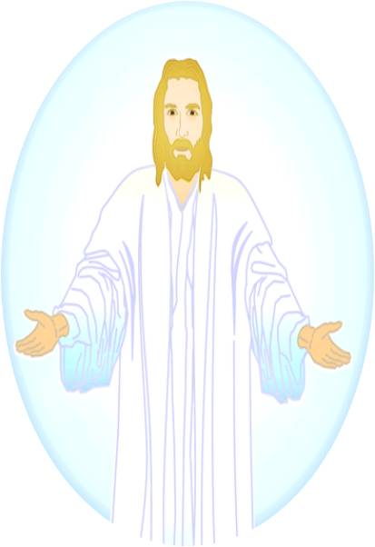
THE LORD
smiley © sherv.net
Jumping heart © www.fg-a.com
There is nothing better than being in Christ!
© GospelGifs.com with permission

Slide 85


17-19. in the Spirit and the Holy Spirit in us, God’s temple.
Thank you, Lord!
“You, however, are not in the flesh but in the Spirit,
if in fact the Spirit of God dwells in you” Rom 8:9
“Do you not know that you are God's temple and that God's Spirit dwells
in you?” 1 Cor 3:16
“Or do you not know that your body is a temple
of the Holy Spirit within you,
whom you have from God?” 1 Cor 6:19
Dove and Bible Microsoft Corp clip art © 2013 .
pulsing heart © clipartbest.com
Jumping heart © www.fg-a.com
NO!
© GospelGifs.com

Slide 86
Because we are sons in the Son, the Spirit loves, fellowships with, and empowers us as he loves, fellowships
with, and empowers
the Son.
Because we are sons, the Spirit of the Son
leads us to love, fellowship with,
and cooperate with
the Holy Spirit
as the Son does.
THE LORD
Father, Son and Spirit oneness
love, fellowship and cooperation
smiley © sherv.net

Slide 87
We thank you, Father, that you put your Spirit in us to make your sons like your Son - to enjoy you completely as your Son does, to want to do your will as your Son does, to join you in your mission to make the good news of Christ known to all nations, and sacrifice anything to finish the work given
to us, as your Son did
in love for you, Abba.
THE LORD
smiley © sherv.net

Slide 88
20-21. in God the Father and God the Father in us!
Thank you, Father!
“To the church of the Thessalonians in God the Father
and the Lord Jesus Christ” 1 Thess 1:1
“If anyone loves me,
he will keep my word,
and my Father
will love him,
and we will come to him
and make our home
with him”
John 14:23
Abba
Abba
pulsing heart © clipartbest.com
Jumping heart © www.fg-a.com
NO!
© GospelGifs.com

Slide 89
20-21. in God the Father and God the Father in us!
Thank you, Father!
“To the church of the Thessalonians in God our Father
and the Lord Jesus Christ” 2 Thess 1:1
“If the Spirit of him
who raised Jesus
from the dead
dwells in you,
. . . his Spirit who dwells in you”
Rom 8:11
Abba
Abba
pulsing heart © clipartbest.com
Jumping heart © www.fg-a.com
NO!
© GospelGifs.com

Slide 90
Because we are sons in the Son, Abba loves, fellowships with, and
is a Father to us as
he loves, fellowships with and is a Father
to his Son.
Because we are sons, the Spirit of the Son
leads us to love, fellowship with,
and cooperate with
the Father as
the Son does.
THE LORD
Father, Son and Spirit oneness
love, fellowship and cooperation
smiley © sherv.net

Slide 91
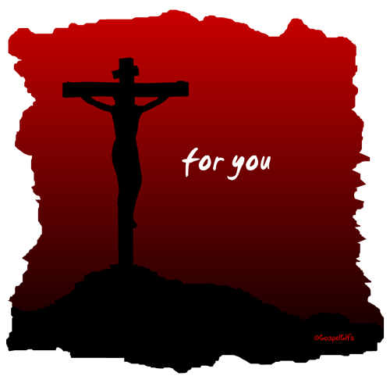
What a privilege! What undeserved favor in Christ!
All because God the Son died for us.
in Christ and Christ in us!
in the Spirit and the Spirit in us!
in the Father and the Father in us!
© GospelGifs.com
used with permission
Complete reconciliation with God!
Thank you, thank you, Lord!
NO!
© GospelGifs.com

Slide 92
Heaven is full of God the Father, Son and Spirit enjoying each other, and God’s people enjoying the LORD!
Life on earth is a bit of heaven as we enjoy
the Father, Son and Spirit as they do!
smiley © sherv.net
Jumping heart © www.fg-a.com
People circle © clipartfest.com

Slide 93

© GospelGifs.com
NO!
22. immersed in the Father, Son and Spirit!
Thank you, Lord!
“Go therefore and make disciples of all nations, baptizing (immersing) them in the name of the Father and of the Son and of the Holy Spirit, teaching them to observe all that I have commanded you.”
Mat 28:19-20
Egyptian smiley © sherv.net
Jumping heart © www.fg-a.com
We are in Christ and Christ is in us.
We are in the Spirit and the Spirit is in us.
We are in the Father and the Father is in us.
We are immersed in Christ in the Spirit in God.
Thank you, Lord!

Slide 94
© GospelGifs.com
Lord, what wisdom in choosing “immersion” to picture two of your great New Testament truths!
NO!
Egyptian smiley © sherv.net
Jumping heart © www.fg-a.com
1. I believe Jesus is
the Messiah who died
for my sins, was buried,
and rose again!
2. I believe God has
immersed me into
Christ and his death
and resurrection.
I died with Christ to sin.
I am raised in Christ to life.
I am immersed and
united with God the
Father, Son and Holy Spirit!
Immersion in the Father, Son and Spirit connects with gifts 32-48: immersed into Christ and united with Christ in death with Christ and resurrection with Christ, old me in Adam crucified and buried with Christ, new me raised and alive with Christ in the Spirit, set free from slavery to sin, under Christ and his grace in the Spirit. Romans 6-8

Slide 95
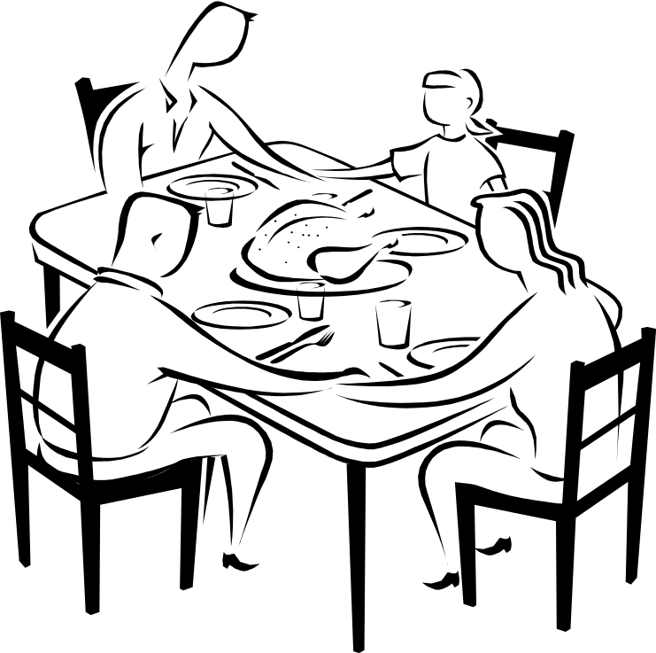
Jesus died to provide full fellowship with God the Father, Son and Spirit. It’s as if we are at the table in their home to share in the personal relationships of love, communion, cooperation and delight they enjoy with each other and want to share with us.
“Our fellowship
is with the
Father and
with his Son
Jesus Christ”
1 John 1:3
Father
“. . . the fellowship
of the Holy Spirit be
with you all”
2 Cor 13:14
Son
Spirit
Microsoft clip art © 2013 Microsoft Corporation.
Jumping heart © www.fg-a.com
heart © clipartbest.com
23. Father, Son and Holy Spirit fellowship with us
and we are in fellowship with them! Thank you, Lord!
NO!
© GospelGifs.com
“called into the fellowship of his Son, Jesus Christ” 1 Cor 1:9

Slide 96
THE LORD
Father, Son and Spirit oneness
love, fellowship, cooperation
smiley © sherv.net
Jumping heart © www.fg-a.com
Do you long to enjoy the relationships of oneness, love, fellowship, and cooperation God the Father, Son and Spirit enjoys within himself and shares with his people now
and far more in glory? Do you want the LORD?

Slide 97
in Christ
in Christ and Christ in us
in the Spirit and the Spirit in us,
making us God’s temple
in God the Father and the Father in us
immersed in the Father, Son and Spirit
Father, Son and Spirit fellowship
with us and we with them
Gifts 15-23
faith
in Christ
Lord, thank you that Christ’s death provides
riches of connection with you, Father, Son and Spirit,
that no one else can give!

Slide 98
Jesus
Mohammed
Confucius
Can anyone else do this for us?
Has anyone else died as God’s once-for-all sacrifice for sin? Is anyone else the infinite
Son of God, our resurrected Messiah and Lord,
who provides in himself all we need in God?
Hindu Gurus
Moses
Buddha

Slide 99
Buddhism says:
Do Do Do
Do Do Do
Do Do.
You Do.
8-fold path
Islam
says:
Do Do Do
Do Do all Allah wants.
You Do.
5 pillars
Hinduism
says:
Do Do Do
Do Do Do
Do Do Do.
You Do.
many paths
Jesus
says:
It is DONE.
I am all you need.
I give, you receive.
I DO 4 U.
Come to me
and drink.
I DO 4 U
More free resources on the grace of God in Christ @ www.GraceGodChrist.com

Slide 100
THE LORD
God’s completely different way
to deepest joy and satisfaction
smiley © sherv.net
Jumping heart © www.fg-a.com
People circle © clipartfest.com
Joy and satisfaction are in Christ, not beauty, music, smart-phones, sports, cars, money, friends, romance, sex, food, drinking parties, homes or jobs! Jesus had supreme joy without sex or money!

Slide 101
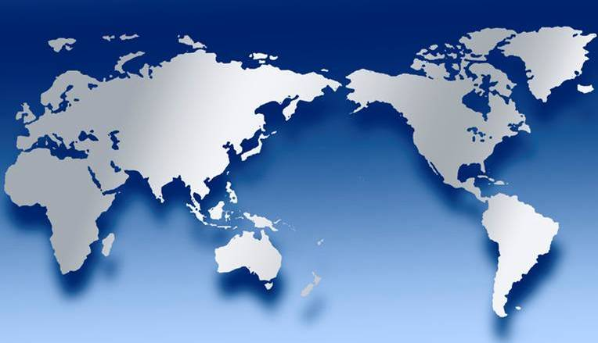
THE LORD
Father, Son and Spirit oneness
love, fellowship, cooperation
smiley © sherv.net
Jumping heart © www.fg-a.com
If we are in Christ, there is another world to live in and enjoy
by faith, the world of God the Father, Son and Spirit!
“They are not of the world, just as I am not of the world” Jn 17:16

Slide 102
I am your ransom
and redemption
I am your forgiveness
from God
I am your
righteousness
from God
justification
I am
your
peace
with God
Find joy and satisfaction in God. Open Christ’s gifts to enjoy the Lord by faith in God’s promises expressed in praise!
Promises - Faith - Praise
I am your
adoption
as God’s
child
I am your
deliverance from darkness
into the kingdom of God’s Son
I am your
hope of glory
I am your
fullness
of blessing
I am your
at-one-ment with the Lord
God’s wrath turned away
I am your fullness
of the Spirit of God
I am your
eternal
life

Slide 103
Highly recommended
Develop the habit of praising the LORD every day for his grace in Christ. Develop a mind and heart that rests in Christ for all.
During your prayer time each of the seven days of the week, praise the Lord through section 1 on Day 1,
section two on Day 2, . . . seven on Day 7!
Monday – Section 1
Tuesday – Section 2
Wednesday – Section 3 Gifts of life at God’s throne
Thursday – Section 4
Friday – Section 5
Saturday – Section 6
Sunday – Section 7

Slide 104
The Grace of God in Christ
100 gifts of delight we receive in the Lord’s gift of Christ crucified
Gifts that are a firm foundation 1-14
Gifts of connection with Father, Son and Spirit 15-23
Gifts of life at God’s throne 24-31
Gifts of being set free from sin 32-48
Gifts of life in the Holy Spirit 48-71
Gifts of being the body of Christ 72-82
Gifts of future glory 83-97
Three great gifts that include all the others 98-100
Use “search” on your smart-phone

Slide 105
in Christ
Gifts 24-31
faith
in Christ
access to God and his grace
answered prayer in Jesus’ name
mercy, grace and help at the throne of grace
every need supplied
the Spirit prays for us, and helps us pray
in the Spirit using God’s word
Christ our High Priest intercedes for us
as the one mediator and ransom for all
Christ our High Priest advocates
his propitiation in our defense
Lord, thank you that Jesus died to give us
riches of gifts that no one else can give!

Slide 106
24. access to God
and his grace
in Christ
in one Spirit!
Praise you, Lord!
Smiley © sherv.net
Jumping heart ©
www.fg-a.com
THE LORD
Photo of sun shining
through curtain
John Crozier
“Jesus . . . yielded up his spirit. . . . the curtain of the
temple was torn in two” Matt 27:50-51
“Through him we have also obtained access by faith
into this grace in which we stand” Rom 5:2
“enter . . . by the blood of Jesus” Heb 10:19
NO!
© GospelGifs.com

Slide 107
24. access to God
and his grace
in Christ
in one Spirit!
Praise you, Lord!
Smiley © sherv.net
Jumping heart ©
www.fg-a.com
THE LORD
Photo of sun shining
through curtain
John Crozier
“For through him we both have access in one Spirit
to the Father” Eph 2:18
“Christ Jesus our Lord, in whom we have boldness and access with confidence through our faith in him”
Eph 3:11-12
NO!
© GospelGifs.com

Slide 108


“I do not speak on my own authority, but the Father who dwells in me does his works . . . whoever believes in me will also do the works that I do . . . Whatever you ask
in my name, this I will do, that the Father may be
glorified in the Son. If you ask me
anything in my name, I will do it”
John 14:10,12-14
25. Answered prayer
in Jesus’ name.
Thank you, Lord!
Praying hands and Bible Microsoft clip art © 2013 Microsoft Corporation.
Jumping heart © www.fg-a.com
“If you abide in me, and my words abide in you, ask whatever you wish, and it will be done for you.
By this my Father is glorified, that you bear much
fruit and so prove to be my disciples” John 15:7-8
NO!
© GospelGifs.com

Slide 109
“You did not choose me, but I chose you and appointed you that you should go and bear fruit and that your fruit
should abide, so that whatever you ask the Father
in my name, he may give it to you”
John 15:16
25. Answered prayer
in Jesus’ name.
Thank you, Lord!
Praying hands and Bible Microsoft clip art © 2013 Microsoft Corporation.
Jumping heart © www.fg-a.com
“Truly, truly, I say to you, whatever you ask of
the Father in my name, he will give it to you.
Until now you have asked nothing in my name.
Ask, and you will receive, that your joy may be full”
John 16:23-24
NO!
© GospelGifs.com

Slide 110
“In that day you will ask in my name, and I do not say
to you that I will ask the Father on your behalf;
for the Father himself loves you, because you
have loved me and have believed
that I came from God”
John 16:26-27
25. Answered prayer
in Jesus’ name.
Thank you, Lord!
Praying hands and Bible Microsoft clip art © 2013 Microsoft Corporation.
Jumping heart © www.fg-a.com
In John 14-16, when we pray in Jesus’ name,
we depend on Christ’s death for access to God,
and we ask what Jesus would ask as we abide in Him
and God’s promises in his Word, that we may
bear much fruit to the Father’s glory.
NO!
© GospelGifs.com

Slide 111
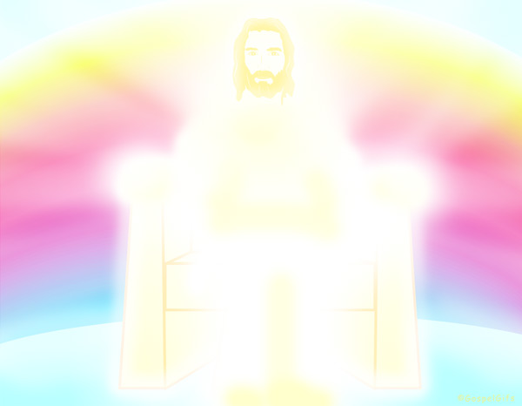
26. Receive grace, mercy and help at the throne of grace!
“For because he himself has suffered when tempted, he is able
to help those who are being tempted. . . .
Let us then with confidence draw near to the throne of grace, that we may receive mercy and find grace to
help in time of need”
Heb 2:18; 4:16
© GospelGifs.com used with permission
NO!
Jumping heart © www.fg-a.com
Thank you, Lord!
Hands Microsoft clip art © 2013 Microsoft Corporation.
© GospelGifs.com

Slide 112
in Christ
27. Every spiritual need supplied
in Christ!
justified in Christ the righteousness of God
ransomed, redeemed Passover Lamb, sin atoned, wrath turned
forgiven peace with God reconciled eternal life adopted sons
welcomed, accepted filled, complete blessed with every blessing
Christ our wisdom from God, righteousness and sanctification and redemption
delivered from the domain of darkness into the light of the kingdom of the beloved Son
in Christ and Christ in us in the Spirit and the Spirit in us, made God’s temple
in God the Father and the Father in us immersed in Father, Son, and Spirit
Father, Son, and Spirit fellowship with us access to God and his grace answered prayer
grace at the throne of grace every need supplied Holy Spirit prays for us, helps us pray
Christ our High Priest intercedes as mediator Christ our High Priest advocates in our defense
immersed into Christ and his death and resurrection united with Christ in death and resurrection
old self crucified and buried with Christ new self raised and alive with Christ
set free from sin instrument for righteousness
under Christ, abundant grace slaves of Christ not sin
joined to Christ one with Christ
seated with Christ hidden with Christ in God
released from law, married to Christ under law of the Spirit
Spirit and God’s love poured out born of the Spirit
given, receive, have Spirit rivers of living water of Spirit
immersed in the Spirit Spirit comes on, falls on us
Spirit power to be ambassadors anointed with the Spirit
sealed with the Spirit guarantee of the Spirit
Spirit of truth helps, teaches Spirit leads
Spirit sanctifies Spirit gifts for service
Spirit fills circumcised, set apart in the Spirit
immeasurably great power God’s workmanship led in triumph and nike victory
members of Christ’s body brothers and sisters branches in Christ’s vine
  chosen race, royal priesthood, holy nation, God’s possession, God’s people
fellow citizens with the saints and members of the household of God
citizenship in heaven hope of glory inheritance, heir, fellow heir
with Christ at death made perfect glorified to be like Jesus
into heavenly kingdom enter joy of Lord delivered from wrath
God’s good work completed resurrection body like Jesus
married to the Lamb every tear wiped away
see God’s face reign forever
loved and saved
in New Covenant
“I can do all things through him who strengthens me . . .
And my God will supply every need
of yours according to
his riches in glory
in Christ Jesus”
Phil 4:13,19
NO!
Hands - Microsoft clip art © 2013 Microsoft Corporation.
Thank you, Lord!
Jumping heart © www.fg-a.com
© GospelGifs.com

Slide 113
THE LORD
Father, Son and Spirit oneness
love, fellowship, cooperation
smiley © sherv.net
Jumping heart © www.fg-a.com
If we are in Christ, there is another world to live in and enjoy
by faith, the world of God the Father, Son and Spirit,
who in Christ meets all our spiritual needs as we trust Him!

Slide 114

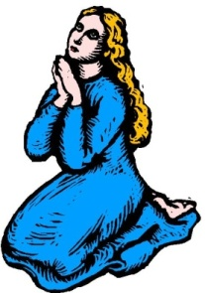
28-29. The Spirit prays for us and helps us pray
in the Spirit using God’s word! Thank you, Lord!
“The Spirit helps us in our weakness. For we do not know what to pray for as we ought, but the Spirit himself intercedes for us . . . the Spirit intercedes for the saints according to the will of God” Rom 8:26-27
The LORD
Dove, Bible, praying woman
Microsoft clip art © 2013
Microsoft Corporation.
Ep 6:17-18
“Take . . . the sword of the Spirit, which is the word of God, praying at all times in the Spirit, with all prayer and supplication . . . with perseverance . . . for all saints”
Eph 6:17-18
(The Spirit helps us use God’s word to pray!)
NO!
© GospelGifs.com

Slide 115
28-29. The Spirit prays for us and helps us pray
in the Spirit using God’s word! Thank you, Lord!
“be filled with the Spirit; Speaking to yourselves in
psalms and hymns and spiritual songs, singing and making melody in your heart to the Lord; Giving thanks always
for all things unto God and the Father in the name of
our Lord Jesus Christ” Eph 5:18-20, KJV
The LORD
Dove, Bible, praying woman
Microsoft clip art © 2013
Microsoft Corporation.
Ep 6:17-18
“But you, beloved, building yourselves up in your most holy faith and praying in the Holy Spirit, keep yourselves in
the love of God, waiting for the mercy of our Lord
Jesus Christ that leads to eternal life” Jude 1:20-21
NO!
© GospelGifs.com

Slide 116
Promises – Faith – Prayer!
The Spirit of God
helps us use
the Word of God
to pray and praise
with faith in God’s faithfulness
to his promises in Christ,
and the power of Christ’s blood
to provide access to God.
Promises – Faith – Praise!
Dove, Bible, praying woman
Microsoft clip art © 2013
Microsoft Corporation.

Slide 117
Are you a believer
who depends on
the Spirit of God
to help you use
the Word of God
to pray and praise?
Do you pray
with faith in God’s faithfulness
to his promises in Christ,
and the power of Christ’s blood
to provide access to God?
Promises – Faith – Prayer!
Dove, Bible, praying woman
Microsoft clip art © 2013
Microsoft Corporation.

Slide 118
30. Christ our High Priest intercedes for us
as the one mediator and ransom for all! Thank you, Lord!
“Who is to condemn? Christ Jesus is the one who died--more than that, who was raised— who is at the right hand of God, who indeed is
interceding for us”
Rom 8:34
Holy LORD
“There is one God,
and there is one
mediator between
God and men,
the man Christ Jesus, who gave himself as a ransom for
all men” 1 Tim 2:5-6
© GospelGifs.com
used with permission
No!
© GospelGifs.com

Slide 119
30. Christ our High Priest intercedes for us
as the one mediator and ransom for all! Thank you, Lord!
“He is able to save to the uttermost those who draw near to God through him, since he always lives to make intercession for them”
Heb 7:25
Holy LORD
“Christ appeared as
a high priest . . . he
entered once for all
into the holy places
. . . by means of his own blood . . .
eternal redemption. . . . he is the
mediator of a new covenant . . .
eternal inheritance” Heb 9:11,12,15
© GospelGifs.com
used with permission
© GospelGifs.com
used with permission
No!
© GospelGifs.com

Slide 120
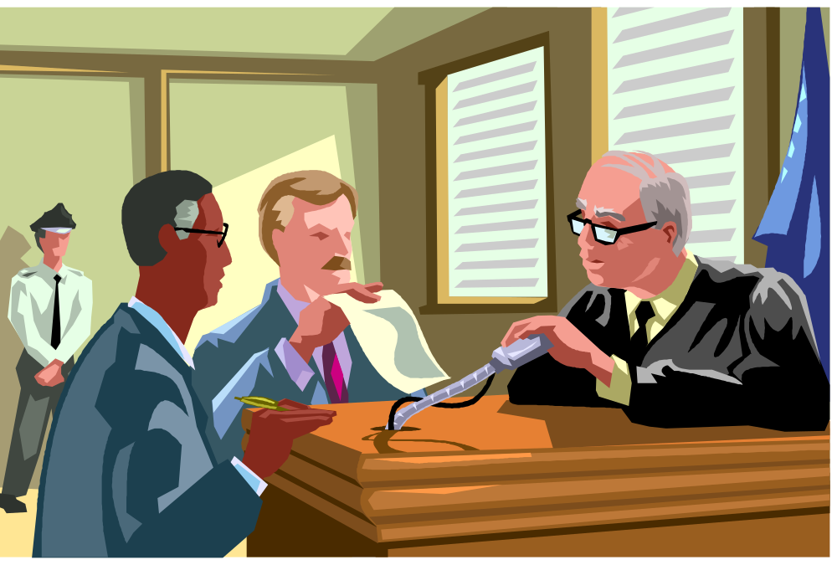
31. Christ our High Priest advocates his propitiation
for our sins in our defense! Praise you, Lord!
Accuser
Advocate
Microsoft clip art © 2013 Microsoft Corporation.
“My little children, I am writing these things to you so that you may not sin. But if anyone does sin, we have an advocate with the Father, Jesus Christ the righteous.
He is the propitiation for our sins, and not for ours only
but also for the sins of the whole world” 1 John 2:1-2
NO!
© GospelGifs.com

Slide 121
31. Christ our High Priest advocates his propitiation
for our sins in our defense! Praise you, Lord!
Accuser
Advocate
Microsoft clip art © 2013 Microsoft Corporation.
“Therefore he had to be made like his brothers in every respect, so that he might become a merciful and faithful high priest in the service of God, to make propitiation for the sins of the people. For because he himself has suffered when tempted, he is able to help those
who are being tempted.” Heb 2:17-18
NO!
© GospelGifs.com

Slide 122
Jesus
Mohammed
Confucius
Can anyone else give us these gifts?
Has anyone else died as God’s once-for-all sacrifice for sin? Is anyone else the infinite
Son of God, our resurrected Messiah and Lord,
who provides in himself all we need in God?
Hindu Gurus
Moses
Buddha

Slide 123
Buddhism says:
Do Do Do
Do Do Do
Do Do.
You Do.
8-fold path
Islam
says:
Do Do Do
Do Do all Allah wants.
You Do.
5 pillars
Hinduism
says:
Do Do Do
Do Do Do
Do Do Do.
You Do.
many paths
Jesus
says:
It is DONE.
I am all you need.
I give, you receive.
I DO 4 U.
Come to me
and drink.
I DO 4 U
More free resources on the grace of God in Christ @ www.GraceGodChrist.com

Slide 124
justified in Christ the righteousness of God
ransomed, redeemed Passover Lamb, sin atoned, wrath turned
forgiven peace with God reconciled eternal life adopted sons
welcomed, accepted filled, complete blessed with every blessing
Christ our wisdom from God, righteousness and sanctification and redemption
delivered from the domain of darkness into the light of the kingdom of the beloved Son
in Christ and Christ in us in the Spirit and the Spirit in us, made God’s temple
in God the Father and the Father in us immersed in the Father, Son, and Spirit
Father, Son, and Spirit fellowship with us access to God and his grace
answered prayer grace at the throne of grace
every need supplied Holy Spirit prays for us, helps us pray
Christ our H.P. intercedes as our mediator Christ our H.P. advocates in our defense
immersed in Christ and his death and res. united with Christ in his death and res.
old self crucified and buried with Christ new self raised and alive with Christ
set free from sin instrument for righteousness
under Christ, abundant grace slaves of Christ not sin
joined to Christ one with Christ
seated with Christ hidden with Christ in God
released from law, married to Christ under law of the Spirit
Spirit and God’s love poured out born of the Spirit
given, receive, have Spirit rivers of living water of Spirit
immersed in the Spirit Spirit comes on, falls on us
Spirit power to be ambassadors anointed with the Spirit
sealed with the Spirit guarantee of the Spirit
Spirit of truth helps, teaches Spirit leads
Spirit sanctifies Spirit gifts for service
Spirit fills circumcised, set apart in the Spirit
immeasurably great power God’s workmanship
led in triumph and nike victory members of Christ’s body
brothers and sisters branches in Christ’s vine
  chosen race, royal priesthood, holy nation God’s possession, God’s people
fellow citizens with the saints members of the household of God
citizenship in heaven hope of glory inheritance, heir, fellow heir
with Christ at death made perfect glorified to be like Jesus
into heavenly kingdom enter joy of Lord delivered from wrath
God’s good work completed resurrection body like Jesus married to the Lamb
every tear wiped away see God’s face reign forever
loved and saved in the New Covenant
Receive me - receive all I am through my cross
I DO 4 U
Jesus © GospelGifs.com
Pulsing heart @clipartbest.com

Slide 125
in Christ
Gifts 24-31
faith
in Christ
access to God and his grace
answered prayer in Jesus’ name
mercy, grace and help at the throne of grace
every need supplied
the Spirit prays for us, and helps us pray
in the Spirit using God’s word
Christ our High Priest intercedes for us
as the one mediator and ransom for all
Christ our High Priest advocates
his propitiation in our defense
Lord, thank you that Jesus died to give us
riches of gifts that no one else can give!

Slide 126
THE LORD
God’s completely different way
to deepest joy and satisfaction
smiley © sherv.net
Jumping heart © www.fg-a.com
People circle © clipartfest.com
Joy and satisfaction are in Christ, not beauty, music, smart-phones, sports, cars, money, friends, romance, sex, food, drinking parties, homes or jobs! Jesus had supreme joy without sex or money!

Slide 127
I am your ransom
and redemption
I am your forgiveness
from God
I am your
righteousness
from God
justification
I am
your
peace
with God
Find joy and satisfaction in God. Open Christ’s gifts to enjoy the Lord by faith in God’s promises expressed in praise!
Promises - Faith - Praise
I am your
adoption
as God’s
child
I am your
deliverance from darkness
into the kingdom of God’s Son
I am your
hope of glory
I am your
fullness
of blessing
I am your
at-one-ment with the Lord
God’s wrath turned away
I am your fullness
of the Spirit of God
I am your
eternal
life

Slide 128
Why did Jesus have the greatest joy of anyone?
Jesus had and sought none of the joys of the world like a nice home and money, but he was the happiest person ever on earth because more than all others, he had the greatest joy in God.
When we stop seeking joy in earthly, temporary things, to seek joy in the eternal God who’s better than all else, we will find joy and satisfaction in Christ that is different and better than joy in anything else.
Jesus died “that my joy may be in you, and that your joy may be full. . . . that they may have my joy fulfilled in themselves” (John 15:11; 17:13).
From “Know Your God,” John’s eBook on God’s attributes, page 52, and
“The Grace of God in Christ,” page 129, both at www.GraceGodChrist.com

Slide 129
Highly recommended
Develop the habit of praising the LORD every day for his grace in Christ. Develop a mind and heart that rests in Christ for all.
During your prayer time each of the seven days of the week, praise the Lord through section 1 on Day 1,
section two on Day 2, . . . seven on Day 7!
Monday – Section 1
Tuesday – Section 2
Wednesday – Section 3
Thursday – Section 4 Gifts of being set free from sin
Friday – Section 5
Saturday – Section 6
Sunday – Section 7

Slide 130
The Grace of God in Christ
100 gifts of delight we receive in the Lord’s gift of Christ crucified
Gifts that are a firm foundation 1-14
Gifts of connection with Father, Son and Spirit 15-23
Gifts of life at God’s throne 24-31
Gifts of being set free from sin 32-48
Gifts of life in the Holy Spirit 48-71
Gifts of being the body of Christ 72-82
Gifts of future glory 83-97
Three great gifts that include all the others 98-100
Use “search” on your smart-phone

Slide 131
Note how almost
all these are in
Romans 6-8
faith
in Christ
immersed into Christ
in death with Christ
and resurrection with Christ
united with Christ in death with Christ
and resurrection with Christ
old self in Adam crucified and buried with Christ
new self in Christ raised and alive with Christ
set free from sin
body members instruments for righteousness under Christ and his abundant grace
slaves to Christ and righteousness, not sin
joined to Christ one with Christ seated with Christ hidden with Christ in God
released from the law to marry Christ
under the law of the Spirit
of life in Christ
Gifts 32-48
Lord, thank you that Jesus died to give us
riches of gifts that set us free from sin!

Slide 132
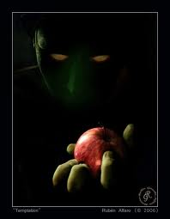
The gifts of grace in Christ
God provides to overcome temptation.

Slide 133


“Do you not know that all of us who have been baptized (immersed) into Christ Jesus were baptized (immersed)
into his death? We were buried therefore
with him by baptism (immersion) into
death, in order that, just as Christ was
raised from the dead by the glory of
the Father, we too might walk in
newness of life”
Rom 6:3-4 (parentheses added,
see also Gal 3:27)
© Yoon Nam Sun
Dove and Bible
Microsoft clip art © 2013
NO!
32. immersed into Christ in death with Christ and resurrection with Christ. Thank you, Lord!
© GospelGifs.com

Slide 134
“For if we have been united with him in a death like his, we shall certainly be united with him in a resurrection
like his” Rom 6:5
“Now if we have died with Christ, we believe
that we will also live with him” Rom 6:8
© Yoon Nam Sun
Dove and Bible
Microsoft clip art © 2013
NO!
33. united with Christ in death with Christ
and resurrection with Christ. Praise you, Lord!
© GospelGifs.com

Slide 135
Immersed and united with Christ
in death and resurrection with Christ
Romans 6
new self raised +
alive with Christ
Faith in Christ crucified
Dead to sin, freed from sin as Master
Under Christ’s authority and grace in the Spirit
without Christ, sin reigns as Master
old self in Adam crucified +
buried with Christ
© Yoon Nam Sun
Dove and Bible
Microsoft clip art © 2013
Walking with Christ in the Spirit
in agape love, fellowship and submission,
enjoying the LORD as our supreme treasure

Slide 136
© Yoon Nam Sun
Dove and Bible
Microsoft clip art © 2013
Has anyone else died for you to set you free
from enslavement to SIN, the cruel master of all sinners?

Slide 137
We were buried therefore with him . . . into death . . . our old self was crucified with him . . . For one who
has died has been set free from sin. Now if
we have died with Christ . . .” Rom 6:4,6,8
Also Gal 2:20; Eph 4:21-22;
Col 2:12; 3:3,9
In Adam Rom 5:12,19
old self in Adam crucified +
buried with Christ
© Yoon Nam Sun
Dove and Bible
Microsoft clip art © 2013
NO!
34-35. old self in Adam crucified and buried with Christ in death with Christ. Praise you, Lord!
© GospelGifs.com

Slide 138
“just as Christ was raised . . . we too might walk in newness of life . . .
we shall certainly be united with him in a resurrection like his. . . .
we will also live with him. . . . he lives to God . . . consider yourselves dead to sin and alive to God in Christ Jesus”
Rom 6:4,5,8,10,11
new self raised +
alive with Christ
Also Eph 2:4-7; 4:22-24;
Col 2:12; 3:1-4; 9-11; 2 Cor 5:17
© Yoon Nam Sun
Dove and Bible
Microsoft clip art © 2013
NO!
36-37. new self in Christ raised and alive with Christ in resurrection with Christ. Thank you, Lord!
© GospelGifs.com

Slide 139
© Yoon Nam Sun
Dove and Bible
Microsoft clip art © 2013
Our new self in Christ is raised with Christ from death in sin, alive with Christ to walk in newness
of life, alive to God in Christ. Thank you, Lord!

Slide 140
© Yoon Nam Sun
Dove and Bible
Microsoft clip art © 2013
Future resurrection with Christ includes being with Christ at death #86, and receiving a resurrection body at Christ’s return #93. Thank you, Lord!

Slide 141
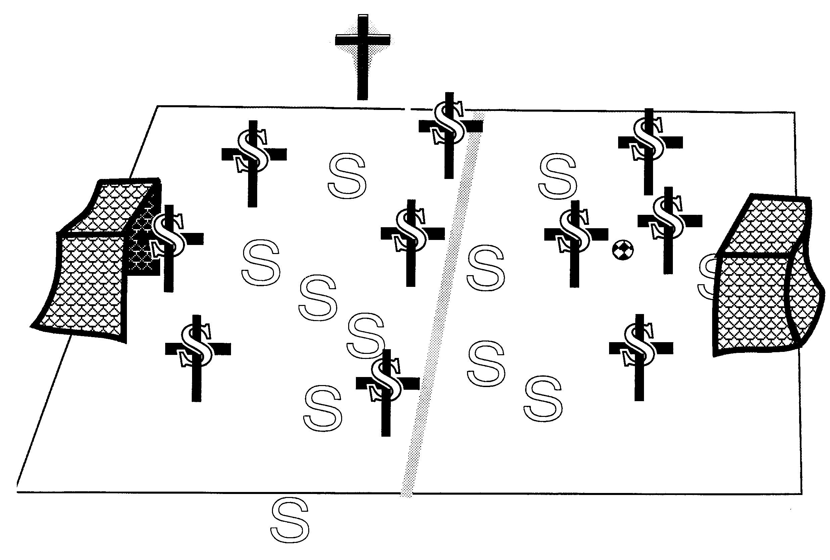

38. Set free from slavery to sin! Praise you, Lord!
Christ is the coach of the crucified-and-raised-with-Christ team
© GospelGifs.com
soccer teams by Kim Graham
our old coach Sin no longer has authority to rule us
“Consider yourselves dead to sin and alive to God
in Christ Jesus” Rom 6:11
“one who has died has been set free from sin . . . set free from sin . . . set free from sin” Rom 6:7, 18, 22

Slide 142
Christ is the coach of the crucified-and-raised-with-Christ team
© GospelGifs.com
soccer teams by Kim Graham
our old coach Sin no longer has authority to rule us
When the old coach yells at you to kick the ball in your own net, who should you listen to? Whose team are you now on? Whose authority are you now under?
Who is in you to empower you to win not lose?

Slide 143
In Romans 6, note the different descriptions of being set free from sin
we died to sin (2)
walk in newness of life (4)
old self crucified, body of sin brought to nothing
= sin no longer reigns over body members (6,12-13)
no longer enslaved to sin (6)
we died . . . set free from sin (7)
we have died with Christ (8)
we are dead to sin and alive to God (11)
sin has no dominion over us (14)
© Yoon Nam Sun
Dove and Bible
Microsoft clip art © 2013
we were once slaves of sin (17)
we have been set free from sin (18)
we have been set free from sin (22)
NO!
© GospelGifs.com

Slide 144
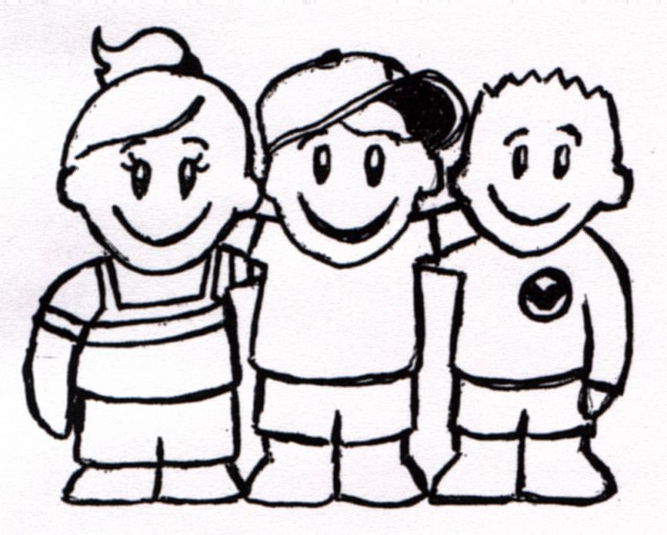
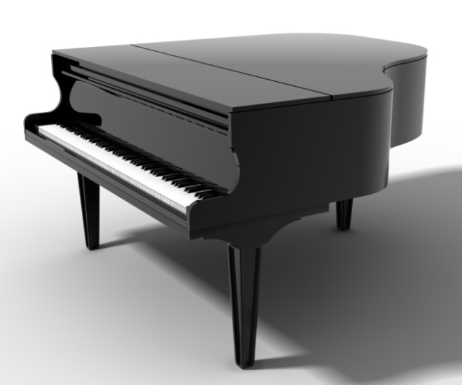
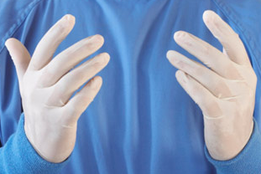
johncrozieris@gmail.com
39. body members now instruments for righteousness.
Thank you, Lord!
Microsoft clip art © 2013
Microsoft Corporation.
instruments for
love and witness
instruments for
worship and prayer
Microsoft clip art © 2013
Microsoft Corporation.
instruments like gloves
on his hand
“Present yourselves to God as those who have been brought from death to life, and your members to
God as instruments for righteousness” Rom 6:13
NO!
© GospelGifs.com

Slide 145


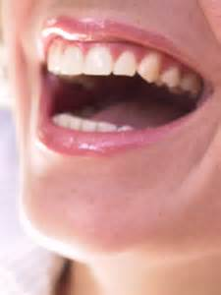
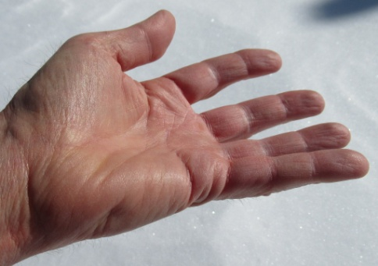
Present your eyes and mind to God to be used for God’s Word,
not pornography or lust!
Do not give your eyes and mind
to sin as instruments for evil!
freeclipart.com
Microsoft clip art © 2013
Microsoft Corporation.
bing images
Yield your mouth and hands to serve others, to help, encourage and give to others, not hurt or take from others.
Microsoft clip art © 2013
Microsoft Corporation.
hand by John Crozier
“Do not present your members to sin as instruments for unrighteousness, but present . . . your members to God
as instruments for righteousness” Rom 6:13

Slide 146
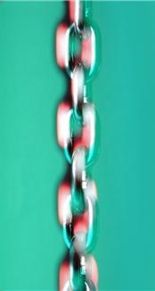
SIN
40. under Christ and
his abundant grace,
not under sin and law.
Thank you, Lord!
GRACE
© GospelGifs.com
used with permission
abundant
Microsoft clip art © 2013
Microsoft Corporation.
in
Adam
in
Christ
© GospelGifs.com
used with permission
“For sin shall no longer be your master, because you
are not under the law, but under grace” Rom 6:14
“abundance of grace” Rom 5:17

Slide 147
41. under Christ
as a slave of Christ
and God to obedience and righteousness,
not a slave of sin.
Thank you, Lord!
SIN
GRACE
© GospelGifs.com
used with permission
abundant
Microsoft clip art © 2013
Microsoft Corporation.
in
Adam
in
Christ
© GospelGifs.com
used with permission
“present yourselves . . . as obedient slaves . . . of obedience . . .
and having been set free from sin, have become slaves of righteousness. . . . present your members as slaves to righteousness leading to sanctification. . . . slaves of God” Rom 6:16,18,19,22

Slide 148
41. under Christ
as a slave of Christ
and God to obedience and righteousness,
not a slave of sin.
Thank you, Lord!
SIN
GRACE
© GospelGifs.com
used with permission
abundant
Microsoft clip art © 2013
Microsoft Corporation.
in
Adam
in
Christ
© GospelGifs.com
used with permission
“If I were still trying to please man, I would not be a servant (slave) of Christ” Gal 1:10 (in days of slavery, translators substituted “servant” for “slave”)
“Epaphras . . . a servant (slave) of Christ Jesus” Col 4:12
“Jude, a servant (slave) of Jesus Christ and brother of James” Jude 1

Slide 149
41. under Christ
as a slave of Christ
and God to obedience and righteousness,
not a slave of sin.
Thank you, Lord!
SIN
GRACE
© GospelGifs.com
used with permission
abundant
Microsoft clip art © 2013
Microsoft Corporation.
in
Adam
in
Christ
© GospelGifs.com
used with permission
Many early Christians were Roman slaves. Roman masters provided food, clothes, lodging and protection as slaves served as directed. Being a slave of the supremely good Messiah King rather than a slave to Satan and sin was very positive! Christ provided all, and their only concern in life was to do as directed, as they awaited the King’s return.

Slide 150

THE LORD
Me! Me! Me!
smiley © sherv.net
jumping heart © www.fg-a.com
angry smiley © sherv.net
“Are we to continue in sin that grace may abound?”
Rm 6:1
“Are we to sin because we are not under law
but under grace?” Rm 6:15

Slide 151
42-45. joined to Christ,
one with Christ,
seated with Christ,
hidden with Christ in God!
Thank you, Lord!
“But he who is joined to the Lord becomes one spirit with him” 1 Cor 6:17
“The two shall become one”
Eph 5:31
“But God . . . raised us up with him and seated us with him in the heavenly places
in Christ” Eph 2:4,6
“For you have died, and
your life is hidden with Christ in God” Col 3:3
These are not in Romans
but are similar to immersed
and united with Christ!
NO!
smiley © sherv.net
© GospelGifs.com

Slide 152
42-45. joined to Christ,
one with Christ,
seated with Christ,
hidden with Christ in God!
Thank you, Lord!
Do you keep in step with
the Lord Jesus?
Do you want to walk together with him in his ways of holiness and
agape love serving others
to the glory of Abba?
Isn’t that the result he intends for those joined to Christ by faith,
one with Christ,
seated with Christ, and
hidden with Christ in God?
Or are you like this guy?
NO!
smiley © sherv.net
© GospelGifs.com

Slide 153


46-47. released from the law to marry Christ in the Spirit! Yes, Lord!
L
A
W
JESUS
© GospelGifs.com
used with permission
Crown, dove, Bible
Microsoft clip art © 2013 Microsoft Corporation.
“You also have died to the law through the body of Christ, so that you may belong to another, to him who has been raised from the dead, in order that we may bear fruit for God . . . we are released from the law . . .
we serve in the new way of the Spirit” Rom 7:4,6
(In 7:4, the verb ginomai translated “belong to” refers to being married, as in 7:2,3)

Slide 154
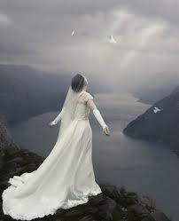
Smiley © sherv.net
Jumping heart ©
www.fg-a.com
I give all of myself to you as you gave and now give all of yourself to me!
many copies
on internet,
original unknown. This is from Kootation.com.
Lord, without Christ I am under the law and captive to a horribly abusive master, sin, but in Christ crucified and reigning I have died to the law through the body of Christ sacrificed for me, so that I may belong to Christ as his bride and bear fruit for you. I’m released from the law to serve you in the new way of the Spirit of life in Christ.

Slide 155
48. The law of the Spirit of life sets us free in Christ Jesus
from the law of sin and death! Yes, Lord!
Christ is the coach of the crucified-and-raised-with-Christ team
© GospelGifs.com
Dove and Bible Microsoft clip art © 2013
Microsoft Corporation.
soccer teams by Kim Graham
our old coach Sin no longer has authority to rule us
“Consider yourselves dead to sin and alive to God
in Christ Jesus” Rom 6:11
“For the law of the Spirit of life has set you free in Christ Jesus from the law of sin and death” Rom 8:2

Slide 156
Christ is the coach of the crucified-and-raised-with-Christ team
© GospelGifs.com
Dove and Bible Microsoft clip art © 2013
Microsoft Corporation.
soccer teams by Kim Graham
our old coach Sin no longer has authority to rule us
When the old coach yells at you to kick the ball in your own net, who should you listen to? Whose team are you now on? Whose authority are you now under?
Who is in you to empower you to win not lose?

Slide 157
me
Dove and Bible
Microsoft clip art © 2013
Microsoft Corporation.
In summary from Romans 6-8,
to overcome temptation:
Consider, Count yourselves dead to sin
and alive to God in Christ 6:11
Don’t let sin reign in you 6:12
Don’t present your members to sin as
instruments for unrighteousness 6:13
Present yourselves and your members to God as
instruments for righteousness 6:13,16,19,22
Walk in the Spirit not the flesh 8:4
Set your mind on the Spirit not the flesh 8:5
By the Spirit kill sinful temptations 8:13
Set your mind on the Spirit not the flesh 8:5
By the Spirit kill sinful temptations 8:13

Slide 158
Consider, Count 6:11. This is true!
Lord, I am counting as true what you say!
I am dead to sin and alive to God
in Christ Jesus! 6:11
I have been immersed and united with Christ and his death and resurrection! 3-5
Dove and Bible
Microsoft clip art © 2013
Microsoft Corporation.
My old self is crucified and buried with Christ! 6
I am
crucified with
Christ
I am no longer enslaved to sin! 6
I am set free from sin! 7
I am raised and alive with Christ! 4,5,8,11
I died to sin and I live for God! 10
I’ve been brought from death to life! 13
My body members are for righteousness! 13
Sin no longer has dominion over me! 14
I am not a slave to sin, under the law! 14
I am under Christ and his grace! 14

Slide 159
In summary from Romans 6-8,
to overcome temptation:
Consider, Count 6:11
Don’t let sin reign 6:12
Don’t present 6:13
Present 6:13,16,19,22
Walk 8:4
Set your mind on 8:5
Kill 8:13
Dove and Bible
Microsoft clip art © 2013
Microsoft Corporation.
I am
crucified with
Christ
Thank you that Christ has done his part
and Christ and the Spirit will do their part
as we do our part!
The four verbs from Romans 6 are commands. The three from
Romans 8 are not written as imperatives, but it is helpful to apply them as commands!

Slide 160
Thank you for making clear in Romans 6-8 our part in overcoming temptation:
________, _______ 6:11
Don’t let ____ ______ 6:12
Don’t _______ 6:13
_______ 6:13,16,19,22
_____ 8:4
____ your _____ on 8:5
_____ 8:13
Dove and Bible
Microsoft clip art © 2013
Microsoft Corporation.
I am
crucified with
Christ
Thank you that Christ has done his part
and Christ and the Spirit will do their part
as we do our part!
The four verbs from Romans 6 are commands. The three from
Romans 8 are not written as imperatives, but it is helpful to apply them as commands!

Slide 161
“Are we to continue in sin that grace may abound?”
Rm 6:1
“I love
You first
Father”
heart © clipartbest.com
original author of picture unknown
“Are we to sin because we are not under law
but under grace?” Rm 6:15

Slide 162
To overcome temptation, note how principles from Romans 6-8 (Gifts 32-48) work together with life in the Spirit (Gifts 48-71).
We die with Christ in order to live with Christ in the Spirit, freed from sin.
Note in particular how the following gifts of life in the Spirit contribute to being set free from sin.
62. The Holy Spirit is constantly teaching us God’s word as part of setting us free from sin.
63-64. The Holy Spirit is always leading us and sanctifying us to walk with Christ and not sin.
66. The Spirit fills us to do the Lord’s will, not sin.
67. We are circumcised by Christ to live in the
Spirit and not live in the flesh and sin.
70-71. The Lord leads us in victory over sin.

Slide 163
Note how almost
all these are in
Romans 6-8
faith
in Christ
immersed into Christ
in death with Christ
and resurrection with Christ
united with Christ in death with Christ
and resurrection with Christ
old self in Adam crucified and buried with Christ
new self in Christ raised and alive with Christ
set free from sin
body members instruments for righteousness under Christ and his abundant grace
slaves to Christ and righteousness, not sin
joined to Christ one with Christ seated with Christ hidden with Christ in God
released from the law to marry Christ
under the law of the Spirit
of life in Christ
Gifts 32-48
Lord, thank you that Jesus died to give us
your gifts of grace that set us free from sin!

Slide 164
Jesus
Mohammed
Confucius
Can anyone else give us these gifts?
Has anyone else died as God’s once-for-all sacrifice for sin? Is anyone else the infinite
Son of God, our resurrected Messiah and Lord,
who provides in himself all we need in God?
Hindu Gurus
Moses
Buddha

Slide 165
Buddhism says:
Do Do Do
Do Do Do
Do Do.
You Do.
8-fold path
Islam
says:
Do Do Do
Do Do all Allah wants.
You Do.
5 pillars
Hinduism
says:
Do Do Do
Do Do Do
Do Do Do.
You Do.
many paths
Jesus
says:
It is DONE.
I am all you need.
I give, you receive.
I DO 4 U.
Come to me
and drink.
I DO 4 U
More free resources on the grace of God in Christ @ www.GraceGodChrist.com

Slide 166
THE LORD
God’s completely different way
to deepest joy and satisfaction
smiley © sherv.net
Jumping heart © www.fg-a.com
People circle © clipartfest.com
Joy and satisfaction are in Christ, not beauty, music, smart-phones, sports, cars, money, friends, romance, sex, food, drinking parties, homes or jobs! Jesus had supreme joy without sex or money!

Slide 167
justified in Christ the righteousness of God
ransomed, redeemed Passover Lamb, sin atoned, wrath turned
forgiven peace with God reconciled eternal life adopted sons
welcomed, accepted filled, complete blessed with every blessing
Christ our wisdom from God, righteousness and sanctification and redemption
delivered from the domain of darkness into the light of the kingdom of the beloved Son
in Christ and Christ in us in the Spirit and the Spirit in us, made God’s temple
in God the Father and the Father in us immersed in the Father, Son, and Spirit
Father, Son, and Spirit fellowship with us access to God and his grace
answered prayer grace at the throne of grace
every need supplied Holy Spirit prays for us, helps us pray
Christ our H.P. intercedes as our mediator Christ our H.P. advocates in our defense
immersed in Christ and his death and res. united with Christ in his death and res.
old self crucified and buried with Christ new self raised and alive with Christ
set free from sin instrument for righteousness
under Christ, abundant grace slaves of Christ not sin
joined to Christ one with Christ
seated with Christ hidden with Christ in God
released from law, married to Christ under law of the Spirit
Spirit and God’s love poured out born of the Spirit
given, receive, have Spirit rivers of living water of Spirit
immersed in the Spirit Spirit comes on, falls on us
Spirit power to be ambassadors anointed with the Spirit
sealed with the Spirit guarantee of the Spirit
Spirit of truth helps, teaches Spirit leads
Spirit sanctifies Spirit gifts for service
Spirit fills circumcised, set apart in the Spirit
immeasurably great power God’s workmanship
led in triumph and nike victory members of Christ’s body
brothers and sisters branches in Christ’s vine
  chosen race, royal priesthood, holy nation God’s possession, God’s people
fellow citizens with the saints members of the household of God
citizenship in heaven hope of glory inheritance, heir, fellow heir
with Christ at death made perfect glorified to be like Jesus
into heavenly kingdom enter joy of Lord delivered from wrath
God’s good work completed resurrection body like Jesus married to the Lamb
every tear wiped away see God’s face reign forever
loved and saved in the New Covenant
Receive me - receive all I provide through my blood
I DO 4 U
Jesus © GospelGifs.com
Pulsing heart @clipartbest.com

Slide 168
Spirit
gifted
glory with Christ
reign
forever
see his face
resurrection
Spirit
fills
sanctified
seated with Christ
Christ
intercedes
in the
Spirit
Christ’s
power
Spirit
anoints
crucified
with Christ
accepted
adopted
Bride of
Christ
Christ’s
body
access
eternal
life
Spirit seals
victory
fullness
kingdom of
Christ
Christ
in us
raised with Christ
alive
in Christ
hidden with Christ in God
immersed
into Christ
every
blessing
peace
New
Covenant
led by
the Spirit
hope
of
glory
set free
from sin
atonement
of Christ
one with
Christ
born of the Spirit
loved
forgiven
reconciled
Christ’s ransom
Christ’s righteousness
Spirit
poured out
saved
When Christ rose,
it’s as if his cross became a tree of life
with many fruits to joyfully eat by faith.
Come to me and eat.
rooted in the blood of Jesus Christ, the Son of God

Slide 169
Spirit
gifted
glory with Christ
reign
forever
see his face
resurrection
Spirit
fills
sanctified
Christ
intercedes
seated with Christ
in the Spirit
Christ’s
power
Spirit
anoints
crucified
with Christ
accepted
adopted
Bride of
Christ
Christ’s
body
access
eternal
life
Spirit seals
victory
fullness
kingdom of
Christ
hope
of
glory
raised with Christ
alive
in Christ
Christ
in us
every
blessing
immersed
into Christ
peace
New
Covenant
atonement
of Christ
one with
Christ
led by
the Spirit
set free
from sin
saved
born of
the Spirit
hidden with Christ in God
forgiven
loved
Spirit
poured out
reconciled
Christ’s ransom
Christ’s righteousness
When Christ rose,
it’s as if his cross became a fountain
of life-giving water to joyfully drink by faith.
Come to me and drink.
a fountain flowing from the blood of Jesus Christ, God’s Son

Slide 170
I am your ransom
and redemption
I am your forgiveness
from God
I am your
righteousness
from God
justification
I am
your
peace
with God
Find joy and satisfaction in God. Open Christ’s gifts to enjoy the Lord by faith in God’s promises expressed in praise!
Promises - Faith - Praise
I am your
adoption
as God’s
child
I am your
deliverance from darkness
into the kingdom of God’s Son
I am your
hope of glory
I am your
fullness
of blessing
I am your
at-one-ment with the Lord
God’s wrath turned away
I am your fullness
of the Spirit of God
I am your
eternal
life

Slide 171
Highly recommended
Develop the habit of praising the LORD every day for his grace in Christ. Develop a mind and heart that rests in Christ for all.
During your prayer time each of the seven days of the week, praise the Lord through section 1 on Day 1,
section two on Day 2, . . . seven on Day 7!
Monday – Section 1
Tuesday – Section 2
Wednesday – Section 3
Thursday – Section 4
Friday – Section 5 Gifts of life in the Holy Spirit
Saturday – Section 6
Sunday – Section 7

Slide 172
The Grace of God in Christ
100 gifts of delight we receive in the Lord’s gift of Christ crucified
Gifts that are a firm foundation 1-14
Gifts of connection with Father, Son and Spirit 15-23
Gifts of life at God’s throne 24-31
Gifts of being set free from sin 32-48
Gifts of life in the Holy Spirit 48-71
Gifts of being the body of Christ 72-82
Gifts of future glory 83-97
Three great gifts that include all the others 98-100
Use “search” on your smart-phone

Slide 173
the law of the Spirit sets free the Spirit and God’s love is poured in born of the Spirit, born of God given, receive, have the gift of the Spirit rivers of life in the Spirit satisfy thirsty hearts immersed in the Spirit the Spirit comes on us, falls on us power of the Spirit to be ambassadors of Christ anointed and sealed with the Spirit of guarantee the Spirit of truth helps and teaches us God’s word the Spirit leads and sanctifies, producing holy fruit the Spirit gifts us for service to others the Spirit fills us to do the Lord’s will circumcised, set apart in the Spirit immeasurably great power of the Spirit
God’s workmanship led in triumph and nike victory
in Christ
Gifts 48-71
faith
in Christ
Thank you
for the
grace
of the
Holy
Spirit
given
through
Christ’s
death!
so we walk in Christ in the Spirit in agape love

Slide 174
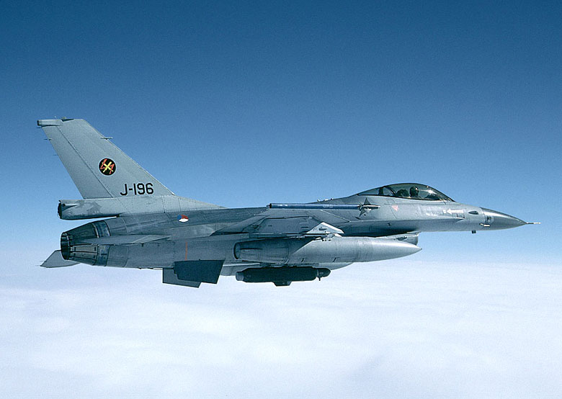
Life in the Spirit:
like the law of aerodynamics overcomes the law of gravity, the law of the Spirit of life in Christ
sets us free from the law of sin
F 16 from raahistory.com

Slide 175
48. the law of the Spirit of life sets us free in Christ Jesus
from the law of sin and death! Yes, Lord!
Christ is the coach of the crucified-and-raised-with-Christ team
© GospelGifs.com
Dove and Bible Microsoft clip art © 2013
Microsoft Corporation.
soccer teams by Kim Graham
our old coach Sin no longer has authority to rule us
“Consider yourselves dead to sin and alive to God
in Christ Jesus” Rom 6:11
“For the law of the Spirit of life has set you free in Christ Jesus from the law of sin and death” Rom 8:2

Slide 176
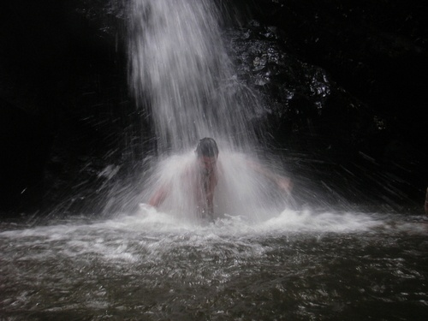
49. the Spirit is poured into
our hearts.
Praise you, Lord!
“And in the last days it shall be,
God declares,
that I will pour out my Spirit on all flesh, . . .
I will pour out my Spirit, and they shall prophesy”
Acts 2:17-18
Dove and Bible
Microsoft clip art © 2013
Microsoft Corporation.
Pariah Springs Trinidad and Tobago
Eco Adventure Tours
heart © clipartbest.com
Prophesy = saying what the Lord says (Ezek 34:2; 35:2-3).
In Acts, New Testament prophecy focuses on
witnessing about Jesus (Acts 1:8), preaching
the word of Christ crucified and risen (Acts 8:4).
NO!
© GospelGifs.com

Slide 177
50. God's love is poured into our hearts through
the Holy Spirit!
Thank you, Lord!
“God's love has been poured into our hearts through the Holy Spirit,
who has been given to us. ... Christ died for us ... justified by his blood ... reconciled … saved by his life”
Rom 5:5-10
Dove and Bible
Microsoft clip art © 2013
Microsoft Corporation.
You first
Lord
Pariah Springs Trinidad and Tobago
Eco Adventure Tours
heart © clipartbest.com
In Romans 5:5-11, God’s love poured into our hearts is the love of
Christ dying for us so we are justified and reconciled to God,
and Christ living for us so we are given the Spirit of agape
and much more saved from the wrath of God !
NO!
© GospelGifs.com

Slide 178
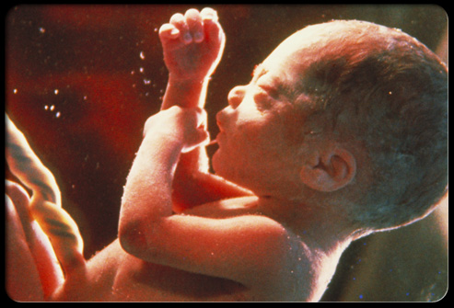

51. born of the Spirit,
born of God.
All praise, Lord!
“For everyone who has been born of God overcomes the world”
1 John 5:4
Dove and Bible
Microsoft clip art © 2013
Microsoft Corporation.
baby
various copies on internet,
original source unknown
“Truly, truly, I say to you, unless one is born of water
and the Spirit, he cannot enter
the kingdom of God” John 3:5
NO!
© GospelGifs.com

Slide 179


52-54. given the Spirit,
receive the gift
of the Holy Spirit,
have the Spirit.
I believe you Lord!
JESUS
CHRIST
psdgraphics.com in kidclipart.com
Jumping heart ©
www.fg-a.com
Dove and Bible Microsoft clip art © 2013 Microsoft Corp
“the Holy Spirit who has been given to us” Rom 5:5
“Repent and be baptized every one of you in the name
of Jesus Christ for the forgiveness of your sins, and you will receive the gift of the Holy Spirit” Acts 2:38
“Anyone who does not have the Spirit of Christ
does not belong to him” Rom 8:9
NO!
© GospelGifs.com

Slide 180
JESUS
CHRIST
Jumping heart ©
www.fg-a.com
I believe
You, Lord!
psdgraphics.com in kidclipart.com
Dove and Bible Microsoft clip art © 2013 Microsoft Corp
“justified by faith in Christ . . . receive the Spirit . . . justified before God . . . Christ redeemed us from the curse of the law by becoming a curse for us . . . so that we might receive the promised Spirit through faith . . . justified by faith.”
Gal 2:16; 3:2, 11, 13-14, 24
Thank you, Lord, that all who are justified by faith in Christ our Redeemer receive the Spirit! Salvation in Christ includes receiving the Spirit in all his New Covenant ministry!

Slide 181
55. rivers of life in the Spirit satisfy our thirsts
and flow out to others. Thank you, Lord!
Dove and Bible
Microsoft clip art © 2013
Microsoft Corporation.
“Whoever believes in me, as the Scripture has said,
'Out of his heart will flow rivers of living water.'
Now this he said about the Spirit . . .”
John 7:38-39
NO!
Me!
Me!
Me!
© GospelGifs.com

Slide 182
Spirit
in us
immersed
in the Spirit
Spirit fellowships with us
in the
Spirit
fellowship with the Spirit
have the Spirit
Spirit
sanctifies
Spirit
leads
Spirit prays for us and helps us pray
adopted sons with Spirit
of Son
Spirit teaches us God’s Word
access in
one Spirit
Spirit anoints
Spirit
comes, falls on us
receive
the Spirit
Spirit
poured
into heart
rivers of life
in the Spirit
law of Spirit sets free
from sin
Spirit
seals
born of
the Spirit
Spirit of Christ in us
released from law to belong to Christ in
the Spirit
Spirit
fills
God’s love poured into heart by
the Spirit
circumcised by Christ in the Spirit
power of Spirit to be ambassadors for Christ
The rivers of the Spirit in Christ are like a gushing fountain flowing from our hearts. “Whoever drinks of the water that I will give him will never be thirsty again. The water that I will give him will become in him a spring of water welling (gushing) up to eternal life” John 4:24

Slide 183
Spirit
in us
immersed
in the Spirit
Spirit fellowships with us
in the
Spirit
fellowship with the Spirit
have the Spirit
Spirit
sanctifies
Spirit
leads
Spirit prays for us and helps us pray
adopted sons with Spirit
of Son
Spirit teaches us God’s Word
access in
one Spirit
Spirit anoints
Spirit
comes, falls on us
receive
the Spirit
Spirit
poured
into heart
rivers of life
in the Spirit
law of Spirit sets free
from sin
Spirit
seals
born of
the Spirit
Spirit of Christ in us
released from law to belong to Christ in
the Spirit
Spirit
fills
God’s love poured into heart by
the Spirit
circumcised by Christ in the Spirit
power of Spirit to be ambassadors for Christ
In Christ the rivers of the Spirit change us from being a desert to others to being an oasis. “Behold, a king will reign in righteousness . . . Each will be like a hiding place from the wind, a shelter from the storm, like streams of water in a dry place, like the shade of a great rock” Isa 32:1-2

Slide 184

56. Immersed in the Holy Spirit! I submit, Lord!
Messiah “is like a refiner's fire . . . he will purify . . . and refine them”
Malachi 3:2-3
“John baptized with water,
but you will
be baptized (immersed)
with the Holy Spirit . . . you will receive power when the Holy Spirit has come upon you, and you will be my witnesses . . .”
Acts 1:5, 8
No!
(Mk 1:8; Acts 11:16
1 Cor 12:13)
Dzieci Pana Boga @enieweglowskaPinterest .jpg
© GospelGifs.com

Slide 185
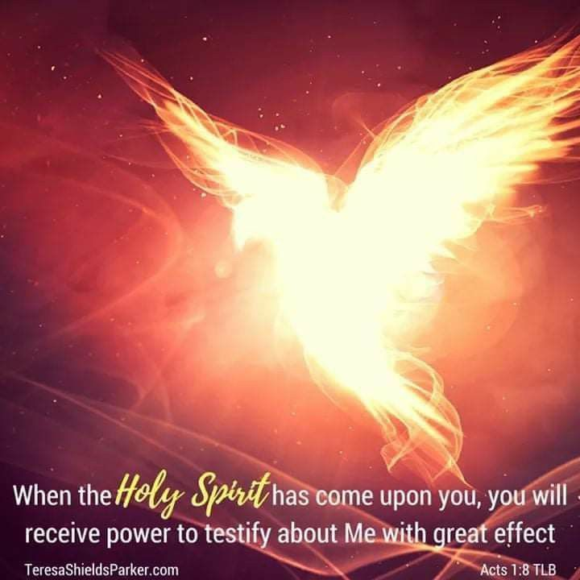

56. Immersed in the Holy Spirit! I submit, Lord!
“For in one Spirit we were all baptized (immersed)
into one body—
Jews or Greeks, slaves or free—and all were made to drink of one Spirit”
1 Cor 12:13
No!
Dove https://i.pinimg.com/originals/0f/9f/13/0f9f13ec39cb5adc246016b7dc6d8743.jpg TeresaShieldsParker.com
Bible and cross Microsoft clip art © 2013 Microsoft Corporation.
© GospelGifs.com

Slide 186
  Repentance toward God and faith in our Lord Jesus Christ
All God’s riches of grace in Christ are given freely at the moment of salvation.
It is not possible to be “in Christ”
but not “immersed in the Spirit.”
Do not empty the cross
of Christ
of its power
(1 Cor 1:17).
in Christ
justified in Christ the righteousness of God
ransomed, redeemed Passover Lamb, sin atoned, wrath turned
forgiven peace with God reconciled eternal life adopted sons
welcomed, accepted filled, complete blessed with every blessing
Christ our wisdom from God, righteousness and sanctification and redemption
delivered from the domain of darkness into the light of the kingdom of the beloved Son
in Christ and Christ in us in the Spirit and the Spirit in us, made God’s temple
in God the Father and the Father in us immersed in Father, Son, and Spirit
Father, Son, and Spirit fellowship with us access to God and his grace answered prayer
grace at the throne of grace every need supplied Holy Spirit prays for us, helps us pray
Christ our High Priest intercedes as mediator Christ our High Priest advocates in our defense
immersed into Christ and his death and resurrection united with Christ in death and resurrection
old self crucified and buried with Christ new self raised and alive with Christ
set free from sin instrument for righteousness
under Christ, abundant grace slaves of Christ not sin
joined to Christ one with Christ
seated with Christ hidden with Christ in God
released from law, married to Christ under law of the Spirit
Spirit and God’s love poured out born of the Spirit
given, receive, have Spirit rivers of living water of Spirit
immersed in the Spirit Spirit comes on, falls on us
Spirit power to be ambassadors anointed with the Spirit
sealed with the Spirit guarantee of the Spirit
Spirit of truth helps, teaches Spirit leads
Spirit sanctifies Spirit gifts for service
Spirit fills circumcised, set apart in the Spirit
immeasurably great power God’s workmanship led in triumph and nike victory
members of Christ’s body brothers and sisters branches in Christ’s vine
  chosen race, royal priesthood, holy nation, God’s possession, God’s people
fellow citizens with the saints and members of the household of God
citizenship in heaven hope of glory inheritance, heir, fellow heir
with Christ at death made perfect glorified to be like Jesus
into heavenly kingdom enter joy of Lord delivered from wrath
God’s good work completed resurrection body like Jesus
married to the Lamb every tear wiped away
see God’s face reign forever
loved and saved
in New Covenant
jumping heart © www.fg-a.com
johncrozieris@gmail.com © 2020

Slide 187
At Pentecost, with his new grasp of what God was doing, what did Peter say God would do from then on?
And Peter said to them, “Repent and be baptized (immersed) every one of you in the name of Jesus Christ for the forgiveness of your sins, and you will receive the gift of the Holy Spirit” (Acts 2:38).
Have you repented and been forgiven through Christ? What does Peter say goes together with forgiveness?
Peter says God also gives the gift of the Holy Spirit!
Does Peter think God’s gift of the Spirit includes the baptism of the Spirit (1:5), receiving power when the Spirit comes upon us (1:8), the filling of the Spirit (2:4), and the pouring out of the Spirit (2:16-18)? Yes!
To Peter, it’s not possible to be forgiven and not also receive the Holy Spirit in all his New Covenant ministry.

Slide 188
Salvation is to be united with the Lord, God the Father, Son and Spirit!
THE LORD
Father, Son and Spirit oneness
love, fellowship and cooperation
The Spirit loves, fellowships with
and empowers sons
in the Son as he loves, fellowships with and empowers the Son.
Brothers of the Son,
immersed in
the Spirit of the Son, love, fellowship with, and cooperate with
the Father and Spirit
as the Son does.
smiley © sherv.net pulsing heart © clipartbest.com

Slide 189

“As I began to speak, the Holy Spirit fell on them just as on us at the beginning”
Acts 11:15
the Lord
“You will receive power when the Holy Spirit has come upon you” Acts 1:8
Dove and Bible
Microsoft clip art © 2013
Microsoft Corporation.
57. the Spirit
comes on us
and falls on us.
Thank you, Lord!
NO!
© GospelGifs.com

Slide 190
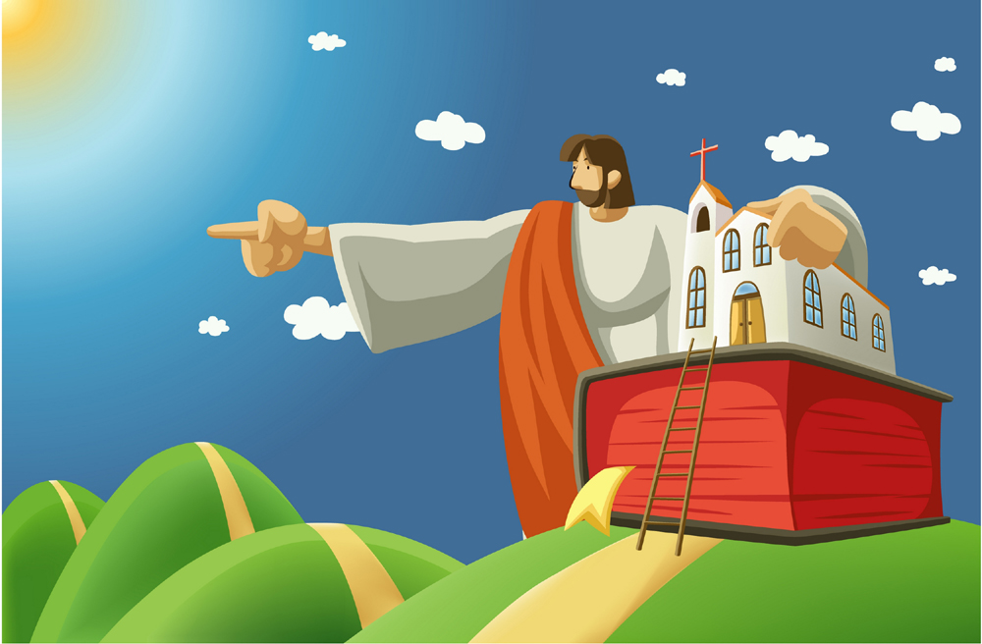
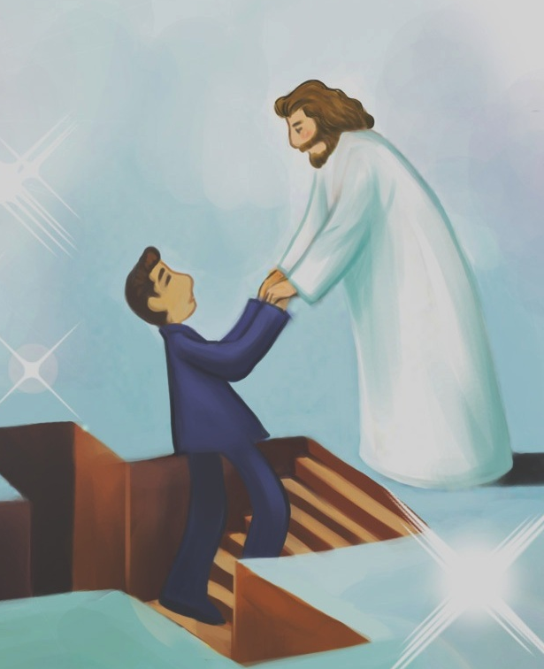
58. empowered by the Spirit to be ambassadors for Christ, imploring on behalf of Christ. Thank you, Lord!
© Yoon Nam Sun
Dove and Bible
Microsoft clip art © 2013
Microsoft Corporation.
© Yoon Nam Sun
© iclickart.co.kr with permission from Iregihwek print shop in Yeosu, South Korea
“Therefore, we are ambassadors for Christ, God making his appeal through us. We implore you on behalf of Christ,
be reconciled to God. For our sake he made him to be sin
who knew no sin, so that in him we might become
the righteousness of God.” 2 Cor 5:20-21
NO!
© GospelGifs.com

Slide 191
58. empowered by the Spirit to be ambassadors for Christ, imploring on behalf of Christ. Thank you, Lord!
© Yoon Nam Sun
Dove and Bible
Microsoft clip art © 2013
Microsoft Corporation.
© Yoon Nam Sun
© iclickart.co.kr with permission from Iregihwek print shop in Yeosu, South Korea
“But you will receive power when the Holy Spirit has come upon you, and you will be my witnesses . . . to the end of the earth.” Acts 1:8
NO!
© GospelGifs.com

Slide 192
58. empowered by the Spirit to be ambassadors for Christ, imploring on behalf of Christ. Thank you, Lord!
© Yoon Nam Sun
Dove and Bible
Microsoft clip art © 2013
Microsoft Corporation.
© Yoon Nam Sun
© iclickart.co.kr with permission from Iregihwek print shop in Yeosu, South Korea
“But when the Helper comes, whom I will send to you from the Father, the Spirit of truth, who proceeds from the Father, he will bear witness about me.
And you also will bear witness” John 15:26-27
NO!
© GospelGifs.com

Slide 193
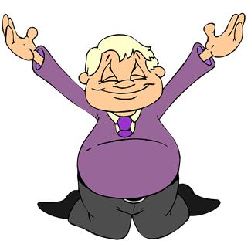
59. anointed with the Spirit.
Thank you, Lord!
Dove and Bible
Microsoft clip art © 2013
Microsoft Corporation.
“And it is God who
. . . has anointed us,
and who has also put his seal on us and given us his Spirit
in our hearts
as a guarantee”
2 Cor 1:21-22
Microsoft clip art © 2013
Microsoft Corporation.
NO!
© GospelGifs.com

Slide 194
60. sealed with the Spirit. Thank you, Lord!
Dove and Bible
Microsoft clip art © 2013
Microsoft Corporation.
Holy to the Lord
“And do not grieve the Holy Spirit of God, by whom you were sealed for the day of redemption” Eph 4:30
NO!
© GospelGifs.com

Slide 195
61. the Spirit is the guarantee of our inheritance.
Thank you, Lord!
100 %
Dove and Bible
Microsoft clip art © 2013
Microsoft Corporation.
Guarantee
of inheritance
100 %
“In him you . . . were sealed with the promised
Holy Spirit, who is the guarantee of our inheritance
until we acquire possession of it” Eph 1:13-14
NO!
© GospelGifs.com

Slide 196
62. the Spirit helps us and teaches us God’s truth in Christ. Praise you, Lord!
“But when the Helper comes, . . . the Spirit of truth . . . he will bear witness about me
. . . he will teach you all things . . .
he will guide you into all the truth”
John 15:26; 14:26;16:13
Dove and Bible
Microsoft clip art © 2013
Microsoft Corporation.
“Take . . . the sword of the Spirit,
which is the word of God,
praying at all times in the Spirit”
Eph 6:17-18
NO!
© GospelGifs.com
Microsoft clip art © 2013 Microsoft Corporation.

Slide 197
62. the Spirit of truth helps us
and teaches us God’s truth in Christ.
John 14:16-18
The Helper / Counselor, the Spirit of truth
helps us and is with us,
lives with us and is in us.
Jesus comes to us by the Spirit.
John 14:26
The Helper / Counselor, the Holy Spirit
teaches and reminds
John 15:26
The Helper / Counselor, the Spirit of truth
testifies about Jesus as we testify
Dove and Bible
Microsoft clip art © 2013
Microsoft Corporation.

Slide 198
62. the Spirit of truth helps us
and teaches us God’s truth in Christ.
John 16:7-11
The Helper / Counselor convicts and convinces
of the sin of unbelief in Jesus,
the righteousness of Jesus,
the judgment of Satan and sin
John 16:13-15
The Spirit of truth
guides into all truth,
reveals future things to come,
glorifies Jesus, makes known Jesus,
makes known all that belongs to Jesus
Dove and Bible
Microsoft clip art © 2013
Microsoft Corporation.

Slide 199
62. the Spirit of truth helps us
and teaches us God’s truth in Christ.
1 Cor 1:23-24; 2:9-16
God’s Spirit reveals what God has prepared
for those who love him; we understand
what God has given us in Christ crucified,
the power and wisdom of God
Eph 6:17-18
The Spirit helps us take the sword of the word of God
to pray in the Spirit with God’s word
1 John 2:20, 26-27
The Holy One anoints us with the Spirit to know his truth.
The Spirit teaches us all God’s truth in Christ
so we discern error and remain in Christ.
Dove and Bible
Microsoft clip art © 2013
Microsoft Corporation.

Slide 200
Why is there a Bible
and cross inside
the dove?
Because of the serious problem around the world with many sincere Christians who are disconnecting the Spirit
from the Bible and from Christ and
the gospel truths of his cross!
Dove and Bible
Microsoft clip art © 2013
Microsoft Corporation.

Slide 201
Why is there a Bible
and cross inside
the dove?
Dove and Bible
Microsoft clip art © 2013
Microsoft Corporation.
The Spirit’s sword is the word of God (Eph 6:17).
The Helper, the Spirit of truth, teaches us God’s
Word as he bears witness to Jesus (John 14:26; 15:26)
with the word of the cross, Christ crucified (1 Cor 1:18, 23). This word of God and Christ crucified, breathed out by God in the Spirit, teaches, reproves, corrects and trains us to be complete, equipped for every good work (2 Tim 3:16-17).

Slide 202

Which view of the Spirit do you have?
Dove and Bible
Microsoft clip art © 2013
Microsoft Corporation.
Our view of the Spirit affects so many things in our soul.
For more on this, download “Charismatic Confusion” at www.graceGodChrist.com

Slide 203
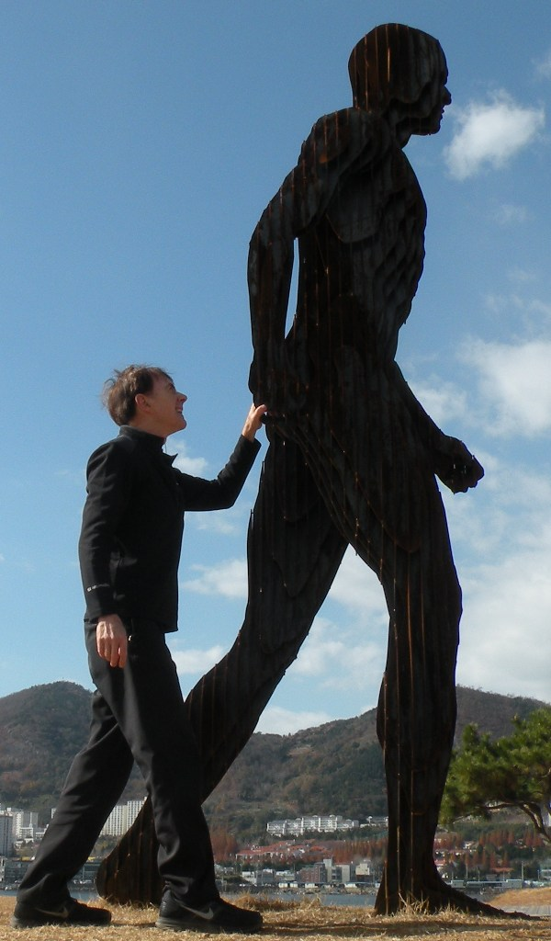
63. the Spirit leads us.
We follow, Lord!
Thank you!
Dove and Bible
Microsoft clip art © 2013
Microsoft Corporation.
“For all who
are led by
the Spirit of God
are sons of God”
Rom 8:14
NO!
photo John Crozier
© GospelGifs.com

Slide 204

64. the Spirit sanctifies us.
Thank you, Lord!
Dove and Bible
Microsoft clip art © 2013
Microsoft Corporation.
“sanctified by the Holy Spirit”
Rom 15:16
“the sanctification of the Spirit, for obedience to
Jesus Christ and
for sprinkling by his blood”
1 Pet 1:2
NO!
© GospelGifs.com

Slide 205
64. the Spirit sanctifies us.
We keep in step, Lord!
love joy
peace longsuffering
kindness goodness
faithfulness gentleness
self-control
Dove and Bible
Microsoft clip art © 2013
Microsoft Corporation.
“sanctified by the Holy Spirit”
Rom 15:16
Gal 5:22-23
sexual immorality
impurity sensuality idolatry sorcery enmity strife jealousy fits of anger
rivalries dissensions
divisions envy
drunkenness
orgies
“God chose you as the firstfruits to be saved, through sanctification by the Spirit and belief in the truth”
2 Thes 2:13
NO!
Gal 5:19-21
© GospelGifs.com

Slide 206
64. the Spirit sanctifies us.
We cooperate, Lord!
compassion kindness
humility meekness
patience forbearance
forgiving love
peace thankful
word of Christ in you richly
doing all in the name
of Jesus
Dove and Bible
Microsoft clip art © 2013
Microsoft Corporation.
“sanctified by the Holy Spirit”
Rom 15:16
Col 3:12-17
sexual immorality impurity passion evil desire covetousness idolatry anger
wrath malice slander
obscene talk
lying
“Flee from sexual immorality . . . do you not know that your body is a temple of the Holy Spirit within you?”
1 Cor 6:18-19
NO!
Col
3:5, 8, 9
© GospelGifs.com

Slide 207
65. the Spirit gifts us to serve others.
Thank you, Lord!
Microsoft clip art © 2013
Microsoft Corporation.
“As each has received
a gift, use it to serve one another, as good stewards
of God's varied grace”
1 Pet 4:10
NO!
© GospelGifs.com

Slide 208

love
joy
Dove and Bible
Microsoft clip art © 2013
Microsoft Corporation.
peace
longsuffering
Jesus
kindness
goodness
faithfulness
gentleness
“Do not get
drunk with wine . . . but be filled with the Spirit” Eph 5:18
self-control
Filled with
the love of Jesus
for God and people
66. filled with the Spirit to do the Lord’s will
and walk as Jesus walked! Yes, Lord, empower us!
NO!
© GospelGifs.com

Slide 209
The Spirit fills believers to love, fellowship with and cooperate with the Father as Jesus does.
The Spirit fills believers to
love others
as Jesus does,
and share
the gospel
as Jesus does.
This is New Covenant salvation!
THE LORD
Father, Son and Spirit oneness
love, fellowship and cooperation
smiley © sherv.net pulsing heart © clipartbest.com

Slide 210
How did Jesus walk with the Father in the Spirit?
“You first
Father”
heart © clipartbest.com
original author of picture unknown

Slide 211
© Yoon Nam Sun
Dove and Bible
Microsoft clip art © 2013
How do we walk with Christ in the Spirit?

Slide 212
How do we walk with Christ in the Spirit?
Christ is the coach of the crucified-and-raised-with-Christ team
© GospelGifs.com
Dove and Bible Microsoft clip art © 2013
Microsoft Corporation.
soccer teams by Kim Graham
our old coach Sin no longer has authority to rule us
“But I say, walk by the Spirit, and you will not gratify the desires of the flesh.” Gal 5:16

Slide 213
me
Dove and Bible
Microsoft clip art © 2013
Microsoft Corporation.
How do we walk with Christ in the Spirit?
Consider, Count yourselves dead to sin
and alive to God in Christ 6:11
Don’t let sin reign in you 6:12
Don’t present your members to sin as
instruments for unrighteousness 6:13
Present yourselves and your members to God as
instruments for righteousness 6:13,16,19,22
Walk in the Spirit not the flesh 8:4
Set your mind on the Spirit not the flesh 8:5
By the Spirit kill sinful temptations 8:13
Set your mind on the Spirit not the flesh 8:5
By the Spirit kill sinful temptations 8:13

Slide 214
How do we walk with Christ in the Spirit?
“be filled with the Spirit; Speaking to yourselves
in psalms and hymns and spiritual songs,
singing and making melody
in your heart to the Lord;
© Yoon Nam Sun
Dove and Bible
Microsoft clip art © 2013
Giving thanks always for all things unto God and the Father in the name of our Lord Jesus Christ; Submitting yourselves one to another
in the fear of God.” Eph 5:18-21 KJV

Slide 215

67. circumcised by Christ in the Spirit, putting off living in the flesh to live in Christ in the Spirit in God. Thank you!
Set apart from
living in the flesh
to live in Christ in
the Spirit in God
Raised with Christ
in the Spirit
smiley © sherv.net
Jumping heart © www.fg-a.com
Faith in Christ
living in the flesh
crucified and buried
with Christ
© Yoon Nam Sun
Dove and Bible
Microsoft clip art © 2013
“In him also you were circumcised . . . without hands, by putting off the body of flesh, by the circumcision of Christ, having been buried with him in baptism, in which you
were also raised with him through faith” Col 2:11-12
“circumcision is . . . of the heart, by the Spirit” Rom 2:29
NO!
© GospelGifs.com

Slide 216

68. immeasurable
power and strength.
Thank you, Lord!
“Having the eyes of your hearts enlightened, that you may know what is . . . the immeasurable greatness of his power toward us who believe” Eph 1:18-19
arms
Microsoft clip art © 2013
Microsoft Corporation.
smileys © sherv.net
“I can do all things through him who strengthens me” Phil 4:13
“clothed with power”
Luke 24:49
NO!
© GospelGifs.com

Slide 217
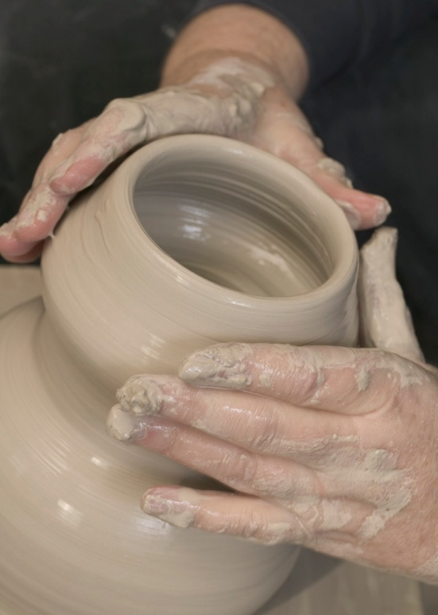
“For we are his workmanship, created in Christ Jesus for good works, which God prepared beforehand, that we should walk in them” Eph 2:10
“For it is God who works in you, both to will and to work for his good pleasure”
Phil 2:13
69. God’s workmanship.
Thank you, Lord!
Microsoft clip art © 2013
Microsoft Corporation.
NO!
© GospelGifs.com

Slide 218










70-71. led in triumphal procession and nike victory in Christ.
Thank you, Lord!
Microsoft clip art © 2013
Microsoft Corporation.
Copyright by Nike
After his victory, our Commander Jesus leads his troops in triumphal procession
“But thanks be to God, who in Christ always leads us
in triumphal procession” 2 Co 2:14
“But thanks be to God, who gives us the victory (nike) through our Lord Jesus Christ” 1 Cor 15:57
NO!
© GospelGifs.com

Slide 219
Jesus Christ has niked and gives us nike victory!
© Copyright by Nike
For how Jesus and the Apostles use the Greek word nike 34 times in the Greek New Testament,
go to www.GraceGodChrist.com
then the “Nike in the New Testament” page,
for PPT and articles.
Download “What the word nike means” for a short summary I give to others that shares how Jesus
and the Apostles used the word “nike.”

Slide 220
the law of the Spirit sets free the Spirit and God’s love is poured in born of the Spirit, born of God given, receive, have the gift of the Spirit rivers of life in the Spirit satisfy thirsty hearts immersed in the Spirit the Spirit comes on us, falls on us power of the Spirit to be ambassadors of Christ anointed and sealed with the Spirit of guarantee the Spirit of truth helps and teaches us God’s word the Spirit leads and sanctifies, producing holy fruit the Spirit gifts us for service to others the Spirit fills us to do the Lord’s will circumcised, set apart in the Spirit immeasurably great power of the Spirit
God’s workmanship led in triumph and nike victory
in Christ
Gifts 48-71
faith
in Christ
Thank you
for the
grace
of the
Holy
Spirit
given
through
Christ’s
death!
so we walk in Christ in the Spirit in agape love

Slide 221
That’s not all! Holy Spirit riches also include:
8 adopted as sons with the Spirit of God’s Son in heart
17, 18 in the Spirit and the Spirit in us,
19 temples of the Holy Spirit
22 immersed in the Father, Son and Spirit
23 fellowship with the Spirit
24 access to the Father through Christ in one Spirit (Eph 2:18)
28, 29 the Spirit prays for us and helps us pray in the Spirit
Wonderful, Lord! Amazing! Thank you!

Slide 222
in the Spirit and the Spirit in us immersed in the Father, Son and Spirit
Father, Son and Spirit fellowship with us adopted as sons with the Spirit of the Son in us released from the Law to marry Christ in the Spirit law of Spirit of life in Christ sets free from law of sin the Spirit and God’s love is poured into heart born of the Spirit, born of God given, receive, have the gift of the Spirit rivers of living water of the Spirit satisfy thirsty hearts the Spirit comes on us, falls on us power of the Spirit to be ambassadors of Christ anointed and sealed with the Spirit of guarantee the Spirit of truth helps and teaches us God’s word the Spirit prays for us and helps us pray with God’s Word the Spirit leads and sanctifies us, producing holy fruit the Spirit gifts us for service to others the Spirit fills us to do the Lord’s will circumcised, set apart in the Spirit immeasurably great power of the Spirit
God’s workmanship led in triumph and nike victory conformed to Christ and his resurrection body
in Christ
faith
in Christ
Lord,
thank you
for the
many
ways
your Spirit ministers
to those
in Christ!
so we walk in Christ in the Spirit in agape love

Slide 223
Jesus
Mohammed
Confucius
Can anyone else give us these gifts?
Has anyone else died as God’s once-for-all sacrifice for sin? Is anyone else the infinite
Son of God, our resurrected Messiah and Lord,
who provides in himself all we need in God?
Hindu Gurus
Moses
Buddha

Slide 224
Buddhism says:
Do Do Do
Do Do Do
Do Do.
You Do.
8-fold path
Islam
says:
Do Do Do
Do Do all Allah wants.
You Do.
5 pillars
Hinduism
says:
Do Do Do
Do Do Do
Do Do Do.
You Do.
many paths
Jesus
says:
It is DONE.
I am all you need.
I give, you receive.
I DO 4 U.
Come to me
and drink.
I DO 4 U
More free resources on the grace of God in Christ @ www.GraceGodChrist.com

Slide 225
justified in Christ the righteousness of God
ransomed, redeemed Passover Lamb, sin atoned, wrath turned
forgiven peace with God reconciled eternal life adopted sons
welcomed, accepted filled, complete blessed with every blessing
Christ our wisdom from God, righteousness and sanctification and redemption
delivered from the domain of darkness into the light of the kingdom of the beloved Son
in Christ and Christ in us in the Spirit and the Spirit in us, made God’s temple
in God the Father and the Father in us immersed in the Father, Son, and Spirit
Father, Son, and Spirit fellowship with us access to God and his grace
answered prayer grace at the throne of grace
every need supplied Holy Spirit prays for us, helps us pray
Christ our H.P. intercedes as our mediator Christ our H.P. advocates in our defense
immersed in Christ and his death and res. united with Christ in his death and res.
old self crucified and buried with Christ new self raised and alive with Christ
set free from sin instrument for righteousness
under Christ, abundant grace slaves of Christ not sin
joined to Christ one with Christ
seated with Christ hidden with Christ in God
released from law, married to Christ under law of the Spirit
Spirit and God’s love poured out born of the Spirit
given, receive, have Spirit rivers of living water of Spirit
immersed in the Spirit Spirit comes on, falls on us
Spirit power to be ambassadors anointed with the Spirit
sealed with the Spirit guarantee of the Spirit
Spirit of truth helps, teaches Spirit leads
Spirit sanctifies Spirit gifts for service
Spirit fills circumcised, set apart in the Spirit
immeasurably great power God’s workmanship
led in triumph and nike victory members of Christ’s body
brothers and sisters branches in Christ’s vine
  chosen race, royal priesthood, holy nation God’s possession, God’s people
fellow citizens with the saints members of the household of God
citizenship in heaven hope of glory inheritance, heir, fellow heir
with Christ at death made perfect glorified to be like Jesus
into heavenly kingdom enter joy of Lord delivered from wrath
God’s good work completed resurrection body like Jesus married to the Lamb
every tear wiped away see God’s face reign forever
loved and saved in the New Covenant
Receive me - receive all I provide through my death
I DO 4 U
Jesus © GospelGifs.com
Pulsing heart @clipartbest.com

Slide 226
THE LORD
God’s completely different way
to deepest joy and satisfaction
smiley © sherv.net
Jumping heart © www.fg-a.com
People circle © clipartfest.com
Joy and satisfaction are in Christ, not beauty, music, smart-phones, sports, cars, money, friends, romance, sex, food, drinking parties, homes or jobs! Jesus had supreme joy without sex or money!

Slide 227
I am your ransom
and redemption
I am your forgiveness
from God
I am your
righteousness
from God
justification
I am reconciliation
to God
I am
your
peace
with God
Find joy and satisfaction in God. Open Christ’s gifts to enjoy the Lord by faith in God’s promises expressed in praise!
Promises - Faith - Praise
I am your
adoption
as God’s
child
I am your
deliverance from darkness
into the kingdom of God’s Son
I am your
hope of glory
I am your
fullness
of blessing
I am your
at-one-ment with the Lord
God’s wrath turned away
I am your fullness
of the Spirit of God
I am your
eternal
life

Slide 228
Highly recommended
Develop the habit of praising the LORD every day for his grace in Christ. Develop a mind and heart that rests in Christ for all.
During your prayer time each of the seven days of the week, praise the Lord through section 1 on Day 1,
section two on Day 2, . . . seven on Day 7!
Monday – Section 1
Tuesday – Section 2
Wednesday – Section 3
Thursday – Section 4
Friday – Section 5
Saturday – Section 6 Gifts of being the body of Christ
Sunday – Section 7

Slide 229
The Grace of God in Christ
100 gifts of delight we receive in the Lord’s gift of Christ crucified
Gifts that are a firm foundation 1-14
Gifts of connection with Father, Son and Spirit 15-23
Gifts of life at God’s throne 24-31
Gifts of being set free from sin 32-48
Gifts of life in the Holy Spirit 48-71
Gifts of being the body of Christ 72-82
Gifts of future glory 83-97
Three great gifts that include all the others 98-100
Use “search” on your smart-phone

Slide 230
in Christ
Gifts 72-82
faith
in Christ
members of Christ’s body
brothers and sisters
branches in Christ’s vine
a chosen race,
royal priesthood, holy nation,
God’s possession, God’s people
fellow citizens with the saints
and members of God’s household
Thank you for the body of Christ riches
provided for us by Christ’s death!

Slide 231
72. members of
Christ’s body, the church, united with Christ our Head.
Thank you, Lord!
“Christ is the head of
the church, his body, . . . we are members
of his body”
Eph 5:23, 30
“For in one Spirit
we were all baptized
into one body”
1 Cor 12:13
NO!
Jumping heart © www.fg-a.com
Jesus © GospelGifs.com with permission
© GospelGifs.com

Slide 232
73. brothers and sisters
in Christ.
Thank you, Lord!
“I commend to you our sister Phoebe” Rom 16:1
“Greet . . . the brothers who are with them.” Rom 16:14
“If a brother or sister
is poorly clothed and lacking in daily food”
Jas 2:15
NO!
Jumping heart © www.fg-a.com
Jesus © GospelGifs.com with permission
© GospelGifs.com

Slide 233
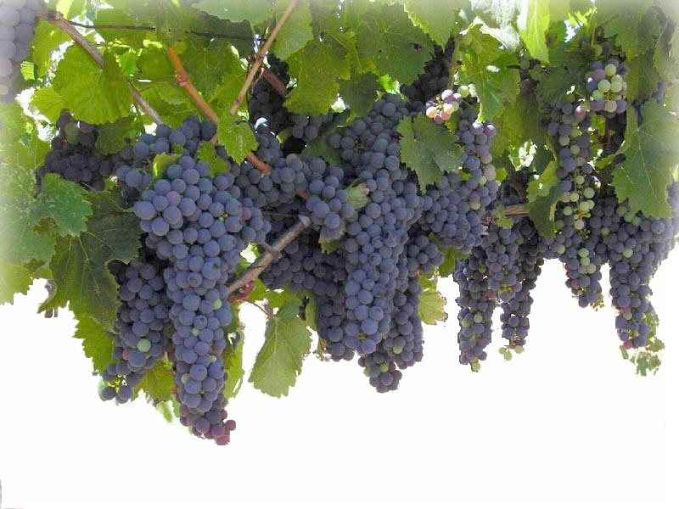
74. branches united with Christ our Vine.
Thank you, Lord!
Microsoft clip art © 2013
Microsoft Corporation.
“I am the vine; you are the branches.
Whoever abides in me and I in him,
he it is that bears much fruit, for apart from me
you can do nothing” John 15:5
NO!
© GospelGifs.com

Slide 234
74. branches united with Christ our Vine.
Thank you, Lord!
John 15:5
Microsoft clip art © 2013
Microsoft Corporation.
“You (Gentiles), although a wild olive shoot, were grafted in . . . now share in the nourishing root of the olive tree, . . . you were cut from what is by nature
a wild olive tree, and grafted, contrary to nature,
into a cultivated olive tree” Rom 11:17,24
NO!
© GospelGifs.com

Slide 235







“But you are a chosen race, a royal priesthood, a holy nation, a people for his own possession . . .
Once you were not a people, but now you are God's people”
1 Pet 2:9-10
75-79. a chosen race,
a royal priesthood,
a holy nation,
a people for God’s own possession, God’s people.
Thank you, Lord!
NO!
Microsoft clip art © 2013
Microsoft Corporation.
© GospelGifs.com
Microsoft clip art © 2013 Microsoft Corporation.

Slide 236

80-82. fellow citizens with the saints
and members of the household of God.
Thank you, Lord!
“you are no longer strangers and aliens,
but you are fellow citizens with the saints and members of the household of God” Eph 2:19
NO!
photo John Crozier
© GospelGifs.com

Slide 237
Are you a saint, set apart from sin and Satan,
made holy to the LORD in Christ in the Holy Spirit?
in sin
in Christ
angry smiley © sherv.net
Jumping heart © www.fg-a.com
“called to be saints . . . the Spirit intercedes for the saints . . .
sanctified by the Holy Spirit . . . worthy of the saints”
Rom 1:7; 8:27; 15:16; 16:2
“the church of God . . . sanctified in Christ Jesus,
called to be saints” 1 Cor 1:2

Slide 238
in Christ
Gifts 72-82
faith
in Christ
members of Christ’s body
brothers and sisters
branches in Christ’s vine
a chosen race,
royal priesthood, holy nation,
God’s possession, God’s people
fellow citizens with the saints
and members of God’s household
Thank you for the body of Christ riches
provided for us by Christ’s death!

Slide 239
Jesus
Mohammed
Confucius
Can anyone else give us these gifts?
Has anyone else died as God’s once-for-all sacrifice for sin? Is anyone else the infinite
Son of God, our resurrected Messiah and Lord,
who provides in himself all we need in God?
Hindu Gurus
Moses
Buddha

Slide 240
Buddhism says:
Do Do Do
Do Do Do
Do Do.
You Do.
8-fold path
Islam
says:
Do Do Do
Do Do all Allah wants.
You Do.
5 pillars
Hinduism
says:
Do Do Do
Do Do Do
Do Do Do.
You Do.
many paths
Jesus
says:
It is DONE.
I DO 4 U.
Believe and receive all.
Come to me
and drink.
I DO 4 U
There is no one else like Jesus!
Jesus is the crucified and reigning
Messiah, Son of God and Savior
who is “I DO 4 U” not “U DO.”
More free resources on the grace of God in Christ @ www.GraceGodChrist.com

Slide 241
THE LORD
God’s completely different way
to deepest joy and satisfaction
smiley © sherv.net
Jumping heart © www.fg-a.com
People circle © clipartfest.com
Joy and satisfaction are in Christ, not beauty, music, smart-phones, sports, cars, money, friends, romance, sex, food, drinking parties, homes or jobs! Jesus had supreme joy without sex or money!

Slide 242
I am your ransom
and redemption
I am your forgiveness
from God
I am your
righteousness
from God
justification
I am
your
peace
with God
Joy and satisfaction are in God. Open Christ’s gifts to enjoy the Lord by faith in God’s promises expressed in praise!
Promises - Faith - Praise
I am your
adoption
as God’s
child
I am your
deliverance from darkness
into the kingdom of God’s Son
I am your
hope of glory
I am your
fullness
of blessing
I am your
at-one-ment with the Lord
God’s wrath turned away
I am your fullness
of the Spirit of God
I am your
eternal
life

Slide 243
  Repentance toward God and faith in our Lord Jesus Christ
It is finished! Will you joyfully draw on the many riches of
God’s grace
in Christ given
the moment we receive salvation in Christ?
in Christ
justified in Christ the righteousness of God
ransomed, redeemed Passover Lamb, sin atoned, wrath turned
forgiven peace with God reconciled eternal life adopted sons
welcomed, accepted filled, complete blessed with every blessing
Christ our wisdom from God, righteousness and sanctification and redemption
delivered from the domain of darkness into the light of the kingdom of the beloved Son
in Christ and Christ in us in the Spirit and the Spirit in us, made God’s temple
in God the Father and the Father in us immersed in Father, Son, and Spirit
Father, Son, and Spirit fellowship with us access to God and his grace answered prayer
grace at the throne of grace every need supplied Holy Spirit prays for us, helps us pray
Christ our High Priest intercedes as mediator Christ our High Priest advocates in our defense
immersed into Christ and his death and resurrection united with Christ in death and resurrection
old self crucified and buried with Christ new self raised and alive with Christ
set free from sin instrument for righteousness
under Christ, abundant grace slaves of Christ not sin
joined to Christ one with Christ
seated with Christ hidden with Christ in God
released from law, married to Christ under law of the Spirit
Spirit and God’s love poured out born of the Spirit
given, receive, have Spirit rivers of living water of Spirit
immersed in the Spirit Spirit comes on, falls on us
Spirit power to be ambassadors anointed with the Spirit
sealed with the Spirit guarantee of the Spirit
Spirit of truth helps, teaches Spirit leads
Spirit sanctifies Spirit gifts for service
Spirit fills circumcised, set apart in the Spirit
immeasurably great power God’s workmanship led in triumph and nike victory
members of Christ’s body brothers and sisters branches in Christ’s vine
  chosen race, royal priesthood, holy nation, God’s possession, God’s people
fellow citizens with the saints and members of the household of God
citizenship in heaven hope of glory inheritance, heir, fellow heir
with Christ at death made perfect glorified to be like Jesus
into heavenly kingdom enter joy of Lord delivered from wrath
God’s good work completed resurrection body like Jesus
married to the Lamb every tear wiped away
see God’s face reign forever
loved and saved
in New Covenant
jumping heart © www.fg-a.com
johncrozieris@gmail.com © 2020

Slide 244
Highly recommended
Develop the habit of praising the LORD every day for his grace in Christ. Develop a mind and heart that rests in Christ for all.
During your prayer time each of the seven days of the week, praise the Lord through section 1 on Day 1,
section two on Day 2, . . . seven on Day 7!
Monday – Section 1
Tuesday – Section 2
Wednesday – Section 3
Thursday – Section 4
Friday – Section 5
Saturday – Section 6
Sunday – Section 7 Gifts of future glory

Slide 245
The Grace of God in Christ
100 gifts of delight we receive in the Lord’s gift of Christ crucified
Gifts that are a firm foundation 1-14
Gifts of connection with Father, Son and Spirit 15-23
Gifts of life at God’s throne 24-31
Gifts of being set free from sin 32-48
Gifts of life in the Holy Spirit 48-71
Gifts of being the body of Christ 72-82
Gifts of future glory 83-97
Three great gifts that include all the others 98-100
Use “search” on your smart-phone

Slide 246
in Christ
Gifts 83-97
faith
in Christ
citizenship in heaven
hope of glory
inheritance, heirs, fellow heirs
with Christ at death
made perfect
glorified to be like Jesus
brought to the heavenly kingdom enter the joy of the Lord
delivered from the wrath to come
God’s good work completed
resurrection body
married to the Lamb
every tear wiped away
see God’s face
reign forever
Lord, thank you that
Jesus died
to give us
riches of
future glory with you!
Only your glory can satisfy our deep longings!

Slide 247
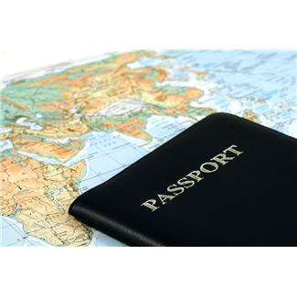
“Their end is destruction, . . . But our citizenship is in heaven, and from it we await a Savior, the Lord Jesus Christ” Phil 3:19-20
“the assembly of the firstborn who are enrolled in heaven” Heb 12:23
Microsoft clip art © 2013 Microsoft Corporation.
ME, ME,ME!
Citizens of heaven
Passport
No citizenship
83. citizenship in heaven!
Thank you, Lord!
citizenship
angry smiley © sherv.net
Jumping heart © www.fg-a.com
Praise you, Lord!

Slide 248
84. the hope of glory!
Wonderful Lord!
“We rejoice in hope of the glory of God”
Rom 5:5
“Christ in you,
the hope of glory”
Col 1:27
many copies
on internet,
original unknown. This is from Kootation.com.
NO!
© GospelGifs.com

Slide 249
85. inheritance,
heirs of God
and fellow heirs with Christ!
Thank you, Lord!
“We are children of God . . . heirs of God
and fellow heirs with Christ” Rom 8:16-17
“Come, you who are blessed by my Father,
inherit the kingdom prepared for you from
the foundation of the world” Matt 25:34
NO!
© GospelGifs.com

Slide 250
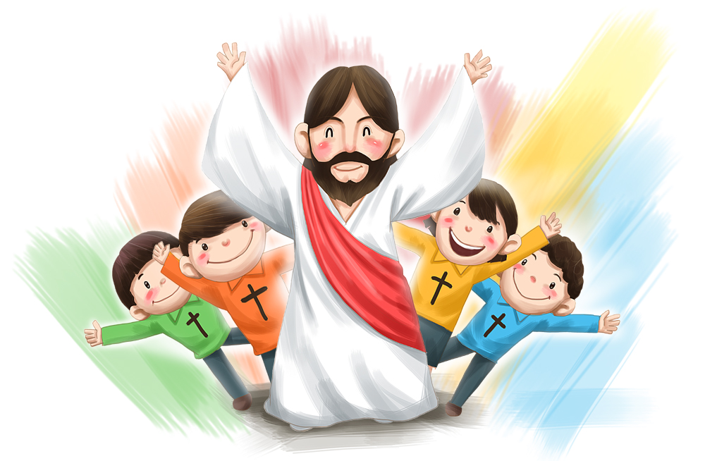
86. with Christ when
we die!
All praise
to you,
Lord!
© iclickart.co.kr with permission from Iregihwek print shop in Yeosu, South Korea
“My desire is to depart and be with Christ” Phil 1:23
“We know that while we are at home in the body we are away from the Lord . . . we would rather be away from
the body and at home with the Lord” 2 Cor 5:6, 8
NO!
© GospelGifs.com

Slide 251
87. made perfect in God’s presence!
All glory to you, Lord!
Righteous souls
in the
blood of
Christ
Made perfect in the presence of Christ
“But you have come to . . . the city of the living God,
the heavenly Jerusalem, . . . and to God, the judge of all, and to the spirits of the righteous made perfect,
and to Jesus, the mediator of a new covenant”
Heb 12:22-24
NO!
© GospelGifs.com

Slide 252

We will think and act like Jesus, love like Jesus,
hate evil like Jesus, be zealous for God’s glory like Jesus . . .
“Maranatha!” © 1988/2000 by Stephen Gjertson. All rights reserved. Used with permission.
88. like Jesus, conformed to his image! Thank you, Lord!
“We know that when he appears we shall be like him, because we shall see him as he is” 1 John 3:2
“For those whom he foreknew he also predestined to be conformed to the image of his Son, in order that
he might be the firstborn among many brothers”
Rom 8:29
NO!
© GospelGifs.com

Slide 253
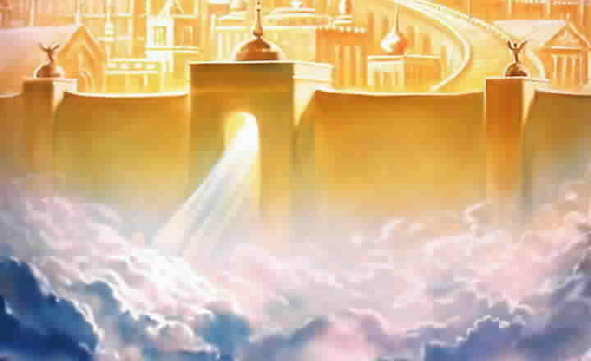
89. brought safely into his heavenly kingdom!
Thank you, Lord!
various copies on internet,
original source unknown
Big tears smiley © sherv.net
Jumping heart © www.fg-a.com
“The Lord will rescue me from every evil deed
and bring me safely into his heavenly kingdom.
To him be the glory forever and ever”
2 Tim 4:18

Slide 254
90. Enter the joy of the Lord! Thank you!
smileys © sherv.net
Jumping heart © www.fg-a.com
People circle © clipartfest.com
big tears smiley © sherv.net
To enter the joy of the Lord is to be in the Lord’s presence delighting and
rejoicing in God as God delights and rejoices in all God’s infinite perfections,
the love and fellowship of the Father, Son and Spirit, and his grace in Christ.
“Well done, good and faithful servant. . . . Enter into
the joy of your master (Greek kurios, Lord)”
Matt 25:21,23

Slide 255
THE LORD
smileys © sherv.net
Jumping heart © www.fg-a.com
People circle © clipartfest.com
big tears smiley © sherv.net
To enter the joy of the Lord in the Lord’s presence is
to delight and rejoice in the Father as Jesus and the Spirit do,
to delight in and rejoice in the Son as the Father and Spirit do,
and to delight in and rejoice in the Spirit as Jesus and the Father do!
“Well done, good and faithful servant. . . . Enter into
the joy of your master (Greek kurios, Lord)”
Matt 25:21,23

Slide 256
“The most satisfying and joy-filled love, communion, and cooperation in the universe flow between the Father, Son, and Spirit.”
“Like joining a happy, loving family for dinner, the Lord shares himself with us by immersing us in God the Father, Son and Spirit to share in their all-satisfying love, delight, communion, and cooperation in their purposes. Joyful communion with God as we do his will is our highest joy in heaven - and now!”
Thank you, Lord, that we can rejoice in and serve you now, eager for entering your eternal joy in the future, the eternal joy of the triune Lord!
From “Know Your God,” John’s discipleship eBook on God’s attributes, page 59, available free at www.GraceGodChrist.com

Slide 257
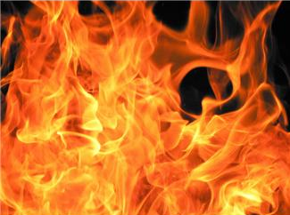
“You turned to God from idols to serve the living and true God,
and to wait for his Son from heaven, whom he raised from
the dead, Jesus who delivers us from the wrath to come”
1 Thess 1:9-10
THE LORD
Sharing in the love of God the Father, Son and Spirit
for eternity
91. delivered from the wrath to come!
All praise to you, Lord!
eternity of wrath
smileys© sherv.net
Jumping heart © www.fg-a.com
heart © clipartbest.com
Fire Microsoft clip art © 2013 Microsoft Corporation.
big tears smiley © sherv.net

Slide 258

“And I am sure of this, that he who began a good work in you will bring it to completion at the day of Jesus Christ” Phil 1:6
eternally perfect
in Christ
various copies on internet, original source unknown,
but this is adapted from pixgood.com
92. The Lord will bring to completion
his good work begun!
Thank you, Lord!
Microsoft clip art © 2013
Microsoft Corporation.
big tears smiley © sherv.net

Slide 259




Dove, cross and Bible
Microsoft clip art © 2013
Microsoft Corp
various copies on internet,
original source unknown
clipartkid.com - boy leaping for joy, children jumping for joy
93. resurrection body like Jesus! Thank you, Lord!
“But in fact Christ has been raised from the dead,
the firstfruits of those who have fallen asleep.
For as by a man came death, by a man has come also the
resurrection of the dead. . . . But each in his own order:
Christ the firstfruits, then at his coming those
who belong to Christ.” 1 Cor 15:20,21,23
big tears smiley © sherv.net

Slide 260
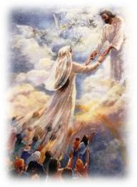
94. marriage of the Lamb
to his Bride!
Thank you, Lord!
“Let us rejoice and exult and give him the glory, for the marriage of
the Lamb has come,
and his Bride has
made herself ready . . .
Blessed are those
who are invited to
the marriage supper
of the Lamb”
Rev 19:7, 9
various copies on internet, original source unknown
This is from Pinterest.com johnkrohn.blogspot.kr
big tears smiley © sherv.net

Slide 261
94. marriage of the Lamb
to his Bride!
Thank you, Lord!
“For I feel a divine jealousy for you, since
I betrothed you to one husband, to present you as a pure virgin to Christ. But I am afraid that as the serpent deceived Eve by his cunning, your thoughts will be led astray from a sincere and pure devotion to Christ”
2 Cor 11:2-3
various copies on internet, original source unknown
This is from Pinterest.com johnkrohn.blogspot.kr
big tears smiley © sherv.net

Slide 262

95. every tear wiped away!
Thank you, Lord!
“For the Lamb in the midst of the throne will be their shepherd, and he will guide them to springs of living water, and God will wipe away every tear from their eyes”
Rev 7:17
(Isa 25:8)
Microsoft clip art © 2013
Microsoft Corporation.
big tears smiley © sherv.net

Slide 263
95. every tear wiped away!
Thank you, Lord!
“He will wipe away every tear from their eyes, and death shall be no more, neither shall there be mourning nor crying nor pain anymore,
for the former things have passed away”
Rev 21:4
(Isa 25:8)
Microsoft clip art © 2013
Microsoft Corporation.
big tears smiley © sherv.net

Slide 264

“They will see his face”
Rev 22:4
96. see his face!
Glory to you, Lord!
The holy
LORD
big tears smiley
© sherv.net
various copies on internet,
original source unknown

Slide 265
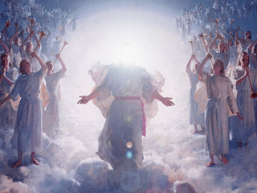
“They will reign forever and ever”
Rev 22:5
97. reign with Christ forever!
All praise to you, Lord!
© Harry Anderson
www.HarryAndersonArt.com
big tears smiley
© sherv.net

Slide 266
Hallelujah! For the Lord our God the Almighty reigns (Rev 19:6), and because of all Christ’s death does for us, we will reign with you forever (Rev 22:5)!
Thanks be to God!
Praise be to God!
Glory be to God!
In the coming ages you will show the immeasurable riches of your grace in kindness toward us in Christ Jesus (Eph 2:7)! For all eternity, all we receive from you flows from the finished work of the Lord Jesus Christ!

Slide 267
in Christ
Gifts 83-97
faith
in Christ
citizenship in heaven
hope of glory
inheritance, heirs, fellow heirs
with Christ at death
made perfect
glorified to be like Jesus
brought to the heavenly kingdom enter the joy of the Lord
delivered from the wrath to come
God’s good work completed
resurrection body
married to the Lamb
every tear wiped away
see God’s face
reign forever
Lord, thank you that
Jesus died
to give us
riches of
future glory with you!
Only your glory can satisfy our deep longings!

Slide 268
Jesus
Mohammed
Confucius
Can anyone else give us these gifts?
Has anyone else died as God’s once-for-all sacrifice for sin? Is anyone else the infinite
Son of God, our resurrected Messiah and Lord,
who provides in himself all we need in God?
Hindu Gurus
Moses
Buddha

Slide 269
Buddhism says:
Do Do Do
Do Do Do
Do Do.
You Do.
8-fold path
Islam
says:
Do Do Do
Do Do all Allah wants.
You Do.
5 pillars
Hinduism
says:
Do Do Do
Do Do Do
Do Do Do.
You Do.
many paths
Jesus
says:
It is DONE.
I am all you need.
I give, you receive.
I DO 4 U.
Come to me
and drink.
I DO 4 U
More free resources on the grace of God in Christ @ www.GraceGodChrist.com

Slide 270
justified in Christ the righteousness of God
ransomed, redeemed Passover Lamb, sin atoned, wrath turned
forgiven peace with God reconciled eternal life adopted sons
welcomed, accepted filled, complete blessed with every blessing
Christ our wisdom from God, righteousness and sanctification and redemption
delivered from the domain of darkness into the light of the kingdom of the beloved Son
in Christ and Christ in us in the Spirit and the Spirit in us, made God’s temple
in God the Father and the Father in us immersed in the Father, Son, and Spirit
Father, Son, and Spirit fellowship with us access to God and his grace
answered prayer grace at the throne of grace
every need supplied Holy Spirit prays for us, helps us pray
Christ our H.P. intercedes as our mediator Christ our H.P. advocates in our defense
immersed in Christ and his death and res. united with Christ in his death and res.
old self crucified and buried with Christ new self raised and alive with Christ
set free from sin instrument for righteousness
under Christ, abundant grace slaves of Christ not sin
joined to Christ one with Christ
seated with Christ hidden with Christ in God
released from law, married to Christ under law of the Spirit
Spirit and God’s love poured out born of the Spirit
given, receive, have Spirit rivers of living water of Spirit
immersed in the Spirit Spirit comes on, falls on us
Spirit power to be ambassadors anointed with the Spirit
sealed with the Spirit guarantee of the Spirit
Spirit of truth helps, teaches Spirit leads
Spirit sanctifies Spirit gifts for service
Spirit fills circumcised, set apart in the Spirit
immeasurably great power God’s workmanship
led in triumph and nike victory members of Christ’s body
brothers and sisters branches in Christ’s vine
  chosen race, royal priesthood, holy nation God’s possession, God’s people
fellow citizens with the saints members of the household of God
citizenship in heaven hope of glory inheritance, heir, fellow heir
with Christ at death made perfect glorified to be like Jesus
into heavenly kingdom enter joy of Lord delivered from wrath
God’s good work completed resurrection body like Jesus married to the Lamb
every tear wiped away see God’s face reign forever
loved and saved in the New Covenant
Receive me - receive all I provide through my blood
I DO 4 U
Jesus © GospelGifs.com
Pulsing heart @clipartbest.com

Slide 271
THE LORD
God’s completely different way
to deepest joy and satisfaction
smiley © sherv.net
Jumping heart © www.fg-a.com
People circle © clipartfest.com
Joy and satisfaction are in Christ, not beauty, music, smart-phones, sports, cars, money, friends, romance, sex, food, drinking parties, homes or jobs! Jesus had supreme joy without sex or money!

Slide 272
I am your ransom
and redemption
I am your forgiveness
from God
I am your
righteousness
from God
justification
I am
your
peace
with God
Joy and satisfaction are in God. Open Christ’s gifts to enjoy the Lord by faith in God’s promises expressed in praise!
Promises - Faith - Praise
I am your
adoption
as God’s
child
I am your
deliverance from darkness
into the kingdom of God’s Son
I am your
hope of glory
I am your
fullness
of blessing
I am your
at-one-ment with the Lord
God’s wrath turned away
I am your fullness
of the Spirit of God
I am your
eternal
life

Slide 273
“Many pursue sexual pleasure far more than they pursue joy in God. Some may agree that temporary sexual pleasures in this life can’t be greater than the pleasures of God in eternity, but what blindness that since God is different and better than all else, joy in God in this life is different and better than all else now, including sexual pleasure!
Jesus had supreme joy without sex!”
From “Know Your God,” John’s discipleship eBook on God’s attributes, page 65, available free at www.GraceGodChrist.com

Slide 274
“The joy Jesus had in God was a joy that was different and better than joy in anything else. Jesus had none of the joys of the world like a nice home and money, but he was the happiest person ever on earth because he, more than all others, had the greatest joy in God.”
“More than anyone else, Jesus sought joy in God, not in the things of the world, and more than all others, Jesus walked in God’s righteous ways, so that his fullness of joy in God was made complete by his always walking in harmony with God’s will.”
“Jesus has shown us the way to deepest, all-satisfying joy in God! When earthly things tempt us, we can turn away to drink joy in God instead!”
From “Know Your God,” John’s eBook on God’s attributes, page 65, at www.GraceGodChrist.com

Slide 275
There is such great benefit in reflecting on each Scripture and praising the Lord for each of his gifts!
Personally applying God’s Word with praise moves God’s truth from the head to the heart.
Praise changes Bible study into fellowship with God.
Faith-filled praise based on God’s promises in Christ is like drinking God’s grace.
Praise completes our joy in God.¹ To be thankful and say so completes our joy vs. being thankful but not saying so!
Since God is different and better than all else, enjoying God with praise, love and doing his will gives different and better joy than all else.

Slide 276
The Grace of God in Christ
100 gifts of delight we receive in the Lord’s gift of Christ crucified
Gifts that are a firm foundation 1-14
Gifts of connection with Father, Son and Spirit 15-23
Gifts of life at God’s throne 24-31
Gifts of being set free from sin 32-48
Gifts of life in the Holy Spirit 48-71
Gifts of being the body of Christ 72-82
Gifts of future glory 83-97
Three great gifts that include all the others 98-100
Use “search” on your smart-phone

Slide 277
Now let’s enjoy three concluding riches of grace in Christ!
They are put last because they involve all the others.

Slide 278
in Christ
Gifts 98-100
faith
in Christ
loved
saved
in the New Covenant
Lord, thank you for these great riches
that involve all the other riches
of grace in Christ!

Slide 279

NO!
No! I reject God’s love in Christ!
98. Loved!
Thank you, Lord!
© GospelGifs.com
smiley © sherv.net
Jumping heart © www.fg-a.com
Pulsing heart © clipartbest.com
Dove and Bible
Microsoft clip art © 2013
Microsoft Corporation.
THE LORD
© GospelGifs.com
used with permission
Christ died for
us to provide
God’s riches of grace in Christ to enjoy the LORD
now and in his
eternal glory!
“God is love. In this the love of God was made manifest among us, that God sent his only Son into the world, so that we might live through him. In this is love, . . . he loved us and sent his Son to be the propitiation for our sins” 1 John 4:8-10

Slide 280
THE LORD
Heaven is a celebration of the LORD, and life now is a bit of heaven when we rejoice in God as God rejoices in God!
Lord, without Christ . . .
but in Christ crucified and reigning . . .
As you promise . . . !
smileys © sherv.net
Jumping heart © www.fg-a.com
People circle © clipartfest.com

Slide 281
NO!
No! I reject God’s love in Christ!
98. Loved!
Thank you, Lord!
© GospelGifs.com
smiley © sherv.net
Jumping heart © www.fg-a.com
Pulsing heart © clipartbest.com
Dove and Bible
Microsoft clip art © 2013
Microsoft Corporation.
THE LORD
© GospelGifs.com
used with permission
Christ died for
us to provide
God’s riches of grace in Christ to enjoy the LORD
now and in his
eternal glory!
“God shows his love for us in that
while we were still sinners, Christ died for us” Rom 5:8

Slide 282
Since the LORD is full of joy and satisfaction in himself because all his infinitely holy qualities make him supremely enjoyable and satisfying, there’s nothing more loving than the LORD saving us from hell by the death of God the Son in order to share himself with us so we also are full of joy and satisfaction in him in his presence, face to face in an eternal covenant of love relationship, in Christ in God in the Spirit, and God the Father, Son and Holy Spirit in us!

Slide 283
99. Saved! Thank you, Lord!
THE LORD
“You shall call his name Jesus, for he will save his people from their sins”
Matt 1:21
Enjoying the Lord
for eternity
Saved
smiley © sherv.net
Jumping heart © www.fg-a.com
Pulsing heart © clipartbest.com
chains
of sin
Satan
death
and hell
Jesus © GospelGifs.com
with permission
“Believe in the Lord Jesus, and you will be saved” Acts 16:31
NO!
photo John Crozier
© GospelGifs.com

Slide 284
99. Saved! Thank you, Lord!
THE LORD
“I am not ashamed of the gospel, for it is the power of God
for salvation to
everyone
who believes”
Rom 1:16
Enjoying the Lord
for eternity
Saved
smiley © sherv.net
Jumping heart © www.fg-a.com
Pulsing heart © clipartbest.com
chains
of sin
Satan
death
and hell
“Since, therefore,
we have now been justified by his blood, much more shall we be saved by him from
the wrath of God” Rom 5:9
Jesus © GospelGifs.com
with permission
NO!
photo John Crozier
© GospelGifs.com

Slide 285
Lord, if Christ had not shed his precious blood . . . but all thanks and praise to you that in Christ . . .
from pqhobbit.files.wordpress.com
“For you know the grace of our Lord Jesus Christ, that though he was rich, yet for your sake he became poor, so that you by his poverty might become rich” 2 Cor 8:9

Slide 286
100. in the
New Covenant!
THE LORD
Enjoying the Lord
for eternity
“Therefore he is the mediator of a new covenant,
so that those who are called may receive the promised eternal inheritance, since a death has occurred that redeems them from the transgressions committed
under the first covenant” Heb 9:15
NO!
smiley s© sherv.net
Jumping heart © www.fg-a.com
Pulsing heart © clipartbest.com
© GospelGifs.com

Slide 287
Lord, without Christ’s blood of the New Covenant . . . but all joy and delight in you that in Christ . . .
from pqhobbit.files.wordpress.com
“the gospel of Christ . . . the surpassing grace of God upon you . . . Thanks be to God for his
inexpressible gift!” 2 Cor 9:13-15

Slide 288
THE LORD
God’s completely different way
to deepest joy and satisfaction
smiley © sherv.net
Jumping heart © www.fg-a.com
People circle © clipartfest.com
Joy and satisfaction are in Christ, not beauty, music, smart-phones, sports, cars, money, friends, romance, sex, food, drinking parties, homes or jobs! Jesus had supreme joy without sex or money!

Slide 289
I am your ransom
and redemption
I am your forgiveness
from God
I am your
righteousness
from God
justification
I am
your
peace
with God
Find joy and satisfaction in God. Open Christ’s gifts to enjoy the Lord by faith in God’s promises expressed in praise!
Promises - Faith - Praise
I am your
adoption
as God’s
child
I am your
deliverance from darkness
into the kingdom of God’s Son
I am your
hope of glory
I am your
fullness
of blessing
I am your
at-one-ment with the Lord
God’s wrath turned away
I am your fullness
of the Spirit of God
I am your
eternal
life

Slide 290
Jesus
Mohammed
Confucius
Can anyone else give us these gifts?
Has anyone else died as God’s once-for-all sacrifice for sin? Is anyone else the infinite
Son of God, our resurrected Messiah and Lord,
who provides in himself all we need in God?
Hindu Gurus
Moses
Buddha

Slide 291
Buddhism says:
Do Do Do
Do Do Do
Do Do.
You Do.
8-fold path
Islam
says:
Do Do Do
Do Do all Allah wants.
You Do.
5 pillars
Hinduism
says:
Do Do Do
Do Do Do
Do Do Do.
You Do.
many paths
Jesus
says:
It is DONE.
I am all you need.
I give, you receive.
I DO 4 U.
Come to me
and drink.
I DO 4 U
More free resources on the grace of God in Christ @ www.GraceGodChrist.com

Slide 292
“In your presence there is fullness
of joy;
THE LORD
at your right hand are pleasures forevermore”
Psa 16:11
smiley © sherv.net
Jumping heart © www.fg-a.com
There is nothing more breath-taking, delightful, exciting, and satisfying than a personal relationship with God
the Father, Son and Spirit to enjoy the supreme oneness, love, fellowship, and cooperation the one holy Lord
God Almighty enjoys in himself and shares with us.
To enjoy God as God enjoys God – what glory!
Heaven is a celebration of God, and life on earth is a bit of heaven when we rejoice in God as God rejoices in God!

Slide 293
in Christ
Gifts 98-100
faith
in Christ
loved
saved
in the New Covenant
Lord, thank you for these great riches
that involve all the other riches
of grace in Christ!

Slide 294
  Repentance toward God and faith in our Lord Jesus Christ
It is finished!
Joyfully drink in
the many riches of
God’s grace
freely given in Christ
the moment we receive salvation
in Christ!
Come to me and drink!
in Christ
justified in Christ the righteousness of God
ransomed, redeemed Passover Lamb, sin atoned, wrath turned
forgiven peace with God reconciled eternal life adopted sons
welcomed, accepted filled, complete blessed with every blessing
Christ our wisdom from God, righteousness and sanctification and redemption
delivered from the domain of darkness into the light of the kingdom of the beloved Son
in Christ and Christ in us in the Spirit and the Spirit in us, made God’s temple
in God the Father and the Father in us immersed in Father, Son, and Spirit
Father, Son, and Spirit fellowship with us access to God and his grace answered prayer
grace at the throne of grace every need supplied Holy Spirit prays for us, helps us pray
Christ our High Priest intercedes as mediator Christ our High Priest advocates in our defense
immersed into Christ and his death and resurrection united with Christ in death and resurrection
old self crucified and buried with Christ new self raised and alive with Christ
set free from sin instrument for righteousness
under Christ, abundant grace slaves of Christ not sin
joined to Christ one with Christ
seated with Christ hidden with Christ in God
released from law, married to Christ under law of the Spirit
Spirit and God’s love poured out born of the Spirit
given, receive, have Spirit rivers of living water of Spirit
immersed in the Spirit Spirit comes on, falls on us
Spirit power to be ambassadors anointed with the Spirit
sealed with the Spirit guarantee of the Spirit
Spirit of truth helps, teaches Spirit leads
Spirit sanctifies Spirit gifts for service
Spirit fills circumcised, set apart in the Spirit
immeasurably great power God’s workmanship led in triumph and nike victory
members of Christ’s body brothers and sisters branches in Christ’s vine
  chosen race, royal priesthood, holy nation, God’s possession, God’s people
fellow citizens with the saints and members of the household of God
citizenship in heaven hope of glory inheritance, heir, fellow heir
with Christ at death made perfect glorified to be like Jesus
into heavenly kingdom enter joy of Lord delivered from wrath
God’s good work completed resurrection body like Jesus
married to the Lamb every tear wiped away
see God’s face reign forever
loved and saved
in New Covenant
jumping heart © www.fg-a.com
johncrozieris@gmail.com © 2020

Slide 295
It is finished!
Joyfully
rest in Christ’s death
to freely provide
all
you need
in God!
Come to me and
find rest!
justified, righteous in Christ, ransomed, redeemed Passover Lamb, propitiation, sin atoned, wrath turned forgiven peace reconciled eternal life
adopted sons accepted filled, complete
blessed with all blessing Christ our wisdom
righteousness and sanctification and redemption
delivered from darkness to light of kingdom of Son
in Christ and Christ in us in the Spirit and the Spirit in us, made God’s temple in God the Father and the Father in us
immersed in Father, Son, and Spirit Father, Son, and Spirit fellowship with us access to God and his grace
answered prayer grace at the throne of grace every need supplied the Spirit prays for us, helps us pray
Christ our High Priest intercedes as mediator Christ our High Priest advocates in our defense
immersed into Christ and his death and resurrection united with Christ in death and resurrection
old self crucified buried with Christ new self raised alive with Christ set free from sin instrument for righteousness
under Christ, abundant grace slaves of Christ not sin joined to Christ one with Christ seated with Christ
hidden with Christ in God released from law, married to Christ under law of the Spirit Spirit and God’s love poured out
born of the Spirit given, receive, have the Spirit
rivers of living water of the Spirit immersed in the Spirit
Spirit comes on, falls on us Spirit power to be ambassadors anointed and sealed with the Spirit guarantee of the Spirit
Spirit of truth helps, teaches Spirit leads and sanctifies Spirit gifts for service Holy Spirit fills
circumcised, by Christ, set apart in the Spirit
immeasurably great power of the Spirit
God’s workmanship created in Christ
led in triumph and nike victory
members of Christ’s body
brothers and sisters
branches in Christ’s vine
  chosen race royal priesthood
  holy nation, God’s possession
  God’s people fellow citizens with saints
members of the household of God
citizenship in heaven hope of glory
inheritance, heirs of God, fellow heirs
with Christ at death made perfect
glorified to be like Jesus
brought safely into the heavenly kingdom
enter joy of Lord delivered from wrath
God’s good work completed in us
resurrection body like Jesus married to the Lamb
every tear wiped away see God’s face reign forever
loved and saved in the New Covenant
johncrozieris@gmail.com
© 2020

Slide 296
  Repentance toward God and faith in our Lord Jesus Christ
Rejoice that Christ’s death
provides
what God gives to satisfy our
deepest
thirsts.
Come.
Drink. Rejoice.
Be satisfied.
in Christ
justified in Christ the righteousness of God
ransomed, redeemed Passover Lamb, sin atoned, wrath turned
forgiven peace with God reconciled eternal life adopted sons
welcomed, accepted filled, complete blessed with every blessing
Christ our wisdom from God, righteousness and sanctification and redemption
delivered from the domain of darkness into the light of the kingdom of the beloved Son
in Christ and Christ in us in the Spirit and the Spirit in us, made God’s temple
in God the Father and the Father in us immersed in Father, Son, and Spirit
Father, Son, and Spirit fellowship with us access to God and his grace answered prayer
grace at the throne of grace every need supplied Holy Spirit prays for us, helps us pray
Christ our High Priest intercedes as mediator Christ our High Priest advocates in our defense
immersed into Christ and his death and resurrection united with Christ in death and resurrection
old self crucified and buried with Christ new self raised and alive with Christ
set free from sin instrument for righteousness
under Christ, abundant grace slaves of Christ not sin
joined to Christ one with Christ
seated with Christ hidden with Christ in God
released from law, married to Christ under law of the Spirit
Spirit and God’s love poured out born of the Spirit
given, receive, have Spirit rivers of living water of Spirit
immersed in the Spirit Spirit comes on, falls on us
Spirit power to be ambassadors anointed with the Spirit
sealed with the Spirit guarantee of the Spirit
Spirit of truth helps, teaches Spirit leads
Spirit sanctifies Spirit gifts for service
Spirit fills circumcised, set apart in the Spirit
immeasurably great power God’s workmanship led in triumph and nike victory
members of Christ’s body brothers and sisters branches in Christ’s vine
  chosen race, royal priesthood, holy nation, God’s possession, God’s people
fellow citizens with the saints and members of the household of God
citizenship in heaven hope of glory inheritance, heir, fellow heir
with Christ at death made perfect glorified to be like Jesus
into heavenly kingdom enter joy of Lord delivered from wrath
God’s good work completed resurrection body like Jesus
married to the Lamb every tear wiped away
see God’s face reign forever
loved and saved
in New Covenant
jumping heart © www.fg-a.com
johncrozieris@gmail.com © 2020

Slide 297
justified in Christ the righteousness of God
ransomed, redeemed Passover Lamb, sin atoned, wrath turned
forgiven peace with God reconciled eternal life adopted sons
welcomed, accepted filled, complete blessed with every blessing
Christ our wisdom from God, righteousness and sanctification and redemption
delivered from the domain of darkness into the light of the kingdom of the beloved Son
in Christ and Christ in us in the Spirit and the Spirit in us, made God’s temple
in God the Father and the Father in us immersed in the Father, Son, and Spirit
Father, Son, and Spirit fellowship with us access to God and his grace
answered prayer grace at the throne of grace
every need supplied Holy Spirit prays for us, helps us pray
Christ our H.P. intercedes as our mediator Christ our H.P. advocates in our defense
immersed in Christ and his death and res. united with Christ in his death and res.
old self crucified and buried with Christ new self raised and alive with Christ
set free from sin instrument for righteousness
under Christ, abundant grace slaves of Christ not sin
joined to Christ one with Christ
seated with Christ hidden with Christ in God
released from law, married to Christ under law of the Spirit
Spirit and God’s love poured out born of the Spirit
given, receive, have Spirit rivers of living water of Spirit
immersed in the Spirit Spirit comes on, falls on us
Spirit power to be ambassadors anointed with the Spirit
sealed with the Spirit guarantee of the Spirit
Spirit of truth helps, teaches Spirit leads
Spirit sanctifies Spirit gifts for service
Spirit fills circumcised, set apart in the Spirit
immeasurably great power God’s workmanship
led in triumph and nike victory members of Christ’s body
brothers and sisters branches in Christ’s vine
  chosen race, royal priesthood, holy nation God’s possession, God’s people
fellow citizens with the saints members of the household of God
citizenship in heaven hope of glory inheritance, heir, fellow heir
with Christ at death made perfect glorified to be like Jesus
into heavenly kingdom enter joy of Lord delivered from wrath
God’s good work completed resurrection body like Jesus married to the Lamb
every tear wiped away see God’s face reign forever
loved and saved in the New Covenant
Receive me - receive all I provide through the cross
I DO 4 U
Jesus © GospelGifs.com
Pulsing heart @clipartbest.com

Slide 298
Spirit
gifted
glory with Christ
reign
forever
see his face
resurrection
Spirit
fills
sanctified
seated with Christ
Christ
intercedes
in the
Spirit
Christ’s
power
Spirit
anoints
crucified
with Christ
accepted
adopted
Bride of
Christ
Christ’s
body
access
eternal
life
Spirit seals
victory
fullness
kingdom of
Christ
Christ
in us
raised with Christ
alive
in Christ
hidden with Christ in God
immersed
into Christ
every
blessing
peace
New
Covenant
led by
the Spirit
hope
of
glory
set free
from sin
atonement
of Christ
one with
Christ
born of the Spirit
loved
forgiven
reconciled
Christ’s ransom
Christ’s righteousness
Spirit
poured out
saved
When Christ rose,
it’s as if his cross became a tree of life
with many fruits to joyfully eat by faith.
Come to me and eat.
rooted in the blood of Jesus Christ, the Son of God

Slide 299
Spirit
gifted
glory with Christ
reign
forever
see his face
resurrection
Spirit
fills
sanctified
Christ
intercedes
seated with Christ
in the Spirit
Christ’s
power
Spirit
anoints
crucified
with Christ
accepted
adopted
Bride of
Christ
Christ’s
body
access
eternal
life
Spirit seals
victory
fullness
kingdom of
Christ
hope
of
glory
raised with Christ
alive
in Christ
Christ
in us
every
blessing
immersed
into Christ
peace
New
Covenant
atonement
of Christ
one with
Christ
led by
the Spirit
set free
from sin
saved
born of
the Spirit
hidden with Christ in God
forgiven
loved
Spirit
poured out
reconciled
Christ’s ransom
Christ’s righteousness
When Christ rose,
it’s as if his cross became a fountain
of life-giving water to joyfully drink by faith.
Come to me and drink.
a fountain flowing from the blood of Jesus Christ, God’s Son

Slide 300
Jesus Christ
Lord, thank you that Jesus came to die for us as your greatest gift to us!

Slide 301
I am your forgiveness
from God
I am your
righteousness
from God
justification
I am
your
peace
with God
I am your ransom
and redemption
I am your
adoption
as God’s
child
Thank you for the many gifts inside the gift that Jesus is to us!
I am your
deliverance from darkness
into the kingdom of God’s Son
I am your
hope of glory
I am your
fullness
of blessing
I am your fullness
of the Spirit of God
I am your
at-one-ment with the Lord
God’s wrath turned away
I am your
eternal
life

Slide 302
“But you will receive power when the Holy Spirit has come upon you, and you will be my witnesses . . . to the end of the earth” Acts 1:8
Like a former beggar now a billionaire in Christ, will you reach out to people who are bankrupt in sin to speak of the Lord who died for them to make them rich in Christ?
Like someone who knows a Doctor who cured you of terminal cancer, will you tell lost people about Christ and his riches that cure us of the cancer of sin?

Slide 303
When we deeply value and enjoy something we receive, thanks and expressions of delight are spontaneous and freely given.
“What a great gift! I love it! Thank you very much!”
Worship is an automatic response to deeply valuing and enjoying God in Christ.
The more we truly enjoy God and his grace in Christ, the more we eagerly praise Him.
If we aren’t praising, we must not be properly believing the grace of God given us in Christ.
C.S. Lewis said, “I had never noticed that all enjoyment spontaneously overflows into praise . . .
The world rings with praise — lovers praising their mistresses, readers their favourite poet, walkers praising the countryside, . . . ” For discussion of this insight from C. S. Lewis, download the free mp3 at desiringGod.org – topic – Christian biography – “How Lewis changed the way I worship” by Sam Storms, 20130927-DGNC13-SMALL_TALKS-SAM_STORMS.mp3 http://www.desiringGod.org/conference-messages/how-lewis-changed-the-way-i-worship #
Storms quotes Lewis from Reflections on the Psalms in the chapter “A Word About Praising” 90-98.

Slide 304
Jesus
Christ
God’s gift of Jesus Christ
is like a big gift with many other gifts inside
psdgraphics.com in kidclipart.com
Receive, open, enjoy and put to use all God freely gives to meet all our needs through his gift of Jesus Christ!

Slide 305
The End but I hope it is just the beginning of using God’s truth in these PPTs to rejoice in God’s greatest gift of the Lord Jesus Christ in whom are many, many gifts, all the gifts we need in God!
Get this on your Smartphone from www.GraceGodChrist.com

Slide 306
Endnote 1 from slide 275.
Praise completes our joy in God.¹ To be thankful and say so completes our joy, vs. being thankful but not saying so!
C.S. Lewis said, “I think we delight to praise what we enjoy because the praise not merely expresses but completes the enjoyment; it is its appointed consummation. It is not out of compliment that lovers keep on telling one another how beautiful they are; the delight is incomplete till it is expressed.”
C. S. Lewis, Reflections on the Psalms (New York: Harcourt, Brace and World, 1958), 95.
For more discussion, see
John Piper “God Is Most Glorified in Us When We Are Most Satisfied in Him” October 13, 2012 at DesiringGod.org and
Sam Storms, “Praise: The Consummation of Joy” November 17, 2013 at DesiringGod.org

Slide 307
Appendices 1
More on justification, gift #1

Slide 308
1. Justified in Christ the righteousness of God.
Thank you, Lord!
Christ the righteousness of God
The LORD
Christ la justice de Dieu
black
unclean
condemned
© GospelGifs.com
white
holy
blameless
one
one
one
pulsing heart © clipartbest.com
smiley © sherv.net
“But now the righteousness of God has been manifested . . . the righteousness of God through faith in Jesus Christ for all who believe. . . . for all have sinned . . .
and are justified by his grace as a gift, through the redemption that is in Christ Jesus” Rom 3:21-24

Slide 309
Our greatest need
THE HOLY LORD
The holy Lord is the source of all lasting joy.
If we want to be accepted into the holy love relationships God the Father, Son and Spirit enjoys within himself and wants to share, then we need a way to be as righteous as God in God’s sight, because the holy Lord won’t join himself to anyone with a speck of unrighteousness.
Opposed
by God as unrighteous,
black with sin
Accepted
by God as righteous
in Christ

Slide 310
1. Justified in Christ the righteousness of God.
Thank you, Lord!
“just-as-if-I’d” never sinned. “just-as-if-I’d” obeyed all.
The Lord accepts us as righteous in Christ and unites with us.
Christ
THE LORD
united with
the Lord
to enjoy
God the Father, Son and Spirit
our sin and
punishment
to Christ
Christ the righteousness
of God to us
smiley © sherv.net
Jumping heart © www.fg-a.com
“For our sake he (God) made him (Jesus) to be sin
who knew no sin, so that in him (Jesus) we might
become the righteousness of God.” 2 Cor 5:21

Slide 311
1. Justified in Christ the righteousness of God
My unrighteousness
Justified in Christ
Counted righteous in God’s sight
in Christ alone
through faith alone
by God’s grace alone
Christ
Me
Christ the righteousness of God
Jesus lived in perfect obedience to all God’s righteous ways.
Jesus died as punishment for all our unrighteousness.
In justification, the LORD counts / credits to us Christ’s obedience as our righteousness, by faith apart from works, and doesn’t count our sins against us as he counts our punishment as fully paid by our substitute, the Lamb of God
(Greek logizomai, Latin imputata Rom 4:3,4,5,6,8,9,10,11,22,23,24).

Slide 312
1. Justified in Christ the righteousness of God.
Thank you, Lord!
Christ the righteousness of God
The LORD
Christ la justice de Dieu
black
unclean
condemned
© GospelGifs.com
white
holy
blameless
one
one
one
pulsing heart © clipartbest.com
smiley © sherv.net
“I count everything as loss . . . in order that
I may gain Christ and be found in him,
not having a righteousness of my own that comes from the law, but that which comes through faith in Christ, the righteousness from God that depends on faith” Phil 3:8-9

Slide 313
1. Justified in Christ the righteousness of God.
Thank you, Lord!
“just-as-if-I’d” never sinned. “just-as-if-I’d” obeyed all.
The Lord accepts us as righteous in Christ and unites with us.
Christ
THE LORD
black
black
black
white
white
white
one
one
one
smiley © sherv.net
Jumping heart © www.fg-a.com
“For as by the one man's disobedience (Adam)
the many were made sinners,
so by the one man's obedience (Jesus)
the many will be made righteous.” Rom 5:19

Slide 314
Thank you, Lord, for the two ways you are just to justify guilty sinners who deserve your just judgment.
1. Thank you for your infinitely righteous Son being your truly just sacrifice of atonement / propitiation so you justly count our sins as fully punished in Christ our substitute punishment. ²
2. Thank you for your infinitely righteous Son obeying all your commands in the law on our behalf so you justly count us as fully righteous in Christ our substitute righteousness. ²
You are just and the justifier of those who trust Jesus as their wrath-bearer and righteousness-provider! ²

Slide 315
THE LORD
smiley © sherv.net
Jumping heart © www.fg-a.com
If we receive Christ the righteousness of God,
the Lord counts us as righteous in Christ and unites with us
in love relationship in Christ, in the Spirit, in God the Father.
The Lord wants to make our hearts jump for joy
in God the Father, Son and Spirit.

Slide 316
“In your presence there is fullness
of joy;
THE LORD
at your right hand are pleasures forevermore”
Psa 16:11
smiley © sherv.net
Jumping heart © www.fg-a.com
heart © clipartbest.com
There is nothing more breath-taking, delightful, exciting, and satisfying than a personal relationship with God
the Father, Son and Spirit to enjoy the supreme oneness, love, fellowship, and cooperation the one holy Lord
God Almighty enjoys in himself and shares with us.
To enjoy God as God enjoys God – what glory!
Heaven is a celebration of God, and life on earth is a bit of heaven when we rejoice in God as God rejoices in God!

Slide 317
THE LORD
God’s completely different way
to deepest joy and satisfaction
smiley © sherv.net
Jumping heart © www.fg-a.com
People circle © clipartfest.com
Joy and satisfaction are in Christ, not beauty, music, smart-phones, sports, cars, money, friends, romance, sex, food, drinking parties, homes or jobs! Jesus had supreme joy without sex or money!

Slide 318
Nothing else can ever satisfy
the deep longings of our souls except God the Father, Son and Spirit in all his infinite perfections.
Alive, Self-existent
Spiritual Personal
Free Self-determining Independent
Wise Intelligent Infinite Eternal Unchanging
Immanent Transcendent Omniscient
Omnipresent Omnipotent Sovereign
Faithful Righteous Just Holy Perfect
Humble Love Gracious Merciful
Good Wrath Longsuffering Patient
True Truthful Jealous Zealous
Oneness and Trinity of Father, Son, Spirit
Creator Upholder/Sustainer Savior
Shepherd Judge King
Joy in Himself
smiley © sherv.net
Jumping heart © www.fg-a.com
People circle © clipartfest.com

Slide 319
  Repentance toward God and faith in our Lord Jesus Christ
Receive Christ and his righteousness – receive all God’s riches of grace
in Christ.
Reject Christ – reject all God’s riches.
in Christ
justified in Christ the righteousness of God
ransomed, redeemed Passover Lamb, sin atoned, wrath turned
forgiven peace with God reconciled eternal life adopted sons
welcomed, accepted filled, complete blessed with every blessing
Christ our wisdom from God, righteousness and sanctification and redemption
delivered from the domain of darkness into the light of the kingdom of the beloved Son
in Christ and Christ in us in the Spirit and the Spirit in us, made God’s temple
in God the Father and the Father in us immersed in Father, Son, and Spirit
Father, Son, and Spirit fellowship with us access to God and his grace answered prayer
grace at the throne of grace every need supplied Holy Spirit prays for us, helps us pray
Christ our High Priest intercedes as mediator Christ our High Priest advocates in our defense
immersed into Christ and his death and resurrection united with Christ in death and resurrection
old self crucified and buried with Christ new self raised and alive with Christ
set free from sin instrument for righteousness
under Christ, abundant grace slaves of Christ not sin
joined to Christ one with Christ
seated with Christ hidden with Christ in God
released from law, married to Christ under law of the Spirit
Spirit and God’s love poured out born of the Spirit
given, receive, have Spirit rivers of living water of Spirit
immersed in the Spirit Spirit comes on, falls on us
Spirit power to be ambassadors anointed with the Spirit
sealed with the Spirit guarantee of the Spirit
Spirit of truth helps, teaches Spirit leads
Spirit sanctifies Spirit gifts for service
Spirit fills circumcised, set apart in the Spirit
immeasurably great power God’s workmanship led in triumph and nike victory
members of Christ’s body brothers and sisters branches in Christ’s vine
  chosen race, royal priesthood, holy nation, God’s possession, God’s people
fellow citizens with the saints and members of the household of God
citizenship in heaven hope of glory inheritance, heir, fellow heir
with Christ at death made perfect glorified to be like Jesus
into heavenly kingdom enter joy of Lord delivered from wrath
God’s good work completed resurrection body like Jesus
married to the Lamb every tear wiped away
see God’s face reign forever
loved and saved
in New Covenant
jumping heart © www.fg-a.com
johncrozieris@gmail.com © 2020

Slide 320
Endnote 2 from slide 314 regarding Christ our substitute punishment and Christ our substitute righteousness
John Piper uses the terms “righteousness-provider” and “sin-bearer” in a sermon on Romans 13:8-10. “Love Is a Fulfilling of the Law, Part 3” August 7, 2005 at DesiringGod.org
John Piper uses the helpful terms Christ our “substitute perfection” and our “substitute pardon” in: John Piper and Justin Taylor, “What God Requires, Christ Provides” January 1, 2004 at DesiringGod.org.
Of his daughter he says, “Jesus' punishment and Jesus' righteousness
. . . Jesus is her righteousness and Jesus is her punishment.”
Piper also uses “substitute punishment” and “substitute perfection” and “substitute sacrifice and substitute righteousness” in:
John Piper, “When Does God Become 100% For Us?
Answering a Good Question” October 3, 2007 at DesiringGod.org
Also see John Piper’s book, Counted Righteous in Christ: Should We Abandon the Imputation of Christ's Righteousness? at DesiringGod.org

Slide 321
Appendices 2
More on fullness, gift #10

Slide 322
“For in him the whole fullness of deity dwells bodily
and you have been filled in him, who is the head
of all rule and authority” Col 2:9-10
fullness of God’s powers
fullness of God’s salvation
10. filled and
complete
in Christ
in whom God’s fullness dwells.
Thank you, Lord!
empty
in myself
© GospelGifs.com
with permission
jumping heart © www.fg-a.com
If we are in Christ in whom God’s fullness dwells, the head of all rule and authority, we are spiritually filled and complete in God by faith.
Nothing else makes us more “spiritual” or more “full” in God’s sight.

Slide 323
“For in him all the fullness of God was pleased to dwell”
Col 1:19
“For in him the whole fullness of deity dwells bodily”
Col 2:9
Alive, Self-existent
Spiritual Personal
Free Self-determining Independent
Wise Intelligent Infinite Eternal Unchanging
Immanent Transcendent Omniscient
Omnipresent Omnipotent Sovereign
Faithful Righteous Just Holy Perfect
Humble Love Gracious Merciful
Good Wrath Longsuffering Patient
True Truthful Jealous Zealous
Oneness - Trinity of Father, Son, Spirit
Creator Upholder/Sustainer Savior
Shepherd Judge King
Joy in God
© GospelGifs.com
with permission
Jesus Christ is the fullness of God in human flesh.
“The Word became flesh and dwelt among us,
and we have seen his glory” John 1:14

Slide 324
“For in him all the fullness of God was pleased to dwell”
Col 1:19
“For in him the whole fullness of deity dwells bodily”
Col 2:9
He is the image of the invisible God
the firstborn of all creation
By him all things were created
All things were created through him and for him
He is before all things
In him all things hold together
He is the head of the body, the church
He is the beginning, the firstborn from the dead
that in everything he might be preeminent
In him all the fullness of God was pleased to dwell
Through him he reconciled to himself all things
making peace by the blood of his cross.
© GospelGifs.com
with permission
The fullness of God in Christ is described in Col 1:15-20

Slide 325
Alive Self-existent
Active Spiritual Personal
Self-conscious Free Self-determining
Independent Wise Intelligent Infinite
Eternal Incomprehensible Omniscient
Omnipotent Sovereign
Omnipresent Immanent
Transcendent Immense Faithful Holy
Righteous Perfect Love Just
Longsuffering True Truthful
Gracious Merciful
Unchanging Jealous
Zealous Wrathful Good Humble
Oneness and Trinity of Father, Son, Spirit
Creator Upholder/Sustainer Savior
Shepherd Judge King
Joy in God
fullness of God’s powers
© GospelGifs.com
with permission
jumping heart © www.fg-a.com
jumping heart © www.fg-a.com

Slide 326
justified in Christ the righteousness of God
ransomed, redeemed Passover Lamb, sin atoned, wrath turned
forgiven peace with God reconciled eternal life adopted sons
welcomed, accepted filled, complete blessed with every blessing
Christ our wisdom from God, righteousness and sanctification and redemption
delivered from the domain of darkness into the light of the kingdom of the beloved Son
in Christ and Christ in us in the Spirit and the Spirit in us, made God’s temple
in God the Father and the Father in us immersed in the Father, Son, and Spirit
Father, Son, and Spirit fellowship with us access to God and his grace
answered prayer grace at the throne of grace
every need supplied Holy Spirit prays for us, helps us pray
Christ our H.P. intercedes as our mediator Christ our H.P. advocates in our defense
immersed in Christ and his death and res. united with Christ in his death and res.
old self crucified and buried with Christ new self raised and alive with Christ
set free from sin instrument for righteousness
under Christ, abundant grace slaves of Christ not sin
joined to Christ one with Christ
seated with Christ hidden with Christ in God
released from law, married to Christ under law of the Spirit
Spirit and God’s love poured out born of the Spirit
given, receive, have Spirit rivers of living water of Spirit
immersed in the Spirit Spirit comes on, falls on us
Spirit power to be ambassadors anointed with the Spirit
sealed with the Spirit guarantee of the Spirit
Spirit of truth helps, teaches Spirit leads
Spirit sanctifies Spirit gifts for service
Spirit fills circumcised, set apart in the Spirit
immeasurably great power God’s workmanship
led in triumph and nike victory members of Christ’s body
brothers and sisters branches in Christ’s vine
  chosen race, royal priesthood, holy nation God’s possession, God’s people
fellow citizens with the saints members of the household of God
citizenship in heaven hope of glory inheritance, heir, fellow heir
with Christ at death made perfect glorified to be like Jesus
into heavenly kingdom enter joy of Lord delivered from wrath
God’s good work completed resurrection body like Jesus married to the Lamb
every tear wiped away see God’s face reign forever
loved and saved in the New Covenant
fullness of God’s salvation
© GospelGifs.com
with permission
jumping heart © www.fg-a.com
jumping heart © www.fg-a.com

Slide 327
Roman gods had some power as heads of some things.
All the powers of all gods made up “the fullness of deity.”
But Jesus has “the whole fullness of deity” and is head of all. All in Christ the fullness of God are “filled” in him by faith; nothing else makes us more spiritual or “full” in God’s sight.
Jesus Christ is Lord of all
X
Ceres
X
Vulcan
X
X
Jupiter
Mercury
X
X
Bacchus
Venus
X
© GospelGifs.com
Minerva
X
Diana
X
Mars
Jesus© GospelGifs.com
with permission
Juno
X
X
X
Neptune
Apollo
World map
various copies on internet,
original source unknown
jumping heart © www.fg-a.com

Slide 328
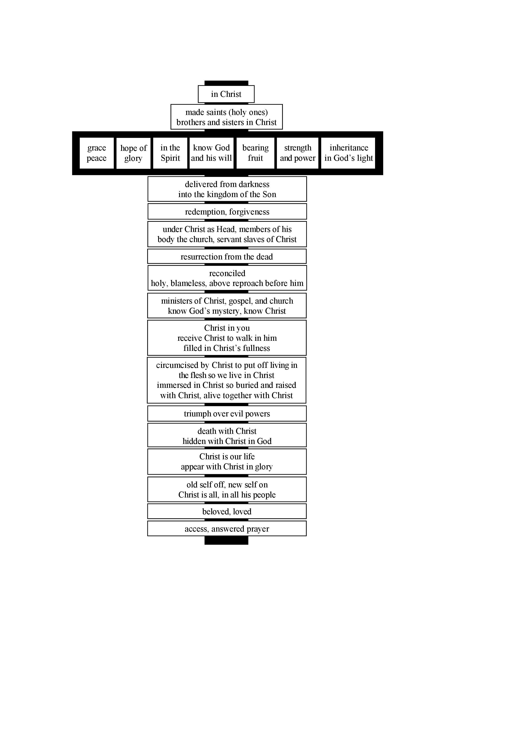
The fullness of God’s grace in Christ crucified is like gifts attached to Christ’s cross.
This diagram shows the gifts of God’s grace in Christ in Colossians.
(For a free diagram for each NT book, go to www.GraceGodChrist.com then to “The Grace of God in Christ eBook” then click on
“The Grace of God in Christ in each NT book”)

Slide 329
  Repentance toward God and faith in our Lord Jesus Christ
in Christ
If we are in Christ,
the fullness of God
is in us, and we
are filled with
Christ and the
fullness of
God's grace
in Christ,
complete
in Christ,
not deficient,
as we wait to
enter the LORD’s
fullness of glory
in his eternal presence.
justified in Christ the righteousness of God
ransomed, redeemed Passover Lamb, sin atoned, wrath turned
forgiven peace with God reconciled eternal life adopted sons
welcomed, accepted filled, complete blessed with every blessing
Christ our wisdom from God, righteousness and sanctification and redemption
delivered from the domain of darkness into the light of the kingdom of the beloved Son
in Christ and Christ in us in the Spirit and the Spirit in us, made God’s temple
in God the Father and the Father in us immersed in Father, Son, and Spirit
Father, Son, and Spirit fellowship with us access to God and his grace answered prayer
grace at the throne of grace every need supplied Holy Spirit prays for us, helps us pray
Christ our High Priest intercedes as mediator Christ our High Priest advocates in our defense
immersed into Christ and his death and resurrection united with Christ in death and resurrection
old self crucified and buried with Christ new self raised and alive with Christ
set free from sin instrument for righteousness
under Christ, abundant grace slaves of Christ not sin
joined to Christ one with Christ
seated with Christ hidden with Christ in God
released from law, married to Christ under law of the Spirit
Spirit and God’s love poured out born of the Spirit
given, receive, have Spirit rivers of living water of Spirit
immersed in the Spirit Spirit comes on, falls on us
Spirit power to be ambassadors anointed with the Spirit
sealed with the Spirit guarantee of the Spirit
Spirit of truth helps, teaches Spirit leads
Spirit sanctifies Spirit gifts for service
Spirit fills circumcised, set apart in the Spirit
immeasurably great power God’s workmanship led in triumph and nike victory
members of Christ’s body brothers and sisters branches in Christ’s vine
  chosen race, royal priesthood, holy nation, God’s possession, God’s people
fellow citizens with the saints and members of the household of God
citizenship in heaven hope of glory inheritance, heir, fellow heir
with Christ at death made perfect glorified to be like Jesus
into heavenly kingdom enter joy of Lord delivered from wrath
God’s good work completed resurrection body like Jesus
married to the Lamb every tear wiped away
see God’s face reign forever
loved and saved
in New Covenant
jumping heart © www.fg-a.com
johncrozieris@gmail.com © 2020

Slide 330
Jesus is our fullness by faith
as Jesus is our righteousness by faith!
Our unrighteousness and emptiness
Filled with spiritual fullness in God,
needing nothing to be more complete,
in Christ alone, through faith alone,
by God’s grace alone
Christ
Me
Christ the righteousness of God
Christ the fullness of God
“reconciled . . . by his death, in order to present you holy and blameless and above reproach before him” Col 1:22
“For in him the whole fullness of deity dwells bodily,
and you have been filled in him, who is the head
of all rule and authority” Col 2:9-10

Slide 331
The false teachers in Colossians taught that being in Christ by faith was not enough for spiritual fullness in God.
They proclaimed deeper “wisdom and knowledge” (2:2,3)
and “fullness” (2:9-10) beyond receiving Christ Jesus
the Lord by faith and walking in him (2:6-7).
Christ is not enough. You need spiritual experiences of knowing and
fullness by worship encounters with angels in visions
of the spirit world
(Col 2:18-19).
Faith is not enough. You need to not eat
certain food and
drink, treat your
body with ascetic severity, and observe special holy days as
you seek angels and visions (Col 2:16-23).
in Christ
spiritual
fullness
in God
Microsoft clip art © 2013
Microsoft Corporation.

Slide 332
No! Christ is enough! Faith is enough!
We are filled in Christ the fullness of God!
In Christ are hidden all
treasures of wisdom
and knowledge!
Dove and Bible
Microsoft clip art © 2013
Microsoft Corporation.
© Yoon Nam Sun
Therefore, as you received Christ Jesus the Lord,
so walk in him, rooted and built up in him
and established in the faith, just as you were taught,
abounding in thanksgiving. (Col 2:6-7)

Slide 333
Receive Christ the Lord by faith (2:6), for God’s wisdom (2:3) and fullness (2:9-10) are by faith in Christ.
Then keep on walking in Christ.
Keep on being rooted in Christ.
Keep on being built up in Christ, established in faith in Christ, the same kind of faith the apostles taught when you received Christ.
Keep on overflowing with thanksgiving because of Christ.
2:8 See to it that no one takes you captive by philosophy and empty deceit, according to human tradition, according to the elemental spirits of the world, and not according to Christ.
(Don’t be taken captive by any who say Christ isn’t enough.
It’s just philosophy, deceit, human, elemental.)

Slide 334
THE LORD
God’s completely different way
to deepest joy and satisfaction
smiley © sherv.net
Jumping heart © www.fg-a.com
People circle © clipartfest.com
Fullness is in Christ, not in beauty, music, smart-phones, sports, cars, money, friends, romance, sex, food,
drinking parties, homes or jobs!

Slide 335
Fullness is not through other gods, meditation similar to Buddha, honoring ancestors, pleasing the spirits, going to witchdoctors, making pilgrimages, bathing in the Ganges, observing special holy days, speaking in tongues, asceticism, worship of angels, visions (Col 2:18) or being a very religious Christian.

Slide 336
Fullness is by faith in Christ the fullness of God!

Slide 337
Stop doing something to be more whole and complete.
Stop searching for fullness in other ways.
Enjoy God’s fullness in Christ by faith in his Word with prayers of thanks.

Slide 338
“I speak in tongues.
I have greater fullness than you.”
“Jesus is the
fullness of God in human flesh.”
When anyone tells you they have a greater “fullness” than the fullness we receive when we receive Christ the fullness of God
by faith apart from
any of our efforts or spiritual experiences,
they repeat the Colossian error.
“If Christ the fullness of God dwells in me
by faith,
I’m filled in him.”
“I have dreams and visions. I speak “words” from God. I’m more spiritual than you.”
Be on guard for anyone who says you will have greater fullness
if you DO something, rather than receiving Christ the fullness of God and walking in him by faith based on all he has DONE.

Slide 339
Those who speak in tongues, please don’t hear me wrong. I’m a missionary longing to share the gospel of Christ with people of another language. I think it would be wonderful if God enabled his people to speak in tongues like in Acts 2, declaring the wonderful works of God in Christ to the lost in their own language that we normally couldn’t speak! We could finish taking Christ to every people group!
bing images
But hear me right on this. If we claim, “I speak in tongues. I have greater “fullness” than you; I’m more “spiritual” than you,” we repeat the Colossian error. Same for dreams, visions and words.
God’s command in Ephesians 6:17-18 is to take the sword of the Spirit, the word of God, to pray in the Spirit. If we make tongues more “spiritual” than praying in the Spirit as the Spirit focuses our minds on God’s promises, we repeat the Colossian error.

Slide 340
“I have greater fullness than you. I’m more spiritual than you.”
“Lord Jesus, you are
the fullness of God,
dwelling in me by faith.”
“You need to DO what
I DO and experience what I experience
to be as full as I am
and as spiritual as I am.”
“You are my spiritual fullness.
You make me fully ‘spiritual.’
Nothing I DO can add to the fullness of God that you are.
Fullness in you is a gift based on what you have DONE on the cross, like all God’s grace in Christ.”

Slide 341
“If we do not rely on Christ for wholeness, all our relationships are an attempt to complete ourselves.” adapted from Drs. Les and Leslie Parrott
Lord, I trust Christ as my spiritual wholeness and fullness, Jesus in whom the whole fullness of God dwells.
I am filled in him who is the fullness of God.
I am filled with the riches of the grace of God in Christ.
It is finished. I am complete in Christ by faith apart from tongues, dreams, visions, miracles, “words”
or anything else!

Slide 342
You can’t DO anything to make yourself more righteous; I am your righteousness.
You can’t DO anything to be more forgiven;
I am your forgiveness from God.
You can’t DO anything to be more reconciled to God;
I am your reconciliation with God.
You can’t DO anything to be more accepted;
I am your acceptance with God.
You can’t DO anything to be more spiritual;
If I, in whom the fullness of God dwells, am in you;
I am your spiritual fullness in God; nothing can add to my spiritual fullness.

Slide 343
“For in him the whole fullness of deity dwells bodily
and you have been filled in him, who is the head
of all rule and authority” Col 2:9-10
fullness of God’s powers
fullness of God’s salvation
10. filled and
complete
in Christ
in whom God’s fullness dwells.
Thank you, Lord!
empty
in myself
© GospelGifs.com
with permission
jumping heart © www.fg-a.com
If we are in Christ in whom God’s fullness dwells, the head of all rule and authority, we are spiritually filled and complete in God by faith.
Nothing else makes us more “spiritual” or more “full” in God’s sight.

Slide 344
Jesus
Mohammed
Confucius
Can anyone else give us fullness in God?
Is anyone else the one in whom God’s fullness dwells, the head of all rule and authority,
who fills all in him with spiritual fullness in God?
Has anyone else died for our sins to become
for us the fullness of God’s blessing?
Hindu Gurus
Moses
Buddha

Slide 345
Buddhism says:
Do Do Do
Do Do Do
Do Do.
You Do.
8-fold path
Islam
says:
Do Do Do
Do Do all Allah wants.
You Do.
5 pillars
Hinduism
says:
Do Do Do
Do Do Do
Do Do Do.
You Do.
many paths
Jesus
says:
It is DONE.
I am all you need.
I give, you receive.
I DO 4 U.
Come to me
and drink.
I DO 4 U
More free resources on the grace of God in Christ @ www.GraceGodChrist.com

Slide 346
  Repentance toward God and faith in our Lord Jesus Christ
Enjoy opening the gifts of God’s grace
in Christ which God has given us to bring us into fullest joy and satisfaction in God!
in Christ
justified in Christ the righteousness of God
ransomed, redeemed Passover Lamb, sin atoned, wrath turned
forgiven peace with God reconciled eternal life adopted sons
welcomed, accepted filled, complete blessed with every blessing
Christ our wisdom from God, righteousness and sanctification and redemption
delivered from the domain of darkness into the light of the kingdom of the beloved Son
in Christ and Christ in us in the Spirit and the Spirit in us, made God’s temple
in God the Father and the Father in us immersed in Father, Son, and Spirit
Father, Son, and Spirit fellowship with us access to God and his grace answered prayer
grace at the throne of grace every need supplied Holy Spirit prays for us, helps us pray
Christ our High Priest intercedes as mediator Christ our High Priest advocates in our defense
immersed into Christ and his death and resurrection united with Christ in death and resurrection
old self crucified and buried with Christ new self raised and alive with Christ
set free from sin instrument for righteousness
under Christ, abundant grace slaves of Christ not sin
joined to Christ one with Christ
seated with Christ hidden with Christ in God
released from law, married to Christ under law of the Spirit
Spirit and God’s love poured out born of the Spirit
given, receive, have Spirit rivers of living water of Spirit
immersed in the Spirit Spirit comes on, falls on us
Spirit power to be ambassadors anointed with the Spirit
sealed with the Spirit guarantee of the Spirit
Spirit of truth helps, teaches Spirit leads
Spirit sanctifies Spirit gifts for service
Spirit fills circumcised, set apart in the Spirit
immeasurably great power God’s workmanship led in triumph and nike victory
members of Christ’s body brothers and sisters branches in Christ’s vine
  chosen race, royal priesthood, holy nation, God’s possession, God’s people
fellow citizens with the saints and members of the household of God
citizenship in heaven hope of glory inheritance, heir, fellow heir
with Christ at death made perfect glorified to be like Jesus
into heavenly kingdom enter joy of Lord delivered from wrath
God’s good work completed resurrection body like Jesus
married to the Lamb every tear wiped away
see God’s face reign forever
loved and saved
in New Covenant
jumping heart © www.fg-a.com
johncrozieris@gmail.com © 2020

Slide 347
Lord, thank you that all these gifts
in Christ
are provided
for us by Christ’s death and resurrection!
It is finished.
You give all
in Christ
the moment we open our hearts to receive Christ.
justified, righteous in Christ, ransomed, redeemed Passover Lamb, propitiation, sin atoned, wrath turned forgiven peace reconciled eternal life
adopted sons accepted filled, complete
blessed with all blessing Christ our wisdom
righteousness and sanctification and redemption
delivered from darkness to light of kingdom of Son
in Christ and Christ in us in the Spirit and the Spirit in us, made God’s temple in God the Father and the Father in us
immersed in Father, Son, and Spirit Father, Son, and Spirit fellowship with us access to God and his grace
answered prayer grace at the throne of grace every need supplied the Spirit prays for us, helps us pray
Christ our High Priest intercedes as mediator Christ our High Priest advocates in our defense
immersed into Christ and his death and resurrection united with Christ in death and resurrection
old self crucified buried with Christ new self raised alive with Christ set free from sin instrument for righteousness
under Christ, abundant grace slaves of Christ not sin joined to Christ one with Christ seated with Christ
hidden with Christ in God released from law, married to Christ under law of the Spirit Spirit and God’s love poured out
born of the Spirit given, receive, have the Spirit
rivers of living water of the Spirit immersed in the Spirit
Spirit comes on, falls on us Spirit power to be ambassadors anointed and sealed with the Spirit guarantee of the Spirit
Spirit of truth helps, teaches Spirit leads and sanctifies Spirit gifts for service Holy Spirit fills
circumcised, by Christ, set apart in the Spirit
immeasurably great power of the Spirit
God’s workmanship created in Christ
led in triumph and nike victory
members of Christ’s body
brothers and sisters
branches in Christ’s vine
  chosen race royal priesthood
  holy nation, God’s possession
  God’s people fellow citizens with saints
members of the household of God
citizenship in heaven hope of glory
inheritance, heirs of God, fellow heirs
with Christ at death made perfect
glorified to be like Jesus
brought safely into the heavenly kingdom
enter joy of Lord delivered from wrath
God’s good work completed in us
resurrection body like Jesus married to the Lamb
every tear wiped away see God’s face reign forever
loved and saved in the New Covenant
johncrozieris@gmail.com
© 2020

Slide 348
  Repentance toward God and faith in our Lord Jesus Christ
Lord, thank you that Jesus died to give us
all your amazing
grace,
the riches of the
grace
of God
in Christ!
in Christ
justified in Christ the righteousness of God
ransomed, redeemed Passover Lamb, sin atoned, wrath turned
forgiven peace with God reconciled eternal life adopted sons
welcomed, accepted filled, complete blessed with every blessing
Christ our wisdom from God, righteousness and sanctification and redemption
delivered from the domain of darkness into the light of the kingdom of the beloved Son
in Christ and Christ in us in the Spirit and the Spirit in us, made God’s temple
in God the Father and the Father in us immersed in Father, Son, and Spirit
Father, Son, and Spirit fellowship with us access to God and his grace answered prayer
grace at the throne of grace every need supplied Holy Spirit prays for us, helps us pray
Christ our High Priest intercedes as mediator Christ our High Priest advocates in our defense
immersed into Christ and his death and resurrection united with Christ in death and resurrection
old self crucified and buried with Christ new self raised and alive with Christ
set free from sin instrument for righteousness
under Christ, abundant grace slaves of Christ not sin
joined to Christ one with Christ
seated with Christ hidden with Christ in God
released from law, married to Christ under law of the Spirit
Spirit and God’s love poured out born of the Spirit
given, receive, have Spirit rivers of living water of Spirit
immersed in the Spirit Spirit comes on, falls on us
Spirit power to be ambassadors anointed with the Spirit
sealed with the Spirit guarantee of the Spirit
Spirit of truth helps, teaches Spirit leads
Spirit sanctifies Spirit gifts for service
Spirit fills circumcised, set apart in the Spirit
immeasurably great power God’s workmanship led in triumph and nike victory
members of Christ’s body brothers and sisters branches in Christ’s vine
  chosen race, royal priesthood, holy nation, God’s possession, God’s people
fellow citizens with the saints and members of the household of God
citizenship in heaven hope of glory inheritance, heir, fellow heir
with Christ at death made perfect glorified to be like Jesus
into heavenly kingdom enter joy of Lord delivered from wrath
God’s good work completed resurrection body like Jesus
married to the Lamb every tear wiped away
see God’s face reign forever
loved and saved
in New Covenant
jumping heart © www.fg-a.com
johncrozieris@gmail.com © 2020

Slide 349
Spirit
gifted
glory with Christ
reign
forever
see his face
resurrection
Spirit
fills
sanctified
seated with Christ
Christ
intercedes
in the
Spirit
Christ’s
power
Spirit
anoints
crucified
with Christ
accepted
adopted
Bride of
Christ
Christ’s
body
access
eternal
life
Spirit seals
victory
fullness
kingdom of
Christ
Christ
in us
raised with Christ
alive
in Christ
hidden with Christ in God
immersed
into Christ
every
blessing
peace
New
Covenant
led by
the Spirit
hope
of
glory
set free
from sin
atonement
of Christ
one with
Christ
born of the Spirit
loved
forgiven
reconciled
Christ’s ransom
Christ’s righteousness
Spirit
poured out
saved
When Christ rose,
it’s as if his cross became a tree of life
with many fruits to joyfully eat by faith.
Come to me and eat.
rooted in the blood of Jesus Christ, the Son of God

Slide 350
Spirit
gifted
glory with Christ
reign
forever
see his face
resurrection
Spirit
fills
sanctified
Christ
intercedes
seated with Christ
in the Spirit
Christ’s
power
Spirit
anoints
crucified
with Christ
accepted
adopted
Bride of
Christ
Christ’s
body
access
eternal
life
Spirit seals
victory
fullness
kingdom of
Christ
hope
of
glory
raised with Christ
alive
in Christ
Christ
in us
every
blessing
immersed
into Christ
peace
New
Covenant
atonement
of Christ
one with
Christ
led by
the Spirit
set free
from sin
saved
born of
the Spirit
hidden with Christ in God
forgiven
loved
Spirit
poured out
reconciled
Christ’s ransom
Christ’s righteousness
When Christ rose,
it’s as if his cross became a fountain
of life-giving water to joyfully drink by faith.
Come to me and drink.
a fountain flowing from the blood of Jesus Christ, God’s Son

Slide 351
From the eBook, “The Grace of God in Christ:
Sixty days of enjoying Jesus Christ and God’s riches of grace in Christ” by John Crozier free eBook at www.GraceGodChrist.com
John was a Pastor in Canada from 1979-2008.
From 2009-2016, John was an ESL teacher and Pastor in South Korea, mainly training Korean missionaries at MTI, the Missionary Training Institute. Now retired, he serves with Engage Today (www.engage.today), with the privilege of encouraging indigenous leaders in India, Bangladesh, Myanmar, Nepal and Indonesia.
John’s Doctor of Ministry is from Trinity Evangelical Divinity School in Deerfield, Illinois (Chicago).
Contact John at: johncrozieris@gmail.com

Slide 352
“John’s carefully calibrated study of the believer’s blessings in Christ is superbly done! It breathes Scripture – exalts Christ – is most practical and adaptable.
These truths are much needed in our time. Highly recommended.”
Dr. David Larsen
Trinity Evangelical Divinity School

Slide 353
“I love being reminded daily of who I am in Christ and of all that Christ has done for me. John's study has helped me to live a more joyous and victorious life.
We are indeed rich in Christ.”
Bob Arnold, SIM International, former Director of SIM Benin

Slide 354
“As I read John’s study, I found myself being blessed by the truths being presented, and incorporated them into my own devotional life.
I shared the list of the riches with my study group and we spent time each week reflecting on each truth.
I commend the study of God’s riches of grace by those who desire to move to the next level of their maturing in Christ.”
Dr. Gene Swanstrom
Trinity Evangelical Divinity School

Slide 355
“Before John’s class at MTI, I didn’t know about the riches of grace even though I’m a seminary grad and a Pastor for ten years. Now I’m excited about God’s grace in Christ, and preaching Christ’s riches. Because the Korean church in general does not preach the riches of grace, it makes church members weak and religious. Now when I teach, God’s people are surprised by God’s wonderful grace and the amazing love of Jesus.”
Pastor Jin Woo Lee, MTI, now a missionary with AIM in Africa

Slide 356
“I love John’s PPT diagrams of the many riches of the Grace of God in Christ.
It’s a great way to learn to share the gospel in depth with simple questions, terms and pictures. I believe this is what mission trainees need. We can use John’s PPT on our smart-phone to share Christ effectively in any language.”
Pastor Hakjin Chun, former Director of SIM Korea

Slide 357
This PPT is “The Grace of God in Christ” a shorter version of “God’s Gifts of Delight in Christ” in English, Korean, Nepali, and Chinese
There are other free PPT’s at www.GraceGodChrist.com
“100 Easter Gifts” and “100 Thanksgiving Gifts” are all based on “God’s Gifts of Delight in Christ”
“Finding true Joy” for sharing Christ with friends
“Nos Richesses” The Grace of God in Christ in French
“How Easter Opens the Door to Deepest Joy” good for sharing the gospel briefly
“The Grace of God in Christ in Romans” in English
“The Grace of God in Christ in Colossians” in English
“Nike in the New Testament” in English, Korean and English/Korean

Slide 358
Sharing with a friend
When you share this on your smart-phone, the slides are set up so you can ask simple who, what, when, where, why, how questions so there can be friendly discussion back and forth.
For instance, #1 justified: What do you see?
What’s the difference between the two?
What does the Bible say?
How did the one change?
Which one do you want to be?

Slide 359
Please spread this PPT to as many as possible without charge.
Please send it to missionaries for their encouragement and use!
I would gladly help missionaries translate the PPT as much as I can if they contact me.
Other resources are available at www.GraceGodChrist.com
Contact John at johncrozieris@gmail.com

Slide 360
John’s book on the powers and perfections of God the Father, Son and Spirit is
“Know Your God:
Thirty days of enjoying the Lord and His Character” by John Crozier free eBook at www.GraceGodChrist.com
In this life, two key fountains to constantly drink from are God’s character and his riches in Christ. They are really one fountain, the fountain of God in Christ. All God’s grace in Christ is that we may know God as he is, rejoicing in him forever.
“Know Your God” focuses on God’s character. “The Grace of God in Christ” focuses on all God provides in Christ.

Slide 361
To get this PPT to play properly so the smileys dance on your smart-phone or other device, you must download a free copy of Microsoft Office Powerpoint onto your phone, and when you go to this PPT, you must press the “play as a PPT” tab. Otherwise the smileys stand still and the heart doesn’t jump for joy!

Slide 362
PPT © copyright by John Crozier 2023
Available without cost.
For educational purposes.
I have used Google image search to try to find the original source of the graphics from the internet in order to give proper credit.
If you know of the original source of any graphics that say
“various copies on internet, original source unknown,” please contact me at: johncrozieris@gmail.com

