Slide 1
To get this PPT to play properly so the smileys dance on your smart-phone or other device, you must download a free copy of Microsoft Office Powerpoint onto your phone, and when you go to this PPT, you must press the “play as a PPT” tab. Otherwise the smileys stand still and the heart doesn’t jump for joy!
All Scripture quotations are taken from
The Holy Bible, English Standard Version (ESV), copyright © 2001 by Crossway Bibles,
a publishing ministry of Good News Publishers.
Used by permission. All rights reserved.

Slide 2

The Grace of God in Christ:
100 gifts of wonderful connection with God we receive
in God’s gift of Christ our crucified Messiah reigning in power!
smiley © sherv.net
jumping heart © www.fg-a.com

Slide 3

Jesus completely changed our understanding of
the one true God, the LORD
THE LORD
Father, Son and Spirit oneness
love, fellowship, cooperation
smiley © sherv.net
heart © clipartbest.com

Slide 4
Jesus also completely changed our understanding
of relationship with the LORD through faith in Christ
THE LORD
Father, Son and Spirit oneness
love, fellowship, cooperation
smiley © sherv.net
heart © clipartbest.com

Slide 5

When we receive God’s gift of his Son
Jesus Christ

Slide 6
we receive all
Jesus is as our crucified and reigning Savior.

Slide 7

I am your ransom
and redemption
I am your forgiveness
from God
I am your
righteousness
from God
justification
I am
your
peace
with God
Receiving Jesus is like receiving a large gift with many gifts inside.
I am your
adoption
as God’s
child
I am your
deliverance from darkness
into the kingdom of God’s Son
I am your
hope of glory
I am your
fullness
of blessing
I am your
at-one-ment with the Lord
God’s wrath turned away
I am your
spiritual fullness
in God
I am your
eternal
life

Slide 8
I am your ransom
and redemption
I am your forgiveness
from God
I am your
righteousness
from God
justification
I am
your
peace
with God
“From his fullness we have all received, grace upon grace.” John 1:16
I am your
adoption
as God’s
child
I am your
deliverance from darkness
into the kingdom of God’s Son
I am your
hope of glory
I am your
fullness
of blessing
I am your
at-one-ment with the Lord
God’s wrath turned away
I am your
spiritual fullness
in God
I am your
eternal
life

Slide 9
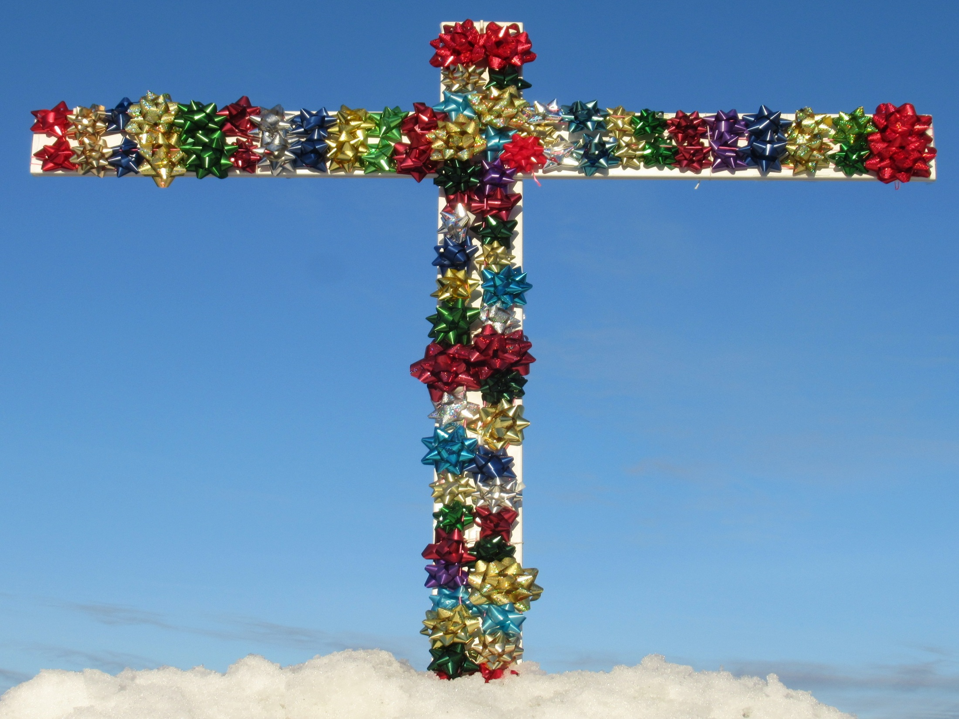
Let’s enjoy all the gifts of “peace by the blood of his cross”
which we receive in
Christ our crucified and reigning Lord!

Slide 10
  Repentance toward God and faith in our Lord Jesus Christ
Lord, thank you that Jesus died to give us
all your amazing
grace,
the riches of the
grace
of God
in Christ,
to know and enjoy you as sons!
in Christ
counted as righteous in Christ the righteousness of God
ransomed, redeemed Passover Lamb, sin atoned, wrath turned
forgiven peace with God reconciled eternal life adopted sons
welcomed, accepted filled, complete blessed with every blessing
Christ our wisdom from God, righteousness and sanctification and redemption
delivered from the domain of darkness into the light of the kingdom of the beloved Son
in Christ and Christ in us in the Spirit and the Spirit in us, made God’s temple
in God the Father and the Father in us immersed in Father, Son, and Spirit
Father, Son, and Spirit fellowship with us access to God and his grace answered prayer
grace at the throne of grace every need supplied Holy Spirit prays for us, helps us pray
Christ our High Priest intercedes as mediator Christ our High Priest advocates in our defense
immersed into Christ and his death and resurrection united with Christ in death and resurrection
old self crucified and buried with Christ new self raised and alive with Christ
set free from sin instrument for righteousness
under Christ, abundant grace slaves of Christ not sin
joined to Christ one with Christ
seated with Christ hidden with Christ in God
released from law, married to Christ under law of the Spirit
Spirit and God’s love poured out born of the Spirit
given, receive, have Spirit rivers of living water of Spirit
immersed in the Spirit Spirit comes on, falls on us
Spirit power to be ambassadors anointed with the Spirit
sealed with the Spirit guarantee of the Spirit
Spirit of truth helps, teaches Spirit leads
Spirit sanctifies Spirit gifts for service
Spirit fills circumcised, set apart in the Spirit
immeasurably great power God’s workmanship led in triumph and nike victory
members of Christ’s body brothers and sisters branches in Christ’s vine
  chosen race, royal priesthood, holy nation, God’s possession, God’s people
fellow citizens with the saints and members of the household of God
citizenship in heaven hope of glory inheritance, heir, fellow heir
with Christ at death made perfect glorified to be like Jesus
into heavenly kingdom enter joy of Lord delivered from wrath
God’s good work completed resurrection body like Jesus
married to the Lamb every tear wiped away
see God’s face reign forever
loved and saved
in New Covenant
jumping heart © www.fg-a.com
johncrozieris@gmail.com © 2022

Slide 11
Lord, thank you that all these gifts
in Christ
are provided
for us by Christ’s death and resurrection!
It is finished.
You give all
in Christ
the moment we open our hearts to receive Christ.
justified, righteous in Christ ransomed, redeemed Passover Lamb, propitiation, sin atoned, wrath turned forgiven peace reconciled eternal life
adopted sons accepted filled, complete
blessed with all blessing Christ our wisdom
righteousness and sanctification and redemption
delivered from darkness to light of kingdom of Son
in Christ and Christ in us in the Spirit and the Spirit in us, made God’s temple in God the Father and the Father in us
immersed in Father, Son, and Spirit Father, Son, and Spirit fellowship with us access to God and his grace
answered prayer grace at the throne of grace every need supplied the Spirit prays for us, helps us pray
Christ our High Priest intercedes as mediator Christ our High Priest advocates in our defense
immersed into Christ and his death and resurrection united with Christ in death and resurrection
old self crucified buried with Christ new self raised alive with Christ set free from sin instrument for righteousness
under Christ, abundant grace slaves of Christ not sin joined to Christ one with Christ seated with Christ
hidden with Christ in God released from law, married to Christ under law of the Spirit Spirit of God’s agape poured out
born of the Spirit given, receive, have the Spirit rivers of living water of the Spirit immersed in the Spirit
Spirit comes on, falls on us Spirit power to be ambassadors anointed and sealed with the Spirit guarantee of the Spirit
Spirit of truth helps, teaches Spirit leads and sanctifies Spirit gifts for service Holy Spirit fills
circumcised, by Christ, set apart in the Spirit
immeasurably great power of the Spirit
God’s workmanship created in Christ
led in triumph and nike victory
members of Christ’s body
brothers and sisters
branches in Christ’s vine
  chosen race royal priesthood
  holy nation, God’s possession
  God’s people fellow citizens with saints
members of the household of God
citizenship in heaven hope of glory
inheritance, heirs of God, fellow heirs
with Christ at death made perfect
glorified to be like Jesus
brought safely into the heavenly kingdom
enter joy of Lord delivered from wrath
God’s good work completed in us
resurrection body like Jesus married to the Lamb
every tear wiped away see God’s face reign forever
loved and saved in the New Covenant
johncrozieris@gmail.com
© 2020

Slide 12

counted as righteous in Christ the righteousness of God
ransomed, redeemed Passover Lamb, sin atoned, wrath turned
forgiven peace with God reconciled eternal life adopted sons
welcomed, accepted filled, complete blessed with every blessing
Christ our wisdom from God, righteousness and sanctification and redemption
delivered from the domain of darkness into the light of the kingdom of the beloved Son
in Christ and Christ in us in the Spirit and the Spirit in us, made God’s temple
in God the Father and the Father in us immersed in the Father, Son, and Spirit
Father, Son, and Spirit fellowship with us access to God and his grace
answered prayer grace at the throne of grace
every need supplied Holy Spirit prays for us, helps us pray
Christ our H.P. intercedes as our mediator Christ our H.P. advocates in our defense
immersed in Christ and his death and res. united with Christ in his death and res.
old self crucified and buried with Christ new self raised and alive with Christ
set free from sin instrument for righteousness
under Christ, abundant grace slaves of Christ not sin
joined to Christ one with Christ
seated with Christ hidden with Christ in God
released from law to marry Christ under law of the Spirit
Spirit of God’s agape poured out born of the Spirit
given, receive, have Spirit rivers of living water of Spirit
immersed in the Spirit Spirit comes on, falls on us
Spirit power to be ambassadors anointed with the Spirit
sealed with the Spirit guarantee of the Spirit
Spirit of truth helps, teaches Spirit leads
Spirit sanctifies Spirit gifts for service
Spirit fills circumcised, set apart in the Spirit
immeasurably great power God’s workmanship
led in triumph and nike victory members of Christ’s body
brothers and sisters branches in Christ’s vine
  chosen race, royal priesthood, holy nation God’s possession, God’s people
fellow citizens with the saints members of the household of God
citizenship in heaven hope of glory inheritance, heir, fellow heir
with Christ at death made perfect glorified to be like Jesus
into heavenly kingdom enter joy of Lord delivered from wrath
God’s good work completed resurrection body like Jesus married to the Lamb
every tear wiped away see God’s face reign forever
loved and saved in the New Covenant
Receive me - receive all I provide through my death
I DO 4 U
Jesus © GospelGifs.com
Pulsing heart @clipartbest.com

Slide 13
The Grace of God in Christ
100 gifts of delight we receive in the Lord’s gift of Christ crucified
Gifts that are a firm foundation 1-14
Gifts of connection with Father, Son and Spirit 15-23
Gifts of life at God’s throne 24-31
Gifts of being set free from sin 32-48
Gifts of life in the Holy Spirit 48-71
Gifts of being the body of Christ 72-82
Gifts of future glory 83-97
Three great gifts that include all the others 98-100
Use “search” on your smart-phone

Slide 14
Highly recommended
Develop the habit of praising the LORD every day for his grace in Christ. Develop a mind and heart that rests in Christ for all.
During your prayer time each of the seven days of the week, praise the Lord through section 1 on Day 1,
section two on Day 2, . . . seven on Day 7!
Monday – Section 1 Gifts that are a firm foundation
Tuesday – Section 2
Wednesday – Section 3
Thursday – Section 4
Friday – Section 5
Saturday – Section 6
Sunday – Section 7

Slide 15
Gifts 1-14
in Christ
counted as righteous in Christ
the righteousness of God
ransomed and redeemed
Passover Lamb and propitiation, atonement, wrath turned away
forgiven peace reconciled adopted sons
eternal life welcomed, accepted
filled in Christ the fullness of God
blessed with every blessing
Christ our wisdom from God, righteousness, sanctification, redemption
delivered from domination of darkness
transferred into the kingdom of light
faith
in Christ
Lord, thank you that Christ’s death provides
such a firm foundation of riches of grace in Christ!

Slide 16
1. counted as righteous in Christ the righteousness of God, justified in Christ the Righteous One. Thank you, Lord!
Christ the righteousness of God
THE LORD
Christ la justice de Dieu
I DO 4 U
black
unclean
condemned
© GospelGifs.com
white
holy
blameless
one
one
one
pulsing heart © clipartbest.com
smiley © sherv.net
“But now the righteousness of God has been manifested . . . the righteousness of God through faith in Jesus Christ for all who believe. . . . for all have sinned . . .
and are justified by his grace as a gift, through the redemption that is in Christ Jesus” Rom 3:21-24

Slide 17
1. counted as righteous in Christ the righteousness of God, justified in Christ the Righteous One. Thank you, Lord!
Christ the righteousness of God
THE LORD
Christ la justice de Dieu
I DO 4 U
black
unclean
condemned
© GospelGifs.com
white
holy
blameless
one
one
one
pulsing heart © clipartbest.com
smiley © sherv.net
“as one trespass (Adam) led to condemnation for all men, so one act of righteousness (Jesus) leads to justification and life for all men. For as by the one man's disobedience (Adam) the many were made sinners, so by the one man's obedience
(Jesus) the many will be made righteous” Rom 5:18-19

Slide 18
1. counted as righteous in Christ the righteousness of God, justified in Christ the Righteous One. Thank you, Lord!
Christ the righteousness of God
THE LORD
Christ la justice de Dieu
I DO 4 U
black
unclean
condemned
© GospelGifs.com
holy
blameless
above reproach
one
one
one
pulsing heart © clipartbest.com
smileys © sherv.net
“For our sake he (God) made him (Jesus) to be sin
who knew no sin, so that in him (Jesus) we might
become the righteousness of God” 2 Cor 5:21
“reconciled . . . by his death, in order to present you holy and blameless and above reproach before him” Col 1:22

Slide 19
1. counted as righteous in Christ the righteousness of God, justified in Christ the Righteous One. Thank you, Lord!
Christ the righteousness of God
THE LORD
Christ la justice de Dieu
I DO 4 U
black
unclean
condemned
© GospelGifs.com
white
holy
blameless
one
one
one
pulsing heart © clipartbest.com
smileys © sherv.net
“we know that a person is not justified by works of the law but through faith in Jesus Christ, so we also have believed in Christ Jesus, in order to be justified by faith in Christ
and not by works of the law, because by works of the law no one will be justified” Gal 2:16

Slide 20
Our greatest need
THE HOLY LORD
The holy, holy, holy Lord doesn’t join himself to even one speck of unrighteousness.
Yet “none is righteous . . . all have sinned” (Rom 3:10,23);
we are forever condemned as unrighteous unless the LORD provides the perfect righteousness He requires!
In justification by faith,
Christ our substitute provides the death our sin requires and the perfect righteousness God requires for sinners to be counted righteous in his sight
in Christ, as righteous as God!
Opposed
by God as unrighteous,
unclean, sinful
Accepted
by God as righteous
in Christ

Slide 21
My unrighteousness
The Great Exchange
of justification in Christ alone
through faith alone by grace alone
Christ
Me
Christ the righteousness of God
Jesus lived in perfect obedience to all God’s righteous ways.
Jesus died as punishment for all our unrighteousness.
In justification, the LORD doesn’t count our sins against us as he counts the punishment we deserve as fully paid by our substitute Lamb of God and he counts / credits to us Christ’s obedience as our righteousness, by faith apart from works.
(Greek logizomai, Latin imputata Rom 4:3,4,5,6,8,9,10,11,22,23,24).

Slide 22
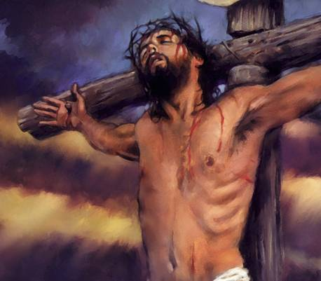
Jesus Christ is our substitute punishment ¹ for the
eternal wrath our sins against the holy LORD deserve.
Jesus Christ is our substitute righteousness ¹ for the
perfect obedience in love the holy LORD requires
to be counted righteous in his sight.
perfect love for Abba
heart © clipartbest.com
original author of picture unknown
Thank you, Lord, for these two great beauties of Jesus
in providing justification for sinners!

Slide 23
Thank you, Lord, for the two ways you are just to justify guilty sinners who deserve your just judgment.
1. Thank you for your infinitely righteous Son being your truly just sacrifice of atonement / propitiation so you justly count our sins as fully punished in Christ our substitute punishment. ¹
2. Thank you for your infinitely righteous Son obeying all your commands in the law on our behalf so you justly count us as fully righteous in Christ our substitute righteousness. ¹
You are just and the justifier of those who trust Jesus as their wrath-bearer and righteousness-provider! ¹

Slide 24
¹ John Piper uses the helpful terms Christ our “substitute perfection” and our “substitute pardon” in: John Piper and Justin Taylor, “What God Requires, Christ Provides” January 1, 2004 at DesiringGod.org.
Of his daughter he says, “Jesus' punishment and Jesus' righteousness
. . . Jesus is her righteousness and Jesus is her punishment.”
John Piper uses the terms “righteousness-provider” and “sin-bearer” in a sermon on Romans 13:8-10. “Love Is a Fulfilling of the Law, Part 3” August 7, 2005 at DesiringGod.org
Piper also uses “substitute punishment” and “substitute perfection” and “substitute sacrifice and substitute righteousness” in:
John Piper, “When Does God Become 100% For Us?
Answering a Good Question” October 3, 2007 at DesiringGod.org
Also see John Piper’s book, Counted Righteous in Christ: Should We Abandon the Imputation of Christ's Righteousness? at DesiringGod.org

Slide 25
1. counted as righteous in Christ the righteousness of God, justified in Christ the Righteous One. Thank you, Lord!
“just-as-if-I’d” never sinned. “just-as-if-I’d” obeyed all.
The Lord accepts us as righteous in Christ and unites with us.
Christ
THE LORD
united with
the Lord
to enjoy
God the Father, Son and Spirit
our sin and
punishment
to Christ
Christ the righteousness
of God to us
smiley © sherv.net
Jumping heart © www.fg-a.com
“I count everything as loss . . . in order that
I may gain Christ and be found in him,
not having a righteousness of my own that comes from the law, but that which comes through faith in Christ, the righteousness from God that depends on faith” Phil 3:8-9

Slide 26
1. counted as righteous in Christ the righteousness of God, justified in Christ the Righteous One. Thank you, Lord!
“just-as-if-I’d” never sinned. “just-as-if-I’d” obeyed all.
The Lord accepts us as righteous in Christ and unites with us.
Christ
THE LORD
black
black
black
white
white
white
one
one
one
smiley © sherv.net
Jumping heart © www.fg-a.com
“I will raise up for David a righteous Branch, and he shall reign as king and deal wisely, and shall execute justice and righteousness in the land. In his days Judah will be saved, and Israel will dwell securely. And this is the name by which he will be called: ‘The LORD is our righteousness’” Jer 23:5-6

Slide 27
1. counted as righteous in Christ the righteousness of God, justified in Christ the Righteous One. Thank you, Lord!
“just-as-if-I’d” never sinned. “just-as-if-I’d” obeyed all.
The Lord accepts us as righteous in Christ and unites with us.
Christ
THE LORD
black
black
black
white
white
white
one
one
one
smiley © sherv.net
Jumping heart © www.fg-a.com
“Out of the anguish of his soul he shall see and be satisfied; by his knowledge shall the righteous one, my servant,
make many to be accounted righteous,
and he shall bear their iniquities” Isa 53:11

Slide 28
  Repentance toward God and faith in our Lord Jesus Christ
Receive Christ and his righteousness – receive all God’s riches of grace
in Christ.
Reject Christ – reject all God’s riches.
in Christ
counted as righteous in Christ the righteousness of God
ransomed, redeemed Passover Lamb, sin atoned, wrath turned
forgiven peace with God reconciled eternal life adopted sons
welcomed, accepted filled, complete blessed with every blessing
Christ our wisdom from God, righteousness and sanctification and redemption
delivered from the domain of darkness into the light of the kingdom of the beloved Son
in Christ and Christ in us in the Spirit and the Spirit in us, made God’s temple
in God the Father and the Father in us immersed in Father, Son, and Spirit
Father, Son, and Spirit fellowship with us access to God and his grace answered prayer
grace at the throne of grace every need supplied Holy Spirit prays for us, helps us pray
Christ our High Priest intercedes as mediator Christ our High Priest advocates in our defense
immersed into Christ and his death and resurrection united with Christ in death and resurrection
old self crucified and buried with Christ new self raised and alive with Christ
set free from sin instrument for righteousness
under Christ, abundant grace slaves of Christ not sin
joined to Christ one with Christ
seated with Christ hidden with Christ in God
released from law, married to Christ under law of the Spirit
Spirit and God’s love poured out born of the Spirit
given, receive, have Spirit rivers of living water of Spirit
immersed in the Spirit Spirit comes on, falls on us
Spirit power to be ambassadors anointed with the Spirit
sealed with the Spirit guarantee of the Spirit
Spirit of truth helps, teaches Spirit leads
Spirit sanctifies Spirit gifts for service
Spirit fills circumcised, set apart in the Spirit
immeasurably great power God’s workmanship led in triumph and nike victory
members of Christ’s body brothers and sisters branches in Christ’s vine
  chosen race, royal priesthood, holy nation, God’s possession, God’s people
fellow citizens with the saints and members of the household of God
citizenship in heaven hope of glory inheritance, heir, fellow heir
with Christ at death made perfect glorified to be like Jesus
into heavenly kingdom enter joy of Lord delivered from wrath
God’s good work completed resurrection body like Jesus
married to the Lamb every tear wiped away
see God’s face reign forever
loved and saved
in New Covenant
jumping heart © www.fg-a.com
johncrozieris@gmail.com © 2020

Slide 29
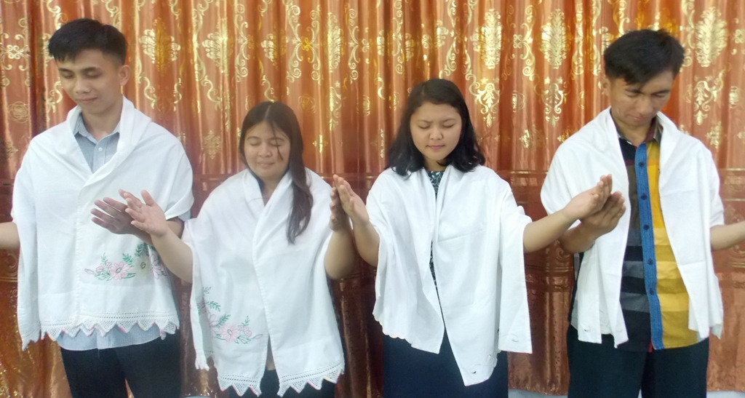
Have you received Jesus Christ, the Righteous One, crucified and risen, as God’s robe of infinite righteousness?
Has God justified you in Christ the righteousness of God?
photo by John Crozier
free to use
No one is as righteous in God’s sight as God himself without receiving Christ as God’s robe of righteousness.
God doesn’t contaminate heaven with one speck of dirt!
Our own efforts to be righteous are not enough!

Slide 30
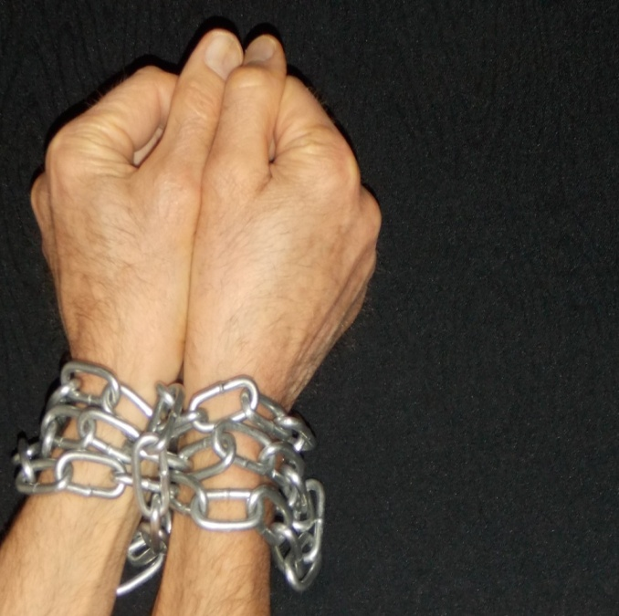
2. Ransom, redemption in Christ. Thank you, Lord!
“the Son of Man came not to be served but to serve, and to give his life as a ransom for many” Mat 20:28
Christ la justice de Dieu
chains
of
sin
Satan
death
hell
THE LORD
No copyright John Crozier
ransom
redemption
chains chains chains
slave slave slave
smileys © sherv.net
Jesus © GospelGifs.com
pulsing heart © clipartbest.com
Jumping heart © www.fg-a.com
free free free
to walk in Christ
“all have sinned . . . and are justified by his grace as a gift, through the redemption that is in Christ” Rom 3:23-24

Slide 31


Redemption from slavery to sin?
I’m a slave to sin?
chains
of
sin
Satan
death
hell
Note how Romans 1:29-31 describes
the enslavement to sin from which Christ died to redeem / free us
in Romans 3:24.
“They were filled with all manner of unrighteousness, evil, covetousness, malice. They are full of envy, murder, strife, deceit, maliciousness.
They are gossips, slanderers,
haters of God, insolent, haughty, boastful, inventors of evil,
disobedient to parents, foolish, faithless, heartless, ruthless.”
No copyright John Crozier
chains chains chains
slave slave slave
Me! Me! Me!
Me first!
© GospelGifs.com

Slide 32
Redemption from slavery to sin?
I’m a slave to sin?
chains
of
sin
Satan
death
hell
To Jews who think they are righteous
and Gentiles are not, God says,
“you . . . practice the very same things. . . . you are storing up wrath for yourself on the day of wrath when God's righteous judgment will be revealed” (Rom 2:1,5). “None is righteous, no, not one . . .
all have sinned” (Rom 3:10,23).
“you once presented your members as slaves to impurity and to lawlessness leading to more lawlessness” (Rom 6:19).
No copyright John Crozier
chains chains chains
slave slave slave
Me! Me! Me!
Me first!
© GospelGifs.com
“I am of the flesh, sold under sin (sold as a slave to sin, NIV)
. . . I have the desire to do what is right,
but not the ability to carry it out” (Rom 7:14,18 ESV).

Slide 33
2. Ransom, redemption in Christ. Thank you, Lord!
Jews in the days of Jesus and Paul thought of redemption as deliverance from being slaves in Egypt, and future redemption as the Messiah delivering Israel from subjugation to the Romans!
Christ la justice de Dieu
chains
of
sin
Satan
death
hell
THE LORD
No copyright John Crozier
ransom
redemption
chains chains chains
slave slave slave
smileys © sherv.net
Jesus © GospelGifs.com
pulsing heart © clipartbest.com
Jumping heart © www.fg-a.com
free free free
to walk in Christ
Jesus knew our greater need was redemption from slavery to sin
in the heart. “For out of the heart come evil thoughts, murder, adultery, sexual immorality, theft, false witness, slander.
These are what defile a person” (Mat 15:19-20).

Slide 34
2. Ransom, redemption in Christ. Thank you, Lord!
“He has delivered us from the domain of darkness and transferred us to the kingdom of his beloved Son, in whom we have redemption” Col 1:13-14
Christ la justice de Dieu
chains
of
sin
Satan
death
hell
THE LORD
No copyright John Crozier
ransom
redemption
chains chains chains
slave slave slave
smileys © sherv.net
Jesus © GospelGifs.com
pulsing heart © clipartbest.com
Jumping heart © www.fg-a.com
free free free
to walk in Christ
“You shall be holy, for I am holy . . . you were ransomed . . . with the precious blood of Christ, like that of a lamb without blemish or spot” 1 Pet 1:16,18-19

Slide 35
2. Ransom, redemption in Christ. Thank you, Lord!
“Whoever says he abides in him ought to walk
in the same way in which he walked” (1 Jn 2:6).
Christ la justice de Dieu
smileys © sherv.net
pulsing heart © clipartbest.com
Jumping heart © www.fg-a.com
Freedom in Christ is NOT freedom to do as we
please, as fleshly, MeMeMe believers think!
THE LORD
“Are we to continue in sin that grace may abound? By no means! . . . Are we to sin because we are not under law but under grace? By no means!” (Rom 6:1,15).
redemption
“For you were called to freedom, brothers. Only do not use your freedom as an opportunity for the flesh, but through love serve one another” (Gal 5:13).
free free free
to walk in Christ
“Certain people have crept in . . . ungodly people,
who pervert the grace of our God into sensuality and
deny our only Master and Lord, Jesus Christ” (Jude 1:4).

Slide 36
2. Ransom, redemption in Christ. Thank you, Lord!
At the cross, instead of being “Me Me Me! What’s best for ME?”
Jesus redeemed us from slavery to “Me Me Me!” by his
ransom payment of “You-first Abba! I do what’s best for U!”
Christ la justice de Dieu
smileys © sherv.net
pulsing heart © clipartbest.com
Jumping heart © www.fg-a.com
redemption
© GospelGifs.com
“You first
Father”
Me! Me! Me!
Me first!
free free free
to walk in Christ
heart © clipartbest.com
original author of picture unknown
Redemption in Christ involves receiving a new heart, a U U U heart like the U U U heart of Jesus for his Abba, delivering us from our Me Me Me hearts enslaved to the Me Me Me
nature of Satan and sin. We become ransomed and redeemed sons in the Son, with the Spirit of the Son in us!

Slide 37
2. Ransom, redemption in Christ. Thank you, Lord!
chains
of
sin
Satan
death
hell
THE LORD
Christ la justice de Dieu
No copyright John Crozier
ransom
redemption
chains chains chains
slave slave slave
smileys © sherv.net
Jesus © GospelGifs.com
pulsing heart © clipartbest.com
Jumping heart © www.fg-a.com
free free free
to walk in Christ
“For the grace of God has appeared, bringing salvation for all people, training us to renounce ungodliness and worldly passions, and to live self-controlled, upright, and godly lives
in the present age, waiting for our blessed hope, the appearing of the glory of our great God and Savior Jesus Christ,
who gave himself for us to redeem us from all lawlessness
and to purify for himself a people for his own possession
who are zealous for good works. Tit 2:11-14

Slide 38
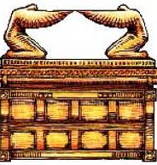
3. Passover Lamb and propitiation, atonement for sin,
God’s wrath turned away. Praise you, Lord!
under God’s wrath
Christ la justice de Dieu
wrath
turned
away
atonement
smileys © sherv.net
Jesus © GospelGifs.com
pulsing heart © clipartbest.com
Jumping heart © www.fg-a.com
at-one-ment
with the Lord
ark jewishvirtuallibrary.org
“Jesus Christ, the righteous. He is the propitiation
(atoning sacrifice, NIV) for our sins, and not for ours only
but also for the sins of the whole world” 1 John 2:1-2
“Christ, our Passover Lamb, has been sacrificed” 1 Cor 5:7

Slide 39

Photo of sun shining
through curtain
John Crozier
Most Holy Place
I DO 4 U
“Jesus . . . yielded up his spirit. . . . the curtain of the
temple was torn in two” Matt 27:50-51
When God the Father tore the curtain, he indicated that he accepted the blood of Jesus as our Passover Lamb, and also as the blood of atonement for sin, the only sacrifice sprinkled on the ark of the covenant behind the curtain.
NO!

Slide 40
Photo of sun shining
through curtain
John Crozier
Most Holy Place
I DO 4 U
“When Christ appeared as a high priest . . . he entered once for all into the holy places . . . by means of his own blood, thus securing an eternal redemption.” Heb 9:11-12
“Christ has entered, not into holy places made with hands
. . . but into heaven itself, now to appear in the presence
of God on our behalf.” Heb 9:24
NO!

Slide 41
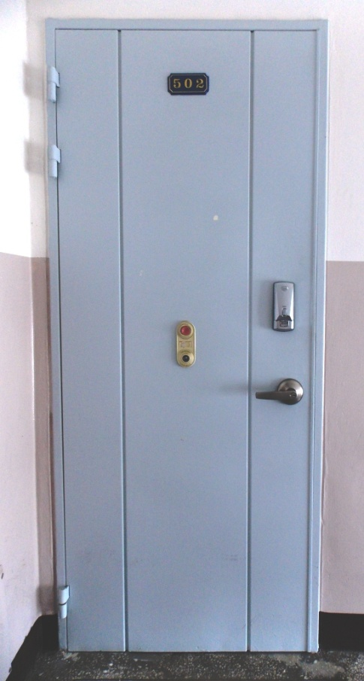
“When I see the blood, I will pass over you, and no plague will befall you to destroy you” Exodus 12:13
Photo of door by John Crozier
Pulsing heart © clipartbest.com
Is the blood
of Christ our Passover Lamb
sprinkled on
the door
of your heart?

Slide 42
3. Passover Lamb and propitiation, atonement for sin,
God’s wrath turned away. Praise you, Lord!
under God’s wrath
Christ la justice de Dieu
wrath
turned
away
atonement
smileys © sherv.net
Jesus © GospelGifs.com
pulsing heart © clipartbest.com
Jumping heart © www.fg-a.com
at-one-ment
with the Lord
ark jewishvirtuallibrary.org
“the day of wrath when God's righteous judgment will be revealed . . . wrath on us . . . Christ Jesus, whom God put forward as a propitiation (sacrifice of atonement, NIV)
by his blood, to be received by faith. He did this to demonstrate his righteousness” Rom 2:5; 3:5, 24-25

Slide 43
1-3
Smiley © sherv.net
Jumping heart © www.fg-a.com
THE LORD
Righteous through Christ, not by keeping the Law! Redemption by Christ from slavery to sin in the heart,
not just redemption from slavery to other nations!
Atonement for all time by Christ’s once-for-all sacrifice! How amazing to Jewish thinking! You tore the curtain; the sacrifices, priests and Temple are finished. Jesus is our sacrifice, High Priest and access into your presence!

Slide 44
Wait a minute!
All the diagrams for riches 1-3
have the same end result.
Christ la justice de Dieu
smileys © sherv.net
pulsing heart © clipartbest.com
Jumping heart © www.fg-a.com
These diagrams arise from the way Jesus
completely changed our understanding of God
and our understanding of relationship with God.
So let’s pause for the next 15 slides to digest these glories a little more before going on with blessing # 4.

Slide 45
Jesus completely changed our understanding of
the one true God, the LORD
THE LORD
Father, Son and Spirit oneness
love, fellowship, cooperation
smiley © sherv.net
heart © clipartbest.com

Slide 46
Jesus revealed that the one LORD God Almighty
enjoys eternal oneness, love, fellowship and cooperation
flowing between God the Father, Son and Spirit
oneness
John 10:30
John 17:21-23
Rev 1:4,5; 5:6,13
2 Cor 13:14
love
John 3:35; 5:20;
14:31; 17:24,26
Eph 1:6; Col 1:13
Mat 3:17; 17:5
THE LORD
Father, Son and Spirit oneness
love, fellowship, cooperation
fellowship
1 John 1:3-7
Lk 5:16
1 Cor 1:9
2 Cor 13:14
cooperation
perfect harmony
Mat 26:39,42
John 1:2; 5:17,19,30
John 16:13
smiley © sherv.net

Slide 47
The Father delights in his Son! The Son delights in his Father! The Holy Spirit delights in the Father and Son!
They have other-centered joy in each other! No Me-Me-Me!
smiley © sherv.net
“This is my beloved Son, with whom I am well pleased” Mt 3:17; 17:5
“I always do the things that are pleasing to him” Jn 8:29
“the Spirit of truth . . . he will not speak on his own authority” Jn 16:13

Slide 48
The cross is a window into the eternal oneness,
love, fellowship and cooperation flowing between
God the Father, Son and Spirit!
“I love You first
Father”
heart © clipartbest.com
original author of picture unknown
“Christ, who through the eternal Spirit offered himself without blemish to God” Heb 9:14
Great is the mystery once concealed now revealed!

Slide 49
The LORD alone is Father, Son and Spirit
in one being of infinite perfections fully dwelling in each unique person,
by eternal nature enjoying within himself perfect,
all-satisfying relationships of oneness, love, fellowship and cooperation
like no other being.
THE LORD
Father, Son and Spirit oneness
love, fellowship and cooperation
smiley © sherv.net

Slide 50
Alive Self-existent Joy in Himself
Spiritual Personal Self-conscious
Self-determining Independent Incomprehensible Wise Intelligent Omniscient
Infinite Eternal
Omnipotent Sovereign
Omnipresent Immanent
Transcendent Immense
Faithful Holy
Righteous Perfect Love Just
Longsuffering True Truthful
Gracious Merciful
Unchanging Jealous
Zealous Wrathful
Good Humble
Oneness and Trinity of Father, Son, and Spirit
Creator Upholder/Sustainer Savior
Shepherd Judge King
one GOD
of infinite perfections
in each unique person
smiley © sherv.net

Slide 51

THE LORD
Father, Son and Spirit oneness
love, fellowship, cooperation
Single-person GOD
all alone in eternity past with no
relational joy as the LORD has
© www.sherv.net
smileys © sherv.net
A single-person God is all alone in eternity past, without the joy of relationships of love, fellowship and cooperation.
Any God who needs to create in order to enjoy love, fellowship and cooperation is not self-sufficient,
and therefore can’t be the infinite, all-sufficient God.

Slide 52

THE LORD
Father, Son and Spirit oneness
love, fellowship, cooperation
Satan
Me Me Me self-centered.
I hate You You You. Me first!
© www.sherv.net
smileys © sherv.net
Jesus revealed that within the LORD are other-centered relationships of love, fellowship and perfectly harmonious cooperation as the Father leads in love and the Son and Spirit submit in love. Their music is U U U, I love what’s best for U!
Satan defiled heaven’s U U U music with Me Me Me first!

Slide 53
The cross is the supreme revelation of the eternal U U U love intercoursing between God the Father, Son and Spirit!
The death of Christ does NOT first of all reveal God loves ME!
perfect love for
Abba
heart © clipartbest.com
original author of picture unknown
It’s no surprise that the supreme act of U U U love is needed
to defeat Me Me Me Satan and save Me Me Me sinners!

Slide 54
Jesus completely changed our understanding of
the one true God, the LORD
THE LORD
Father, Son and Spirit oneness
love, fellowship, cooperation
smiley © sherv.net
heart © clipartbest.com

Slide 55
Jesus also completely changed our understanding
of relationship with the LORD through faith in Christ
THE LORD
Father, Son and Spirit oneness
love, fellowship, cooperation
smiley © sherv.net
heart © clipartbest.com

Slide 56
Salvation is to be reconciled
to God the Father, Son and Spirit through the death of
the Son, so that we are
in Christ, accepted
as sons in the Son,
loved by the Father
as he loves his Son,
empowered by the
Spirit to delight in
the Father as the Son
does, conformed to
the image of the Son,
living in Christ in the Spirit
in oneness, love, fellowship and cooperation with the LORD, kept unto eternal glory!
THE LORD
Father, Son and Spirit oneness
love, fellowship and cooperation
smiley © sherv.net heart © clipartbest.com

Slide 57
At the cross, instead of being
“Me Me Me!
What’s best for ME?”
Jesus revealed his eternal
nature of “You-first Abba!
I do what’s best for U!”
Salvation in Christ
involves receiving
a new heart,
a U U U heart like
the U U U heart of
Jesus for his Abba,
to deliver us from
our Me Me Me hearts
that are like the Me Me Me
nature of Satan and sin.
We become sons in the Son,
with the Spirit of the Son in us!
THE LORD
Father, Son and Spirit oneness
love, fellowship and cooperation
smiley © sherv.net heart © clipartbest.com

Slide 58

Heaven is full of God the Father, Son and Spirit enjoying each other, and God’s people enjoying the LORD!
The grace God provides in Christ through his death saves us from MeMeMe sinfulness to enjoy God as God enjoys God!
smiley © sherv.net
People circle © clipartfest.com

Slide 59
All the riches of the grace of God in Christ now and in eternity are gifts of connection with the LORD to enjoy him!
THE LORD
Father, Son and Spirit oneness
love, fellowship, cooperation
smiley © sherv.net
heart © clipartbest.com
Now let’s go on to grace in Christ crucified gift # 4.

Slide 60
God covers our sins
God cancels our debts
God sends away our sins
God frees us from our sins
God lifts off (nasa) our sins
God removes our sins from us
4. Forgiven
Smiley © sherv.net
God treads our sins underfoot
God casts our sins into the sea
God casts our sins behind his back
God blots out / wipes out our sins
God washes / cleanses us from sin
God remembers our sins no more
God does not count our sins against us
“Blessed are those whose lawless deeds are forgiven,
and whose sins are covered; blessed is the man against whom the Lord will not count his sin” Rom 4:7-8
“In him… redemption… forgiveness of our trespasses” Eph 1:7

Slide 61
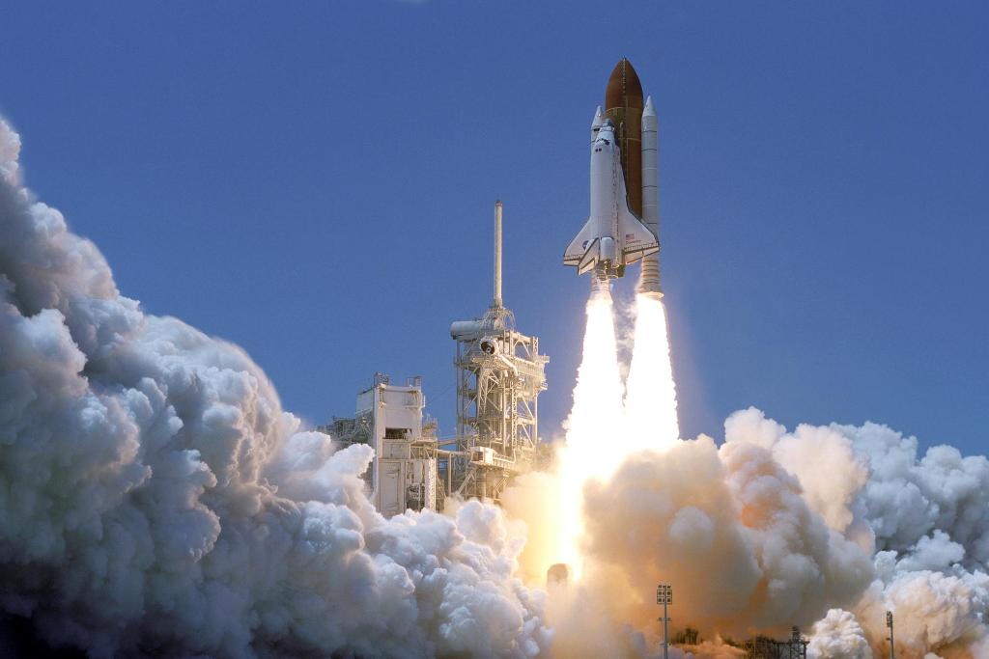
Lord, thank you that when you forgive us you “lift off / nasa” our sins from us.
Praise you that all can join your NASA (lift off) program of forgiveness!
“Please forgive (Hebrew nasa = lift off) the transgression of your brothers and their sin, because they did evil to you. And now, please forgive (nasa) the transgression
of the servants of the God of your father.” Gen 50:17
www.nasa.gov 152294main_Launch-lg.jpg

Slide 62

5. Peace with God. Thank you, Lord!
THE LORD
Christ la justice de Dieu
THE LORD
peace
War War War
Me! Me! Me!
Peace Peace Peace
You! You! You!
smileys © sherv.net
Smiley with sword © sherv.net
Jesus © GospelGifs.com
pulsing heart © clipartbest.com
Jumping heart © www.fg-a.com
“Since we have been justified by faith, we have peace with God through our Lord Jesus Christ” Rom 5:1
“Peace by the blood of his cross” Col 1:20

Slide 63
This can make your time with God more wonderful.
1. For each of the riches, look at the diagrams and praise the Lord for the truths you see.
2. Look at the Bible verses and praise the Lord for what he says he gives us through the death and resurrection of Christ!
As you learn to do this, you will be thrilled as the Lord gives you fresh insights over and over.

Slide 64

Lord, without Jesus Christ . . . but I praise you that through Christ’s death . . .
When you praise the Lord for what Christ has done,
if you start by reflecting on the condition you would be in without Christ, it increases your praise and joy in Christ.
from pqhobbit.files.wordpress.com

Slide 65
Lord, without Jesus Christ I am in chains, chains, chains, a slave, slave, slave to sin, Satan, death and hell . . . but I praise you that through Christ’s death I am free, free, free, since Christ’s ransom payment redeems me . . .
Lord, without Jesus Christ I am black, black, black
in your sight, totally unrighteous, unholy . . .
but I praise you that through Christ’s death I am white, white, white in Christ’s righteousness . . .
from pqhobbit.files.wordpress.com

Slide 66
6. Reconciled to God. Praise you, Lord!
THE LORD
Christ la justice de Dieu
THE LORD
reconciliation
Fight Fight Fight
No! No! No!
Friends Friends Friends
Yes! Yes! Yes!
Egyptian smileys © sherv.net
Smiley with sword © sherv.net
Jesus © GospelGifs.com
pulsing heart © clipartbest.com
Jumping heart © www.fg-a.com
“While we were enemies we were reconciled to God
by the death of his Son” Rom 5:10
“God, who through Christ reconciled us to himself
and gave us the ministry of reconciliation” 2 Cor 5:18

Slide 67
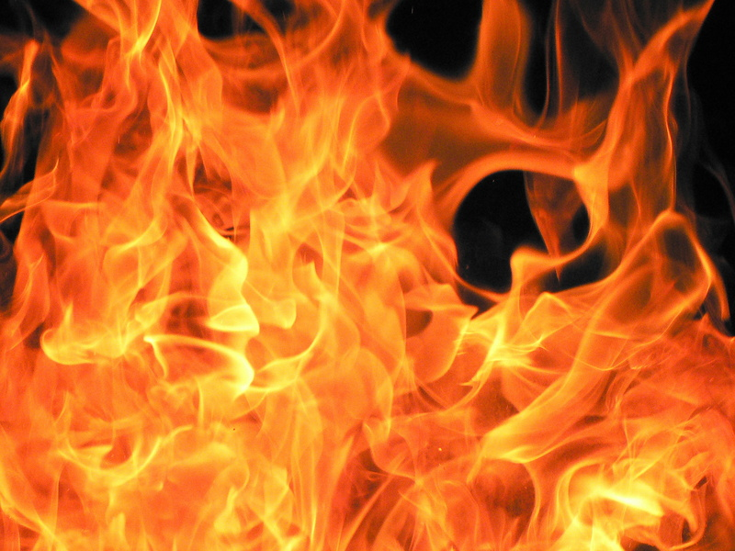
7. Eternal life in Christ. Thank you, Lord!
Christ la justice de Dieu
THE LORD
eternal life
Microsoft clip art © 2013 Microsoft Corp
death death death
perish perish perish
life, life, life
now and forever
smileys © sherv.net
Jesus © GospelGifs.com
pulsing heart © clipartbest.com
Jumping heart © www.fg-a.com
“I give them eternal life, and they will never perish,
and no one will snatch them out of my hand” John 10:28
“the wages of sin is death, but the free gift of God is eternal life in Christ Jesus our Lord” Rom 6:23

Slide 68
Jesus Christ believed in eternal life and eternal fire.
“I give them eternal life, and they will never perish”
John 10:28
“thrown into the eternal fire” Mat 18:8
“Depart from me . . . into the eternal fire” Mat 25:41
fire Microsoft Corp clip art © 2013

Slide 69
Jesus Christ believed in eternal life and eternal fire.
“The Son of Man will send his angels, and they will gather out of his kingdom all causes of sin and all law-breakers, and throw them into the fiery furnace. In that place there will be weeping and gnashing of teeth. Then the righteous will shine like the sun in the kingdom of their Father. He who has ears, let him hear.” (Jesus in Matthew 13:41-43)
fire Microsoft Corp clip art © 2013

Slide 70
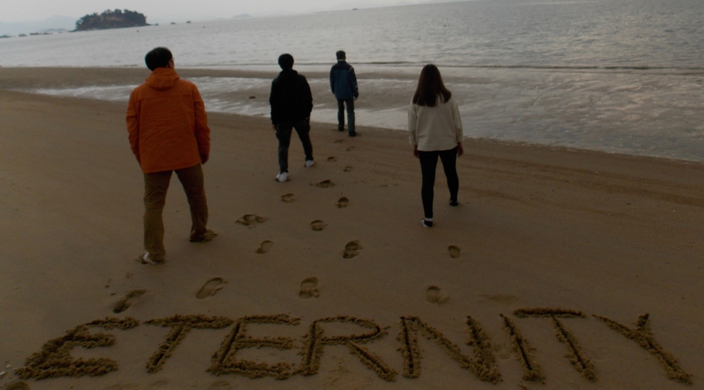
Everyone is going into eternity.
Photo John Crozier
Where will you go?

Slide 71
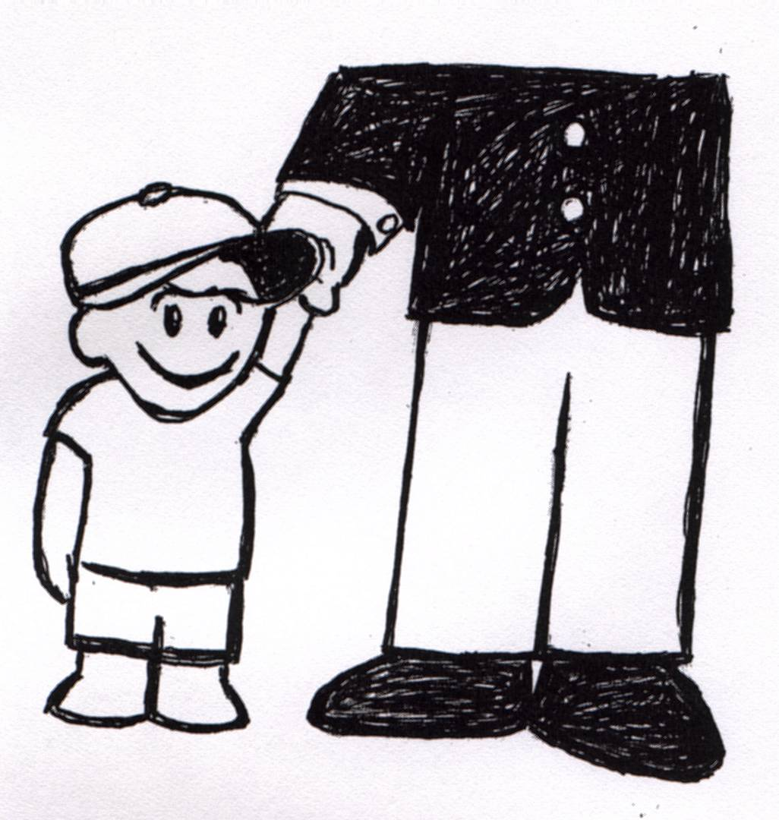

8. adopted as sons with the Spirit of God’s Son
sent into our hearts. Thank you, Father!
“Because you are sons, God has sent the Spirit of his Son
into our hearts, crying, ‘Abba! Father!’” Gal 4:6
adopted
by
Abba
sketch adapted from original
by Phil Crozier
Bible and Dove
Microsoft clip art © 2013
Microsoft Corporation.
smiley © sherv.net
“the Spirit of God dwells in you . . . the Spirit of Christ . . .
Christ is in you . . . the Spirit of him who raised Jesus
from the dead is in you . . . all who are led by the
Spirit of God are sons of God” (Rom 8:9-11, 14)
NO!
© GospelGifs.com

Slide 72
8. adopted as sons with the Spirit of God’s Son
sent into our hearts. Thank you, Father!
“He predestined us for adoption as sons through
Jesus Christ” Eph 1:5
adopted
by
Abba
sketch adapted from original
by Phil Crozier
Bible and Dove
Microsoft clip art © 2013
Microsoft Corporation.
smiley © sherv.net
“All who are led by the Spirit of God are sons of God. . . . you have received the Spirit of adoption as sons, by whom we cry, “Abba! Father!” The Spirit himself bears witness
with our spirit that we are children of God” Rom 8:14-16
NO!
© GospelGifs.com

Slide 73
THE LORD
Adopted as God’s sons.
Loved as God’s sons.
Conformed to the
image of God’s Son.
Sons in the Son.
Brothers with the Son.
Children of God.
Amazing Lord!
smiley © sherv.net
NO!
© GospelGifs.com

Slide 74
8. adopted as sons with the Spirit of God’s Son
sent into our hearts. Thank you, Father!
“See what kind of love the Father has given to us, that we should be called children of God; and so we are. . . .
adopted
by
Abba
sketch adapted from original
by Phil Crozier
Bible and Dove
Microsoft clip art © 2013
Microsoft Corporation.
smiley © sherv.net
Beloved, we are God's children now, and what we will be
has not yet appeared; but we know that when he
appears we shall be like him, because we shall
see him as he is.” 1 John 3:1-2
NO!
© GospelGifs.com

Slide 75
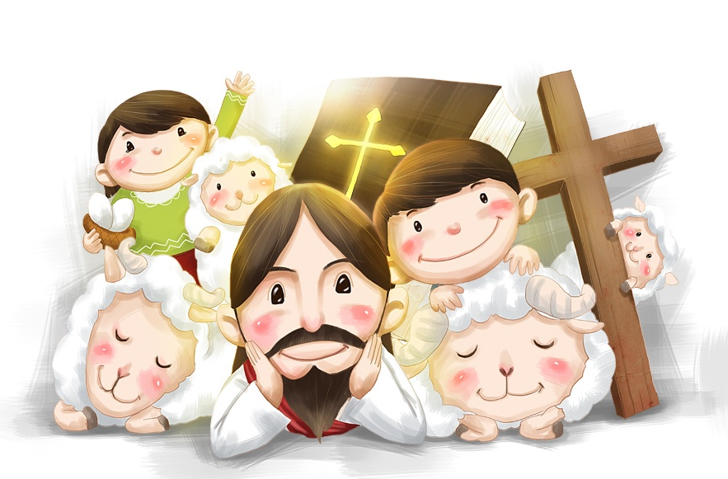
9. welcomed and accepted in Christ.
Praise you, Lord!
not accepted
© iclickart.co.kr with permission from Iregihwek print shop in Yeosu, South Korea
“Welcome one another as Christ has welcomed you,
for the glory of God” Rom 15:7 ESV
(welcome in ESV, RSV, accept NIV, NASB, receive KJV, ASV)
“their rejection . . . their acceptance” Rom 11:15 ESV, NIV

Slide 76
“For in him all the fullness of God was pleased to dwell . . .
in him the whole fullness of deity dwells bodily
and you have been filled in him, who is the head
of all rule and authority” Col 1:19; 2:9-10
fullness of God’s powers
fullness of God’s salvation
10. filled and
complete
in Christ
in whom God’s fullness dwells.
Thank you, Lord!
empty
in myself
Jesus © GospelGifs.com
with permission
pulsing heart © clipartbest.com
jumping heart © www.fg-a.com
If we are in Christ in whom God’s fullness dwells,
Christ makes us spiritually filled and complete in God by faith.
Nothing “I DO” makes me more “spiritual” or more “full” in God’s sight.

Slide 77
“The Word was God . . . the Word became flesh . . .
the only Son from the Father . . . from his fullness
we have all received, grace upon grace” John 1:1,16,18
fullness of God’s powers
fullness of God’s salvation
10. filled and
complete
in Christ
in whom God’s fullness dwells.
Thank you, Lord!
empty
in myself
Jesus © GospelGifs.com
with permission
pulsing heart © clipartbest.com
jumping heart © www.fg-a.com
If we are in Christ in whom God’s fullness dwells,
Christ makes us spiritually filled and complete in God by faith.
Nothing “I DO” makes me more “spiritual” or more “full” in God’s sight.

Slide 78
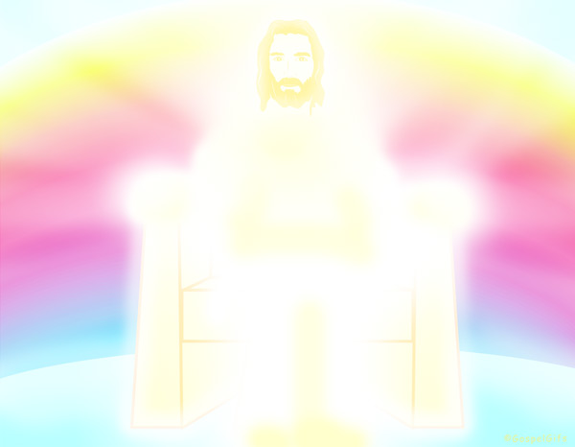
“For in him all the fullness of God was pleased to dwell”
Col 1:19
“For in him the whole fullness of deity dwells bodily”
Col 2:9
He is the image of the invisible God
the firstborn of all creation
By him all things were created
All things were created through him and for him
He is before all things
In him all things hold together
He is the head of the body, the church
He is the beginning, the firstborn from the dead
that in everything he might be preeminent
In him all the fullness of God was pleased to dwell
Through him he reconciled to himself all things
making peace by the blood of his cross.
© GospelGifs.com
with permission
Paul sets forth the fullness of God in Christ in Col 1:15-20 because the false teachers of early Gnosticism claim that faith in Christ is not enough. They claim greater “fullness.”
They claim to “know” more and to have greater “wisdom.”

Slide 79
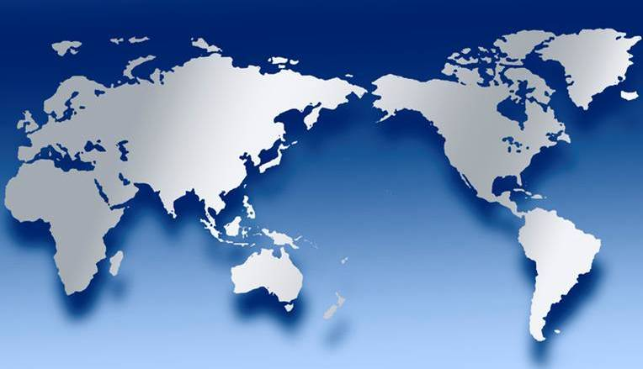
In Roman / Greek beliefs, different gods ruled different areas of creation with their different limited powers.
Poseidon ruled over the sea. Bacchus had power over grapes and wine. Aphrodite was the goddess of sex.
Ceres
Aphrodite
Vulcan
Mercury
Jupiter
Bacchus
Venus
Poseidon
Minerva
Neptune
Diana
Mars
Juno
Apollo
World map
various copies on internet,
original source unknown

Slide 80
Ceres
Aphrodite
Vulcan
Mercury
Jupiter
Bacchus
Venus
Poseidon
Minerva
Neptune
Diana
Mars
Juno
Apollo
World map
various copies on internet,
original source unknown
If you want favor from the god of childbirth, or the god of the sun, or the god of rain, you need to give them offerings and devotion. The total power of all the powers of all gods was called “the whole fullness of deity.”

Slide 81
Ceres
Aphrodite
Vulcan
Mercury
Jupiter
Bacchus
Venus
Poseidon
Minerva
Neptune
Diana
Mars
Juno
Apollo
World map
various copies on internet,
original source unknown
In Roman / Greek beliefs, there is no god who has
“the whole fullness of deity” (Col 2:9).
There is no one who is
“the head of all rule and authority” (Col 2:9).

Slide 82
In Jesus Christ “the whole fullness of deity dwells bodily.”
He is “the head of all rule and authority.”
X
Ceres
X
X
Vulcan
Mercury
X
Jupiter
X
X
Bacchus
Venus
X
© GospelGifs.com
Minerva
Jesus © GospelGifs.com
X
Poseidon
X
Diana
X
Mars
X
Neptune
Juno
X
X
Apollo
World map
various copies on internet,
original source unknown
Jesus completely overthrows Roman / Greek beliefs.
“By him all things were created . . . in him all things hold together . . . in him all the fullness of God was pleased to
dwell . . . in him the whole fullness of deity dwells bodily . . .
the head of all rule and authority” 1:16-19;2:9-10

Slide 83
In Jesus Christ “the whole fullness of deity dwells bodily”
He is “the head of all rule and authority”
X
Ceres
X
X
Vulcan
Mercury
X
Jupiter
X
X
Bacchus
Venus
X
© GospelGifs.com
Minerva
Jesus © GospelGifs.com
X
Poseidon
X
Diana
X
Mars
X
Neptune
Juno
X
X
Apollo
World map
various copies on internet,
original source unknown
Jesus has all the powers of all the Roman / Greek gods!
Plus salvation power the Roman / Greek gods don’t have!
“For in him all the fullness of God was pleased to dwell,
and through him to reconcile to himself all things . . .
making peace by the blood of his cross” (Col 1:19-20).

Slide 84
Then another shock! Human “fullness” is by being in Christ!
“In him the whole fullness of deity dwells bodily,
and you have been filled in him” Col 2:9-10
fullness of God’s powers
fullness of God’s salvation
Jesus © GospelGifs.com
with permission
pulsing heart © clipartbest.com
jumping heart © www.fg-a.com
All in Christ are “filled” in him by faith; nothing “I DO”
from the Law (2:16) or “know” from an angel or vision (2:18)
makes me more spiritual or “full” as the false teachers claim.
In Christ is all “wisdom and knowledge” (2:3) and “fullness”.
If we are in Christ in whom God’s fullness dwells,
Christ makes us spiritually filled and complete in God by faith.
Nothing “I DO” makes me more “spiritual” or more “full” in God’s sight.

Slide 85
“In him the whole fullness of deity dwells bodily,
and you have been filled in him” Col 2:9-10
Ceres
Aphrodite
Vulcan
Mercury
Jupiter
Bacchus
Venus
Minerva
Jesus © GospelGifs.com
Diana
Mars
Poseidon
Juno
Apollo
World map
various copies on internet,
original source unknown
Neptune
To a Gentile in Colossae, “fullness” for people would be to have all the gods always and only using their powers to bless you. Paul is completely amazing to say Jesus has the “fullness” of all the powers of all the gods and that all in Christ are “filled in him.” As John also says, “From his fullness we have all received, grace upon grace” (John 1:16).

Slide 86
The false teachers in Colossians taught that being in Christ by faith was not enough for spiritual fullness in God.
They proclaimed deeper “wisdom and knowledge” (2:3)
and “fullness” (2:9-10) beyond receiving Christ Jesus
the Lord by faith and walking in him (2:6-7).
Christ is not enough. You need spiritual experiences of knowing and
fullness by worship encounters with angels in visions
of the spirit world
(Col 2:18-19).
Faith is not enough. You need to not eat
certain food and
drink, treat your
body with ascetic severity, and observe special holy days as
you seek angels and visions (Col 2:16-23).
in Christ
spiritual
fullness
in God
Microsoft clip art © 2013
Microsoft Corporation.

Slide 87

How does Paul describe the false teaching?
“See to it that no one takes you captive by philosophy
and empty deceit, according to human tradition,
according to the elemental spirits of the world,
and not according to Christ” Col 2:8
“Let no one disqualify you, insisting on asceticism and worship of angels, going on in detail about visions,
puffed up without reason by his sensuous mind,
and not holding fast to the Head” Col 2:18-19
“Human precepts and teachings? These have indeed an appearance of wisdom in promoting self-made religion and asceticism and severity to the body, but they are of no value in stopping the indulgence of the flesh” Col 2:22-23

Slide 88
Christ the fullness of God is in
those in Christ,
but the false teachers
in Colossae say,
“We are more spiritual;
We have greater fullness.”
Are you serious?
Christ, the fullness of God in you, does not make you spiritually full?
God the Father, Son and Spirit is
in you, and you aren’t filled
with spiritual fullness? Really?
Christ la justice de Dieu
Christ the fullness of God
Jesus © GospelGifs.com
pulsing heart © clipartbest.com
smileys © sherv.net
To better understand how those today who claim to be more spiritual repeat the error of the false teachers in Colossians, see Appendices 1, slide 363

Slide 89
Alive Self-existent
Active Spiritual Personal
Self-conscious Free Self-determining
Independent Wise Intelligent Infinite
Eternal Incomprehensible Omniscient
Omnipotent Sovereign
Omnipresent Immanent
Transcendent Immense Faithful Holy
Righteous Perfect Love Just
Longsuffering True Truthful
Gracious Merciful
Unchanging Jealous
Zealous Wrathful Good Humble
Oneness and Trinity of Father, Son, Spirit
Creator Upholder/Sustainer Savior
Shepherd Judge King
Fullness of joy in God
fullness of God’s powers
Jesus © GospelGifs.com
jumping heart © www.fg-a.com

Slide 90
counted as righteous in Christ the righteousness of God
ransomed, redeemed Passover Lamb, sin atoned, wrath turned
forgiven peace with God reconciled eternal life adopted sons
welcomed, accepted filled, complete blessed with every blessing
Christ our wisdom from God, righteousness and sanctification and redemption
delivered from the domain of darkness into the light of the kingdom of the beloved Son
in Christ and Christ in us in the Spirit and the Spirit in us, made God’s temple
in God the Father and the Father in us immersed in the Father, Son, and Spirit
Father, Son, and Spirit fellowship with us access to God and his grace
answered prayer grace at the throne of grace
every need supplied Holy Spirit prays for us, helps us pray
Christ our H.P. intercedes as our mediator Christ our H.P. advocates in our defense
immersed in Christ and his death and res. united with Christ in his death and res.
old self crucified and buried with Christ new self raised and alive with Christ
set free from sin instrument for righteousness
under Christ, abundant grace slaves of Christ not sin
joined to Christ one with Christ
seated with Christ hidden with Christ in God
released from law, married to Christ under law of the Spirit
Spirit and God’s love poured out born of the Spirit
given, receive, have Spirit rivers of living water of Spirit
immersed in the Spirit Spirit comes on, falls on us
Spirit power to be ambassadors anointed with the Spirit
sealed with the Spirit guarantee of the Spirit
Spirit of truth helps, teaches Spirit leads
Spirit sanctifies Spirit gifts for service
Spirit fills circumcised, set apart in the Spirit
immeasurably great power God’s workmanship
led in triumph and nike victory members of Christ’s body
brothers and sisters branches in Christ’s vine
  chosen race, royal priesthood, holy nation God’s possession, God’s people
fellow citizens with the saints members of the household of God
citizenship in heaven hope of glory inheritance, heir, fellow heir
with Christ at death made perfect glorified to be like Jesus
into heavenly kingdom enter joy of Lord delivered from wrath
God’s good work completed resurrection body like Jesus married to the Lamb
every tear wiped away see God’s face reign forever
loved and saved in the New Covenant
fullness of God’s salvation
Jesus © GospelGifs.com
jumping heart © www.fg-a.com

Slide 91
  Repentance toward God and faith in our Lord Jesus Christ
in Christ
If we are in Christ
who is the fullness of God in us, we are
filled with
Christ and the
fullness of
God's grace
in Christ,
complete
in Christ,
not deficient,
as we wait to
enter the LORD’s
fullness of glory
in his eternal presence.
counted as righteous in Christ the righteousness of God
ransomed, redeemed Passover Lamb, sin atoned, wrath turned
forgiven peace with God reconciled eternal life adopted sons
welcomed, accepted filled, complete blessed with every blessing
Christ our wisdom from God, righteousness and sanctification and redemption
delivered from the domain of darkness into the light of the kingdom of the beloved Son
in Christ and Christ in us in the Spirit and the Spirit in us, made God’s temple
in God the Father and the Father in us immersed in Father, Son, and Spirit
Father, Son, and Spirit fellowship with us access to God and his grace answered prayer
grace at the throne of grace every need supplied Holy Spirit prays for us, helps us pray
Christ our High Priest intercedes as mediator Christ our High Priest advocates in our defense
immersed into Christ and his death and res. united with Christ in death and res.
old self crucified and buried with Christ new self raised and alive with Christ
set free from sin instrument for righteousness
under Christ, abundant grace slaves of Christ not sin
joined to Christ one with Christ
seated with Christ hidden with Christ in God
released from law, married to Christ under law of the Spirit
Spirit and God’s love poured out born of the Spirit
given, receive, have Spirit rivers of living water of Spirit
immersed in the Spirit Spirit comes on, falls on us
Spirit power to be ambassadors anointed with the Spirit
sealed with the Spirit guarantee of the Spirit
Spirit of truth helps, teaches Spirit leads
Spirit sanctifies Spirit gifts for service
Spirit fills circumcised, set apart in the Spirit
immeasurably great power God’s workmanship led in triumph and nike victory
members of Christ’s body brothers and sisters branches in Christ’s vine
  chosen race, royal priesthood, holy nation, God’s possession, God’s people
fellow citizens with the saints and members of the household of God
citizenship in heaven hope of glory inheritance, heir, fellow heir
with Christ at death made perfect glorified to be like Jesus
into heavenly kingdom enter joy of Lord delivered from wrath
God’s good work completed resurrection body like Jesus
married to the Lamb every tear wiped away
see God’s face reign forever
loved and saved
in New Covenant
Jesus © GospelGifs.com
jumping heart © www.fg-a.com
johncrozieris@gmail.com © 2024

Slide 92
in Christ
made saints (holy, set apart to God) brothers and sisters in Christ
grace
peace
hope
of glory
in the Spirit
know God, his will and wisdom
bearing fruit
strength
and power
inheritance
in God’s light
delivered from the domain of darkness
transferred to the kingdom of the Son
redemption, forgiveness
This diagram shows the fullness of God’s salvation
in Christ as described
in Colossians, like gifts attached to Christ’s cross.
(For a free diagram for each NT book,
go to www.GraceGodChrist.com then to “The Grace of God in Christ eBook”
then click on
“The Grace of God in Christ in each NT book”)
in Christ our Creator, Upholder, Head, Lord members of Christ’s body the church
servant slaves of Christ our perfect Master
resurrection from the dead
reconciled
holy, blameless, above reproach before him
ministers of Christ, the gospel, and church
know Christ, God’s mystery, wisdom
Christ in you
receive Christ to walk in him
filled in Christ in whom God’s fullness dwells
circumcised by Christ, living in the flesh
put off to live in Christ in the Spirit
immersed in Christ, buried with Christ, raised with Christ, alive with Christ
triumph over evil powers
death with Christ
hidden with Christ in God
Christ is our life
appear with Christ in glory
old self off, new self on
Christ is all, in all his people in Christ
beloved, loved
access, answered prayer

Slide 93











The LORD
God’s completely different way
to fullness!
smiley © sherv.net
People circle © clipartfest.com
Fullness is in Christ, not in beauty, music, phones, games, movies, sports, cars, money, friends, romance, sex, food, drinking, drugs, homes or jobs! Jesus had supreme joy without sex or money!

Slide 94
Fullness is in Christ, not:
other gods,
meditation as in Buddhism,
honoring ancestors,
pleasing the spirits,
going to witchdoctors,
making pilgrimages,
bathing in the Ganges,
observing special holy days,
being very religious,
speaking in tongues,
or “insisting on asceticism
and worship of angels,
going on in detail about visions” (Col 2:18).
Christ la justice de Dieu
Christ the fullness of God
Jesus © GospelGifs.com
pulsing heart © clipartbest.com

Slide 95
Stop doing something to be more whole and complete.
Stop searching for fullness in other ways.
Enjoy God’s fullness in Christ by faith in his Word with prayers of thanks.

Slide 96
“If we do not rely on Christ for wholeness, all our relationships are an attempt to complete ourselves.” adapted from Drs. Les and Leslie Parrott
Lord, I trust Jesus as my spiritual wholeness and fullness. I am filled in Christ in whom the whole fullness of God dwells bodily. I am filled with Christ and his riches of the grace of God in Christ, receiving grace upon grace from his fullness. It is finished! I am complete in Christ by faith apart from tongues, dreams, visions, miracles, ‘words’ or praying more, giving more, serving more!

Slide 97
Jesus is our fullness by faith
as Jesus is our righteousness by faith!
Our unrighteousness and emptiness
Filled with spiritual fullness in God,
needing nothing to be more complete,
in Christ alone, through faith alone,
by God’s grace alone
Christ
Me
Christ the righteousness of God
Christ the fullness of God
“reconciled . . . by his death, in order to present you holy and blameless and above reproach before him” Col 1:22
“For in him the whole fullness of deity dwells bodily,
and you have been filled in him, who is the head
of all rule and authority” Col 2:9-10

Slide 98
You can’t DO anything to make yourself more righteous;
I am your righteousness.
You can’t DO anything to be more forgiven;
I am your forgiveness from God.
You can’t DO anything to be more reconciled to God;
I am your reconciliation with God.
You can’t DO anything to be more accepted;
I am your acceptance with God.
You can’t DO anything to be more spiritual;
I am your spiritual fullness in God.
If I in whom the fullness of God dwells am in you, nothing you DO can add to the spiritual fullness I provide.

Slide 99
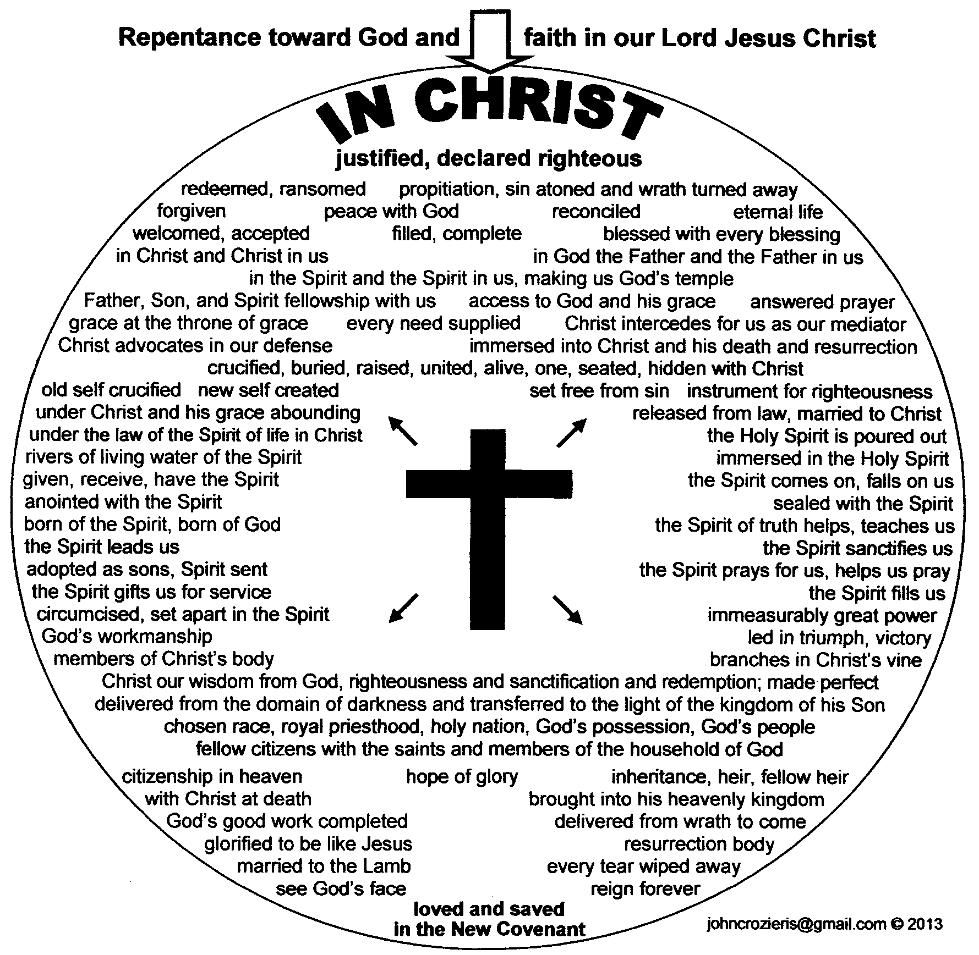


smiley © sherv.net
Jumping heart © www.fg-a.com
THE LORD
“Blessed be the God and Father
of our Lord Jesus Christ, who has blessed us in Christ with every spiritual blessing in the heavenly places”
Eph 1:3
11. blessed
in Christ
with every spiritual blessing.
Thank you, Lord!
big tears smiley © sherv.net
no blessing
all blessing
Hands - Microsoft clip art © 2013
Microsoft Corporation.

Slide 100
  Repentance toward God and faith in our Lord Jesus Christ
in Christ
Lord, thank you that Jesus is
the fullness of your blessing!
Thank you
that Christ’s death and resurrection provides all
your
blessing!
It is finished!
We believe
and receive all you freely give
in Christ!
counted as righteous in Christ the righteousness of God
ransomed, redeemed Passover Lamb, sin atoned, wrath turned
forgiven peace with God reconciled eternal life adopted sons
welcomed, accepted filled, complete blessed with every blessing
Christ our wisdom from God, righteousness and sanctification and redemption
delivered from the domain of darkness into the light of the kingdom of the beloved Son
in Christ and Christ in us in the Spirit and the Spirit in us, made God’s temple
in God the Father and the Father in us immersed in Father, Son, and Spirit
Father, Son, and Spirit fellowship with us access to God and his grace answered prayer
grace at the throne of grace every need supplied Holy Spirit prays for us, helps us pray
Christ our High Priest intercedes as mediator Christ our High Priest advocates in our defense
immersed into Christ and his death and res. united with Christ in death and res.
old self crucified and buried with Christ new self raised and alive with Christ
set free from sin instrument for righteousness
under Christ, abundant grace slaves of Christ not sin
joined to Christ one with Christ
seated with Christ hidden with Christ in God
released from law, married to Christ under law of the Spirit
Spirit and God’s love poured out born of the Spirit
given, receive, have Spirit rivers of living water of Spirit
immersed in the Spirit Spirit comes on, falls on us
Spirit power to be ambassadors anointed with the Spirit
sealed with the Spirit guarantee of the Spirit
Spirit of truth helps, teaches Spirit leads
Spirit sanctifies Spirit gifts for service
Spirit fills circumcised, set apart in the Spirit
immeasurably great power God’s workmanship led in triumph and nike victory
members of Christ’s body brothers and sisters branches in Christ’s vine
  chosen race, royal priesthood, holy nation, God’s possession, God’s people
fellow citizens with the saints and members of the household of God
citizenship in heaven hope of glory inheritance, heir, fellow heir
with Christ at death made perfect glorified to be like Jesus
into heavenly kingdom enter joy of Lord delivered from wrath
God’s good work completed resurrection body like Jesus
married to the Lamb every tear wiped away
see God’s face reign forever
loved and saved
in New Covenant
Jesus © GospelGifs.com
jumping heart © www.fg-a.com
johncrozieris@gmail.com © 2024

Slide 101
smiley © sherv.net
Jumping heart © www.fg-a.com
THE LORD
“If God is for us, who can be against us? He who did not spare his own Son but gave him up for us all, how will he not also with him graciously give us all things?” Rom 8:31-32
11. blessed
in Christ
with every spiritual blessing.
Thank you, Lord!
big tears smiley © sherv.net
no blessing
all blessing
Hands - Microsoft clip art © 2013
Microsoft Corporation.

Slide 102
Lord, we praise you that the fullness of your blessing is given
in Christ
by faith in what Christ has DONE, and not by things we DO.
It is finished!
We rest in Christ and his finished work rather than DO, DO, DO
to earn your blessing.
justified, righteous in Christ, ransomed, redeemed Passover Lamb, propitiation, sin atoned, wrath turned forgiven peace reconciled eternal life
adopted sons accepted filled, complete
blessed with all blessing Christ our wisdom
righteousness and sanctification and redemption
delivered from darkness to light of kingdom of Son
in Christ and Christ in us in the Spirit and the Spirit in us, made God’s temple in God the Father and the Father in us
immersed in Father, Son, and Spirit Father, Son, and Spirit fellowship with us access to God and his grace
answered prayer grace at the throne of grace every need supplied the Spirit prays for us, helps us pray
Christ our High Priest intercedes as mediator Christ our High Priest advocates in our defense
immersed into Christ and his death and resurrection united with Christ in death and resurrection
old self crucified buried with Christ new self raised alive with Christ set free from sin instrument for righteousness
under Christ, abundant grace slaves of Christ not sin joined to Christ one with Christ seated with Christ
hidden with Christ in God released from law, married to Christ under law of the Spirit Spirit and God’s love poured out
born of the Spirit given, receive, have the Spirit
rivers of living water of the Spirit immersed in the Spirit
Spirit comes on, falls on us Spirit power to be ambassadors anointed and sealed with the Spirit guarantee of the Spirit
Spirit of truth helps, teaches Spirit leads and sanctifies Spirit gifts for service Holy Spirit fills
circumcised, by Christ, set apart in the Spirit
immeasurably great power of the Spirit
God’s workmanship created in Christ
led in triumph and nike victory
members of Christ’s body
brothers and sisters
branches in Christ’s vine
  chosen race royal priesthood
  holy nation, God’s possession
  God’s people fellow citizens with saints
members of the household of God
citizenship in heaven hope of glory
inheritance, heirs of God, fellow heirs
with Christ at death made perfect
glorified to be like Jesus
brought safely into the heavenly kingdom
enter joy of Lord delivered from wrath
God’s good work completed in us
resurrection body like Jesus married to the Lamb
every tear wiped away see God’s face reign forever
loved and saved in the New Covenant
johncrozieris@gmail.com
© 2020

Slide 103
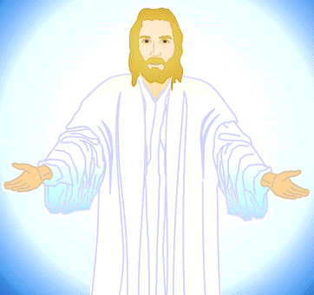
Receive me and you receive all I am as
your crucified and
reigning Lord and
Saviour, the
fullness of
God’s blessing.
Find all in Me
by faith, so
you stop
demanding
others serve
you and meet
your needs, and
you are freed
to walk with me
in the Spirit in agape
love serving others.
justified in Christ the righteousness of God
ransomed, redeemed Passover Lamb, sin atoned, wrath turned
forgiven peace with God reconciled eternal life adopted sons
welcomed, accepted filled, complete blessed with every blessing
Christ our wisdom from God, righteousness and sanctification and redemption
delivered from the domain of darkness into the light of the kingdom of the beloved Son
in Christ and Christ in us in the Spirit and the Spirit in us, made God’s temple
in God the Father and the Father in us immersed in Father, Son, and Spirit
Father, Son, and Spirit fellowship with us access to God and his grace answered prayer
grace at the throne of grace every need supplied Holy Spirit prays for us, helps us pray
Christ our High Priest intercedes as mediator Christ our High Priest advocates in our defense
immersed into Christ and his death and resurrection united with Christ in death and resurrection
old self crucified and buried with Christ new self raised and alive with Christ set free from sin
instrument for righteousness under Christ, abundant grace slaves of Christ not sin joined to Christ
one with Christ seated with Christ hidden with Christ in God released from law, married to Christ
under law of the Spirit Spirit and God’s love poured out born of the Spirit given, receive, have Spirit
rivers living water of Spirit immersed in Spirit Spirit comes, falls on us Spirit power to be ambassadors
anointed, sealed with Spirit guarantee of Spirit Spirit of truth helps, teaches Spirit leads, sanctifies
Spirit gifts for service Spirit fills circumcised, set apart in the Spirit immeasurably great power
God’s workmanship led in triumph + nike victory members of Christ’s body brothers and sisters branches in Christ’s vine chosen race,royal priesthood,holy nation,God’s possession,God’s people
fellow citizens with the saints and members of the household of God
citizenship in heaven hope of glory inheritance, heir, fellow heir
with Christ at death made perfect glorified to be like Jesus
into heavenly kingdom enter joy of Lord delivered from wrath
God’s good work completed resurrection body like Jesus
married to the Lamb every tear wiped away
see God’s face reign forever
loved saved
in the New Covenant
© GospelGifs.com used with permission

Slide 104

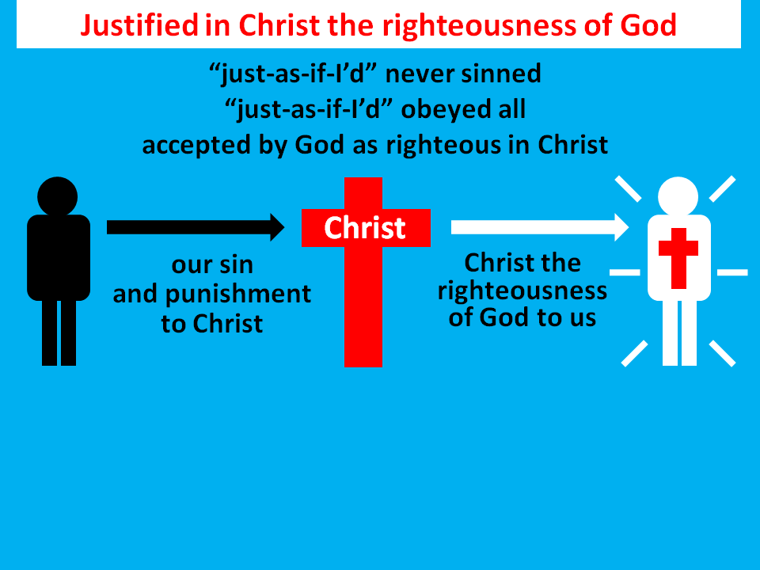

© Yoon Nam Sun
© GospelGifs.com
Christ our
righteousness
Christ our
holiness
Christ our
redemption
jumping heart © www.fg-a.com
12. wisdom from God
“It is because of him that you are in Christ Jesus,
who has become for us wisdom from God—
that is, our righteousness, holiness and redemption” 1 Cor 1:30 NIV
Thank you, Lord!
Thank you!
foolish
unwise

Slide 105

13-14. delivered from
the domain of darkness
and transferred to the kingdom of God’s Son.
Praise you, Lord!
© GospelGifs.com
“out of darkness into his marvelous light” 1 Pet 2:9
jumping heart © www.fg-a.com
“He has delivered us from the domain of darkness and transferred us to the kingdom of his beloved Son” Col 1:13
dominated by darkness
Microsoft clip art © 2013 Microsoft Corporation.

Slide 106
dominated by darkness
© GospelGifs.com
Microsoft clip art © 2013 Microsoft Corporation.
jumping heart © www.fg-a.com
Thank you, Lord, that if you have delivered us from the domain of darkness into the kingdom of your Son,
we are under the authority of the King of kings,
the Lord of all, and Christ’s death has freed us from
the domination of spirits of darkness, as it is written,
“He disarmed the rulers and authorities and put them to open shame, by triumphing over them in him” Col 2:15!

Slide 107
Gifts 1-14
in Christ
counted as righteous in Christ
the righteousness of God
ransomed and redeemed
Passover Lamb and propitiation, atonement, wrath turned away
forgiven peace reconciled adopted sons
eternal life welcomed, accepted
filled in Christ the fullness of God
blessed with every blessing
Christ our wisdom from God, righteousness, sanctification, redemption
delivered from domination of darkness
transferred into the kingdom of light
faith
in Christ
Lord, thank you that Christ’s death provides
such a firm foundation of riches of grace in Christ!

Slide 108
Jesus
Mohammed
Confucius
Can anyone else give us these gifts?
Has anyone else died as God’s once-for-all sacrifice for sin? Is anyone else the infinite
Son of God, our resurrected Messiah and Lord,
who provides in himself all we need in God?
Hindu Gurus
Moses
Buddha

Slide 109
Buddhism says:
Do Do Do
Do Do Do
Do Do.
You Do.
8-fold path
Islam
says:
Do Do Do
Do Do all Allah wants.
You Do.
5 pillars
Hinduism
says:
Do Do Do
Do Do Do
Do Do Do.
You Do.
many paths
Jesus
says:
It is DONE.
I DO 4 U.
Come to me
and drink.
Receive me and
you receive all
I DO 4 U
I DO 4 U
There is no one else like Jesus!
Jesus is the crucified and reigning
Messiah, Son of God and Savior
who is “I DO 4 U” not “U DO.”
More free resources on the grace of God in Christ @ www.GraceGodChrist.com

Slide 110
THE LORD
God’s completely different way
to deepest joy and satisfaction!
smiley © sherv.net
People circle © clipartfest.com
Joy and satisfaction are in Christ, not beauty, music, phones, movies, games, sports, cars, money, friends, romance, sex, food, drinking, drugs, homes or jobs! Jesus had supreme joy without sex or money!

Slide 111
THE LORD
God’s completely different way
to deepest joy and satisfaction!
smiley © sherv.net
People circle © clipartfest.com
“as you received Christ Jesus the Lord, so walk in him, rooted and built up in him and established in the faith . . . abounding in thanksgiving” Col 2:6-7
“the cares of the world and
the deceitfulness of riches and
the desires for other things enter in and choke the word.” Mk 4:19

Slide 112
counted as righteous in Christ the righteousness of God
ransomed, redeemed Passover Lamb, sin atoned, wrath turned
forgiven peace with God reconciled eternal life adopted sons
welcomed, accepted filled, complete blessed with every blessing
Christ our wisdom from God, righteousness and sanctification and redemption
delivered from the domain of darkness into the light of the kingdom of the beloved Son
in Christ and Christ in us in the Spirit and the Spirit in us, made God’s temple
in God the Father and the Father in us immersed in the Father, Son, and Spirit
Father, Son, and Spirit fellowship with us access to God and his grace
answered prayer grace at the throne of grace
every need supplied Holy Spirit prays for us, helps us pray
Christ our H.P. intercedes as our mediator Christ our H.P. advocates in our defense
immersed in Christ and his death and res. united with Christ in his death and res.
old self crucified and buried with Christ new self raised and alive with Christ
set free from sin instrument for righteousness
under Christ, abundant grace slaves of Christ not sin
joined to Christ one with Christ
seated with Christ hidden with Christ in God
released from law to marry Christ under law of the Spirit
Spirit and God’s love poured out born of the Spirit
given, receive, have Spirit rivers of living water of Spirit
immersed in the Spirit Spirit comes on, falls on us
Spirit power to be ambassadors anointed with the Spirit
sealed with the Spirit guarantee of the Spirit
Spirit of truth helps, teaches Spirit leads
Spirit sanctifies Spirit gifts for service
Spirit fills circumcised, set apart in the Spirit
immeasurably great power God’s workmanship
led in triumph and nike victory members of Christ’s body
brothers and sisters branches in Christ’s vine
  chosen race, royal priesthood, holy nation God’s possession, God’s people
fellow citizens with the saints members of the household of God
citizenship in heaven hope of glory inheritance, heir, fellow heir
with Christ at death made perfect glorified to be like Jesus
into heavenly kingdom enter joy of Lord delivered from wrath
God’s good work completed resurrection body like Jesus married to the Lamb
every tear wiped away see God’s face reign forever
loved and saved in the New Covenant
Receive me - receive all I provide through my death
I DO 4 U
Jesus © GospelGifs.com
Pulsing heart @clipartbest.com

Slide 113
Spirit
gifted
glory with Christ
reign
forever
see his face
resurrection
Spirit
fills
sanctified
seated with Christ
Christ
intercedes
in the
Spirit
Christ’s
power
Spirit
anoints
crucified
with Christ
accepted
adopted
Bride of
Christ
Christ’s
body
access
eternal
life
Spirit seals
victory
fullness
kingdom of
Christ
Christ
in us
raised with Christ
alive
in Christ
hidden with Christ in God
immersed
into Christ
every
blessing
peace
New
Covenant
led by
the Spirit
hope
of
glory
set free
from sin
atonement
of Christ
one with
Christ
born of the Spirit
loved
forgiven
reconciled
Christ’s ransom
Christ’s righteousness
Spirit
poured out
saved
When Christ rose,
it’s as if his cross became a tree of life
with many fruits to joyfully eat by faith.
Come to me and eat.
rooted in the blood of Jesus Christ, the Son of God

Slide 114
Spirit
gifted
glory with Christ
reign
forever
see his face
resurrection
Spirit
fills
sanctified
Christ
intercedes
seated with Christ
in the Spirit
Christ’s
power
Spirit
anoints
crucified
with Christ
accepted
adopted
Bride of
Christ
Christ’s
body
access
eternal
life
Spirit seals
victory
fullness
kingdom of
Christ
hope
of
glory
raised with Christ
alive
in Christ
Christ
in us
every
blessing
immersed
into Christ
peace
New
Covenant
atonement
of Christ
one with
Christ
led by
the Spirit
set free
from sin
saved
born of
the Spirit
hidden with Christ in God
forgiven
loved
Spirit
poured out
reconciled
Christ’s ransom
Christ’s righteousness
When Christ rose,
it’s as if his cross became a fountain
of life-giving water to joyfully drink by faith.
Come to me and drink.
a fountain flowing from the blood of Jesus Christ, God’s Son

Slide 115
What is SIN?
S
I
N
Seeking joy and satisfaction in created things
rather than in our supremely enjoyable Creator
Suppressing, exchanging truth about God for lies
and other loves, disapproving of God (Rom 1:18,23,25,28)
Storing up wrath for ourselves on the day God’s
righteous judgment will be revealed (Rom 2:5)
Idolatrous Independence from God ; Ignoring God
I do what I want; I am lord over my choices
Iniquity = “crookedness” from God’s way
Not honoring, thanking, believing, worshipping,
serving, and approving of our Creator (Rom 1:21,25,28)

Slide 116
What is sin? It’s more than we think!
"You shall have no other gods before me.
You shall not make for yourself a carved image . . .
You shall not bow down to them or serve them . . .
You shall not take the name of the LORD your God in vain . . . Remember the Sabbath day, to keep it holy. On it you shall not do any work . . .
Honor your father and your mother . . .
You shall not murder. You shall not commit adultery.
You shall not steal.
You shall not bear false witness against your neighbor.
You shall not covet your neighbor's house; you shall not covet your neighbor's wife . . . or anything that is your neighbor's.” The Ten Commandments in Exodus 20:3-17

Slide 117
What is sin?
“God will judge the sexually immoral and adulterous.”
Heb 13:4 (Do you please yourself with pornography?
Do you think about having sex with those who attract you?)
Consider the contrast at the end of the Bible:
“Blessed are those who wash their robes, so that they may have the right to the tree of life and that they may enter the city by the gates. Outside are . . . sorcerers and the sexually immoral and murderers and idolaters, and everyone who loves and practices falsehood.” Rev 22:14-15
Do we not all desperately need Jesus, the Son of God, whose death alone provides righteousness, redemption, atonement, forgiveness and peace with God?
Are you desperate to connect with Jesus and his cross?

Slide 118
THE LORD
God’s completely different way
to deepest joy and satisfaction!
smiley © sherv.net
Jumping heart © www.fg-a.com
People circle © clipartfest.com
Sin is seeking joy and satisfaction in beauty, music, phones, games, movies, sports, cars, money, friends, romance, sex, food, drinking, homes or jobs instead of enjoying the Lord! The Great Deception!

Slide 119
I am your ransom
and redemption
I am your forgiveness
from God
I am your
righteousness
from God
justification
I am
your
peace
with God
Joy and satisfaction are in God. Open Christ’s gifts to enjoy the Lord by faith in God’s promises expressed in praise!
Promises - Faith - Praise
I am your
adoption
as God’s
child
I am your
deliverance from darkness
into the kingdom of God’s Son
I am your
hope of glory
I am your
fullness
of blessing
I am your
at-one-ment with the Lord
God’s wrath turned away
I am your
spiritual fullness
in God
I am your
eternal
life

Slide 120
counted as righteous in Christ the righteousness of God
ransomed, redeemed Passover Lamb, sin atoned, wrath turned
forgiven peace with God reconciled eternal life adopted sons
welcomed, accepted filled, complete blessed with every blessing
Christ our wisdom from God, righteousness and sanctification and redemption
delivered from the domain of darkness into the light of the kingdom of the beloved Son
in Christ and Christ in us in the Spirit and the Spirit in us, made God’s temple
in God the Father and the Father in us immersed in the Father, Son, and Spirit
Father, Son, and Spirit fellowship with us access to God and his grace
answered prayer grace at the throne of grace
every need supplied Holy Spirit prays for us, helps us pray
Christ our H.P. intercedes as our mediator Christ our H.P. advocates in our defense
immersed in Christ and his death and res. united with Christ in his death and res.
old self crucified and buried with Christ new self raised and alive with Christ
set free from sin instrument for righteousness
under Christ, abundant grace slaves of Christ not sin
joined to Christ one with Christ
seated with Christ hidden with Christ in God
released from law to marry Christ under law of the Spirit
Spirit and God’s love poured out born of the Spirit
given, receive, have Spirit rivers of living water of Spirit
immersed in the Spirit Spirit comes on, falls on us
Spirit power to be ambassadors anointed with the Spirit
sealed with the Spirit guarantee of the Spirit
Spirit of truth helps, teaches Spirit leads
Spirit sanctifies Spirit gifts for service
Spirit fills circumcised, set apart in the Spirit
immeasurably great power God’s workmanship
led in triumph and nike victory members of Christ’s body
brothers and sisters branches in Christ’s vine
  chosen race, royal priesthood, holy nation God’s possession, God’s people
fellow citizens with the saints members of the household of God
citizenship in heaven hope of glory inheritance, heir, fellow heir
with Christ at death made perfect glorified to be like Jesus
into heavenly kingdom enter joy of Lord delivered from wrath
God’s good work completed resurrection body like Jesus married to the Lamb
every tear wiped away see God’s face reign forever
loved and saved in the New Covenant
Walk with Me enjoying, trusting, serving, confessing+forsaking
WALK WITH CHRIST
IN THE SPIRIT IN GOD’S WORD
enjoying the LORD with praise
trusting God’s grace in Christ for all needs
serving others in agape love, witness, prayer
confessing and forsaking all sin
Jesus © GospelGifs.com
with permission

Slide 121
Highly recommended
Develop the habit of praising the LORD every day for his grace in Christ. Develop a mind and heart that rests in Christ for all.
During your prayer time each of the seven days of the week, praise the Lord through section 1 on Day 1,
section two on Day 2, . . . seven on Day 7!
Monday – Section 1
Tuesday – 2 Gifts of connection with Father, Son and Spirit
Wednesday – Section 3
Thursday – Section 4
Friday – Section 5
Saturday – Section 6
Sunday – Section 7

Slide 122
The Grace of God in Christ
100 gifts of delight we receive in the Lord’s gift of Christ crucified
Gifts that are a firm foundation 1-14
Gifts of connection with Father, Son and Spirit 15-23
Gifts of life at God’s throne 24-31
Gifts of being set free from sin 32-48
Gifts of life in the Holy Spirit 48-71
Gifts of being the body of Christ 72-82
Gifts of future glory 83-97
Three great gifts that include all the others 98-100
Use “search” on your smart-phone

Slide 123
in Christ
in Christ and Christ in us
in the Spirit and the Spirit in us,
making us God’s temple
in God the Father and the Father in us
immersed in the Father, Son and Spirit
Father, Son and Spirit fellowship
with us and we with them
Gifts 15-23
faith
in Christ
Lord, thank you that Christ’s death provides
riches of connection with you, Father, Son and Spirit,
that no one else can give!

Slide 124
15-16. in Christ and Christ in us!
Thank you, Lord!
“To the saints and faithful brothers in Christ
in Colossae” Col 1:2
“I have been crucified with Christ. It is . . .
Christ who lives in me . . .
the Son of God,
who loved me and
gave himself for me”
Gal 2:20
Jesus © GospelGifs.com
pulsing heart © clipartbest.com
Jumping heart © www.fg-a.com
NO!
“In Christ, in him, in whom, in the Beloved”
is stressed more than 160 times in the NT
© GospelGifs.com

Slide 125
  Repentance toward God and faith in our Lord Jesus Christ
in Christ
Lord, thank you that if you place us in Christ,
you give us
all Christ provides
through
his death
for our sin!
It is finished!
We believe
and freely receive all Jesus is as Lamb of God and Lord of all!
jcounted as righteous in Christ the righteousness of God
ransomed, redeemed Passover Lamb, sin atoned, wrath turned
forgiven peace with God reconciled eternal life adopted sons
welcomed, accepted filled, complete blessed with every blessing
Christ our wisdom from God, righteousness and sanctification and redemption
delivered from the domain of darkness into the light of the kingdom of the beloved Son
in Christ and Christ in us in the Spirit and the Spirit in us, made God’s temple
in God the Father and the Father in us immersed in Father, Son, and Spirit
Father, Son, and Spirit fellowship with us access to God and his grace answered prayer
grace at the throne of grace every need supplied Holy Spirit prays for us, helps us pray
Christ our High Priest intercedes as mediator Christ our High Priest advocates in our defense
immersed into Christ and his death and resurrection united with Christ in death and resurrection
old self crucified and buried with Christ new self raised and alive with Christ
set free from sin instrument for righteousness
under Christ, abundant grace slaves of Christ not sin
joined to Christ one with Christ
seated with Christ hidden with Christ in God
released from law, married to Christ under law of the Spirit
Spirit and God’s love poured out born of the Spirit
given, receive, have Spirit rivers of living water of Spirit
immersed in the Spirit Spirit comes on, falls on us
Spirit power to be ambassadors anointed with the Spirit
sealed with the Spirit guarantee of the Spirit
Spirit of truth helps, teaches Spirit leads
Spirit sanctifies Spirit gifts for service
Spirit fills circumcised, set apart in the Spirit
immeasurably great power God’s workmanship led in triumph and nike victory
members of Christ’s body brothers and sisters branches in Christ’s vine
  chosen race, royal priesthood, holy nation, God’s possession, God’s people
fellow citizens with the saints and members of the household of God
citizenship in heaven hope of glory inheritance, heir, fellow heir
with Christ at death made perfect glorified to be like Jesus
into heavenly kingdom enter joy of Lord delivered from wrath
God’s good work completed resurrection body like Jesus
married to the Lamb every tear wiped away
see God’s face reign forever
loved and saved
in New Covenant
jumping heart © www.fg-a.com
johncrozieris@gmail.com © 2020

Slide 126
Thank you, Father,
that if we are in your Son,
you relate to us
as you relate to your Son;
you love us
as you love
your Son,
you fellowship
with us
as you fellowship
with your Son,
and you will raise us
as you raised your Son!
All praise to you!
THE LORD
smiley © sherv.net
sons and daughters
in the Son

Slide 127
THE LORD
If we are in the Son, the Son works in us
so we relate to
the Father and
the Spirit like he does,
as his brothers
and sisters.
smiley © sherv.net
brothers and sisters
of the Son

Slide 128
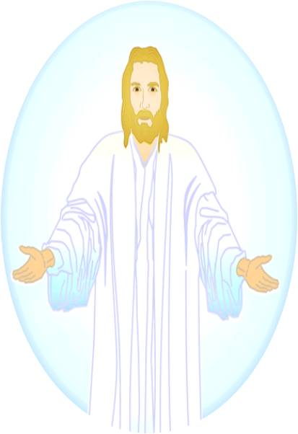
THE LORD
smiley © sherv.net
Jumping heart © www.fg-a.com
There is nothing better than being in Christ,
fully reconciled to God by faith in Christ,
apart from any efforts of our own each day!
Jesus © GospelGifs.com

Slide 129


17-19. in the Spirit and the Holy Spirit in us, God’s temple.
Thank you, Lord!
“You, however, are not in the flesh but in the Spirit,
if in fact the Spirit of God dwells in you” Rom 8:9
“Do you not know that you are God's temple and that God's Spirit dwells
in you?” 1 Cor 3:16
“Or do you not know that your body is a temple
of the Holy Spirit within you,
whom you have from God?” 1 Cor 6:19
Dove and Bible Microsoft Corp clip art © 2013 .
pulsing heart © clipartbest.com
Jumping heart © www.fg-a.com
NO!
© GospelGifs.com

Slide 130
Because we are sons
in the Son, the Spirit
loves, fellowships
with, and empowers
us as He loves, fellowships with,
and empowers
the Son.
Because we are sons
in the Son, the Son
leads us to love, fellowship with,
and cooperate with
the Holy Spirit
as the Son does.
THE LORD
Father, Son and Spirit oneness
love, fellowship and cooperation
smiley © sherv.net

Slide 131
We thank you, Father, that your Spirit conforms your sons to the image of your Son to enjoy you completely as your Son does,
to want to do your
will as your Son does,
to join you in your mission to make the good news of Christ known to all nations, and sacrifice anything
to finish the work given
to us, as your Son did
in love for you, Abba.
THE LORD
smiley © sherv.net

Slide 132
20-21. in God the Father and God the Father in us!
Thank you, Father!
“To the church of the Thessalonians in God the Father
and the Lord Jesus Christ” 1 Thess 1:1
“If anyone loves me,
he will keep my word,
and my Father
will love him,
and we will come to him
and make our home
with him”
John 14:23
Abba
Abba
pulsing heart © clipartbest.com
Jumping heart © www.fg-a.com
NO!
© GospelGifs.com

Slide 133
20-21. in God the Father and God the Father in us!
Thank you, Father!
“To the church of the Thessalonians in God our Father
and the Lord Jesus Christ” 2 Thess 1:1
“If the Spirit of him
who raised Jesus
from the dead
dwells in you,
. . . his Spirit who dwells in you”
Rom 8:11
Abba
Abba
pulsing heart © clipartbest.com
Jumping heart © www.fg-a.com
NO!
© GospelGifs.com

Slide 134
Because we are sons in the Son, Abba loves, fellowships with, and
is a Father to us as
he loves, fellowships with, and is a Father
to his Son.
Because we are sons, the Spirit of the Son
leads us to love, fellowship with,
and cooperate with
the Father as
the Son does.
THE LORD
Father, Son and Spirit oneness
love, fellowship and cooperation
smiley © sherv.net

Slide 135
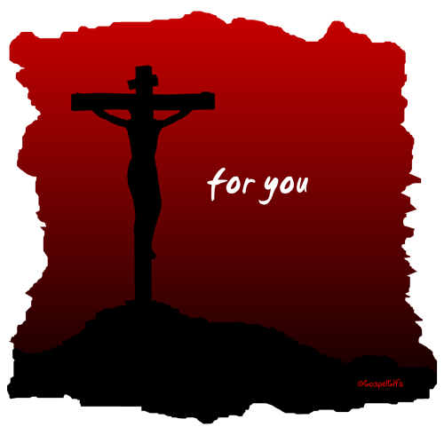
What a privilege! What undeserved favor in Christ!
All because God the Son died for us.
in Christ and Christ in us!
in the Spirit and the Spirit in us!
in the Father and the Father in us!
© GospelGifs.com
used with permission
Complete reconciliation with God!
Thank you, thank you, Lord!
NO!
© GospelGifs.com

Slide 136
Heaven is full of God the Father, Son and Spirit enjoying each other, and God’s people enjoying the LORD!
Life on earth is a bit of heaven as we delight in the Father, Son and Spirit as they delight in each other!
smiley © sherv.net
Jumping heart © www.fg-a.com
People circle © clipartfest.com

Slide 137

© GospelGifs.com
NO!
22. immersed in the Father, Son and Spirit!
Thank you, Lord!
“Go therefore and make disciples of all nations, baptizing (immersing) them in the name (ha Shem in Hebrew) of the Father and of the Son and of the Holy Spirit, teaching them to observe all that I have commanded you.”
Mat 28:19-20
Egyptian smiley © sherv.net
Jumping heart © www.fg-a.com
We are in Christ and Christ is in us.
We are in the Spirit and the Spirit is in us.
We are in the Father and the Father is in us.
We are immersed in Christ in the Spirit in God.
Thank you, Lord!

Slide 138
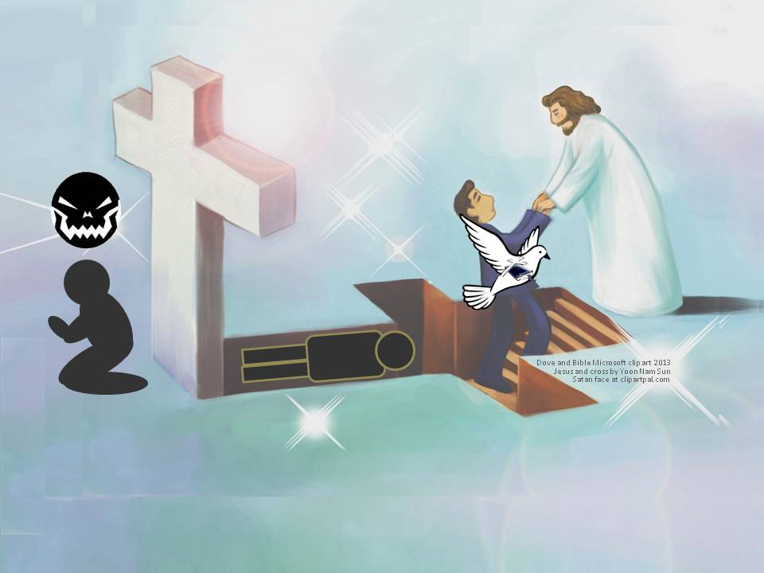
Lord, what wisdom in choosing “immersion” to picture
two great New Testament truths!
I believe Jesus is the Messiah who died for my sins, was buried, and rose again! 2. I believe God has immersed me into Christ
and his death and resurrection. I died with Christ to sin.
I am raised with Christ to live in God in the Spirit.
I am immersed and united with God the Father, Son and Holy Spirit!

Slide 139
Lord, what wisdom in choosing “immersion” to also picture two new inclinations of a heart that has saving faith.
1. I turn from serving sin and all its evil ways.
2. I turn to Christ as my Savior and Master to follow Jesus
in his ways of agape love in the Spirit.
(more about this diagram in gifts 32-41 to follow)

Slide 140
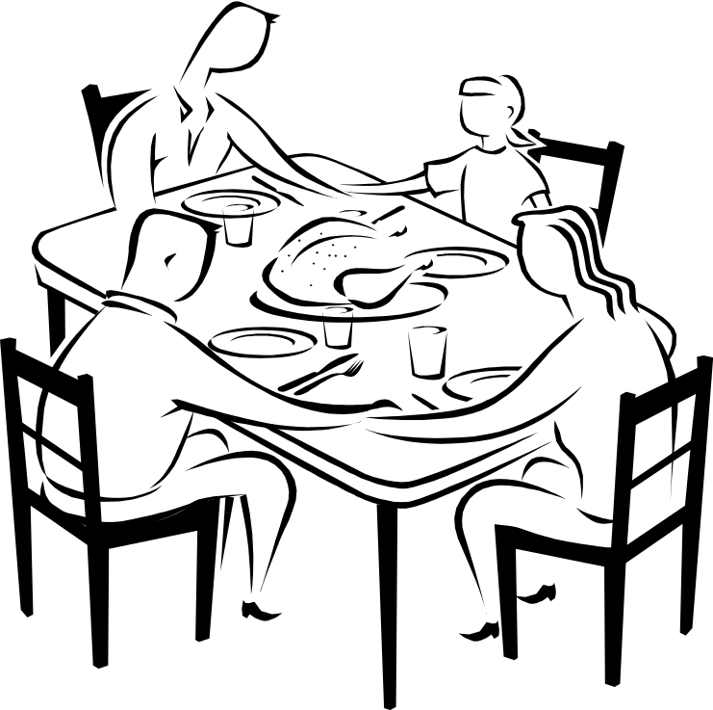
Jesus died to provide full fellowship with God the Father, Son and Spirit. It’s like being at the table in their home to share in the personal relationships of love, communion, cooperation and delight they enjoy with each other and want to share with us.
“Our fellowship
is with the
Father and
with his Son
Jesus Christ”
1 John 1:3
Father
“. . . the fellowship
of the Holy Spirit be
with you all”
2 Cor 13:14
Son
Spirit
Microsoft clip art © 2013 Microsoft Corporation.
Jumping heart © www.fg-a.com
heart © clipartbest.com
23. Father, Son and Holy Spirit fellowship with us
and we are in fellowship with them! Thank you, Lord!
NO!
© GospelGifs.com
“called into the fellowship of his Son, Jesus Christ” 1 Cor 1:9

Slide 141
THE LORD
Father, Son and Spirit oneness
love, fellowship, cooperation
smiley © sherv.net
Jumping heart © www.fg-a.com
Is this happy heart you? Are you enjoying God the Father, Son and Spirit as he shares with you the oneness, love, fellowship, and perfectly harmonious cooperation he enjoys in himself, with far more to come in glory? If not, why not?

Slide 142
in Christ
in Christ and Christ in us
in the Spirit and the Spirit in us,
making us God’s temple
in God the Father and the Father in us
immersed in the Father, Son and Spirit
Father, Son and Spirit fellowship
with us and we with them
Gifts 15-23
faith
in Christ
Lord, thank you that Christ’s death provides
riches of connection with you, Father, Son and Spirit,
that no one else can give!

Slide 143
Jesus
Mohammed
Confucius
Can anyone else do this for us?
Has anyone else died as God’s once-for-all sacrifice for sin? Is anyone else the infinite
Son of God, our resurrected Messiah and Lord,
who provides in himself all we need in God?
Hindu Gurus
Moses
Buddha

Slide 144
Buddhism says:
Do Do Do
Do Do Do
Do Do.
You Do.
8-fold path
Islam
says:
Do Do Do
Do Do all Allah wants.
You Do.
5 pillars
Hinduism
says:
Do Do Do
Do Do Do
Do Do Do.
You Do.
many paths
Jesus
says:
It is DONE.
I DO 4 U.
I give.
You receive.
Receive me and
you receive all
I DO 4 U
I DO 4 U
There is no one else like Jesus!
Jesus is the crucified and reigning
Messiah, Son of God and Savior
who is “I DO 4 U” not “U DO.”
More free resources on the grace of God in Christ @ www.GraceGodChrist.com

Slide 145
THE LORD
God’s completely different way
to deepest joy and satisfaction!
smiley © sherv.net
People circle © clipartfest.com
Joy and satisfaction are in Christ, not beauty, music, phones, movies, games, sports, cars, money, friends, romance, sex, food, drinking, drugs, homes or jobs! Jesus had supreme joy without sex or money!

Slide 146
THE LORD
Father, Son and Spirit oneness
love, fellowship, cooperation
smiley © sherv.net
Jumping heart © www.fg-a.com
If we are in Christ, there is another world to live in and enjoy
by faith, the world of God the Father, Son and Spirit!
“They are not of the world, just as I am not of the world” Jn 17:16

Slide 147
I am your ransom
and redemption
I am your forgiveness
from God
I am your
righteousness
from God
justification
I am
your
peace
with God
Find joy and satisfaction in God. Open Christ’s gifts to enjoy the Lord by faith in God’s promises expressed in praise!
Promises - Faith - Praise
I am your
adoption
as God’s
child
I am your
deliverance from darkness
into the kingdom of God’s Son
I am your
hope of glory
I am your
fullness
of blessing
I am your
at-one-ment with the Lord
God’s wrath turned away
I am your
spiritual fullness
in God
I am your
eternal
life

Slide 148
Highly recommended
Develop the habit of praising the LORD every day for his grace in Christ. Develop a mind and heart that rests in Christ for all.
During your prayer time each of the seven days of the week, praise the Lord through section 1 on Day 1,
section two on Day 2, . . . seven on Day 7!
Monday – Section 1
Tuesday – Section 2
Wednesday – Section 3 Gifts of life at God’s throne
Thursday – Section 4
Friday – Section 5
Saturday – Section 6
Sunday – Section 7

Slide 149
The Grace of God in Christ
100 gifts of delight we receive in the Lord’s gift of Christ crucified
Gifts that are a firm foundation 1-14
Gifts of connection with Father, Son and Spirit 15-23
Gifts of life at God’s throne 24-31
Gifts of being set free from sin 32-48
Gifts of life in the Holy Spirit 48-71
Gifts of being the body of Christ 72-82
Gifts of future glory 83-97
Three great gifts that include all the others 98-100
Use “search” on your smart-phone

Slide 150
in Christ
Gifts 24-31
faith
in Christ
access to God and his grace
answered prayer in Jesus’ name
mercy, grace and help at the throne of grace
every need supplied
the Spirit prays for us, and helps us pray
in the Spirit using God’s word
Christ our High Priest intercedes for us
as the one mediator and ransom for all
Christ our High Priest advocates
his propitiation in our defense
Lord, thank you that Jesus died to give us
riches of gifts that no one else can give!

Slide 151
24. access to God
and his grace
in Christ
in one Spirit!
Praise you, Lord!
Smiley © sherv.net
Jumping heart ©
www.fg-a.com
THE LORD
Photo of sun shining
through curtain
John Crozier
“Jesus . . . yielded up his spirit. . . . the curtain of the
temple was torn in two” Matt 27:50-51
“Through him we have also obtained access by faith
into this grace in which we stand” Rom 5:2
NO!
© GospelGifs.com

Slide 152
24. access to God
and his grace
in Christ
in one Spirit!
Praise you, Lord!
Smiley © sherv.net
Jumping heart ©
www.fg-a.com
THE LORD
Photo of sun shining
through curtain
John Crozier
“For through him we both (Jew and Gentile) have access
in one Spirit to the Father” Eph 2:18
“Christ Jesus our Lord, in whom we have boldness and access with confidence through our faith in him” Eph 3:11-12
“we have confidence to enter the holy places
by the blood of Jesus” Heb 10:19
NO!
© GospelGifs.com

Slide 153


“I do not speak on my own authority, but the Father who dwells in me does his works . . . whoever believes in me will also do the works that I do . . . Whatever you ask in my name, this I will do, that the Father may be glorified
in the Son. If you ask me anything in my name,
I will do it” John 14:10,12-14
25. Answered prayer
in Jesus’ name.
Thank you, Lord!
Jumping heart © www.fg-a.com
Praying hands and Bible Microsoft clip art © 2013 Microsoft Corp.
Access (24) and answered prayer (25) go together.
In John 14-16 Jesus dramatically changes the Jewish concept of access and prayer. “I have access into God’s presence in the name of Jesus anywhere, anytime, and I receive anything I ask in his name??!!
NO!
© GospelGifs.com

Slide 154
“If you abide in me, and my words abide in you,
ask whatever you wish, and it will be done for you.
By this my Father is glorified, that you bear much
fruit and so prove to be my disciples”
John 15:7-8
25. Answered prayer
in Jesus’ name.
Thank you, Lord!
Jumping heart © www.fg-a.com
Praying hands and Bible Microsoft clip art © 2013 Microsoft Corp.
“You did not choose me, but I chose you and
appointed you that you should go and bear fruit
and that your fruit should abide, so that
whatever you ask the Father in my name,
he may give it to you” John 15:16
NO!
© GospelGifs.com

Slide 155
“Truly, truly, I say to you, whatever you ask of the Father in my name, he will give it to you. Until now you have asked nothing in my name. Ask, and you will receive,
that your joy may be full” John 16:23-24
25. Answered prayer
in Jesus’ name.
Thank you, Lord!
Jumping heart © www.fg-a.com
Praying hands and Bible Microsoft clip art © 2013 Microsoft Corp.
In John 14-16, we pray in Jesus’ name
depending on Christ’s death for access to God,
abiding in Christ and his Word,
asking what Jesus would ask,
to bear much fruit to the Father’s glory.
NO!
© GospelGifs.com

Slide 156
“In that day you will ask in my name, and I do not say
to you that I will ask the Father on your behalf;
for the Father himself loves you, because you have loved me and have believed that I came from God”
John 16:26-27
25. Answered prayer
in Jesus’ name.
Thank you, Lord!
Jumping heart © www.fg-a.com
Praying hands and Bible Microsoft clip art © 2013 Microsoft Corp.
In John 14-16, we pray in Jesus’ name
depending on Christ’s death for access to God,
abiding in Christ and his Word,
asking what Jesus would ask,
to bear much fruit to the Father’s glory.
NO!
© GospelGifs.com

Slide 157
26. Receive grace, mercy and help at the throne of grace!
“For because he himself has suffered when tempted, he is able to help those who are being tempted. . . .
We have a great high priest . . . Jesus, the Son of God . . .
Let us then with confidence draw near to the throne of grace, that we may receive mercy and find grace to
help in time of need”
Heb 2:18; 4:14,16
© GospelGifs.com used with permission
NO!
Jumping heart © www.fg-a.com
Thank you, Lord!
Hands Microsoft clip art © 2013 Microsoft Corporation.
© GospelGifs.com

Slide 158
in Christ
27. Every spiritual need supplied
in Christ!
counted as righteous in Christ the righteousness of God
ransomed, redeemed Passover Lamb, sin atoned, wrath turned
forgiven peace with God reconciled eternal life adopted sons
welcomed, accepted filled, complete blessed with every blessing
Christ our wisdom from God, righteousness and sanctification and redemption
delivered from the domain of darkness into the light of the kingdom of the beloved Son
in Christ and Christ in us in the Spirit and the Spirit in us, made God’s temple
in God the Father and the Father in us immersed in Father, Son, and Spirit
Father, Son, and Spirit fellowship with us access to God and his grace answered prayer
grace at the throne of grace every need supplied Holy Spirit prays for us, helps us pray
Christ our High Priest intercedes as mediator Christ our High Priest advocates in our defense
immersed into Christ and his death and resurrection united with Christ in death and resurrection
old self crucified and buried with Christ new self raised and alive with Christ
set free from sin instrument for righteousness
under Christ, abundant grace slaves of Christ not sin
joined to Christ one with Christ
seated with Christ hidden with Christ in God
released from law, married to Christ under law of the Spirit
Spirit and God’s love poured out born of the Spirit
given, receive, have Spirit rivers of living water of Spirit
immersed in the Spirit Spirit comes on, falls on us
Spirit power to be ambassadors anointed with the Spirit
sealed with the Spirit guarantee of the Spirit
Spirit of truth helps, teaches Spirit leads
Spirit sanctifies Spirit gifts for service
Spirit fills circumcised, set apart in the Spirit
immeasurably great power God’s workmanship led in triumph and nike victory
members of Christ’s body brothers and sisters branches in Christ’s vine
  chosen race, royal priesthood, holy nation, God’s possession, God’s people
fellow citizens with the saints and members of the household of God
citizenship in heaven hope of glory inheritance, heir, fellow heir
with Christ at death made perfect glorified to be like Jesus
into heavenly kingdom enter joy of Lord delivered from wrath
God’s good work completed resurrection body like Jesus
married to the Lamb every tear wiped away
see God’s face reign forever
loved and saved
in New Covenant
“I can do all things through him who strengthens me . . .
And my God will supply every need
of yours according to
his riches in glory
in Christ Jesus”
Phil 4:13,19
NO!
Hands - Microsoft clip art © 2013 Microsoft Corporation.
Thank you, Lord!
Jumping heart © www.fg-a.com
© GospelGifs.com

Slide 159
THE LORD
Father, Son and Spirit oneness
love, fellowship, cooperation
smiley © sherv.net
Jumping heart © www.fg-a.com
If we are in Christ, there is another world to live in and enjoy
by faith, the world of God the Father, Son and Spirit,
who in Christ meets all our spiritual needs as we trust Him!

Slide 160

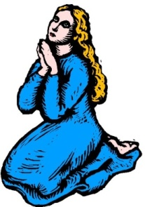
28-29. The Spirit prays for us and helps us pray
in the Spirit using God’s word! Thank you, Lord!
“The Spirit helps us in our weakness. For we do not know what to pray for as we ought, but the Spirit himself intercedes for us . . . the Spirit intercedes for the saints according to the will of God” Rom 8:26-27
The LORD
Dove, Bible, praying woman
Microsoft clip art © 2013
Microsoft Corporation.
Ep 6:17-18
“Take . . . the sword of the Spirit, which is the word of God, praying at all times in the Spirit, with all prayer and supplication . . . with perseverance . . . for all saints”
Eph 6:17-18
(The Spirit helps us use God’s word to pray!)
NO!
© GospelGifs.com

Slide 161
28-29. The Spirit prays for us and helps us pray
in the Spirit using God’s word! Thank you, Lord!
“be filled with the Spirit; Speaking to yourselves in
psalms and hymns and spiritual songs, singing and making melody in your heart to the Lord; Giving thanks always
for all things unto God and the Father in the name of
our Lord Jesus Christ” Eph 5:18-20, KJV
The LORD
Dove, Bible, praying woman
Microsoft clip art © 2013
Microsoft Corporation.
Ep 6:17-18
“But you, beloved, building yourselves up in your most holy faith and praying in the Holy Spirit, keep yourselves in
the love of God, waiting for the mercy of our Lord
Jesus Christ that leads to eternal life” Jude 1:20-21
NO!
© GospelGifs.com

Slide 162
Promises – Faith – Prayer!
The Spirit of God
helps us use
the Word of God
to pray and praise
with faith in God’s faithfulness
to his promises in Christ,
and the power of Christ’s blood
to provide access to God.
Promises – Faith – Praise!
Dove, Bible, praying woman
Microsoft clip art © 2013
Microsoft Corporation.

Slide 163
Are you a believer
who depends on
the Spirit of God
to help you use
the Word of God
to pray and praise?
Do you follow the Spirit’s
leading to pray
with faith in God’s faithfulness
to his promises in Christ,
and the power of Christ’s blood
to provide access to God?
Promises – Faith – Prayer!
Dove, Bible, praying woman
Microsoft clip art © 2013
Microsoft Corporation.

Slide 164
30. Christ our High Priest intercedes for us
as the one mediator and ransom for all! Thank you, Lord!
“There is one God, and there is one mediator between God and men,
the man Christ Jesus,
who gave himself as a
ransom for all men”
1 Tim 2:5-6
Holy LORD
“Who is to
condemn?
Christ Jesus is
the one who died—
more than that, who was raised—
who is at the right hand of God, who
indeed is interceding for us” Rom 8:34
© GospelGifs.com
used with permission
No!
© GospelGifs.com

Slide 165
30. Christ our High Priest intercedes for us
as the one mediator and ransom for all! Thank you, Lord!
“When Christ appeared as a high priest . . . he entered once for all into the holy places . . . by means of his
own blood . . . securing an eternal redemption
. . . he is the mediator of
a new covenant . . .
eternal inheritance”
Heb 9:11,12,15
Holy LORD
“He is able to save
to the uttermost
those who draw near
to God through him,
since he always lives to make intercession for them” Heb 7:25
© GospelGifs.com
used with permission
No!
© GospelGifs.com

Slide 166
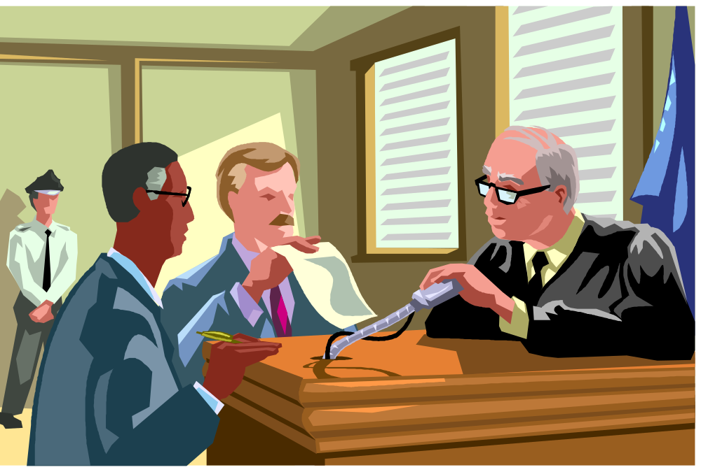
31. Christ our High Priest advocates his propitiation
for our sins in our defense! Praise you, Lord!
Accuser
Advocate
Microsoft clip art © 2013 Microsoft Corporation.
“My little children, I am writing these things to you so that you may not sin. But if anyone does sin, we have an advocate with the Father, Jesus Christ the righteous.
He is the propitiation for our sins, and not for ours only
but also for the sins of the whole world” 1 John 2:1-2
NO!
© GospelGifs.com

Slide 167
31. Christ our High Priest advocates his propitiation
for our sins in our defense! Praise you, Lord!
Accuser
Advocate
Microsoft clip art © 2013 Microsoft Corporation.
“Therefore he had to be made like his brothers in every respect, so that he might become a merciful and faithful high priest in the service of God, to make propitiation for the sins of the people. For because he himself has suffered when tempted, he is able to help those
who are being tempted.” Heb 2:17-18
NO!
© GospelGifs.com

Slide 168
Jesus
Mohammed
Confucius
Can anyone else give us these gifts?
Has anyone else died as God’s once-for-all sacrifice for sin? Is anyone else the infinite
Son of God, our resurrected Messiah and Lord,
who provides in himself all we need in God?
Hindu Gurus
Moses
Buddha

Slide 169
Buddhism says:
Do Do Do
Do Do Do
Do Do.
You Do.
8-fold path
Islam
says:
Do Do Do
Do Do all Allah wants.
You Do.
5 pillars
Hinduism
says:
Do Do Do
Do Do Do
Do Do Do.
You Do.
many paths
Jesus
says:
It is DONE.
I DO 4 U.
Come to me
and drink.
Receive me and
you receive all
I DO 4 U
I DO 4 U
There is no one else like Jesus!
Jesus is the crucified and reigning
Messiah, Son of God and Savior
who is “I DO 4 U” not “U DO.”
More free resources on the grace of God in Christ @ www.GraceGodChrist.com

Slide 170
counted as righteous in Christ the righteousness of God
ransomed, redeemed Passover Lamb, sin atoned, wrath turned
forgiven peace with God reconciled eternal life adopted sons
welcomed, accepted filled, complete blessed with every blessing
Christ our wisdom from God, righteousness and sanctification and redemption
delivered from the domain of darkness into the light of the kingdom of the beloved Son
in Christ and Christ in us in the Spirit and the Spirit in us, made God’s temple
in God the Father and the Father in us immersed in the Father, Son, and Spirit
Father, Son, and Spirit fellowship with us access to God and his grace
answered prayer grace at the throne of grace
every need supplied Holy Spirit prays for us, helps us pray
Christ our H.P. intercedes as our mediator Christ our H.P. advocates in our defense
immersed in Christ and his death and res. united with Christ in his death and res.
old self crucified and buried with Christ new self raised and alive with Christ
set free from sin instrument for righteousness
under Christ, abundant grace slaves of Christ not sin
joined to Christ one with Christ
seated with Christ hidden with Christ in God
released from law to marry Christ under law of the Spirit
Spirit and God’s love poured out born of the Spirit
given, receive, have Spirit rivers of living water of Spirit
immersed in the Spirit Spirit comes on, falls on us
Spirit power to be ambassadors anointed with the Spirit
sealed with the Spirit guarantee of the Spirit
Spirit of truth helps, teaches Spirit leads
Spirit sanctifies Spirit gifts for service
Spirit fills circumcised, set apart in the Spirit
immeasurably great power God’s workmanship
led in triumph and nike victory members of Christ’s body
brothers and sisters branches in Christ’s vine
  chosen race, royal priesthood, holy nation God’s possession, God’s people
fellow citizens with the saints members of the household of God
citizenship in heaven hope of glory inheritance, heir, fellow heir
with Christ at death made perfect glorified to be like Jesus
into heavenly kingdom enter joy of Lord delivered from wrath
God’s good work completed resurrection body like Jesus married to the Lamb
every tear wiped away see God’s face reign forever
loved and saved in the New Covenant
Receive me - receive all I am through my cross
I DO 4 U
Jesus © GospelGifs.com
Pulsing heart @clipartbest.com

Slide 171
in Christ
Gifts 24-31
faith
in Christ
access to God and his grace
answered prayer in Jesus’ name
mercy, grace and help at the throne of grace
every need supplied
the Spirit prays for us, and helps us pray
in the Spirit using God’s word
Christ our High Priest intercedes for us
as the one mediator and ransom for all
Christ our High Priest advocates
his propitiation in our defense
Lord, thank you that Jesus died to give us
riches of gifts that no one else can give!

Slide 172
THE LORD
God’s completely different way
to deepest joy and satisfaction!
smiley © sherv.net
People circle © clipartfest.com
Joy and satisfaction are in Christ, not beauty, music, phones, movies, games, sports, cars, money, friends, romance, sex, food, drinking, drugs, homes or jobs! Jesus had supreme joy without sex or money!

Slide 173
I am your ransom
and redemption
I am your forgiveness
from God
I am your
righteousness
from God
justification
I am
your
peace
with God
Find joy and satisfaction in God. Open Christ’s gifts to enjoy the Lord by faith in God’s promises expressed in praise!
Promises - Faith - Praise
I am your
adoption
as God’s
child
I am your
deliverance from darkness
into the kingdom of God’s Son
I am your
hope of glory
I am your
fullness
of blessing
I am your
at-one-ment with the Lord
God’s wrath turned away
I am your
spiritual fullness
in God
I am your
eternal
life

Slide 174
Why did Jesus have the greatest joy of anyone?
Jesus had and sought none of the joys of the world like a nice home and money, but he was the happiest person ever on earth because more than all others, he had the greatest joy in God.
When we stop seeking joy in earthly, temporary things, to seek joy in the eternal God who’s better than all else, we will find joy and satisfaction in Christ that is different and better than joy in anything else.
Jesus died “that my joy may be in you, and that your joy may be full. . . . that they may have my joy fulfilled in themselves” (John 15:11; 17:13).
From “Know Your God,” John’s eBook on God’s attributes, page 52, and
“The Grace of God in Christ,” page 129, both at www.GraceGodChrist.com

Slide 175
Highly recommended
Develop the habit of praising the LORD every day for his grace in Christ. Develop a mind and heart that rests in Christ for all.
During your prayer time each of the seven days of the week, praise the Lord through section 1 on Day 1,
section two on Day 2, . . . seven on Day 7!
Monday – Section 1
Tuesday – Section 2
Wednesday – Section 3
Thursday – Section 4 Gifts of being set free from sin
Friday – Section 5
Saturday – Section 6
Sunday – Section 7

Slide 176
The Grace of God in Christ
100 gifts of delight we receive in the Lord’s gift of Christ crucified
Gifts that are a firm foundation 1-14
Gifts of connection with Father, Son and Spirit 15-23
Gifts of life at God’s throne 24-31
Gifts of being set free from sin 32-48
Gifts of life in the Holy Spirit 48-71
Gifts of being the body of Christ 72-82
Gifts of future glory 83-97
Three great gifts that include all the others 98-100
Use “search” on your smart-phone

Slide 177
Note how almost
all these are in
Romans 6-8
faith
in Christ
immersed into Christ
in death with Christ
and resurrection with Christ
united with Christ in death with Christ
and resurrection with Christ
old self in Adam crucified and buried with Christ
new self in Christ raised and alive with Christ
set free from sin
body members instruments for righteousness under Christ and his abundant grace
slaves to Christ and righteousness, not sin
joined to Christ one with Christ seated with Christ hidden with Christ in God
released from the law to marry Christ
under the law of the Spirit
of life in Christ
Gifts 32-48
Lord, thank you that Jesus died to give us
riches of gifts that set us free from sin!

Slide 178
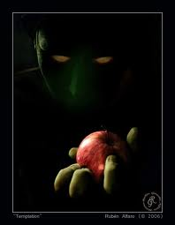
The gifts of grace in Christ
God provides to overcome temptation.

Slide 179
32. immersed into Christ in death with Christ and resurrection
with Christ. Thank you, Lord!
“Do you not know that all of us who have been baptized (immersed) into Christ Jesus were baptized (immersed) into his death?
We were buried therefore with him by baptism (immersion) into death, in order that, just as Christ was raised from the dead by the glory of the Father, we too might walk in newness of life” Rom 6:3-4

Slide 180
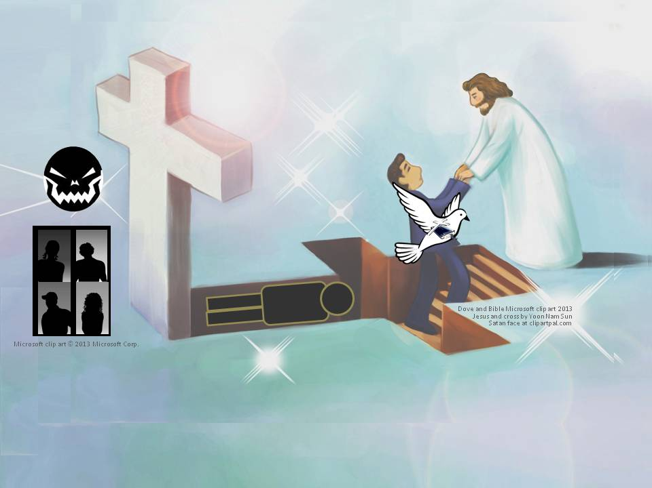
32. Immersed into Christ in death with Christ and resurrection
with Christ. Praise you, Lord!
“You were dead in the trespasses and sins in which you once walked
. . . following the prince of the power of the air, the spirit that is now at work in the sons of disobedience . . . and were by nature children of wrath . . . But God . . . made us alive together with Christ . . . and raised us up with him and seated us with him . . . we are his workmanship, created in Christ Jesus for good works” Eph 2:1-6,10

Slide 181
32. immersed into Christ in death with Christ and resurrection
with Christ. Thank you, Lord!
“For as many of you as were baptized into Christ have put on Christ”
Gal 3:27

Slide 182
33. united with Christ in death with Christ and resurrection
with Christ. Praise you, Lord!
“For if we have been united with him in a death like his, we shall certainly be united with him in a resurrection like his” Rom 6:5
“Now if we have died with Christ, we believe that we will also
live with him” Rom 6:8

Slide 183
Immersed and united with Christ in death
and resurrection with Christ
new self raised +
alive with Christ
faith in Christ
crucified
In Christ freed from sin + Satan as Master, dead to sin
Under Christ’s authority and grace in the Spirit
without Christ, sin + Satan reign as Master
old self in Adam crucified +
buried with Christ
Walking with Christ in the Spirit
in agape love, fellowship and submission,
enjoying the LORD as our supreme treasure

Slide 184
Has anyone else died for you to redeem and set you free
from enslavement to SIN, the cruel master of all sinners?

Slide 185
34-35. old self in Adam crucified and buried with Christ
in death with Christ. Thank you, Lord!
old self in Adam crucified +
buried with Christ
We were buried therefore with him . . . into death . . . our old self was crucified with him . . . For one who has died has been set free from sin. Now if we have died with Christ . . .” Rom 6:4,6,8
also Gal 2:20; Eph 4:21-22; Col 2:12; 3:3,9; in Adam Rom 5:12,19

Slide 186
36-37. new self in Christ raised and alive with Christ in
resurrection with Christ. Thank you, Lord!
new self raised +
alive with Christ
“just as Christ was raised . . . we too might walk in newness of life . . .
we shall certainly be united with him in a resurrection like his. . . .
we will also live with him. . . . he lives to God . . . consider yourselves dead to sin and alive to God in Christ Jesus” Rom 6:4,5,8,10,11
Also Eph 2:4-7; 4:22-24; Col 2:12; 3:1-4; 9-11; 2 Cor 5:17

Slide 187
Our new self in Christ is raised with Christ from death in sin, alive with Christ to walk in newness
of life, alive to God in Christ. Thank you, Lord!

Slide 188
Future resurrection with Christ includes being with Christ at death #86, and receiving a resurrection body at Christ’s return #93. Thank you, Lord!

Slide 189
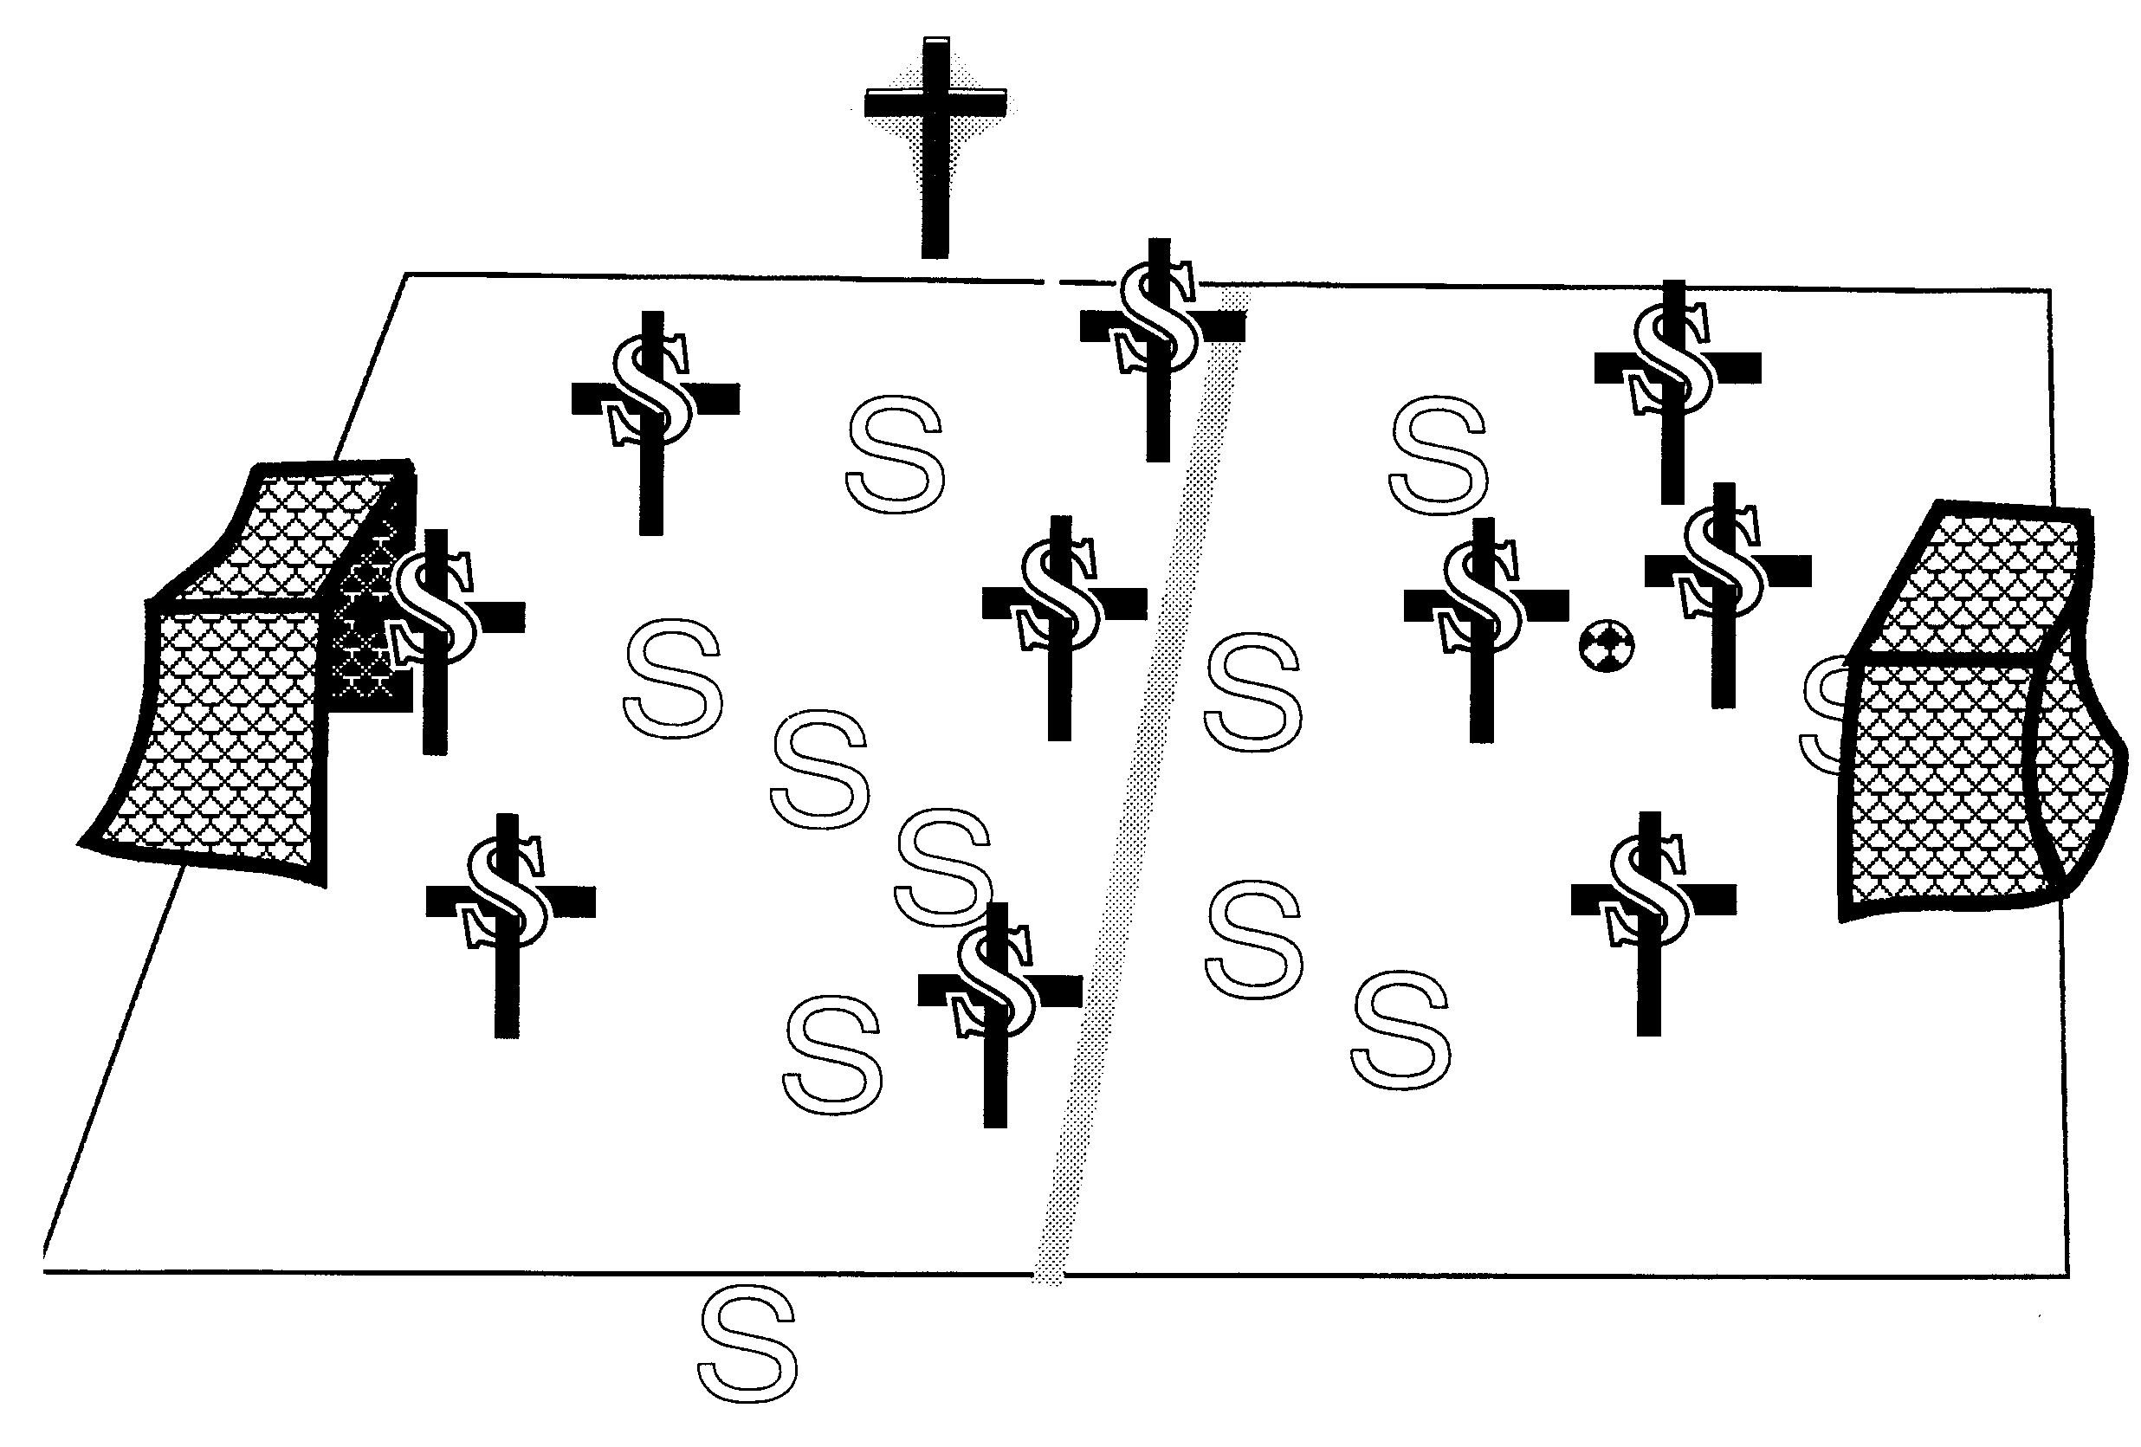

38. Set free from slavery to sin! Praise you, Lord!
Christ is the coach of the crucified-and-raised-with-Christ team
© GospelGifs.com
soccer teams by Kim Graham
our old coach Sin no longer has authority to rule us
“Consider yourselves dead to sin and alive to God
in Christ Jesus” Rom 6:11
“one who has died has been set free from sin . . . set free from sin . . . set free from sin” Rom 6:7, 18, 22

Slide 190
Christ is the coach of the crucified-and-raised-with-Christ team
© GospelGifs.com
soccer teams by Kim Graham
our old coach Sin no longer has authority to rule us
When the old coach yells at you to kick the ball in your own net, who should you listen to? Whose team are you now on? Whose authority are you now under?
Who is in you to empower you to win not lose?

Slide 191


In Romans 6, note the different descriptions of being set free from sin
we died to sin (2)
walk in newness of life (4)
old self crucified, body of sin brought to nothing
= sin no longer reigns over body members (6,12-13)
no longer enslaved to sin (6)
we died . . . set free from sin (7)
we have died with Christ (8)
we are dead to sin and alive to God (11)
sin has no dominion over us (14)
© Yoon Nam Sun
Dove and Bible
Microsoft clip art © 2013
we were once slaves of sin (17)
we have been set free from sin (18)
we have been set free from sin (22)
NO!
© GospelGifs.com

Slide 192
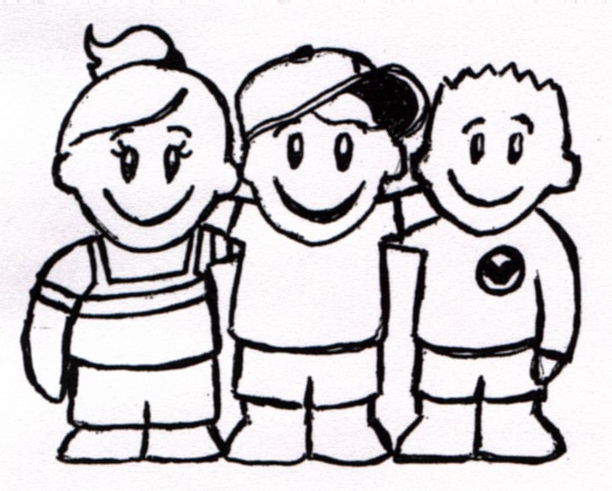
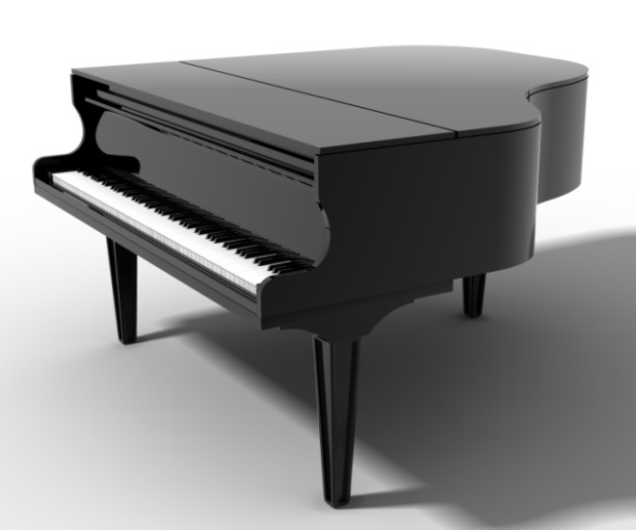
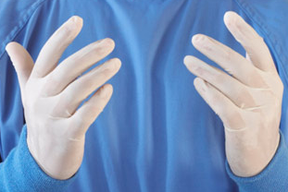
johncrozieris@gmail.com
jumping heart © www.fg-a.com
39. body members now instruments for righteousness.
Thank you, Lord!
Microsoft clip art © 2013
Microsoft Corporation.
instruments for
love and witness
instruments for
worship and prayer
Microsoft clip art © 2013
Microsoft Corporation.
instruments like gloves
on his hand
“Present yourselves to God as those who have been brought from death to life, and your members to
God as instruments for righteousness” Rom 6:13
NO!
© GospelGifs.com

Slide 193


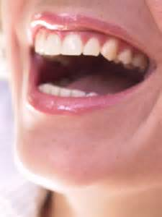
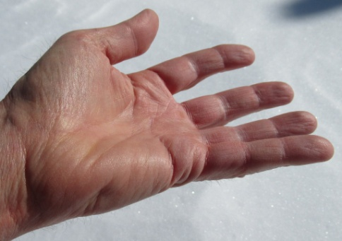
Present your eyes and mind to God to be used for God’s Word,
not pornography or lust!
Do not give your eyes and mind
to sin as instruments for evil!
freeclipart.com
Microsoft clip art © 2013
Microsoft Corporation.
bing images
Yield your mouth and hands to serve others, to help, encourage and give to others, not hurt or take from others.
Microsoft clip art © 2013
Microsoft Corporation.
hand by John Crozier
“Do not present your members to sin as instruments for unrighteousness, but present . . . your members to God
as instruments for righteousness” Rom 6:13

Slide 194
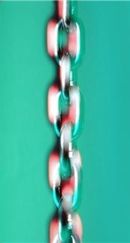
SIN
40. under Christ and
his abundant grace,
not under sin and law.
Thank you, Lord!
GRACE
© GospelGifs.com
used with permission
abundant
Microsoft clip art © 2013
Microsoft Corporation.
in
Adam
in
Christ
© GospelGifs.com
used with permission
“For sin will have no dominion over you,
since you are not under law but under grace” Rom 6:14
“abundance of grace” Rom 5:17

Slide 195
  Repentance toward God and faith in our Lord Jesus Christ
in Christ
“Under Christ and his abundant
grace”
is another
way of
expressing
how we
receive all
the grace of God in Christ when we surrender
to Christ !!!!
jcounted as righteous in Christ the righteousness of God
ransomed, redeemed Passover Lamb, sin atoned, wrath turned
forgiven peace with God reconciled eternal life adopted sons
welcomed, accepted filled, complete blessed with every blessing
Christ our wisdom from God, righteousness and sanctification and redemption
delivered from the domain of darkness into the light of the kingdom of the beloved Son
in Christ and Christ in us in the Spirit and the Spirit in us, made God’s temple
in God the Father and the Father in us immersed in Father, Son, and Spirit
Father, Son, and Spirit fellowship with us access to God and his grace answered prayer
grace at the throne of grace every need supplied Holy Spirit prays for us, helps us pray
Christ our High Priest intercedes as mediator Christ our High Priest advocates in our defense
immersed into Christ and his death and resurrection united with Christ in death and resurrection
old self crucified and buried with Christ new self raised and alive with Christ
set free from sin instrument for righteousness
under Christ, abundant grace slaves of Christ not sin
joined to Christ one with Christ
seated with Christ hidden with Christ in God
released from law, married to Christ under law of the Spirit
Spirit and God’s love poured out born of the Spirit
given, receive, have Spirit rivers of living water of Spirit
immersed in the Spirit Spirit comes on, falls on us
Spirit power to be ambassadors anointed with the Spirit
sealed with the Spirit guarantee of the Spirit
Spirit of truth helps, teaches Spirit leads
Spirit sanctifies Spirit gifts for service
Spirit fills circumcised, set apart in the Spirit
immeasurably great power God’s workmanship led in triumph and nike victory
members of Christ’s body brothers and sisters branches in Christ’s vine
  chosen race, royal priesthood, holy nation, God’s possession, God’s people
fellow citizens with the saints and members of the household of God
citizenship in heaven hope of glory inheritance, heir, fellow heir
with Christ at death made perfect glorified to be like Jesus
into heavenly kingdom enter joy of Lord delivered from wrath
God’s good work completed resurrection body like Jesus
married to the Lamb every tear wiped away
see God’s face reign forever
loved and saved
in New Covenant
jumping heart © www.fg-a.com
johncrozieris@gmail.com © 2020

Slide 196
“For if, because of one man's trespass, death reigned through that one man, much
more will
those who
receive the abundance
of grace and
the free gift of
righteousness
reign in life
through the one man Jesus Christ” Rom 5:17
justified in Christ the righteousness of God
ransomed, redeemed Passover Lamb, sin atoned, wrath turned
forgiven peace with God reconciled eternal life adopted sons
welcomed, accepted filled, complete blessed with every blessing
Christ our wisdom from God, righteousness and sanctification and redemption
delivered from the domain of darkness into the light of the kingdom of the beloved Son
in Christ and Christ in us in the Spirit and the Spirit in us, made God’s temple
in God the Father and the Father in us immersed in Father, Son, and Spirit
Father, Son, and Spirit fellowship with us access to God and his grace answered prayer
grace at the throne of grace every need supplied Holy Spirit prays for us, helps us pray
Christ our High Priest intercedes as mediator Christ our High Priest advocates in our defense
immersed into Christ and his death and resurrection united with Christ in death and resurrection
old self crucified and buried with Christ new self raised and alive with Christ set free from sin
instrument for righteousness under Christ, abundant grace slaves of Christ not sin joined to Christ
one with Christ seated with Christ hidden with Christ in God released from law, married to Christ
under law of the Spirit Spirit and God’s love poured out born of the Spirit given, receive, have Spirit
rivers living water of Spirit immersed in Spirit Spirit comes, falls on us Spirit power to be ambassadors
anointed, sealed with Spirit guarantee of Spirit Spirit of truth helps, teaches Spirit leads, sanctifies
Spirit gifts for service Spirit fills circumcised, set apart in the Spirit immeasurably great power
God’s workmanship led in triumph + nike victory members of Christ’s body brothers and sisters branches in Christ’s vine chosen race,royal priesthood,holy nation,God’s possession,God’s people
fellow citizens with the saints and members of the household of God
citizenship in heaven hope of glory inheritance, heir, fellow heir
with Christ at death made perfect glorified to be like Jesus
into heavenly kingdom enter joy of Lord delivered from wrath
God’s good work completed resurrection body like Jesus
married to the Lamb every tear wiped away
see God’s face reign forever
loved saved
in the New Covenant
© GospelGifs.com used with permission

Slide 197
41. under Christ
as a slave of Christ
and God to obedience and righteousness,
not a slave of sin.
Thank you, Lord!
SIN
GRACE
© GospelGifs.com
used with permission
abundant
Microsoft clip art © 2013
Microsoft Corporation.
in
Adam
in
Christ
© GospelGifs.com
used with permission
“present yourselves . . . as obedient slaves . . . of obedience . . .
and having been set free from sin, have become slaves of righteousness. . . . present your members as slaves to righteousness leading to sanctification. . . . slaves of God” Rom 6:16,18,19,22

Slide 198
41. under Christ
as a slave of Christ
and God to obedience and righteousness,
not a slave of sin.
Thank you, Lord!
SIN
GRACE
© GospelGifs.com
used with permission
abundant
Microsoft clip art © 2013
Microsoft Corporation.
in
Adam
in
Christ
© GospelGifs.com
used with permission
“If I were still trying to please man, I would not be a servant (slave) of Christ” Gal 1:10 (in days of slavery, translators substituted “servant” for “slave”)
“Epaphras . . . a servant (slave) of Christ Jesus” Col 4:12
“Jude, a servant (slave) of Jesus Christ and brother of James” Jude 1

Slide 199
41. under Christ
as a slave of Christ
and God to obedience and righteousness,
not a slave of sin.
Thank you, Lord!
SIN
GRACE
© GospelGifs.com
used with permission
abundant
Microsoft clip art © 2013
Microsoft Corporation.
in
Adam
in
Christ
© GospelGifs.com
used with permission
Many early Christians were Roman slaves. Roman masters provided food, clothes, lodging and protection as slaves served as directed. Being a slave of the supremely good Messiah King rather than a slave to Satan and sin was very positive! Christ provided all, and their only concern in life was to do as directed, as they awaited the King’s return.

Slide 200
THE LORD
Me! Me! Me!
Me first!
smiley © sherv.net
jumping heart © www.fg-a.com
angry smiley © sherv.net
“Are we to continue in sin that grace may abound?”
Rm 6:1
“Are we to sin because we are not under law
but under grace?” Rm 6:15

Slide 201
42-45. joined to Christ,
one with Christ,
seated with Christ,
hidden with Christ in God!
Thank you, Lord!
“But he who is joined to the Lord becomes one spirit with him” 1 Cor 6:17
“The two shall become one”
Eph 5:31
“But God . . . raised us up with him and seated us with him in the heavenly places
in Christ” Eph 2:4,6
“For you have died, and
your life is hidden with Christ in God” Col 3:3
These are not in Romans
but are similar to immersed
and united with Christ!
NO!
smiley © sherv.net
© GospelGifs.com

Slide 202
42-45. joined to Christ,
one with Christ,
seated with Christ,
hidden with Christ in God!
Thank you, Lord!
Do you keep in step with
the Lord Jesus?
Do you walk together with him in his ways of holiness and agape love serving others to the glory of Abba?
Isn’t that God’s way if joined to Christ by faith,
one with Christ,
seated with Christ,
and hidden with Christ
in God?
Or are you like this guy?
NO!
smiley © sherv.net
© GospelGifs.com

Slide 203


46-47. released from the law to marry Christ in the Spirit! Yes, Lord!
L
A
W
JESUS
© GospelGifs.com
used with permission
Crown, dove, Bible
Microsoft clip art © 2013 Microsoft Corporation.
“You also have died to the law through the body of Christ, so that you may belong to another, to him who has been raised from the dead, in order that we may bear fruit for God . . . we are released from the law . . .
we serve in the new way of the Spirit” Rom 7:4,6
(In 7:4, the verb ginomai translated “belong to” refers to being married, as in 7:2,3)

Slide 204
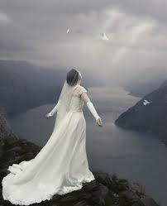
Smiley © sherv.net
Jumping heart ©
www.fg-a.com
I give all of myself to you as you gave and now give all of yourself to me!
many copies
on internet,
original unknown. This is from Kootation.com.
Lord, without Christ I am under the law and captive to a horribly abusive master, sin, but in Christ crucified and reigning I have died to the law through the body of Christ sacrificed for me, so that I may belong to Christ as his bride and bear fruit for you. I’m released from the law to serve you in the new way of the Spirit of life in Christ.

Slide 205
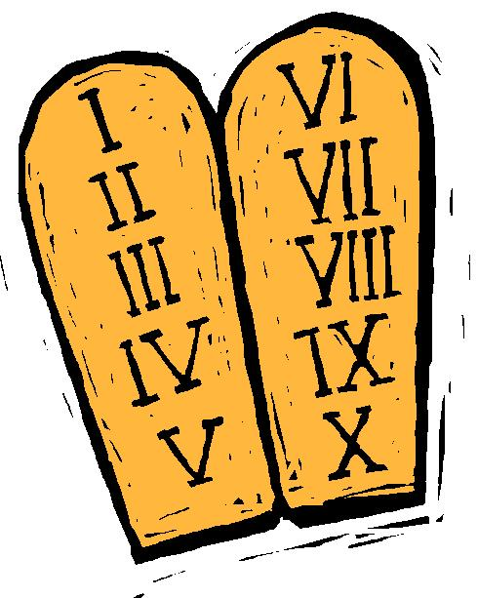

The law of sin and death:
the soul that sins
against my law dies!
48. the law of the Spirit of life
in Christ Jesus sets us free
from the law of sin and death!
Praise you, Lord!
10 Commandments
Microsoft clip art © 2013
Love God and his ways?
NO!
Dove and Bible Microsoft clip art © 2013
Jesus © GospelGifs.com
“Consider yourselves dead to sin and alive to God in Christ Jesus
. . . brought from death to life” Rom 6:11,13
jumping heart © www.fg-a.com
Me Me Me!
boy © GospelGifs.com
Satan face at clipartpal.com
slavery to sin and Satan

Slide 206
The law of sin and death:
the soul that sins
against my law dies!
48. the law of the Spirit of life
in Christ Jesus sets us free
from the law of sin and death!
Praise you, Lord!
10 Commandments
Microsoft clip art © 2013
Love God and his ways?
NO!
Dove and Bible Microsoft clip art © 2013
Jesus © GospelGifs.com
“For the law of the Spirit of life has set you free in Christ Jesus from the law of sin and death” Rom 8:2
jumping heart © www.fg-a.com
Me Me Me!
boy © GospelGifs.com
Satan face at clipartpal.com
slavery to sin and Satan

Slide 207
Christ is the coach of the crucified-and-raised-with-Christ team
© GospelGifs.com
Dove and Bible Microsoft clip art © 2013
Microsoft Corporation.
soccer teams by Kim Graham
our old coach Sin no longer has authority to rule us
When the old coach yells at you to kick the ball in your own net, who should you listen to? Whose team are you now on? Whose authority are you now under?
Who is in you to empower you to win not lose?

Slide 208
me
Dove and Bible
Microsoft clip art © 2013
Microsoft Corporation.
In summary from Romans 6-8,
to overcome temptation:
Consider, Count yourselves dead to sin
and alive to God in Christ 6:11
Don’t let sin reign in you 6:12
Don’t present your members to sin as
instruments for unrighteousness 6:13
Present yourselves and your members to God as
instruments for righteousness 6:13,16,19,22
Walk/live according to the Spirit not the flesh 8:4
Set your mind on the Spirit not the flesh 8:5
By the Spirit kill sinful temptations as sons of God
follow the leading of the Spirit of God 8:13-14

Slide 209
Consider, Count 6:11. This is true!
Lord, I am counting as true what you say!
I am dead to sin and alive to God
in Christ Jesus! 6:11
I have been immersed and united with Christ into his death and resurrection! 3-5
Dove and Bible
Microsoft clip art © 2013
Microsoft Corporation.
My old self is crucified and buried with Christ! 6
I am
crucified with
Christ
I am no longer enslaved to sin! 6
I am set free from sin! 7
I am raised and alive with Christ! 4,5,8,11
I died to sin to live for God! 10
I’ve been brought from death to life! 13
My body members are for righteousness! 13
Sin no longer has dominion over me! 14
I am not a slave to sin, under the law! 14
I am under Christ and his grace! 14

Slide 210
In summary from Romans 6-8,
to overcome temptation:
Consider, Count 6:11
Don’t let sin reign 6:12
Don’t present 6:13
Present 6:13,16,19,22
Walk 8:4
Set your mind on 8:5
Kill as you follow 8:13-14
Dove and Bible
Microsoft clip art © 2013
Microsoft Corporation.
I am
crucified with
Christ
Thank you that Christ has done his part
and Christ and the Spirit will do their part
as we do our part!
The four verbs from Romans 6 are commands. The three from
Romans 8 are not written as imperatives, but it is helpful to apply them as commands!

Slide 211
Thank you for making clear in Romans 6-8 our part in overcoming temptation:
________, _______ 6:11
Don’t let ____ ______ 6:12
Don’t _______ 6:13
_______ 6:13,16,19,22
_____ 8:4
____ your _____ on 8:5
_____ 8:13 _____ 8:14
Dove and Bible
Microsoft clip art © 2013
Microsoft Corporation.
I am
crucified with
Christ
Thank you that Christ has done his part
and Christ and the Spirit will do their part
as we do our part!
The four verbs from Romans 6 are commands. The three from
Romans 8 are not written as imperatives, but it is helpful to apply them as commands!

Slide 212
“Are we to continue in sin that grace may abound?”
Rm 6:1
“I love
You first
Father”
heart © clipartbest.com
original author of picture unknown
“Are we to sin because we are not under law
but under grace?” Rm 6:15

Slide 213
To overcome temptation, note how principles from Romans 6-8 (Gifts 32-48) work together with life in the Spirit (Gifts 48-71).
We die with Christ in order to live with Christ in the Spirit, freed from sin.
Note in particular how the following gifts of life in the Spirit contribute to being set free from sin.
62. The Holy Spirit is constantly teaching us God’s word as part of setting us free from sin.
63-64. The Holy Spirit is always leading us and sanctifying us to walk with Christ and not sin.
66. The Spirit fills us to do the Lord’s will, not sin.
67. We are circumcised by Christ to live in the
Spirit and not live in the flesh and sin.
70-71. The Lord leads us in victory over sin.

Slide 214
Note how almost
all these are in
Romans 6-8
faith
in Christ
immersed into Christ
in death with Christ
and resurrection with Christ
united with Christ in death with Christ
and resurrection with Christ
old self in Adam crucified and buried with Christ
new self in Christ raised and alive with Christ
set free from sin
body members instruments for righteousness under Christ and his abundant grace
slaves to Christ and righteousness, not sin
joined to Christ one with Christ seated with Christ hidden with Christ in God
released from the law to marry Christ
under the law of the Spirit
of life in Christ
Gifts 32-48
Lord, thank you that Jesus died to give us
your gifts of grace that set us free from sin!

Slide 215
Jesus
Mohammed
Confucius
Can anyone else give us these gifts?
Has anyone else died as God’s once-for-all sacrifice for sin? Is anyone else the infinite
Son of God, our resurrected Messiah and Lord,
who provides in himself all we need in God?
Hindu Gurus
Moses
Buddha

Slide 216
Buddhism says:
Do Do Do
Do Do Do
Do Do.
You Do.
8-fold path
Islam
says:
Do Do Do
Do Do all Allah wants.
You Do.
5 pillars
Hinduism
says:
Do Do Do
Do Do Do
Do Do Do.
You Do.
many paths
Jesus
says:
It is DONE.
I DO 4 U.
I give.
You receive.
Receive me and
you receive all
I DO 4 U
I DO 4 U
There is no one else like Jesus!
Jesus is the crucified and reigning
Messiah, Son of God and Savior
who is “I DO 4 U” not “U DO.”
More free resources on the grace of God in Christ @ www.GraceGodChrist.com

Slide 217
THE LORD
God’s completely different way
to deepest joy and satisfaction!
smiley © sherv.net
People circle © clipartfest.com
Joy and satisfaction are in Christ, not beauty, music, phones, movies, games, sports, cars, money, friends, romance, sex, food, drinking, drugs, homes or jobs! Jesus had supreme joy without sex or money!

Slide 218
counted as righteous in Christ the righteousness of God
ransomed, redeemed Passover Lamb, sin atoned, wrath turned
forgiven peace with God reconciled eternal life adopted sons
welcomed, accepted filled, complete blessed with every blessing
Christ our wisdom from God, righteousness and sanctification and redemption
delivered from the domain of darkness into the light of the kingdom of the beloved Son
in Christ and Christ in us in the Spirit and the Spirit in us, made God’s temple
in God the Father and the Father in us immersed in the Father, Son, and Spirit
Father, Son, and Spirit fellowship with us access to God and his grace
answered prayer grace at the throne of grace
every need supplied Holy Spirit prays for us, helps us pray
Christ our H.P. intercedes as our mediator Christ our H.P. advocates in our defense
immersed in Christ and his death and res. united with Christ in his death and res.
old self crucified and buried with Christ new self raised and alive with Christ
set free from sin instrument for righteousness
under Christ, abundant grace slaves of Christ not sin
joined to Christ one with Christ
seated with Christ hidden with Christ in God
released from law to marry Christ under law of the Spirit
Spirit and God’s love poured out born of the Spirit
given, receive, have Spirit rivers of living water of Spirit
immersed in the Spirit Spirit comes on, falls on us
Spirit power to be ambassadors anointed with the Spirit
sealed with the Spirit guarantee of the Spirit
Spirit of truth helps, teaches Spirit leads
Spirit sanctifies Spirit gifts for service
Spirit fills circumcised, set apart in the Spirit
immeasurably great power God’s workmanship
led in triumph and nike victory members of Christ’s body
brothers and sisters branches in Christ’s vine
  chosen race, royal priesthood, holy nation God’s possession, God’s people
fellow citizens with the saints members of the household of God
citizenship in heaven hope of glory inheritance, heir, fellow heir
with Christ at death made perfect glorified to be like Jesus
into heavenly kingdom enter joy of Lord delivered from wrath
God’s good work completed resurrection body like Jesus married to the Lamb
every tear wiped away see God’s face reign forever
loved and saved in the New Covenant
Receive me - receive all I provide through my blood
I DO 4 U
Jesus © GospelGifs.com
Pulsing heart @clipartbest.com

Slide 219
Spirit
gifted
glory with Christ
reign
forever
see his face
resurrection
Spirit
fills
sanctified
seated with Christ
Christ
intercedes
in the
Spirit
Christ’s
power
Spirit
anoints
crucified
with Christ
accepted
adopted
Bride of
Christ
Christ’s
body
access
eternal
life
Spirit seals
victory
fullness
kingdom of
Christ
Christ
in us
raised with Christ
alive
in Christ
hidden with Christ in God
immersed
into Christ
every
blessing
peace
New
Covenant
led by
the Spirit
hope
of
glory
set free
from sin
atonement
of Christ
one with
Christ
born of the Spirit
loved
forgiven
reconciled
Christ’s ransom
Christ’s righteousness
Spirit
poured out
saved
When Christ rose,
it’s as if his cross became a tree of life
with many fruits to joyfully eat by faith.
Come to me and eat.
rooted in the blood of Jesus Christ, the Son of God

Slide 220
Spirit
gifted
glory with Christ
reign
forever
see his face
resurrection
Spirit
fills
sanctified
Christ
intercedes
seated with Christ
in the Spirit
Christ’s
power
Spirit
anoints
crucified
with Christ
accepted
adopted
Bride of
Christ
Christ’s
body
access
eternal
life
Spirit seals
victory
fullness
kingdom of
Christ
hope
of
glory
raised with Christ
alive
in Christ
Christ
in us
every
blessing
immersed
into Christ
peace
New
Covenant
atonement
of Christ
one with
Christ
led by
the Spirit
set free
from sin
saved
born of
the Spirit
hidden with Christ in God
forgiven
loved
Spirit
poured out
reconciled
Christ’s ransom
Christ’s righteousness
When Christ rose,
it’s as if his cross became a fountain
of life-giving water to joyfully drink by faith.
Come to me and drink.
a fountain flowing from the blood of Jesus Christ, God’s Son

Slide 221
I am your ransom
and redemption
I am your forgiveness
from God
I am your
righteousness
from God
justification
I am
your
peace
with God
Find joy and satisfaction in God. Open Christ’s gifts to enjoy the Lord by faith in God’s promises expressed in praise!
Promises - Faith - Praise
I am your
adoption
as God’s
child
I am your
deliverance from darkness
into the kingdom of God’s Son
I am your
hope of glory
I am your
fullness
of blessing
I am your
at-one-ment with the Lord
God’s wrath turned away
I am your
spiritual fullness
in God
I am your
eternal
life

Slide 222
Highly recommended
Develop the habit of praising the LORD every day for his grace in Christ. Develop a mind and heart that rests in Christ for all.
During your prayer time each of the seven days of the week, praise the Lord through section 1 on Day 1,
section two on Day 2, . . . seven on Day 7!
Monday – Section 1
Tuesday – Section 2
Wednesday – Section 3
Thursday – Section 4
Friday – Section 5 Gifts of life in the Holy Spirit
Saturday – Section 6
Sunday – Section 7

Slide 223
The Grace of God in Christ
100 gifts of delight we receive in the Lord’s gift of Christ crucified
Gifts that are a firm foundation 1-14
Gifts of connection with Father, Son and Spirit 15-23
Gifts of life at God’s throne 24-31
Gifts of being set free from sin 32-48
Gifts of life in the Holy Spirit 48-71
Gifts of being the body of Christ 72-82
Gifts of future glory 83-97
Three great gifts that include all the others 98-100
Use “search” on your smart-phone

Slide 224
the law of the Spirit sets free the Spirit and God’s love is poured in born of the Spirit, born of God given, receive, have the gift of the Spirit rivers of life in the Spirit satisfy thirsty hearts immersed in the Spirit the Spirit comes on us, falls on us power of the Spirit to be ambassadors of Christ anointed and sealed with the Spirit of guarantee the Spirit of truth helps and teaches us God’s word the Spirit leads and sanctifies, producing holy fruit the Spirit gifts us for service to others the Spirit fills us to do the Lord’s will circumcised, set apart in the Spirit immeasurably great power of the Spirit
God’s workmanship led in triumph and nike victory
in Christ
Gifts 48-71
faith
in Christ
Thank you
for the
grace
of the
Holy
Spirit
given
through
Christ’s
death!
so we walk in Christ in the Spirit in agape love

Slide 225
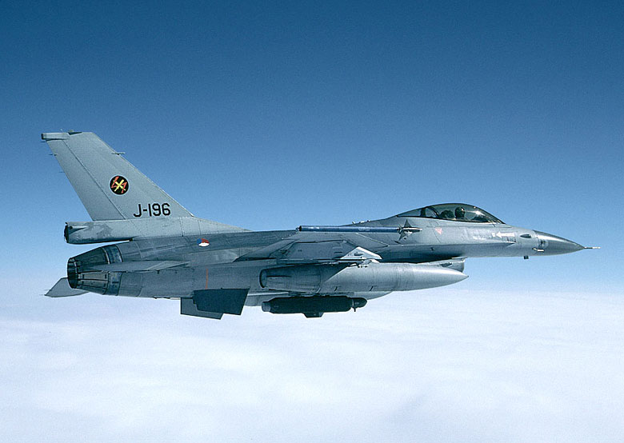
Life in the Spirit:
the law of the Spirit of life in Christ
sets us free from the law of sin
like the law of aerodynamics
overpowers the law of gravity
F 16 from raahistory.com

Slide 226
The law of sin and death:
the soul that sins
against my law dies!
48. the law of the Spirit of life
in Christ Jesus sets us free
from the law of sin and death!
Praise you, Lord!
10 Commandments
Microsoft clip art © 2013
Love God and his ways?
NO!
Dove and Bible Microsoft clip art © 2013
Jesus © GospelGifs.com
“For the law of the Spirit of life has set you free in Christ Jesus from the law of sin and death” Rom 8:2
jumping heart © www.fg-a.com
Me Me Me!
boy © GospelGifs.com
Satan face at clipartpal.com
slavery to sin and Satan

Slide 227
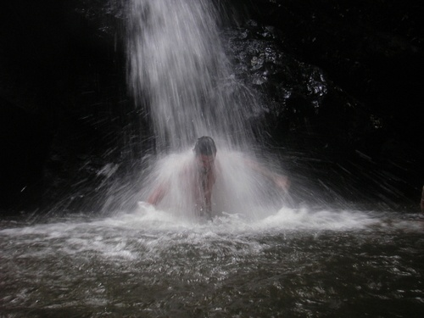
49. the Spirit is poured into our hearts. Praise you, Lord!
“And in the last days it shall be,
God declares,
that I will pour out my Spirit on all flesh, . . .
I will pour out my Spirit, and they shall prophesy”
Acts 2:17-18
“God's love has been poured into our hearts through the Holy Spirit, who has been given to us” Rom 5:5
Dove and Bible
Microsoft clip art © 2013 Micro. Corp.
heart © clipartbest.com
Pariah Springs Trinidad and Tobago
Eco Adventure Tours
heart © clipartbest.com
Prophesy = saying what the Lord says (Ezek 34:2; 35:2-3).
In Acts, New Testament prophecy focuses on witnessing about Jesus (Acts 1:8), preaching the word of Christ crucified and risen (Acts 8:4).
Christians prophesy when they share Christ using God’s Word,
saying, “Thus says the LORD. This is what the LORD says.”
NO!
© GospelGifs.com

Slide 228
50. the Spirit of agape love
is poured into
our hearts.
Thank you, Lord!
“God's love has been poured into our hearts through the Holy Spirit,
who has been given to us. ... Christ died for us ... justified by his blood ... reconciled … saved by his life”
Rom 5:5-10
Dove and Bible
Microsoft clip art © 2013 Micro. Corp.
heart © clipartbest.com
You first
Lord
Pariah Springs Trinidad and Tobago
Eco Adventure Tours
heart © clipartbest.com
In Romans 5:5-11, God’s love poured into our hearts includes
the love of Christ dying for us to justify us and reconcile us to God,
and Christ living for us to pour into us the Spirit of God’s nature
of agape love and to much more save us from God’s wrath!
NO!
© GospelGifs.com

Slide 229
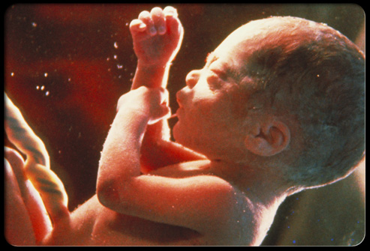
51. born of the Spirit,
born of God.
All praise, Lord!
“For everyone who has been born of God overcomes the world”
1 John 5:4
Dove and Bible
Microsoft clip art © 2013
Microsoft Corporation.
baby
various copies on internet,
original source unknown
“Truly, truly, I say to you, unless one is born of water
and the Spirit, he cannot enter
the kingdom of God” John 3:5
NO!
© GospelGifs.com

Slide 230


52-54. given the Spirit,
receive the gift
of the Holy Spirit,
have the Spirit.
I believe you Lord!
JESUS
CHRIST
psdgraphics.com in kidclipart.com
Jumping heart ©
www.fg-a.com
Dove and Bible Microsoft clip art © 2013 Microsoft Corp
“the Holy Spirit who has been given to us” Rom 5:5
“Repent and be baptized every one of you in the name
of Jesus Christ for the forgiveness of your sins, and you will receive the gift of the Holy Spirit” Acts 2:38
“Anyone who does not have the Spirit of Christ
does not belong to him” Rom 8:9
NO!
© GospelGifs.com

Slide 231
JESUS
CHRIST
Jumping heart ©
www.fg-a.com
I believe
You, Lord!
psdgraphics.com in kidclipart.com
Dove and Bible Microsoft clip art © 2013 Microsoft Corp
“justified by faith in Christ . . . receive the Spirit . . . justified before God . . . Christ redeemed us from the curse of the law by becoming a curse for us . . . so that we might receive the promised Spirit through faith . . . justified by faith.”
Gal 2:16; 3:2, 11, 13-14, 24
Thank you, Lord, that all who are justified by faith in Christ our Redeemer receive the Spirit! Salvation in Christ includes receiving the Spirit in all his New Covenant ministry!

Slide 232
55. rivers of life in the Spirit satisfy our thirsts
and flow out in love to others. Thank you, Lord!
heart © clipartbest.com
Jesus © GospelGifs.com
Dove and Bible Microsoft clip art © 2013
“If anyone thirsts, let him come to me and drink. Whoever believes in me, as the Scripture has said,
'Out of his heart will flow rivers of living water.'
Now this he said about the Spirit . . .”
John 7:37-39
NO!
Me!
Me!
Me!
© GospelGifs.com

Slide 233
Spirit
in us
immersed
in the Spirit
Spirit fellowships with us
in the
Spirit
fellowship with the Spirit
have the Spirit
Spirit
sanctifies
Spirit
leads
Spirit prays for us and helps us pray
adopted sons with Spirit
of Son
Spirit teaches us God’s Word
access in
one Spirit
Spirit anoints
Spirit
comes, falls on us
receive
the Spirit
Spirit
poured
into heart
rivers of life
in the Spirit
law of Spirit sets free
from sin
Spirit
seals
born of
the Spirit
Spirit of Christ in us
released from law to belong to Christ in
the Spirit
Spirit
fills
God’s love poured into heart by
the Spirit
circumcised by Christ in the Spirit
power of Spirit to be ambassadors for Christ
The rivers of the Spirit of Christ are like a gushing fountain flowing from our hearts. “Whoever drinks of the water that I will give him will never be thirsty again. The water that I will give him will become in him a spring of water welling (gushing) up to eternal life” John 4:24

Slide 234
Spirit
in us
immersed
in the Spirit
Spirit fellowships with us
in the
Spirit
fellowship with the Spirit
have the Spirit
Spirit
sanctifies
Spirit
leads
Spirit prays for us and helps us pray
adopted sons with Spirit
of Son
Spirit teaches us God’s Word
access in
one Spirit
Spirit anoints
Spirit
comes, falls on us
receive
the Spirit
Spirit
poured
into heart
rivers of life
in the Spirit
law of Spirit sets free
from sin
Spirit
seals
born of
the Spirit
Spirit of Christ in us
released from law to belong to Christ in
the Spirit
Spirit
fills
God’s love poured into heart by
the Spirit
circumcised by Christ in the Spirit
power of Spirit to be ambassadors for Christ
In Christ the rivers of the Spirit change us from being a desert to others to being an oasis. “Behold, a king will reign in righteousness . . . Each will be like a hiding place from the wind, a shelter from the storm, like streams of water in a dry place, like the shade of a great rock” Isa 32:1-2

Slide 235

56. Immersed in the Holy Spirit! I submit, Lord!
Messiah “is like a refiner's fire . . . he will purify . . . and refine them”
Malachi 3:2-3
“John baptized with water,
but you will
be baptized (immersed)
with the Holy Spirit . . . you will receive power when the Holy Spirit has come upon you, and you will be my witnesses . . .”
Acts 1:5, 8
No!
(Mk 1:8; Acts 11:16
1 Cor 12:13)
Dzieci Pana Boga @enieweglowskaPinterest .jpg
© GospelGifs.com

Slide 236
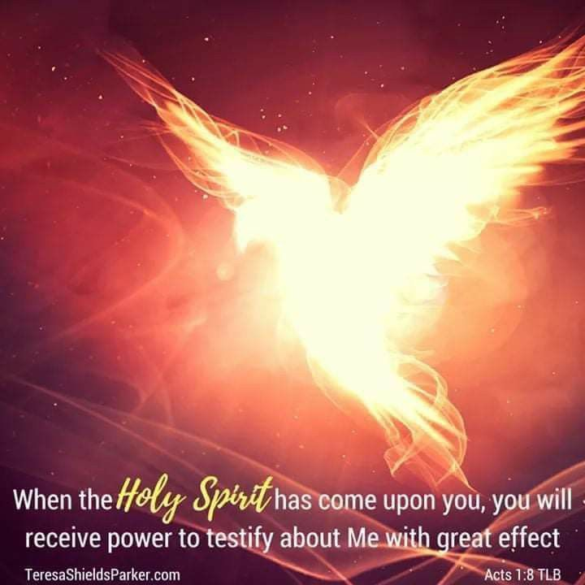

56. Immersed in the Holy Spirit! I submit, Lord!
“For in one Spirit we were all baptized (immersed)
into one body—
Jews or Greeks, slaves or free—and all were made to drink of one Spirit”
1 Cor 12:13
No!
Dove https://i.pinimg.com/originals/0f/9f/13/0f9f13ec39cb5adc246016b7dc6d8743.jpg TeresaShieldsParker.com
Bible and cross Microsoft clip art © 2013 Microsoft Corporation.
© GospelGifs.com

Slide 237
  Repentance toward God and faith in our Lord Jesus Christ
All God’s riches of grace in Christ are given freely at the moment of salvation.
It is not possible to be “in Christ”
but not “immersed in the Spirit.”
Do not empty the cross
of Christ
of its power
(1 Cor 1:17).
in Christ
counted as righteous in Christ the righteousness of God
ransomed, redeemed Passover Lamb, sin atoned, wrath turned
forgiven peace with God reconciled eternal life adopted sons
welcomed, accepted filled, complete blessed with every blessing
Christ our wisdom from God, righteousness and sanctification and redemption
delivered from the domain of darkness into the light of the kingdom of the beloved Son
in Christ and Christ in us in the Spirit and the Spirit in us, made God’s temple
in God the Father and the Father in us immersed in Father, Son, and Spirit
Father, Son, and Spirit fellowship with us access to God and his grace answered prayer
grace at the throne of grace every need supplied Holy Spirit prays for us, helps us pray
Christ our High Priest intercedes as mediator Christ our High Priest advocates in our defense
immersed into Christ and his death and resurrection united with Christ in death and resurrection
old self crucified and buried with Christ new self raised and alive with Christ
set free from sin instrument for righteousness
under Christ, abundant grace slaves of Christ not sin
joined to Christ one with Christ
seated with Christ hidden with Christ in God
released from law, married to Christ under law of the Spirit
Spirit and God’s love poured out born of the Spirit
given, receive, have Spirit rivers of living water of Spirit
immersed in the Spirit Spirit comes on, falls on us
Spirit power to be ambassadors anointed with the Spirit
sealed with the Spirit guarantee of the Spirit
Spirit of truth helps, teaches Spirit leads
Spirit sanctifies Spirit gifts for service
Spirit fills circumcised, set apart in the Spirit
immeasurably great power God’s workmanship led in triumph and nike victory
members of Christ’s body brothers and sisters branches in Christ’s vine
  chosen race, royal priesthood, holy nation, God’s possession, God’s people
fellow citizens with the saints and members of the household of God
citizenship in heaven hope of glory inheritance, heir, fellow heir
with Christ at death made perfect glorified to be like Jesus
into heavenly kingdom enter joy of Lord delivered from wrath
God’s good work completed resurrection body like Jesus
married to the Lamb every tear wiped away
see God’s face reign forever
loved and saved
in New Covenant
jumping heart © www.fg-a.com
johncrozieris@gmail.com © 2020

Slide 238
At Pentecost, with his new grasp of what God was doing, what did Peter say God would do from then on?
And Peter said to them, “Repent and be baptized (immersed) every one of you in the name of Jesus Christ for the forgiveness of your sins, and you will receive the gift of the Holy Spirit” (Acts 2:38).
Have you repented and been forgiven through Christ? What does Peter say goes together with forgiveness?
Peter says God also gives the gift of the Holy Spirit!
Does Peter think God’s gift of the Spirit includes the baptism of the Spirit (1:5), receiving power when the Spirit comes upon us (1:8), the filling of the Spirit (2:4), and the pouring out of the Spirit (2:16-18)? Yes!
To Peter, it’s not possible to be forgiven and not also receive the Holy Spirit in all his New Covenant ministry.

Slide 239
Salvation is to be united with the LORD, God the Father, Son and Spirit!
The moment we are made sons in the Son, we are in Christ, immersed into the
“The Name” of the LORD who is Father, Son and Spirit.
We are fully reconciled to God the Father, Son and Spirit, in Christ and Christ in us, in the Spirit and the Spirit in us,
in the Father and
the Father in us!
Thank you, LORD!
THE LORD
Father, Son and Spirit oneness
love, fellowship and cooperation
smiley © sherv.net pulsing heart © clipartbest.com

Slide 240
For Jews, the stunning conclusion of the gospel
of Matthew is that Jesus wants to make disciples
of all nations (Gentiles)
and immerse them into
“The Name” (“Ha Shem” in Hebrew), the name
of the Father, Son and Holy Spirit (Mat 28:19). All who rely on Jesus
to save them from
their sins (Mat 1:21) are immersed into God the Father, Son and Spirit!
It’s not possible to be saved without immersion in the Spirit.
THE LORD
Father, Son and Spirit oneness
love, fellowship and cooperation
smiley © sherv.net pulsing heart © clipartbest.com

Slide 241

“As I began to speak, the Holy Spirit fell on them just as on us at the beginning”
Acts 11:15
the Lord
“You will receive power when the Holy Spirit has come upon you” Acts 1:8
Dove and Bible
Microsoft clip art © 2013
Microsoft Corporation.
57. the Spirit
comes on us
and falls on us.
Thank you, Lord!
NO!
© GospelGifs.com

Slide 242
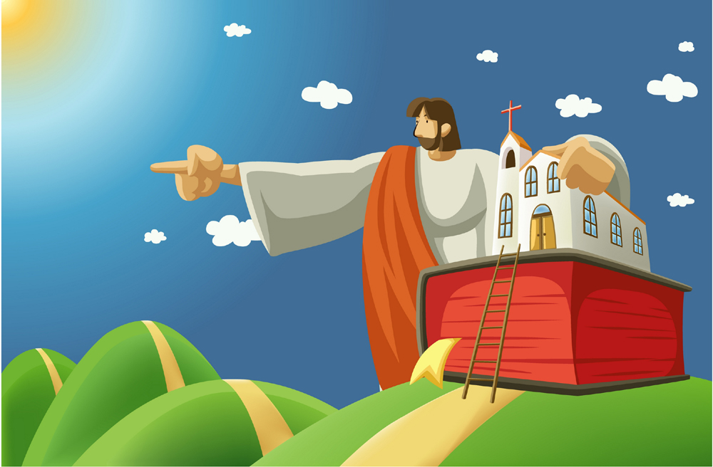
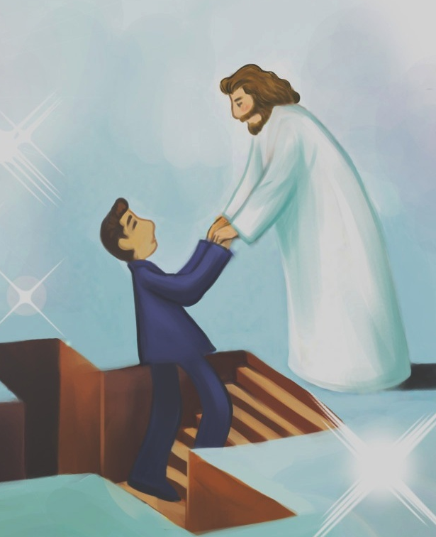
58. empowered by the Spirit to be ambassadors for Christ, imploring on behalf of Christ. Thank you, Lord!
© Yoon Nam Sun
Dove and Bible
Microsoft clip art © 2013
Microsoft Corporation.
© Yoon Nam Sun
© iclickart.co.kr with permission from Iregihwek print shop in Yeosu, South Korea
“Therefore, we are ambassadors for Christ, God making his appeal through us. We implore you on behalf of Christ,
be reconciled to God. For our sake he made him to be sin
who knew no sin, so that in him we might become
the righteousness of God.” 2 Cor 5:20-21
NO!
© GospelGifs.com

Slide 243
58. empowered by the Spirit to be ambassadors for Christ, imploring on behalf of Christ. Thank you, Lord!
© Yoon Nam Sun
Dove and Bible
Microsoft clip art © 2013
Microsoft Corporation.
© Yoon Nam Sun
© iclickart.co.kr with permission from Iregihwek print shop in Yeosu, South Korea
“But you will receive power when the Holy Spirit has come upon you, and you will be my witnesses . . . to the end of the earth.” Acts 1:8
NO!
© GospelGifs.com

Slide 244
58. empowered by the Spirit to be ambassadors for Christ, imploring on behalf of Christ. Thank you, Lord!
© Yoon Nam Sun
Dove and Bible
Microsoft clip art © 2013
Microsoft Corporation.
© Yoon Nam Sun
© iclickart.co.kr with permission from Iregihwek print shop in Yeosu, South Korea
“But when the Helper comes, whom I will send to you from the Father, the Spirit of truth, who proceeds from the Father, he will bear witness about me.
And you also will bear witness” John 15:26-27
NO!
© GospelGifs.com

Slide 245
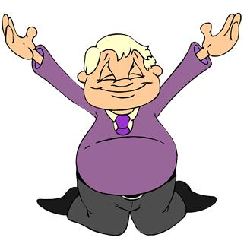
59. anointed with the Spirit.
Thank you, Lord!
Dove and Bible
Microsoft clip art © 2013
Microsoft Corporation.
“And it is God who
establishes us with you in Christ, and
has anointed us,
and who has also put his seal on us and given us his Spirit
in our hearts
as a guarantee”
2 Cor 1:21-22
Microsoft clip art © 2013
Microsoft Corporation.
NO!
© GospelGifs.com

Slide 246
60. sealed with the Spirit. Thank you, Lord!
Dove and Bible
Microsoft clip art © 2013
Microsoft Corporation.
Holy to the Lord
“And do not grieve the Holy Spirit of God, by whom you were sealed for the day of redemption” Eph 4:30
NO!
© GospelGifs.com

Slide 247
61. the Spirit is the guarantee of our inheritance.
Thank you, Lord!
100 %
Dove and Bible
Microsoft clip art © 2013
Microsoft Corporation.
Guarantee
of inheritance
100 %
“In him you . . . were sealed with the promised
Holy Spirit, who is the guarantee of our inheritance
until we acquire possession of it” Eph 1:13-14
NO!
© GospelGifs.com

Slide 248
62. the Spirit helps us and teaches us God’s truth in Christ. Praise you, Lord!
“But when the Helper comes, . . . the Spirit of truth . . . he will bear witness about me
. . . he will teach you all things . . .
he will guide you into all the truth”
John 15:26; 14:26;16:13
Dove and Bible
Microsoft clip art © 2013
Microsoft Corporation.
“Take . . . the sword of the Spirit,
which is the word of God,
praying at all times in the Spirit”
Eph 6:17-18
NO!
© GospelGifs.com
Microsoft clip art © 2013 Microsoft Corporation.

Slide 249
62. the Spirit of truth helps us
and teaches us God’s truth in Christ.
John 14:16-18
The Helper / Counselor, the Spirit of truth
helps us and is with us,
lives with us and is in us.
Jesus comes to us by the Spirit.
John 14:26
The Helper / Counselor, the Holy Spirit
teaches and reminds
John 15:26
The Helper / Counselor, the Spirit of truth
testifies about Jesus as we testify
Dove and Bible
Microsoft clip art © 2013
Microsoft Corporation.

Slide 250
62. the Spirit of truth helps us
and teaches us God’s truth in Christ.
John 16:7-11
The Helper / Counselor convicts and convinces
of the sin of unbelief in Jesus,
the righteousness of Jesus,
the judgment of Satan and sin
John 16:13-15
The Spirit of truth
guides into all truth,
reveals future things to come,
glorifies Jesus, makes known Jesus,
makes known all that belongs to Jesus
Dove and Bible
Microsoft clip art © 2013
Microsoft Corporation.

Slide 251
62. the Spirit of truth helps us
and teaches us God’s truth in Christ.
1 Cor 1:23-24; 2:9-16
God’s Spirit reveals what God has prepared
for those who love him; we understand
what God has given us in Christ crucified,
the power and wisdom of God
Eph 6:17-18
The Spirit helps us take the sword of the word of God
to pray in the Spirit with God’s word
1 John 2:20, 26-27
The Holy One anoints us with the Spirit to know his truth.
The Spirit teaches us all God’s truth in Christ
so we discern error and remain in Christ.
Dove and Bible
Microsoft clip art © 2013
Microsoft Corporation.

Slide 252
Why is there a Bible
and cross inside
the dove?
Dove, Bible with cross
Microsoft clip art © 2013
Microsoft Corporation.
The Spirit’s sword is the word of God (Eph 6:17).
The Helper, the Spirit of truth, teaches us God’s
Word as he bears witness to Jesus (John 14:26; 15:26)
with the word of the cross, Christ crucified (1 Cor 1:18, 23). This word of God and Christ crucified, breathed out by God in the Spirit, teaches, reproves, corrects and trains us to be complete, equipped for every good work (2 Tim 3:16-17).

Slide 253
Why is there a Bible
and cross inside
the dove?
Dove, Bible with cross
Microsoft clip art © 2013
Microsoft Corporation.
Because of the serious problem
around the world with many sincere
Christians who are disconnecting
the Spirit of truth from the Bible
and from Christ and his cross!

Slide 254

Many today prefer and emphasize new ‘words,’ dreams, and visions
of personal direction, not of Christ crucified of whom the Spirit testifies.
Thus the Bible, the inerrant word
of God, is not the final authority
in all matters of faith and practice,
nor is Christ and his finished work
the preeminent focus of the Spirit. Many focus on tongues they don’t understand, which therefore can’t build up in Christ, rather than abiding in Christ and his words abiding in them, and praying in the Spirit with the Spirit’s sword of the word of God.
Dove
Microsoft clip art © 2013
Microsoft Corporation.

Slide 255
Charismatic confusion
all over the world
leads people away from
joy-filled rest in Christ
and his finished work
that provides every spiritual blessing.
Many promote all sorts of spiritual experiences as being “more spiritual”
than those who
receive Christ by faith,
walk in the fullness of Christ by faith,
and overflow with thanksgiving (Col 2:6-7).
The false teachers did this in Colossians,
and many are repeating the error today.
Dove
Microsoft clip art © 2013
Microsoft Corporation.

Slide 256
Which view of the Spirit do you have?
Dove, Bible with cross
Microsoft clip art © 2013
Microsoft Corporation.
Our view of the Spirit affects so many things in our soul.
For more on this, download “Charismatic Confusion” at www.graceGodChrist.com

Slide 257
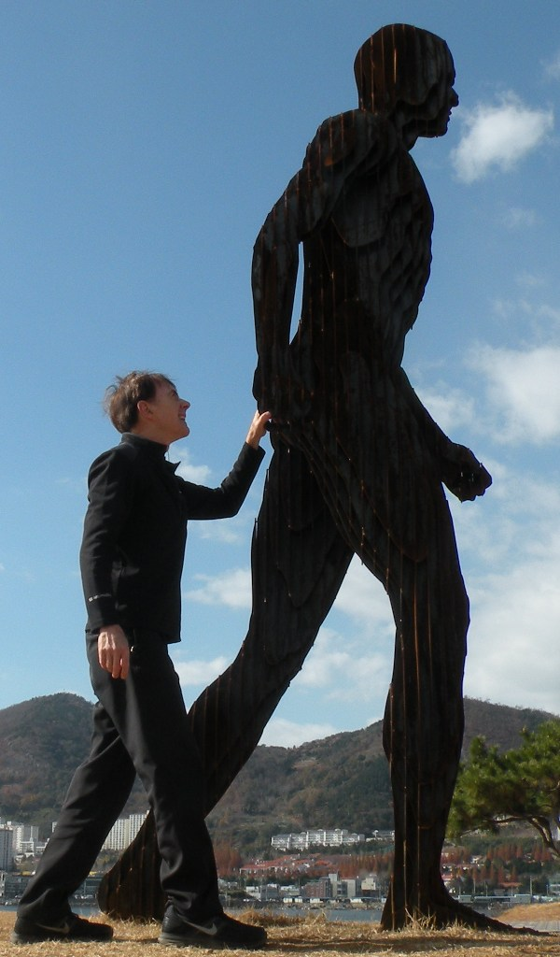

63. the Spirit leads us.
We follow, Lord!
Thank you!
Dove and Bible
Microsoft clip art © 2013
Microsoft Corporation.
“For all who
are led by
the Spirit of God
are sons of God”
Rom 8:14
NO!
photo John Crozier
© GospelGifs.com

Slide 258

64. the Spirit sanctifies us.
Thank you, Lord!
Dove and Bible
Microsoft clip art © 2013
Microsoft Corporation.
“sanctified by the Holy Spirit”
Rom 15:16
“the sanctification of the Spirit, for obedience to
Jesus Christ and
for sprinkling by his blood”
1 Pet 1:2
NO!
© GospelGifs.com

Slide 259
64. the Spirit sanctifies us.
We keep in step, Lord!
love joy
peace longsuffering
kindness goodness
faithfulness gentleness
self-control
Dove and Bible
Microsoft clip art © 2013
Microsoft Corporation.
“sanctified by the Holy Spirit”
Rom 15:16
Gal 5:22-23
sexual immorality
impurity sensuality idolatry sorcery enmity strife jealousy fits of anger
rivalries dissensions
divisions envy
drunkenness
orgies
“God chose you as the firstfruits to be saved, through sanctification by the Spirit and belief in the truth”
2 Thes 2:13
NO!
Gal 5:19-21
© GospelGifs.com

Slide 260
64. the Spirit sanctifies us.
We cooperate, Lord!
compassion kindness
humility meekness
patience forbearance
forgiving love
peace thankful
word of Christ in you richly
doing all in the name
of Jesus
Dove and Bible
Microsoft clip art © 2013
Microsoft Corporation.
“sanctified by the Holy Spirit”
Rom 15:16
Col 3:12-17
sexual immorality impurity passion evil desire covetousness idolatry anger
wrath malice slander
obscene talk
lying
“Flee from sexual immorality . . . do you not know that your body is a temple of the Holy Spirit within you?”
1 Cor 6:18-19
NO!
Col
3:5, 8, 9
© GospelGifs.com

Slide 261
65. the Spirit gifts us to serve others.
Thank you, Lord!
Microsoft clip art © 2013
Microsoft Corporation.
“As each has received
a gift, use it to serve one another, as good stewards
of God's varied grace”
1 Pet 4:10
NO!
© GospelGifs.com

Slide 262

66. filled with the Spirit of agape to walk as Jesus walked
doing the Lord’s will! Yes, Lord, empower us!
Dove and Bible
Microsoft clip art © 2013
Microsoft Corporation.
“Do not get drunk with wine . . . but
be filled with the Spirit” Eph 5:18
love
joy
peace
longsuffering
Jesus
kindness
goodness
Filled with the
Spirit of Jesus;
filled with God’s nature
of love for God and people
faithfulness
gentleness
self-control
NO!
© GospelGifs.com

Slide 263
The Spirit fills believers to love, fellowship with and cooperate with the Father as Jesus does.
The Spirit fills believers to
love others
as Jesus does,
and share
the gospel
as Jesus does.
This is New Covenant salvation!
THE LORD
Father, Son and Spirit oneness
love, fellowship and cooperation
smiley © sherv.net pulsing heart © clipartbest.com

Slide 264
How did Jesus walk with the Father in the Spirit?
“You first
Father”
heart © clipartbest.com
original author of picture unknown

Slide 265
How do we walk with Christ in the Spirit?

Slide 266
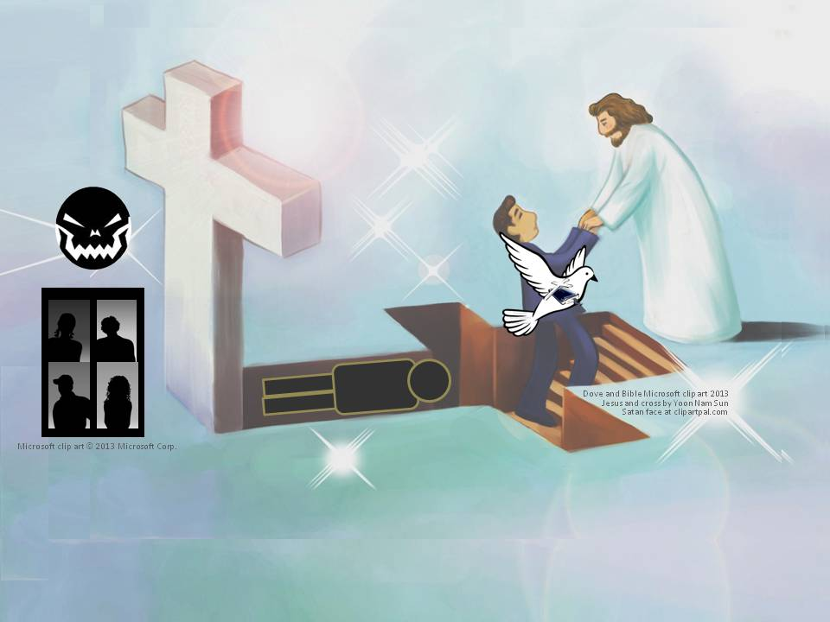
How do we walk with Christ in the Spirit?
“be filled with the Spirit; Speaking to yourselves in psalms and hymns and spiritual songs, singing and making melody in your heart to the Lord; Giving thanks always for all things unto God and the Father in the name of our Lord Jesus Christ; Submitting yourselves one to another in the fear of God.” Eph 5:18-21 KJV

Slide 267
How do we walk with Christ in the Spirit?
Christ is the coach of the crucified-and-raised-with-Christ team
© GospelGifs.com
Dove and Bible Microsoft clip art © 2013
Microsoft Corporation.
soccer teams by Kim Graham
our old coach Sin no longer has authority to rule us
“But I say, walk by the Spirit, and you will not gratify the desires of the flesh.” Gal 5:16

Slide 268
me
Dove and Bible
Microsoft clip art © 2013
Microsoft Corporation.
How do we walk with Christ in the Spirit?
Consider, Count yourselves dead to sin
and alive to God in Christ 6:11
Don’t let sin reign in you 6:12
Don’t present your members to sin as
instruments for unrighteousness 6:13
Present yourselves and your members to God as
instruments for righteousness 6:13,16,19,22
Walk/live according to the Spirit not the flesh 8:4
Set your mind on the Spirit not the flesh 8:5
By the Spirit kill sinful temptations as sons of God
follow the leading of the Spirit of God 8:13-14

Slide 269
67. circumcised by Christ in the Spirit, putting off living in the flesh to live in Christ in the Spirit in God. Thank you!
raised with Christ
in the Spirit
faith in Christ
living in Christ
in the Spirit in God
living in the flesh
crucified + buried
with Christ
“In him also you were circumcised . . . without hands, by putting off the body of flesh, by the circumcision of Christ, having been buried with him in baptism, in which you
were also raised with him through faith” Col 2:11-12
“circumcision is . . . of the heart, by the Spirit” Rom 2:29
NO!
© GospelGifs.com

Slide 270

68. immeasurable
power and strength.
Thank you, Lord!
“Having the eyes of your hearts enlightened, that you may know what is . . . the immeasurable greatness of his power toward us who believe” Eph 1:18-19
arms
Microsoft clip art © 2013
Microsoft Corporation.
smileys © sherv.net
“I can do all things through him who strengthens me” Phil 4:13
“clothed with power”
Luke 24:49
NO!
© GospelGifs.com

Slide 271
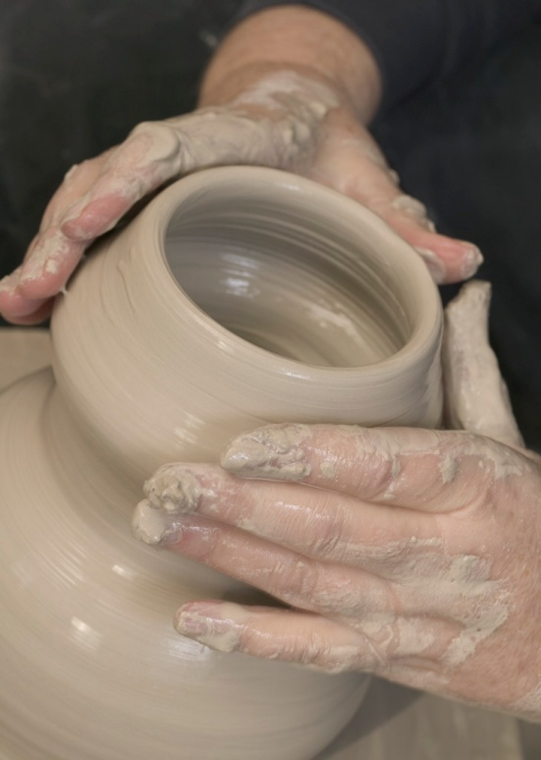
“For we are his workmanship, created in Christ Jesus for good works, which God prepared beforehand, that we should walk in them” Eph 2:10
“For it is God who works in you, both to will and to work for his good pleasure”
Phil 2:13
69. God’s workmanship.
Thank you, Lord!
Jumping heart © www.fg-a.com
Pottery Microsoft clip art © 2013
Microsoft Corporation.
NO!
© GospelGifs.com

Slide 272










70-71. led in triumphal procession and nike victory in Christ.
Thank you, Lord!
Microsoft clip art © 2013
Microsoft Corporation.
Copyright by Nike
After his victory, our Commander Jesus leads his troops in triumphal procession
“But thanks be to God, who in Christ always leads us
in triumphal procession” 2 Co 2:14
“But thanks be to God, who gives us the victory (nike) through our Lord Jesus Christ” 1 Cor 15:57
NO!
© GospelGifs.com

Slide 273
Jesus Christ has niked and gives us nike victory!
© Copyright by Nike
For how Jesus and the Apostles use the Greek word nike 34 times in the Greek New Testament,
go to www.GraceGodChrist.com
then the “Nike in the New Testament” page,
for PPT and articles.
Download “What the word nike means” for a short summary I give to others that shares how Jesus
and the Apostles used the word “nike.”

Slide 274
the law of the Spirit sets free the Spirit and God’s love is poured in born of the Spirit, born of God given, receive, have the gift of the Spirit rivers of life in the Spirit satisfy thirsty hearts immersed in the Spirit the Spirit comes on us, falls on us power of the Spirit to be ambassadors of Christ anointed and sealed with the Spirit of guarantee the Spirit of truth helps and teaches us God’s word the Spirit leads and sanctifies, producing holy fruit the Spirit gifts us for service to others the Spirit fills us to do the Lord’s will circumcised, set apart in the Spirit immeasurably great power of the Spirit
God’s workmanship led in triumph and nike victory
in Christ
Gifts 48-71
faith
in Christ
Thank you
for the
grace
of the
Holy
Spirit
given
through
Christ’s
death!
so we walk in Christ in the Spirit in agape love

Slide 275
That’s not all! Holy Spirit riches also include:
8 adopted as sons with the Spirit of God’s Son in heart
17, 18 in the Spirit and the Spirit in us,
19 temples of the Holy Spirit
22 immersed in the Father, Son and Spirit
23 fellowship with the Spirit
24 access to the Father through Christ in one Spirit (Eph 2:18)
28, 29 the Spirit prays for us and helps us pray in the Spirit
Wonderful, Lord! Amazing! Thank you!

Slide 276
in the Spirit and the Spirit in us immersed in the Father, Son and Spirit
Father, Son and Spirit fellowship with us adopted as sons with the Spirit of the Son in us released from the Law to marry Christ in the Spirit law of Spirit of life in Christ sets free from law of sin the Spirit and God’s love is poured into heart born of the Spirit, born of God given, receive, have the gift of the Spirit rivers of living water of the Spirit satisfy thirsty hearts the Spirit comes on us, falls on us power of the Spirit to be ambassadors of Christ anointed and sealed with the Spirit of guarantee the Spirit of truth helps and teaches us God’s word the Spirit prays for us and helps us pray with God’s Word the Spirit leads and sanctifies us, producing holy fruit the Spirit gifts us for service to others the Spirit fills us to do the Lord’s will circumcised, set apart in the Spirit immeasurably great power of the Spirit
God’s workmanship led in triumph and nike victory conformed to Christ and his resurrection body
in Christ
faith
in Christ
Lord,
thank you
for the
many
ways
your Spirit ministers
to those
in Christ!
so we walk in Christ in the Spirit in agape love

Slide 277
Jesus
Mohammed
Confucius
Can anyone else give us these gifts?
Has anyone else died as God’s once-for-all sacrifice for sin? Is anyone else the infinite
Son of God, our resurrected Messiah and Lord,
who provides in himself all we need in God?
Hindu Gurus
Moses
Buddha

Slide 278
Buddhism says:
Do Do Do
Do Do Do
Do Do.
You Do.
8-fold path
Islam
says:
Do Do Do
Do Do all Allah wants.
You Do.
5 pillars
Hinduism
says:
Do Do Do
Do Do Do
Do Do Do.
You Do.
many paths
Jesus
says:
It is DONE.
I DO 4 U.
Come to me
and drink.
Receive me and
you receive all
I DO 4 U
I DO 4 U
There is no one else like Jesus!
Jesus is the crucified and reigning
Messiah, Son of God and Savior
who is “I DO 4 U” not “U DO.”
More free resources on the grace of God in Christ @ www.GraceGodChrist.com

Slide 279
counted as righteous in Christ the righteousness of God
ransomed, redeemed Passover Lamb, sin atoned, wrath turned
forgiven peace with God reconciled eternal life adopted sons
welcomed, accepted filled, complete blessed with every blessing
Christ our wisdom from God, righteousness and sanctification and redemption
delivered from the domain of darkness into the light of the kingdom of the beloved Son
in Christ and Christ in us in the Spirit and the Spirit in us, made God’s temple
in God the Father and the Father in us immersed in the Father, Son, and Spirit
Father, Son, and Spirit fellowship with us access to God and his grace
answered prayer grace at the throne of grace
every need supplied Holy Spirit prays for us, helps us pray
Christ our H.P. intercedes as our mediator Christ our H.P. advocates in our defense
immersed in Christ and his death and res. united with Christ in his death and res.
old self crucified and buried with Christ new self raised and alive with Christ
set free from sin instrument for righteousness
under Christ, abundant grace slaves of Christ not sin
joined to Christ one with Christ
seated with Christ hidden with Christ in God
released from law to marry Christ under law of the Spirit
Spirit and God’s love poured out born of the Spirit
given, receive, have Spirit rivers of living water of Spirit
immersed in the Spirit Spirit comes on, falls on us
Spirit power to be ambassadors anointed with the Spirit
sealed with the Spirit guarantee of the Spirit
Spirit of truth helps, teaches Spirit leads
Spirit sanctifies Spirit gifts for service
Spirit fills circumcised, set apart in the Spirit
immeasurably great power God’s workmanship
led in triumph and nike victory members of Christ’s body
brothers and sisters branches in Christ’s vine
  chosen race, royal priesthood, holy nation God’s possession, God’s people
fellow citizens with the saints members of the household of God
citizenship in heaven hope of glory inheritance, heir, fellow heir
with Christ at death made perfect glorified to be like Jesus
into heavenly kingdom enter joy of Lord delivered from wrath
God’s good work completed resurrection body like Jesus married to the Lamb
every tear wiped away see God’s face reign forever
loved and saved in the New Covenant
Receive me - receive all I provide through my death
I DO 4 U
Jesus © GospelGifs.com
Pulsing heart @clipartbest.com

Slide 280
THE LORD
God’s completely different way
to deepest joy and satisfaction!
smiley © sherv.net
People circle © clipartfest.com
Joy and satisfaction are in Christ, not beauty, music, phones, movies, games, sports, cars, money, friends, romance, sex, food, drinking, drugs, homes or jobs! Jesus had supreme joy without sex or money!

Slide 281
I am your ransom
and redemption
I am your forgiveness
from God
I am your
righteousness
from God
justification
I am reconciliation
to God
I am
your
peace
with God
Find joy and satisfaction in God. Open Christ’s gifts to enjoy the Lord by faith in God’s promises expressed in praise!
Promises - Faith - Praise
I am your
adoption
as God’s
child
I am your
deliverance from darkness
into the kingdom of God’s Son
I am your
hope of glory
I am your
fullness
of blessing
I am your
at-one-ment with the Lord
God’s wrath turned away
I am your
spiritual fullness
in God
I am your
eternal
life

Slide 282
Highly recommended
Develop the habit of praising the LORD every day for his grace in Christ. Develop a mind and heart that rests in Christ for all.
During your prayer time each of the seven days of the week, praise the Lord through section 1 on Day 1,
section two on Day 2, . . . seven on Day 7!
Monday – Section 1
Tuesday – Section 2
Wednesday – Section 3
Thursday – Section 4
Friday – Section 5
Saturday – Section 6 Gifts of being the body of Christ
Sunday – Section 7

Slide 283
The Grace of God in Christ
100 gifts of delight we receive in the Lord’s gift of Christ crucified
Gifts that are a firm foundation 1-14
Gifts of connection with Father, Son and Spirit 15-23
Gifts of life at God’s throne 24-31
Gifts of being set free from sin 32-48
Gifts of life in the Holy Spirit 48-71
Gifts of being the body of Christ 72-82
Gifts of future glory 83-97
Three great gifts that include all the others 98-100
Use “search” on your smart-phone

Slide 284
in Christ
Gifts 72-82
faith
in Christ
members of Christ’s body
brothers and sisters
branches in Christ’s vine
a chosen race,
royal priesthood, holy nation,
God’s possession, God’s people
fellow citizens with the saints
and members of God’s household
Thank you for the body of Christ riches
provided for us by Christ’s death!

Slide 285
72. members of
Christ’s body, the church, united with Christ our Head.
Thank you, Lord!
“Christ is the head of
the church, his body, . . . we are members
of his body”
Eph 5:23, 30
“For in one Spirit
we were all baptized
into one body”
1 Cor 12:13
NO!
Jumping heart © www.fg-a.com
Jesus © GospelGifs.com with permission
© GospelGifs.com

Slide 286
73. brothers and sisters
in Christ.
Thank you, Lord!
“I commend to you our sister Phoebe” Rom 16:1
“Greet . . . the brothers who are with them.” Rom 16:14
“If a brother or sister
is poorly clothed and lacking in daily food”
Jas 2:15
NO!
Jumping heart © www.fg-a.com
Jesus © GospelGifs.com with permission
© GospelGifs.com

Slide 287
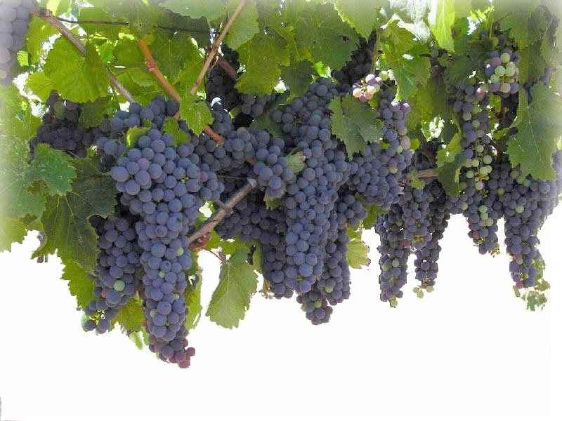
74. branches united with Christ our Vine.
Thank you, Lord!
Microsoft clip art © 2013
Microsoft Corporation.
“I am the vine; you are the branches.
Whoever abides in me and I in him,
he it is that bears much fruit, for apart from me
you can do nothing” John 15:5
NO!
© GospelGifs.com

Slide 288
74. branches united with Christ our Vine.
Thank you, Lord!
John 15:5
Microsoft clip art © 2013
Microsoft Corporation.
“You (Gentiles), although a wild olive shoot, were grafted in . . . now share in the nourishing root of the olive tree, . . . you were cut from what is by nature
a wild olive tree, and grafted, contrary to nature,
into a cultivated olive tree” Rom 11:17,24
NO!
© GospelGifs.com

Slide 289







“But you are a chosen race, a royal priesthood, a holy nation, a people for his own possession, that you may proclaim the excellencies of him who called you out of darkness into his marvelous light. . . . now you are God's people” 1 Pet 2:9-10
75-79. a chosen race,
a royal priesthood,
a holy nation, a people
for God’s own possession, God’s people.
Thank you, Lord!
Microsoft clip art © 2013
Microsoft Corporation.
NO!
© GospelGifs.com
Microsoft clip art © 2013 Microsoft Corporation.

Slide 290

80-82. fellow citizens with the saints
and members of the household of God.
Thank you, Lord!
“you are no longer strangers and aliens,
but you are fellow citizens with the saints and members of the household of God” Eph 2:19
NO!
photo John Crozier
© GospelGifs.com

Slide 291
Are you a saint, set apart from sin and Satan,
made holy to the LORD in Christ in the Holy Spirit?
in Christ
in sin
angry smiley © sherv.net
Jumping heart © www.fg-a.com
“called to be saints . . . the Spirit intercedes for the saints . . .
sanctified by the Holy Spirit . . . worthy of the saints”
Rom 1:7; 8:27; 15:16; 16:2
“the church of God . . . sanctified in Christ Jesus,
called to be saints” 1 Cor 1:2

Slide 292
in Christ
Gifts 72-82
faith
in Christ
members of Christ’s body
brothers and sisters
branches in Christ’s vine
a chosen race,
royal priesthood, holy nation,
God’s possession, God’s people
fellow citizens with the saints
and members of God’s household
Thank you for the body of Christ riches
provided for us by Christ’s death!

Slide 293
Jesus
Mohammed
Confucius
Can anyone else give us these gifts?
Has anyone else died as God’s once-for-all sacrifice for sin? Is anyone else the infinite
Son of God, our resurrected Messiah and Lord,
who provides in himself all we need in God?
Hindu Gurus
Moses
Buddha

Slide 294
Buddhism says:
Do Do Do
Do Do Do
Do Do.
You Do.
8-fold path
Islam
says:
Do Do Do
Do Do all Allah wants.
You Do.
5 pillars
Hinduism
says:
Do Do Do
Do Do Do
Do Do Do.
You Do.
many paths
Jesus
says:
It is DONE.
I DO 4 U.
I give.
You receive.
Come to me
and drink all
I DO 4 U.
I DO 4 U
There is no one else like Jesus!
Jesus is the crucified and reigning
Messiah, Son of God and Savior
who is “I DO 4 U” not “U DO.”
More free resources on the grace of God in Christ @ www.GraceGodChrist.com

Slide 295
THE LORD
God’s completely different way
to deepest joy and satisfaction!
smiley © sherv.net
People circle © clipartfest.com
Joy and satisfaction are in Christ, not beauty, music, phones, movies, games, sports, cars, money, friends, romance, sex, food, drinking, drugs, homes or jobs! Jesus had supreme joy without sex or money!

Slide 296
I am your ransom
and redemption
I am your forgiveness
from God
I am your
righteousness
from God
justification
I am
your
peace
with God
Joy and satisfaction are in God. Open Christ’s gifts to enjoy the Lord by faith in God’s promises expressed in praise!
Promises - Faith - Praise
I am your
adoption
as God’s
child
I am your
deliverance from darkness
into the kingdom of God’s Son
I am your
hope of glory
I am your
fullness
of blessing
I am your
at-one-ment with the Lord
God’s wrath turned away
I am your
spiritual fullness
in God
I am your
eternal
life

Slide 297
  Repentance toward God and faith in our Lord Jesus Christ
It is finished! Will you joyfully draw on the many riches of
God’s grace
in Christ given
the moment we receive salvation in Christ?
in Christ
counted as righteous in Christ the righteousness of God
ransomed, redeemed Passover Lamb, sin atoned, wrath turned
forgiven peace with God reconciled eternal life adopted sons
welcomed, accepted filled, complete blessed with every blessing
Christ our wisdom from God, righteousness and sanctification and redemption
delivered from the domain of darkness into the light of the kingdom of the beloved Son
in Christ and Christ in us in the Spirit and the Spirit in us, made God’s temple
in God the Father and the Father in us immersed in Father, Son, and Spirit
Father, Son, and Spirit fellowship with us access to God and his grace answered prayer
grace at the throne of grace every need supplied Holy Spirit prays for us, helps us pray
Christ our High Priest intercedes as mediator Christ our High Priest advocates in our defense
immersed into Christ and his death and resurrection united with Christ in death and resurrection
old self crucified and buried with Christ new self raised and alive with Christ
set free from sin instrument for righteousness
under Christ, abundant grace slaves of Christ not sin
joined to Christ one with Christ
seated with Christ hidden with Christ in God
released from law, married to Christ under law of the Spirit
Spirit and God’s love poured out born of the Spirit
given, receive, have Spirit rivers of living water of Spirit
immersed in the Spirit Spirit comes on, falls on us
Spirit power to be ambassadors anointed with the Spirit
sealed with the Spirit guarantee of the Spirit
Spirit of truth helps, teaches Spirit leads
Spirit sanctifies Spirit gifts for service
Spirit fills circumcised, set apart in the Spirit
immeasurably great power God’s workmanship led in triumph and nike victory
members of Christ’s body brothers and sisters branches in Christ’s vine
  chosen race, royal priesthood, holy nation, God’s possession, God’s people
fellow citizens with the saints and members of the household of God
citizenship in heaven hope of glory inheritance, heir, fellow heir
with Christ at death made perfect glorified to be like Jesus
into heavenly kingdom enter joy of Lord delivered from wrath
God’s good work completed resurrection body like Jesus
married to the Lamb every tear wiped away
see God’s face reign forever
loved and saved
in New Covenant
jumping heart © www.fg-a.com
johncrozieris@gmail.com © 2020

Slide 298
Highly recommended
Develop the habit of praising the LORD every day for his grace in Christ. Develop a mind and heart that rests in Christ for all.
During your prayer time each of the seven days of the week, praise the Lord through section 1 on Day 1,
section two on Day 2, . . . seven on Day 7!
Monday – Section 1
Tuesday – Section 2
Wednesday – Section 3
Thursday – Section 4
Friday – Section 5
Saturday – Section 6
Sunday – Section 7 Gifts of future glory

Slide 299
The Grace of God in Christ
100 gifts of delight we receive in the Lord’s gift of Christ crucified
Gifts that are a firm foundation 1-14
Gifts of connection with Father, Son and Spirit 15-23
Gifts of life at God’s throne 24-31
Gifts of being set free from sin 32-48
Gifts of life in the Holy Spirit 48-71
Gifts of being the body of Christ 72-82
Gifts of future glory 83-97
Three great gifts that include all the others 98-100
Use “search” on your smart-phone

Slide 300
in Christ
Gifts 83-97
faith
in Christ
citizenship in heaven
hope of glory
inheritance, heirs, fellow heirs
with Christ at death
made perfect
glorified to be like Jesus
brought to the heavenly kingdom enter the joy of the Lord
delivered from the wrath to come
God’s good work completed
resurrection body
married to the Lamb
every tear wiped away
see God’s face
reign forever
Lord, thank you that
Jesus died
to give us
riches of
future glory with you!
Only your glory can satisfy our deep longings!

Slide 301
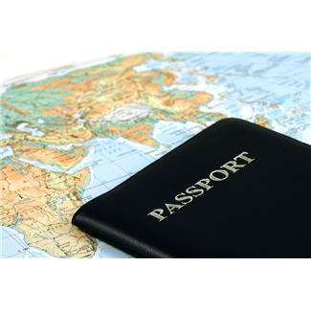
“Their end is destruction, . . . But our citizenship is in heaven, and from it we await a Savior, the Lord Jesus Christ” Phil 3:19-20
“the assembly of the firstborn who are enrolled in heaven” Heb 12:23 Praise you, Lord!
Microsoft clip art © 2013 Microsoft Corporation.
ME, ME,ME!
Citizens of heaven
Passport
No citizenship
83. citizenship in heaven!
Thank you, Lord!
citizenship
angry smiley © sherv.net
Jumping heart © www.fg-a.com

Slide 302
84. the hope of glory!
Wonderful Lord!
“We rejoice in hope of the glory of God”
Rom 5:5
“Christ in you,
the hope of glory”
Col 1:27
many copies
on internet,
original unknown. This is from Kootation.com.
NO!
© GospelGifs.com

Slide 303
85. inheritance,
heirs of God
and fellow heirs with Christ!
Thank you, Lord!
“We are children of God . . . heirs of God
and fellow heirs with Christ” Rom 8:16-17
“Come, you who are blessed by my Father,
inherit the kingdom prepared for you from
the foundation of the world” Matt 25:34
NO!
© GospelGifs.com

Slide 304
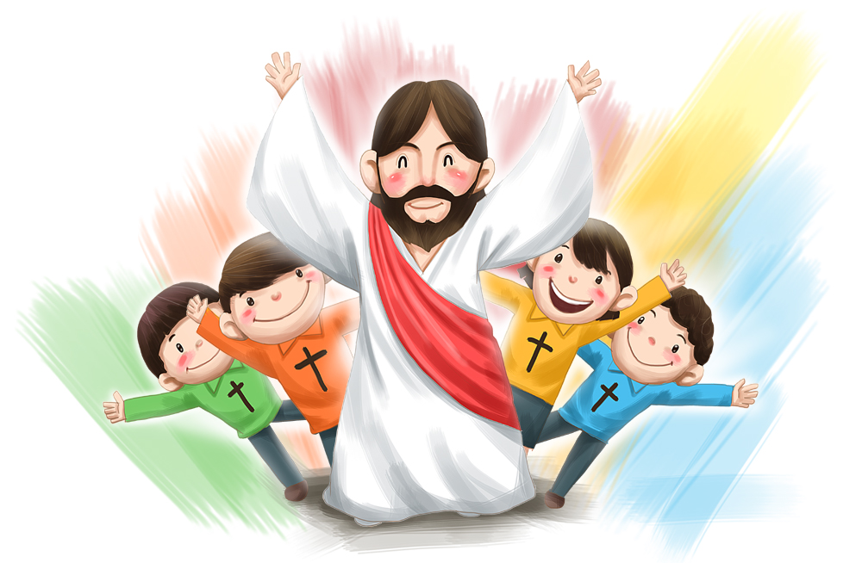
86. with Christ when
we die!
All praise
to you,
Lord!
© iclickart.co.kr with permission from Iregihwek print shop in Yeosu, South Korea
“My desire is to depart and be with Christ” Phil 1:23
“We know that while we are at home in the body we are away from the Lord . . . we would rather be away from
the body and at home with the Lord” 2 Cor 5:6, 8
NO!
© GospelGifs.com

Slide 305
87. made perfect in God’s presence!
All glory to you, Lord!
Righteous souls
in the
blood of
Christ
Made perfect in the presence of Christ
“But you have come to . . . the city of the living God,
the heavenly Jerusalem, . . . and to God, the judge of all, and to the spirits of the righteous made perfect,
and to Jesus, the mediator of a new covenant”
Heb 12:22-24
NO!
© GospelGifs.com

Slide 306

We will think and act like Jesus, love like Jesus,
hate evil like Jesus, be zealous for God’s glory like Jesus . . .
“Maranatha!” © 1988/2000 by Stephen Gjertson. All rights reserved. Used with permission.
88. like Jesus, conformed to his image! Thank you, Lord!
“We know that when he appears we shall be like him, because we shall see him as he is” 1 John 3:2
“For those whom he foreknew he also predestined to be conformed to the image of his Son, in order that
he might be the firstborn among many brothers”
Rom 8:29
NO!
© GospelGifs.com

Slide 307
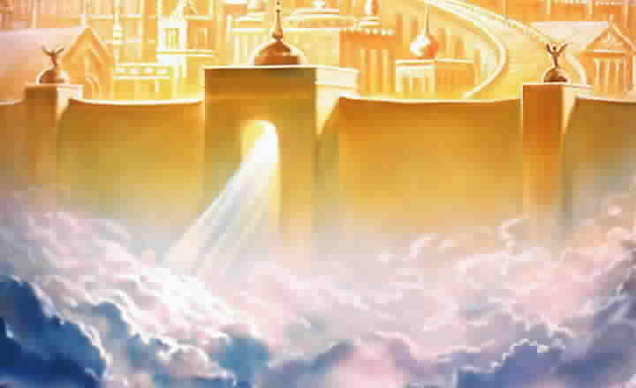
89. brought safely into his heavenly kingdom!
Thank you, Lord!
various copies on internet,
original source unknown
Big tears smiley © sherv.net
Jumping heart © www.fg-a.com
“The Lord will rescue me from every evil deed
and bring me safely into his heavenly kingdom.
To him be the glory forever and ever”
2 Tim 4:18

Slide 308
90. Enter the joy of the Lord! Thank you!
smileys © sherv.net
Jumping heart © www.fg-a.com
People circle © clipartfest.com
big tears smiley © sherv.net
To enter the joy of the Lord is to be in the Lord’s presence delighting and
rejoicing in God as God delights and rejoices in all God’s infinite perfections,
the love and fellowship of the Father, Son and Spirit, and his grace in Christ.
“Well done, good and faithful servant. . . . Enter into
the joy of your master (Greek kurios, Lord)”
Matt 25:21,23

Slide 309
THE LORD
smileys © sherv.net
Jumping heart © www.fg-a.com
People circle © clipartfest.com
big tears smiley © sherv.net
To enter the joy of the Lord in the Lord’s presence is
to delight and rejoice in the Father as Jesus and the Spirit do,
to delight in and rejoice in the Son as the Father and the Spirit do,
and to delight in and rejoice in the Spirit as Jesus and the Father do!
“Well done, good and faithful servant. . . . Enter into
the joy of your master (Greek kurios, Lord)”
Matt 25:21,23

Slide 310
“The most satisfying and joy-filled love, communion, and cooperation in the universe flow between the Father, Son, and Spirit.”
“Like joining a happy, loving family for dinner, the Lord shares himself with us by immersing us in God the Father, Son and Spirit to share in their all-satisfying love, delight, communion, and cooperation in their purposes. Joyful communion with God as we do his will is our highest joy in heaven - and now!”
Thank you, Lord, that we can rejoice in and serve you now, eager for entering the joy of the Lord in the future, the eternal joy flowing between the Father, Son and Spirit!
From “Know Your God,” John’s discipleship eBook on God’s attributes, page 59, available free at www.GraceGodChrist.com

Slide 311
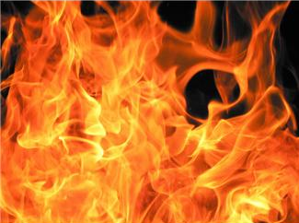
“You turned to God from idols to serve the living and true God,
and to wait for his Son from heaven, whom he raised from
the dead, Jesus who delivers us from the wrath to come”
1 Thess 1:9-10
THE LORD
Sharing in the love
of God the Father,
Son and Spirit
for eternity
91. delivered from the wrath to come!
All praise to you, Lord!
eternity of wrath
Fire Microsoft clip art © 2013 Microsoft Corporation.
smileys© sherv.net
heart © clipartbest.com
big tears smiley © sherv.net

Slide 312
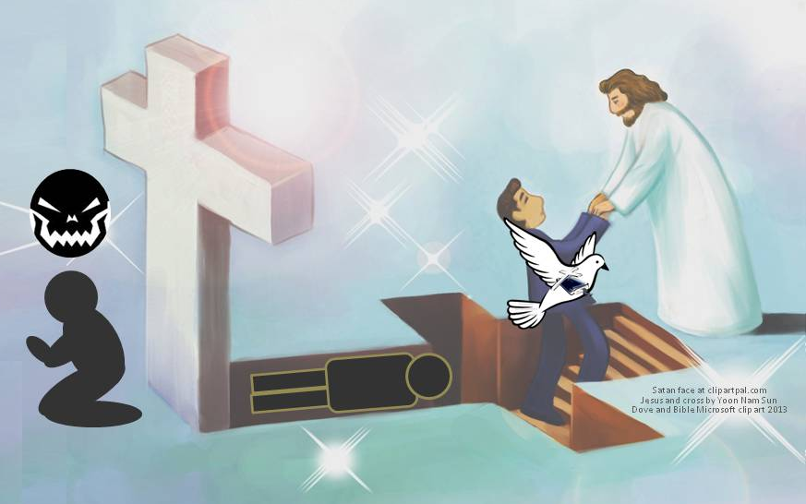
“And I am sure of this, that he who began a good work in you will bring it to completion at the day of Jesus Christ” Phil 1:6
THE LORD
smileys© sherv.net
heart © clipartbest.com
Sharing in the love
of God the Father,
Son and Spirit
for eternity
Microsoft clip art © 2013
Microsoft Corporation.
92. The Lord will bring
to completion his
good work begun!
Thank you, Lord!
faith in Christ
© Yoon Nam Sun
Dove and Bible
Microsoft clip art © 2013
big tears smiley © sherv.net

Slide 313




Dove, cross and Bible
Microsoft clip art © 2013
Microsoft Corp
various copies on internet,
original source unknown
clipartkid.com - boy leaping for joy, children jumping for joy
93. resurrection body like Jesus! Thank you, Lord!
“But in fact Christ has been raised from the dead,
the firstfruits of those who have fallen asleep.
For as by a man came death, by a man has come also the
resurrection of the dead. . . . But each in his own order:
Christ the firstfruits, then at his coming those
who belong to Christ.” 1 Cor 15:20,21,23
big tears smiley © sherv.net

Slide 314
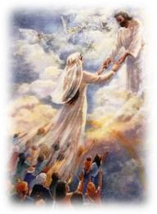
94. marriage of the Lamb
to his Bride!
Thank you, Lord!
“Let us rejoice and exult and give him the glory, for the marriage of
the Lamb has come,
and his Bride has
made herself ready . . .
Blessed are those
who are invited to
the marriage supper
of the Lamb”
Rev 19:7, 9
various copies on internet, original source unknown
This is from Pinterest.com johnkrohn.blogspot.kr
big tears smiley © sherv.net

Slide 315
94. marriage of the Lamb
to his Bride!
Thank you, Lord!
“For I feel a divine jealousy for you, since
I betrothed you to one husband, to present you as a pure virgin to Christ. But I am afraid that as the serpent deceived Eve by his cunning, your thoughts will be led astray from a sincere and pure devotion to Christ”
2 Cor 11:2-3
various copies on internet, original source unknown
This is from Pinterest.com johnkrohn.blogspot.kr
big tears smiley © sherv.net

Slide 316

95. every tear wiped away!
Thank you, Lord!
“For the Lamb in the midst of the throne will be their shepherd, and he will guide them to springs of living water, and God will wipe away every tear from their eyes”
Rev 7:17
(Isa 25:8)
Microsoft clip art © 2013
Microsoft Corporation.
big tears smiley © sherv.net

Slide 317
95. every tear wiped away!
Thank you, Lord!
“He will wipe away every tear from their eyes, and death shall be no more, neither shall there be mourning nor crying nor pain anymore,
for the former things have passed away”
Rev 21:4
(Isa 25:8)
Microsoft clip art © 2013
Microsoft Corporation.
big tears smiley © sherv.net

Slide 318

“They will see his face”
Rev 22:4
96. see his face!
Glory to you, Lord!
The holy
LORD
big tears smiley
© sherv.net
various copies on internet,
original source unknown

Slide 319

“They will reign forever and ever”
Rev 22:5
97. reign with Christ forever!
All praise to you, Lord!
© Harry Anderson
www.HarryAndersonArt.com
big tears smiley
© sherv.net

Slide 320
Hallelujah! For the Lord our God the Almighty reigns (Rev 19:6), and because of all Christ’s death does for us, we will reign with you forever (Rev 22:5)!
Thanks be to God!
Praise be to God!
Glory be to God!
In the coming ages you will show the immeasurable riches of your grace in kindness toward us in Christ Jesus (Eph 2:7)! For all eternity, all we receive from you flows from the finished work of the Lord Jesus Christ!

Slide 321
in Christ
Gifts 83-97
faith
in Christ
citizenship in heaven
hope of glory
inheritance, heirs, fellow heirs
with Christ at death
made perfect
glorified to be like Jesus
brought to the heavenly kingdom enter the joy of the Lord
delivered from the wrath to come
God’s good work completed
resurrection body
married to the Lamb
every tear wiped away
see God’s face
reign forever
Lord, thank you that
Jesus died
to give us
riches of
future glory with you!
Only your glory can satisfy our deep longings!

Slide 322
Jesus
Mohammed
Confucius
Can anyone else give us these gifts?
Has anyone else died as God’s once-for-all sacrifice for sin? Is anyone else the infinite
Son of God, our resurrected Messiah and Lord,
who provides in himself all we need in God?
Hindu Gurus
Moses
Buddha

Slide 323
Buddhism says:
Do Do Do
Do Do Do
Do Do.
You Do.
8-fold path
Islam
says:
Do Do Do
Do Do all Allah wants.
You Do.
5 pillars
Hinduism
says:
Do Do Do
Do Do Do
Do Do Do.
You Do.
many paths
Jesus
says:
It is DONE.
I DO 4 U.
I give.
You receive.
Come to me
and drink all
I DO 4 U.
I DO 4 U
There is no one else like Jesus!
Jesus is the crucified and reigning
Messiah, Son of God and Savior
who is “I DO 4 U” not “U DO.”
More free resources on the grace of God in Christ @ www.GraceGodChrist.com

Slide 324
counted as righteous in Christ the righteousness of God
ransomed, redeemed Passover Lamb, sin atoned, wrath turned
forgiven peace with God reconciled eternal life adopted sons
welcomed, accepted filled, complete blessed with every blessing
Christ our wisdom from God, righteousness and sanctification and redemption
delivered from the domain of darkness into the light of the kingdom of the beloved Son
in Christ and Christ in us in the Spirit and the Spirit in us, made God’s temple
in God the Father and the Father in us immersed in the Father, Son, and Spirit
Father, Son, and Spirit fellowship with us access to God and his grace
answered prayer grace at the throne of grace
every need supplied Holy Spirit prays for us, helps us pray
Christ our H.P. intercedes as our mediator Christ our H.P. advocates in our defense
immersed in Christ and his death and res. united with Christ in his death and res.
old self crucified and buried with Christ new self raised and alive with Christ
set free from sin instrument for righteousness
under Christ, abundant grace slaves of Christ not sin
joined to Christ one with Christ
seated with Christ hidden with Christ in God
released from law to marry Christ under law of the Spirit
Spirit and God’s love poured out born of the Spirit
given, receive, have Spirit rivers of living water of Spirit
immersed in the Spirit Spirit comes on, falls on us
Spirit power to be ambassadors anointed with the Spirit
sealed with the Spirit guarantee of the Spirit
Spirit of truth helps, teaches Spirit leads
Spirit sanctifies Spirit gifts for service
Spirit fills circumcised, set apart in the Spirit
immeasurably great power God’s workmanship
led in triumph and nike victory members of Christ’s body
brothers and sisters branches in Christ’s vine
  chosen race, royal priesthood, holy nation God’s possession, God’s people
fellow citizens with the saints members of the household of God
citizenship in heaven hope of glory inheritance, heir, fellow heir
with Christ at death made perfect glorified to be like Jesus
into heavenly kingdom enter joy of Lord delivered from wrath
God’s good work completed resurrection body like Jesus married to the Lamb
every tear wiped away see God’s face reign forever
loved and saved in the New Covenant
Receive me - receive all I provide through my blood
I DO 4 U
Jesus © GospelGifs.com
Pulsing heart @clipartbest.com

Slide 325
THE LORD
God’s completely different way
to deepest joy and satisfaction!
smiley © sherv.net
People circle © clipartfest.com
Joy and satisfaction are in Christ, not beauty, music, phones, movies, games, sports, cars, money, friends, romance, sex, food, drinking, drugs, homes or jobs! Jesus had supreme joy without sex or money!

Slide 326
I am your ransom
and redemption
I am your forgiveness
from God
I am your
righteousness
from God
justification
I am
your
peace
with God
Joy and satisfaction are in God. Open Christ’s gifts to enjoy the Lord by faith in God’s promises expressed in praise!
Promises - Faith - Praise
I am your
adoption
as God’s
child
I am your
deliverance from darkness
into the kingdom of God’s Son
I am your
hope of glory
I am your
fullness
of blessing
I am your
at-one-ment with the Lord
God’s wrath turned away
I am your
spiritual fullness
in God
I am your
eternal
life

Slide 327
“Many pursue sexual pleasure far more than they pursue joy in God. Some may agree that temporary sexual pleasures in this life can’t be greater than the pleasures of God in eternity, but what blindness that since God is different and better than all else, joy in God in this life is different and better than all else now, including sexual pleasure!
Jesus had supreme joy without sex!”
From “Know Your God,” John’s discipleship eBook on God’s attributes, page 65, available free at www.GraceGodChrist.com

Slide 328
“The joy Jesus had in God was a joy that was different and better than joy in anything else. Jesus had none of the joys of the world like a nice home and money, but he was the happiest person ever on earth because he, more than all others, had the greatest joy in God.”
“More than anyone else, Jesus sought joy in God, not in the things of the world, and more than all others, Jesus walked in God’s righteous ways, so that his fullness of joy in God was made complete by his always walking in harmony with God’s will.”
“Jesus has shown us the way to deepest, all-satisfying joy in God! When earthly things tempt us, we can turn away to drink joy in God instead!”
From “Know Your God,” John’s eBook on God’s attributes, page 65, at www.GraceGodChrist.com

Slide 329
There is such great benefit in reflecting on each Scripture and praising the Lord for each of his gifts!
Personally applying God’s Word with praise moves God’s truth from the head to the heart.
Praise changes Bible study into fellowship with God.
Faith-filled praise based on God’s promises in Christ is like drinking God’s grace.
Praise completes our joy in God.² To be thankful and say so completes our joy vs. being thankful but not saying so!
Since God is different and better than all else, enjoying God with praise, love and doing his will gives different and better joy than all else.

Slide 330
Praise completes our joy in God.² To be thankful and say so completes our joy, vs. being thankful but not saying so!
C.S. Lewis said, “I think we delight to praise what we enjoy because the praise not merely expresses but completes the enjoyment; it is its appointed consummation. It is not out of compliment that lovers keep on telling one another how beautiful they are; the delight is incomplete till it is expressed.”
C. S. Lewis, Reflections on the Psalms (New York: Harcourt, Brace and World, 1958), 95.
For more discussion, see
John Piper “God Is Most Glorified in Us When We Are Most Satisfied in Him” October 13, 2012 at DesiringGod.org and
Sam Storms, “Praise: The Consummation of Joy” November 17, 2013 at DesiringGod.org

Slide 331
The Grace of God in Christ
100 gifts of delight we receive in the Lord’s gift of Christ crucified
Gifts that are a firm foundation 1-14
Gifts of connection with Father, Son and Spirit 15-23
Gifts of life at God’s throne 24-31
Gifts of being set free from sin 32-48
Gifts of life in the Holy Spirit 48-71
Gifts of being the body of Christ 72-82
Gifts of future glory 83-97
Three great gifts that include all the others 98-100
Use “search” on your smart-phone

Slide 332
Now let’s enjoy three concluding riches of grace in Christ!
They are put last because they involve all the others.

Slide 333
in Christ
Gifts 98-100
faith
in Christ
loved
saved
in the New Covenant
Lord, thank you for these great riches
that involve all the other riches
of grace in Christ!

Slide 334

NO!
No! I reject God’s love in Christ!
98. Loved!
Thank you, Lord!
© GospelGifs.com
smiley © sherv.net
Pulsing heart © clipartbest.com
Dove and Bible
Microsoft clip art © 2013
Microsoft Corporation.
THE LORD
© GospelGifs.com
used with permission
Christ died for
us to provide
God’s riches of grace in Christ to enjoy the LORD
now and in his
eternal glory!
“God is love. In this the love of God was made manifest among us, that God sent his only Son into the world, so that we might live through him. In this is love, . . . he loved us and sent his Son to be the propitiation for our sins” 1 John 4:8-10

Slide 335
THE LORD
Heaven is full of joy in the LORD, and life now is a bit of heaven when we rejoice in God as God rejoices in God!
Lord, without Christ . . .
but in Christ crucified and reigning . . .
As you promise . . . !
smileys © sherv.net
Jumping heart © www.fg-a.com
People circle © clipartfest.com

Slide 336
NO!
No! I reject God’s love in Christ!
98. Loved!
Thank you, Lord!
© GospelGifs.com
smiley © sherv.net
Pulsing heart © clipartbest.com
Dove and Bible
Microsoft clip art © 2013
Microsoft Corporation.
THE LORD
© GospelGifs.com
used with permission
Christ died for
us to provide
God’s riches of grace in Christ to enjoy the LORD
now and in his
eternal glory!
“God shows his love for us in that
while we were still sinners, Christ died for us” Rom 5:8

Slide 337
Since the LORD is full of joy and satisfaction in himself because all his infinitely holy qualities make him supremely enjoyable and satisfying, there’s nothing more loving than the LORD saving us from the hell we deserve by the death of God the Son in order to share himself with us so we also are full of joy and satisfaction in him in his presence, face to face in an eternal covenant of love relationship, in Christ in God in the Spirit, and God the Father, Son and Holy Spirit in us!

Slide 338
99. Saved! Thank you, Lord!
THE LORD
“You shall call his name Jesus, for he will save his people from their sins”
Matt 1:21
Enjoying the Lord
for eternity
Saved
smiley © sherv.net
Pulsing heart © clipartbest.com
chains
of sin
Satan
death
and hell
Jesus © GospelGifs.com
with permission
“Believe in the Lord Jesus, and you will be saved” Acts 16:31
NO!
photo John Crozier
© GospelGifs.com

Slide 339
99. Saved! Thank you, Lord!
THE LORD
“I am not ashamed of the gospel, for it is the power of God
for salvation to
everyone
who believes”
Rom 1:16
Enjoying the Lord
for eternity
Saved
smiley © sherv.net
Pulsing heart © clipartbest.com
chains
of sin
Satan
death
and hell
“Since, therefore,
we have now been justified by his blood, much more shall we be saved by him from
the wrath of God” Rom 5:9
Jesus © GospelGifs.com
with permission
NO!
photo John Crozier
© GospelGifs.com

Slide 340
Lord, if Christ had not shed his precious blood . . . but all thanks and praise to you that in Christ . . .
from pqhobbit.files.wordpress.com
“For you know the grace of our Lord Jesus Christ, that though he was rich, yet for your sake he became poor, so that you by his poverty might become rich” 2 Cor 8:9

Slide 341
100. in the
New Covenant!
THE LORD
Enjoying the Lord
for eternity
“Therefore he is the mediator of a new covenant,
so that those who are called may receive the promised eternal inheritance, since a death has occurred that redeems them from the transgressions committed
under the first covenant” Heb 9:15
NO!
smiley s© sherv.net
Pulsing heart © clipartbest.com
© GospelGifs.com

Slide 342
Lord, without Christ’s blood of the New Covenant . . . but all joy and delight in you that in Christ . . .
from pqhobbit.files.wordpress.com
“the gospel of Christ . . . the surpassing grace of God upon you . . . Thanks be to God for his
inexpressible gift!” 2 Cor 9:13-15

Slide 343
THE LORD
God’s completely different way
to deepest joy and satisfaction!
smiley © sherv.net
People circle © clipartfest.com
Joy and satisfaction are in Christ, not beauty, music, phones, movies, games, sports, cars, money, friends, romance, sex, food, drinking, drugs, homes or jobs! Jesus had supreme joy without sex or money!

Slide 344
I am your ransom
and redemption
I am your forgiveness
from God
I am your
righteousness
from God
justification
I am
your
peace
with God
Find joy and satisfaction in God. Open Christ’s gifts to enjoy the Lord by faith in God’s promises expressed in praise!
Promises - Faith - Praise
I am your
adoption
as God’s
child
I am your
deliverance from darkness
into the kingdom of God’s Son
I am your
hope of glory
I am your
fullness
of blessing
I am your
at-one-ment with the Lord
God’s wrath turned away
I am your
spiritual fullness
in God
I am your
eternal
life

Slide 345
Jesus
Mohammed
Confucius
Can anyone else give us these gifts?
Has anyone else died as God’s once-for-all sacrifice for sin? Is anyone else the infinite
Son of God, our resurrected Messiah and Lord,
who provides in himself all we need in God?
Hindu Gurus
Moses
Buddha

Slide 346
Buddhism says:
Do Do Do
Do Do Do
Do Do.
You Do.
8-fold path
Islam
says:
Do Do Do
Do Do all Allah wants.
You Do.
5 pillars
Hinduism
says:
Do Do Do
Do Do Do
Do Do Do.
You Do.
many paths
Jesus
says:
It is DONE.
I DO 4 U.
I give.
You receive.
Come to me
and drink all
I DO 4 U.
I DO 4 U
There is no one else like Jesus!
Jesus is the crucified and reigning
Messiah, Son of God and Savior
who is “I DO 4 U” not “U DO.”
More free resources on the grace of God in Christ @ www.GraceGodChrist.com

Slide 347
“In your presence there is fullness
of joy;
THE LORD
at your right hand are pleasures forevermore”
Psa 16:11
smiley © sherv.net
Jumping heart © www.fg-a.com
There is nothing more breath-taking, delightful, exciting, and satisfying than a personal relationship with God
the Father, Son and Spirit to enjoy the supreme oneness, love, fellowship, and cooperation the one holy Lord
God Almighty enjoys in himself and shares with us.
To enjoy God as God enjoys God – what glory!
Heaven is a celebration of God, and life on earth is a bit of heaven when we rejoice in God as God rejoices in God!

Slide 348
Alive, Self-existent
Spiritual Personal
Free Self-determining Independent
Wise Intelligent Infinite Eternal Unchanging
Immanent Transcendent Omniscient
Omnipresent Omnipotent Sovereign
Faithful Righteous Just Holy Perfect
Humble Love Gracious Merciful
Good Wrath Longsuffering Patient
True Truthful Jealous Zealous
Oneness and Trinity of Father, Son, Spirit
Creator Upholder/Sustainer Savior
Shepherd Judge King
Joy in Himself
smiley © sherv.net
Jumping heart © www.fg-a.com
People circle © clipartfest.com
Nothing else can ever satisfy the deep longings of our souls except God the Father, Son and Spirit
in all his infinite perfections.

Slide 349
in Christ
Gifts 98-100
faith
in Christ
loved
saved
in the New Covenant
Lord, thank you for these great riches
that involve all the other riches
of grace in Christ!

Slide 350
All 100 riches of the grace of God in Christ now and in eternity are gifts of connection with the LORD to enjoy him!
The Son died to provide all; without dying we have nothing!
THE LORD
Father, Son and Spirit oneness
love, fellowship, cooperation
smiley © sherv.net
heart © clipartbest.com

Slide 351
  Repentance toward God and faith in our Lord Jesus Christ
It is finished!
Joyfully drink in
the many riches of
God’s grace
freely given in Christ
the moment we receive salvation
in Christ!
Come to me and drink!
in Christ
counted as righteous in Christ the righteousness of God
ransomed, redeemed Passover Lamb, sin atoned, wrath turned
forgiven peace with God reconciled eternal life adopted sons
welcomed, accepted filled, complete blessed with every blessing
Christ our wisdom from God, righteousness and sanctification and redemption
delivered from the domain of darkness into the light of the kingdom of the beloved Son
in Christ and Christ in us in the Spirit and the Spirit in us, made God’s temple
in God the Father and the Father in us immersed in Father, Son, and Spirit
Father, Son, and Spirit fellowship with us access to God and his grace answered prayer
grace at the throne of grace every need supplied Holy Spirit prays for us, helps us pray
Christ our High Priest intercedes as mediator Christ our High Priest advocates in our defense
immersed into Christ and his death and resurrection united with Christ in death and resurrection
old self crucified and buried with Christ new self raised and alive with Christ
set free from sin instrument for righteousness
under Christ, abundant grace slaves of Christ not sin
joined to Christ one with Christ
seated with Christ hidden with Christ in God
released from law, married to Christ under law of the Spirit
Spirit and God’s love poured out born of the Spirit
given, receive, have Spirit rivers of living water of Spirit
immersed in the Spirit Spirit comes on, falls on us
Spirit power to be ambassadors anointed with the Spirit
sealed with the Spirit guarantee of the Spirit
Spirit of truth helps, teaches Spirit leads
Spirit sanctifies Spirit gifts for service
Spirit fills circumcised, set apart in the Spirit
immeasurably great power God’s workmanship led in triumph and nike victory
members of Christ’s body brothers and sisters branches in Christ’s vine
  chosen race, royal priesthood, holy nation, God’s possession, God’s people
fellow citizens with the saints and members of the household of God
citizenship in heaven hope of glory inheritance, heir, fellow heir
with Christ at death made perfect glorified to be like Jesus
into heavenly kingdom enter joy of Lord delivered from wrath
God’s good work completed resurrection body like Jesus
married to the Lamb every tear wiped away
see God’s face reign forever
loved and saved
in New Covenant
jumping heart © www.fg-a.com
johncrozieris@gmail.com © 2020

Slide 352
It is finished!
Joyfully
rest in Christ’s death
to freely provide
all
you need
in God!
Come to me and
find rest!
justified, righteous in Christ, ransomed, redeemed Passover Lamb, propitiation, sin atoned, wrath turned forgiven peace reconciled eternal life
adopted sons accepted filled, complete
blessed with all blessing Christ our wisdom
righteousness and sanctification and redemption
delivered from darkness to light of kingdom of Son
in Christ and Christ in us in the Spirit and the Spirit in us, made God’s temple in God the Father and the Father in us
immersed in Father, Son, and Spirit Father, Son, and Spirit fellowship with us access to God and his grace
answered prayer grace at the throne of grace every need supplied the Spirit prays for us, helps us pray
Christ our High Priest intercedes as mediator Christ our High Priest advocates in our defense
immersed into Christ and his death and resurrection united with Christ in death and resurrection
old self crucified buried with Christ new self raised alive with Christ set free from sin instrument for righteousness
under Christ, abundant grace slaves of Christ not sin joined to Christ one with Christ seated with Christ
hidden with Christ in God released from law, married to Christ under law of the Spirit Spirit and God’s love poured out
born of the Spirit given, receive, have the Spirit
rivers of living water of the Spirit immersed in the Spirit
Spirit comes on, falls on us Spirit power to be ambassadors anointed and sealed with the Spirit guarantee of the Spirit
Spirit of truth helps, teaches Spirit leads and sanctifies Spirit gifts for service Holy Spirit fills
circumcised, by Christ, set apart in the Spirit
immeasurably great power of the Spirit
God’s workmanship created in Christ
led in triumph and nike victory
members of Christ’s body
brothers and sisters
branches in Christ’s vine
  chosen race royal priesthood
  holy nation, God’s possession
  God’s people fellow citizens with saints
members of the household of God
citizenship in heaven hope of glory
inheritance, heirs of God, fellow heirs
with Christ at death made perfect
glorified to be like Jesus
brought safely into the heavenly kingdom
enter joy of Lord delivered from wrath
God’s good work completed in us
resurrection body like Jesus married to the Lamb
every tear wiped away see God’s face reign forever
loved and saved in the New Covenant
johncrozieris@gmail.com
© 2020

Slide 353
  Repentance toward God and faith in our Lord Jesus Christ
Rejoice that Christ’s death
provides
what God gives to satisfy our
deepest
thirsts.
Come.
Drink. Rejoice.
Be satisfied.
in Christ
counted as righteous in Christ the righteousness of God
ransomed, redeemed Passover Lamb, sin atoned, wrath turned
forgiven peace with God reconciled eternal life adopted sons
welcomed, accepted filled, complete blessed with every blessing
Christ our wisdom from God, righteousness and sanctification and redemption
delivered from the domain of darkness into the light of the kingdom of the beloved Son
in Christ and Christ in us in the Spirit and the Spirit in us, made God’s temple
in God the Father and the Father in us immersed in Father, Son, and Spirit
Father, Son, and Spirit fellowship with us access to God and his grace answered prayer
grace at the throne of grace every need supplied Holy Spirit prays for us, helps us pray
Christ our High Priest intercedes as mediator Christ our High Priest advocates in our defense
immersed into Christ and his death and resurrection united with Christ in death and resurrection
old self crucified and buried with Christ new self raised and alive with Christ
set free from sin instrument for righteousness
under Christ, abundant grace slaves of Christ not sin
joined to Christ one with Christ
seated with Christ hidden with Christ in God
released from law, married to Christ under law of the Spirit
Spirit and God’s love poured out born of the Spirit
given, receive, have Spirit rivers of living water of Spirit
immersed in the Spirit Spirit comes on, falls on us
Spirit power to be ambassadors anointed with the Spirit
sealed with the Spirit guarantee of the Spirit
Spirit of truth helps, teaches Spirit leads
Spirit sanctifies Spirit gifts for service
Spirit fills circumcised, set apart in the Spirit
immeasurably great power God’s workmanship led in triumph and nike victory
members of Christ’s body brothers and sisters branches in Christ’s vine
  chosen race, royal priesthood, holy nation, God’s possession, God’s people
fellow citizens with the saints and members of the household of God
citizenship in heaven hope of glory inheritance, heir, fellow heir
with Christ at death made perfect glorified to be like Jesus
into heavenly kingdom enter joy of Lord delivered from wrath
God’s good work completed resurrection body like Jesus
married to the Lamb every tear wiped away
see God’s face reign forever
loved and saved
in New Covenant
jumping heart © www.fg-a.com
johncrozieris@gmail.com © 2020

Slide 354
counted as righteous in Christ the righteousness of God
ransomed, redeemed Passover Lamb, sin atoned, wrath turned
forgiven peace with God reconciled eternal life adopted sons
welcomed, accepted filled, complete blessed with every blessing
Christ our wisdom from God, righteousness and sanctification and redemption
delivered from the domain of darkness into the light of the kingdom of the beloved Son
in Christ and Christ in us in the Spirit and the Spirit in us, made God’s temple
in God the Father and the Father in us immersed in the Father, Son, and Spirit
Father, Son, and Spirit fellowship with us access to God and his grace
answered prayer grace at the throne of grace
every need supplied Holy Spirit prays for us, helps us pray
Christ our H.P. intercedes as our mediator Christ our H.P. advocates in our defense
immersed in Christ and his death and res. united with Christ in his death and res.
old self crucified and buried with Christ new self raised and alive with Christ
set free from sin instrument for righteousness
under Christ, abundant grace slaves of Christ not sin
joined to Christ one with Christ
seated with Christ hidden with Christ in God
released from law to marry Christ under law of the Spirit
Spirit and God’s love poured out born of the Spirit
given, receive, have Spirit rivers of living water of Spirit
immersed in the Spirit Spirit comes on, falls on us
Spirit power to be ambassadors anointed with the Spirit
sealed with the Spirit guarantee of the Spirit
Spirit of truth helps, teaches Spirit leads
Spirit sanctifies Spirit gifts for service
Spirit fills circumcised, set apart in the Spirit
immeasurably great power God’s workmanship
led in triumph and nike victory members of Christ’s body
brothers and sisters branches in Christ’s vine
  chosen race, royal priesthood, holy nation God’s possession, God’s people
fellow citizens with the saints members of the household of God
citizenship in heaven hope of glory inheritance, heir, fellow heir
with Christ at death made perfect glorified to be like Jesus
into heavenly kingdom enter joy of Lord delivered from wrath
God’s good work completed resurrection body like Jesus married to the Lamb
every tear wiped away see God’s face reign forever
loved and saved in the New Covenant
Receive me - receive all I provide through the cross
I DO 4 U
Jesus © GospelGifs.com
Pulsing heart @clipartbest.com

Slide 355
Spirit
gifted
glory with Christ
reign
forever
see his face
resurrection
Spirit
fills
sanctified
seated with Christ
Christ
intercedes
in the
Spirit
Christ’s
power
Spirit
anoints
crucified
with Christ
accepted
adopted
Bride of
Christ
Christ’s
body
access
eternal
life
Spirit seals
victory
fullness
kingdom of
Christ
Christ
in us
raised with Christ
alive
in Christ
hidden with Christ in God
immersed
into Christ
every
blessing
peace
New
Covenant
led by
the Spirit
hope
of
glory
set free
from sin
atonement
of Christ
one with
Christ
born of the Spirit
loved
forgiven
reconciled
Christ’s ransom
Christ’s righteousness
Spirit
poured out
saved
When Christ rose,
it’s as if his cross became a tree of life
with many fruits to joyfully eat by faith.
Come to me and eat.
rooted in the blood of Jesus Christ, the Son of God

Slide 356
Spirit
gifted
glory with Christ
reign
forever
see his face
resurrection
Spirit
fills
sanctified
Christ
intercedes
seated with Christ
in the Spirit
Christ’s
power
Spirit
anoints
crucified
with Christ
accepted
adopted
Bride of
Christ
Christ’s
body
access
eternal
life
Spirit seals
victory
fullness
kingdom of
Christ
hope
of
glory
raised with Christ
alive
in Christ
Christ
in us
every
blessing
immersed
into Christ
peace
New
Covenant
atonement
of Christ
one with
Christ
led by
the Spirit
set free
from sin
saved
born of
the Spirit
hidden with Christ in God
forgiven
loved
Spirit
poured out
reconciled
Christ’s ransom
Christ’s righteousness
When Christ rose,
it’s as if his cross became a fountain
of life-giving water to joyfully drink by faith.
Come to me and drink.
a fountain flowing from the blood of Jesus Christ, God’s Son

Slide 357
Jesus Christ
Lord, thank you that Jesus came to die for us as your greatest gift to us!

Slide 358
I am your forgiveness
from God
I am your
righteousness
from God
justification
I am
your
peace
with God
I am your ransom
and redemption
I am your
adoption
as God’s
child
Thank you for the many gifts inside the gift that Jesus is to us!
I am your
deliverance from darkness
into the kingdom of God’s Son
I am your
hope of glory
I am your
fullness
of blessing
I am your
spiritual fullness
in God
I am your
at-one-ment with the Lord
God’s wrath turned away
I am your
eternal
life

Slide 359
“But you will receive power when the Holy Spirit has come upon you, and you will be my witnesses . . . to the end of the earth” Acts 1:8
Like a former beggar now a billionaire in Christ, will you reach out to people who are bankrupt in sin to speak of the Lord who died for them to make them rich in Christ?
Like someone who knows a Doctor who cured you of terminal cancer, will you tell lost people about Christ and his riches that cure us of the cancer of sin?

Slide 360
When we deeply value and enjoy something we receive, thanks and expressions of delight are spontaneous and freely given.
“What a great gift! I love it! Thank you very much!”
Worship is an automatic response to deeply valuing and enjoying God in Christ.
The more we truly enjoy God and his grace in Christ, the more we eagerly praise Him.
If we aren’t praising, we must not be properly believing the grace of God given us in Christ.
C.S. Lewis said, “I had never noticed that all enjoyment spontaneously overflows into praise . . .
The world rings with praise — lovers praising their mistresses, readers their favourite poet, walkers praising the countryside, . . . ” For discussion of this insight from C. S. Lewis, download the free mp3 at desiringGod.org – topic – Christian biography – “How Lewis changed the way I worship” by Sam Storms, 20130927-DGNC13-SMALL_TALKS-SAM_STORMS.mp3 http://www.desiringGod.org/conference-messages/how-lewis-changed-the-way-i-worship #
Storms quotes Lewis from Reflections on the Psalms in the chapter “A Word About Praising” 90-98.

Slide 361
Jesus
Christ
God’s gift of Jesus Christ
is like a big gift with many other gifts inside
psdgraphics.com in kidclipart.com
Receive, open, enjoy and put to use all God freely gives to meet all our needs through his gift of Jesus Christ!

Slide 362
The End but I hope it is just the beginning of using God’s truth in these PPTs to rejoice in God’s greatest gift of the Lord Jesus Christ in whom are many, many gifts, all the gifts we need in God!
Get this on your Smartphone from www.GraceGodChrist.com

Slide 363
Appendices 1
More on fullness, gift #10
Especially, let’s try to better understand how
those today who claim to be more spiritual
repeat the error of the false teachers in Colossians

Slide 364
“For in him all the fullness of God was pleased to dwell . . .
in him the whole fullness of deity dwells bodily
and you have been filled in him, who is the head
of all rule and authority” Col 1:19; 2:9-10
fullness of God’s powers
fullness of God’s salvation
10. filled and
complete
in Christ
in whom God’s fullness dwells.
Thank you, Lord!
empty
in myself
Jesus © GospelGifs.com
with permission
pulsing heart © clipartbest.com
jumping heart © www.fg-a.com
If we are in Christ in whom God’s fullness dwells,
Christ makes us spiritually filled and complete in God by faith.
Nothing “I DO” makes me more “spiritual” or more “full” in God’s sight.

Slide 365
The false teachers in Colossians taught that being in Christ by faith was not enough for spiritual fullness in God.
They proclaimed deeper “wisdom and knowledge” (2:2,3)
and “fullness” (2:9-10) beyond receiving Christ Jesus
the Lord by faith and walking in him (2:6-7).
Christ is not enough. You need spiritual experiences of knowing and
fullness by worship encounters with angels in visions
of the spirit world
(Col 2:18-19).
Faith is not enough. You need to not eat
certain food and
drink, treat your
body with ascetic severity, and observe special holy days as
you seek angels and visions (Col 2:16-23).
in Christ
spiritual
fullness
in God
Microsoft clip art © 2013
Microsoft Corporation.

Slide 366
How does Paul describe the false teaching?
“See to it that no one takes you captive by philosophy
and empty deceit, according to human tradition,
according to the elemental spirits of the world,
and not according to Christ” Col 2:8
“Let no one disqualify you, insisting on asceticism and worship of angels, going on in detail about visions,
puffed up without reason by his sensuous mind,
and not holding fast to the Head” Col 2:18-19
“Human precepts and teachings? These have indeed an appearance of wisdom in promoting self-made religion and asceticism and severity to the body, but they are of no value in stopping the indulgence of the flesh” Col 2:22-23

Slide 367
Christ the fullness of God is in
those in Christ,
but the false teachers
in Colossae say,
“We are more spiritual;
We have greater fullness.”
Are you serious?
Christ, the fullness of God in you, does not make you spiritually full?
God the Father, Son and Spirit is
in you, and you aren’t filled
with spiritual fullness? Really?
Christ la justice de Dieu
Christ the fullness of God
Jesus © GospelGifs.com
pulsing heart © clipartbest.com
smileys © sherv.net
Now let’s try to better understand how those today who claim to be more spiritual repeat the error of the false teachers in Colossians

Slide 368
“I speak in tongues.
I have greater fullness than you.”
“Jesus is the
fullness of God
in human flesh.”
When anyone tells you they have a greater “fullness” than the fullness we receive when we receive Christ the fullness of God
by faith apart from
any of our efforts or spiritual experiences,
they repeat the Colossian error.
vs.
“If Christ the fullness of God dwells in me
by faith,
I’m filled in him.”
“I have dreams and visions. I speak “words” from God. I’m more spiritual than you.”
Be on guard for anyone who says you will have greater fullness
if you DO something, rather than receiving Christ the fullness of God and walking in him by faith based on all he has DONE.

Slide 369
Those who speak in tongues, please don’t hear me wrong. I’m a missionary longing to share the gospel of Christ with people of another language. I think it would be wonderful if God enabled his people to speak in tongues like in Acts 2, declaring the wonderful works of God in Christ to the lost in their own language that we normally couldn’t speak! We could finish taking Christ to every people group!
bing images
But hear me right on this. If we claim, “I speak in tongues. I have greater “fullness” than you; I’m more “spiritual” than you,” we repeat the Colossian error. Same for dreams, visions and words.
God’s command in Ephesians 6:17-18 is to take the sword of the Spirit, the word of God, to pray in the Spirit. If we make tongues more “spiritual” than praying in the Spirit as the Spirit focuses our minds on God’s promises, we repeat the Colossian error.

Slide 370
“I have greater fullness than you. I’m more spiritual than you.”
“Lord Jesus, you are
the fullness of God,
dwelling in me by faith.”
vs.
“You need to DO what
I DO and experience what I experience
to be as full as I am
and as spiritual as I am.”
“You are my spiritual fullness.
You make me fully ‘spiritual.’
Nothing I DO can add to the fullness of God that you are.
Fullness in you is a gift based on what you have DONE on the cross, like all God’s grace in Christ.”

Slide 371
Jesus
Mohammed
Confucius
Can anyone else give us fullness in God?
Is anyone else the one in whom God’s fullness dwells, the head of all rule and authority,
who fills all in him with spiritual fullness in God?
Has anyone else died for our sins to become
for us the fullness of God’s blessing?
Hindu Gurus
Moses
Buddha

Slide 372
Buddhism says:
Do Do Do
Do Do Do
Do Do.
You Do.
8-fold path
Islam
says:
Do Do Do
Do Do all Allah wants.
You Do.
5 pillars
Hinduism
says:
Do Do Do
Do Do Do
Do Do Do.
You Do.
many paths
Jesus
says:
It is DONE.
I DO 4 U.
I give.
You receive.
Come to me
and drink all
I DO 4 U.
I DO 4 U
There is no fullness except in Christ!
Jesus is the crucified and reigning
Messiah, Son of God and Savior
who is “I DO 4 U” not “U DO.”
More free resources on the grace of God in Christ @ www.GraceGodChrist.com

Slide 373
“For in him all the fullness of God was pleased to dwell . . .
in him the whole fullness of deity dwells bodily
and you have been filled in him, who is the head
of all rule and authority” Col 1:19; 2:9-10
fullness of God’s powers
fullness of God’s salvation
10. filled and
complete
in Christ
in whom God’s fullness dwells.
Thank you, Lord!
empty
in myself
Jesus © GospelGifs.com
with permission
pulsing heart © clipartbest.com
jumping heart © www.fg-a.com
If we are in Christ in whom God’s fullness dwells,
Christ makes us spiritually filled and complete in God by faith.
Nothing “I DO” makes me more “spiritual” or more “full” in God’s sight.

Slide 374
counted as righteous in Christ the righteousness of God
ransomed, redeemed Passover Lamb, sin atoned, wrath turned
forgiven peace with God reconciled eternal life adopted sons
welcomed, accepted filled, complete blessed with every blessing
Christ our wisdom from God, righteousness and sanctification and redemption
delivered from the domain of darkness into the light of the kingdom of the beloved Son
in Christ and Christ in us in the Spirit and the Spirit in us, made God’s temple
in God the Father and the Father in us immersed in the Father, Son, and Spirit
Father, Son, and Spirit fellowship with us access to God and his grace
answered prayer grace at the throne of grace
every need supplied Holy Spirit prays for us, helps us pray
Christ our H.P. intercedes as our mediator Christ our H.P. advocates in our defense
immersed in Christ and his death and res. united with Christ in his death and res.
old self crucified and buried with Christ new self raised and alive with Christ
set free from sin instrument for righteousness
under Christ, abundant grace slaves of Christ not sin
joined to Christ one with Christ
seated with Christ hidden with Christ in God
released from law to marry Christ under law of the Spirit
Spirit of God’s agape poured out born of the Spirit
given, receive, have Spirit rivers of living water of Spirit
immersed in the Spirit Spirit comes on, falls on us
Spirit power to be ambassadors anointed with the Spirit
sealed with the Spirit guarantee of the Spirit
Spirit of truth helps, teaches Spirit leads
Spirit sanctifies Spirit gifts for service
Spirit fills circumcised, set apart in the Spirit
immeasurably great power God’s workmanship
led in triumph and nike victory members of Christ’s body
brothers and sisters branches in Christ’s vine
  chosen race, royal priesthood, holy nation God’s possession, God’s people
fellow citizens with the saints members of the household of God
citizenship in heaven hope of glory inheritance, heir, fellow heir
with Christ at death made perfect glorified to be like Jesus
into heavenly kingdom enter joy of Lord delivered from wrath
God’s good work completed resurrection body like Jesus married to the Lamb
every tear wiped away see God’s face reign forever
loved and saved in the New Covenant
Rest and rejoice in Me as your fullness in God!
I DO 4 U
Jesus © GospelGifs.com
Pulsing heart @clipartbest.com

Slide 375
From the eBook, “The Grace of God in Christ:
Sixty days of enjoying Jesus Christ and God’s riches of grace in Christ” by John Crozier free eBook at www.GraceGodChrist.com
John was a Pastor in Canada from 1979-2008.
From 2009-2016, John was an ESL teacher and Pastor in South Korea, mainly training Korean missionaries at MTI, the Missionary Training Institute. Now retired, he serves with Engage Today (www.engage.today), with the privilege of encouraging indigenous leaders in India, Bangladesh, Myanmar, Nepal and Indonesia.
John’s Doctor of Ministry is from Trinity Evangelical Divinity School in Deerfield, Illinois (Chicago).
Contact John at: johncrozieris@gmail.com

Slide 376
“John’s carefully calibrated study of the believer’s blessings in Christ is superbly done! It breathes Scripture – exalts Christ – is most practical and adaptable.
These truths are much needed in our time. Highly recommended.”
Dr. David Larsen
Trinity Evangelical Divinity School

Slide 377
“I love being reminded daily of who I am in Christ and of all that Christ has done for me. John's study has helped me to live a more joyous and victorious life.
We are indeed rich in Christ.”
Bob Arnold, SIM International, former Director of SIM Benin

Slide 378
“As I read John’s study, I found myself being blessed by the truths being presented, and incorporated them into my own devotional life.
I shared the list of the riches with my study group and we spent time each week reflecting on each truth.
I commend the study of God’s riches of grace by those who desire to move to the next level of their maturing in Christ.”
Dr. Gene Swanstrom
Trinity Evangelical Divinity School

Slide 379
“Before John’s class at MTI, I didn’t know about the riches of grace even though I’m a seminary grad and a Pastor for ten years. Now I’m excited about God’s grace in Christ, and preaching Christ’s riches. Because the Korean church in general does not preach the riches of grace, it makes church members weak and religious. Now when I teach, God’s people are surprised by God’s wonderful grace and the amazing love of Jesus.”
Pastor Jin Woo Lee, MTI, now a missionary with AIM in Africa

Slide 380
“I love John’s PPT diagrams of the many riches of the Grace of God in Christ.
It’s a great way to learn to share the gospel in depth with simple questions, terms and pictures. I believe this is what mission trainees need. We can use John’s PPT on our smart-phone to share Christ effectively in any language.”
Pastor Hakjin Chun, former Director of SIM Korea

Slide 381
This PPT is “The Grace of God in Christ” a shorter version is “God’s Gifts of Delight in Christ” in English, Korean, Nepali, and Chinese
There are other free PPT’s at www.GraceGodChrist.com
“100 Easter Gifts” and “100 Thanksgiving Gifts” are all based on “God’s Gifts of Delight in Christ”
“Finding true Joy” for sharing Christ with friends
“Nos Richesses” The Grace of God in Christ in French
“How Easter Opens the Door to Deepest Joy” good for sharing the gospel briefly
“The Grace of God in Christ in Romans” in English
“The Grace of God in Christ in Colossians” in English
“Nike in the New Testament” in English, Korean and English/Korean

Slide 382
Sharing with a friend
When you share this on your smart-phone, the slides are set up so you can ask simple who, what, when, where, why, how questions so there can be friendly discussion back and forth.
For instance, #1 justified: What do you see?
What’s the difference between the two?
What does the Bible say?
How did the one change?
Which one do you want to be?

Slide 383
Please spread this PPT to as many as possible without charge.
Please send it to missionaries for their encouragement and use!
I would gladly help missionaries translate the PPT as much as I can if they contact me.
Other resources are available at www.GraceGodChrist.com
Contact John at johncrozieris@gmail.com

Slide 384
John’s book on the powers and perfections of God the Father, Son and Spirit is
“Know Your God:
Thirty days of enjoying the Lord and His Character” by John Crozier free eBook at www.GraceGodChrist.com
In this life, two key fountains to constantly drink from are God’s character and his riches in Christ. They are really one fountain, the fountain of God in Christ. All God’s grace in Christ is that we may know God as he is, rejoicing in him forever.
“Know Your God” focuses on God’s character. “The Grace of God in Christ” focuses on all God provides in Christ.

Slide 385
To get this PPT to play properly so the smileys dance on your smart-phone or other device, you must download a free copy of Microsoft Office Powerpoint onto your phone, and when you go to this PPT, you must press the “play as a PPT” tab. Otherwise the smileys stand still and the heart doesn’t jump for joy!

Slide 386
PPT © copyright by John Crozier 2024
Available without cost.
For educational purposes.
I have used Google image search to try to find the original source of the graphics from the internet in order to give proper credit.
If you know of the original source of any graphics that say
“various copies on internet, original source unknown,” please contact me at: johncrozieris@gmail.com

